Slide 1
Class Overview
JavaScript Introduction
why learn JavaScript?
JavaScript Where
JavaScript Output
JavaScript Statements
JavaScript Syntax
JavaScript Comments
JavaScript Variables
JavaScript Operators

Slide 2
JavaScript Introduction

Slide 3
why learn JavaScript?

Slide 4
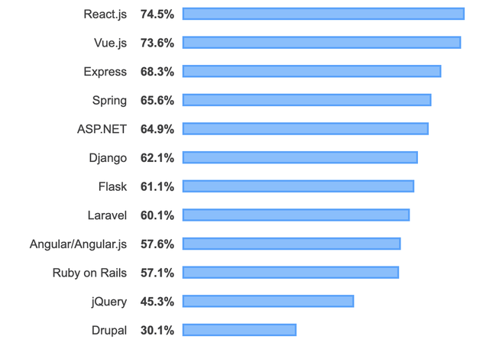
Javascript frameworks

Slide 5
JavaScript Libraries
1. Anime.js
2. Howler.js
3. Chart.js
4. Reveal.js
5. Three.js
6. Pixi.js
7. Video.js

Slide 6
JavaScript Where

Slide 7
JavaScript Output
innerHTML
document.write()
window.alert()
using console.log()

Slide 8
JavaScript Statements

Slide 9
JavaScript Syntax

Slide 10
JavaScript Comments
Single Line Comments
Multi-line Comments

Slide 11
JavaScript Variables

Slide 12
JavaScript Operators
JavaScript Arithmetic Operators
JavaScript Assignment Operators
JavaScript String Operators
JavaScript Comparison Operators
JavaScript Logical Operators
JavaScript Type Operators
JavaScript Bitwise Operators

Slide 13
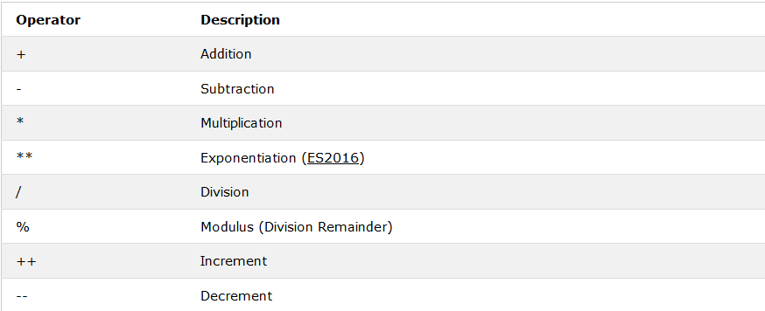
JavaScript Arithmetic Operators

Slide 14
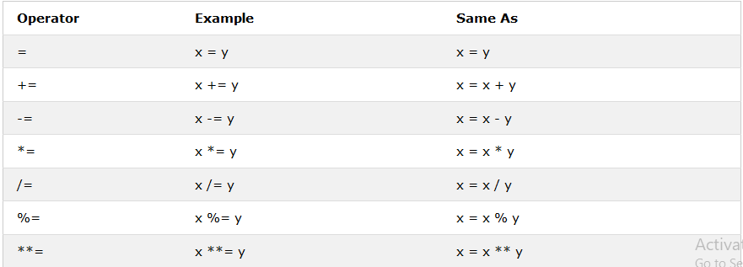
JavaScript Assignment Operators

Slide 15
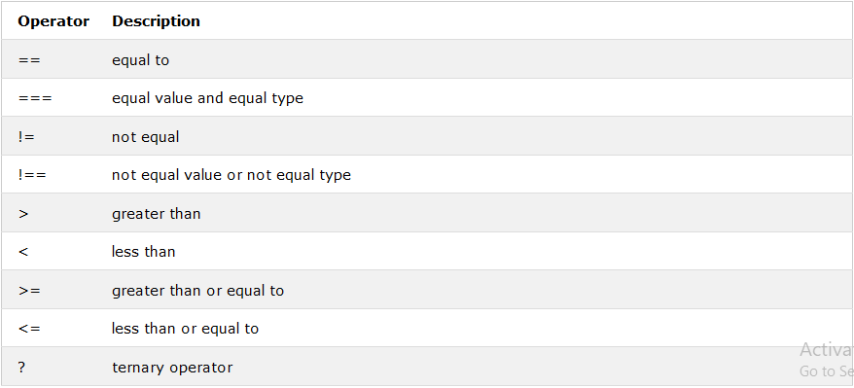
JavaScript Comparison Operators

Slide 16
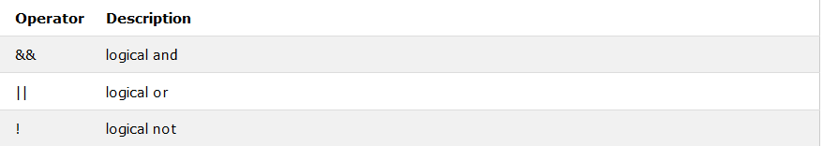
JavaScript Logical Operators

Slide 17
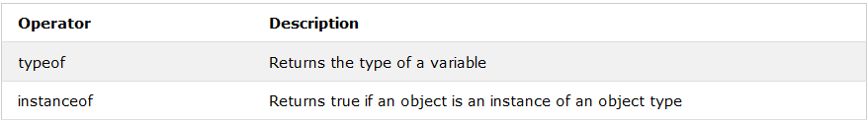
JavaScript Type Operators

Slide 18
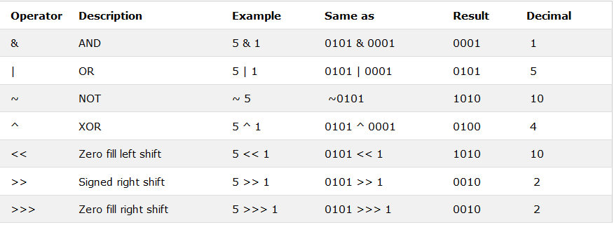
JavaScript Bitwise Operators

