Slide 1
JavaScript Operators
JavaScript Arithmetic Operators
JavaScript Assignment Operators
JavaScript String Operators
JavaScript Comparison Operators
JavaScript Logical Operators
JavaScript Type Operators
JavaScript Bitwise Operators

Slide 2
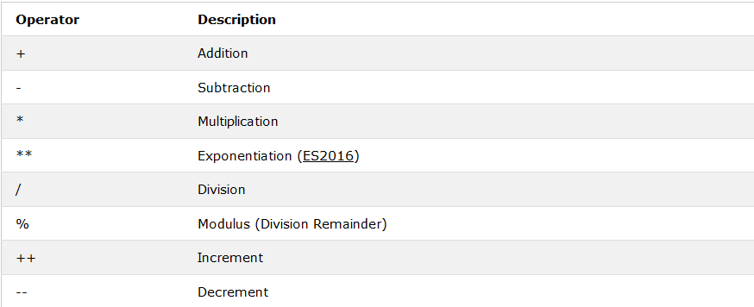
JavaScript Arithmetic Operators

Slide 3
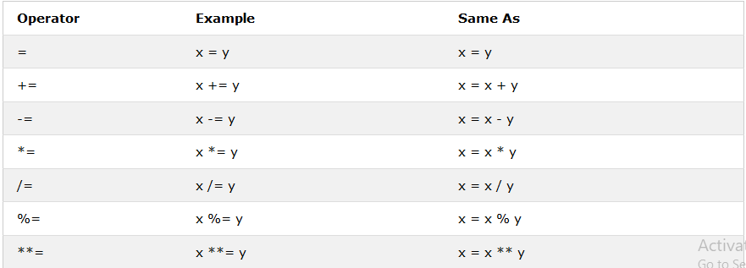
JavaScript Assignment Operators

Slide 4
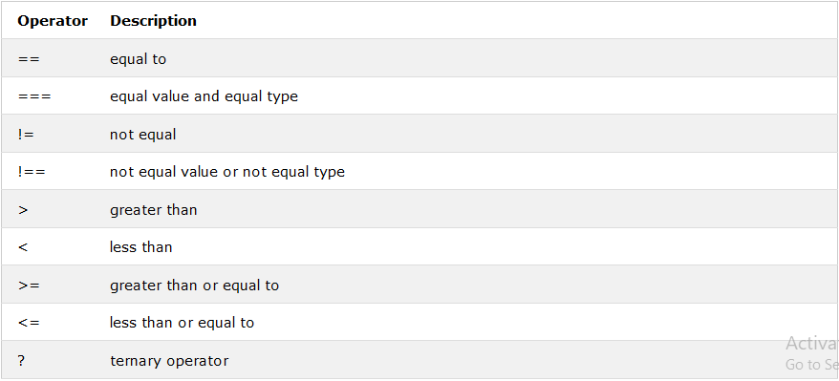
JavaScript Comparison Operators

Slide 5
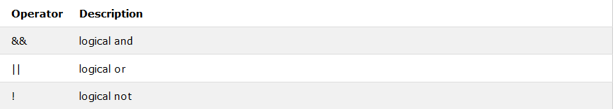
JavaScript Logical Operators

Slide 6
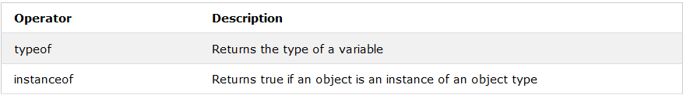
JavaScript Type Operators

Slide 7
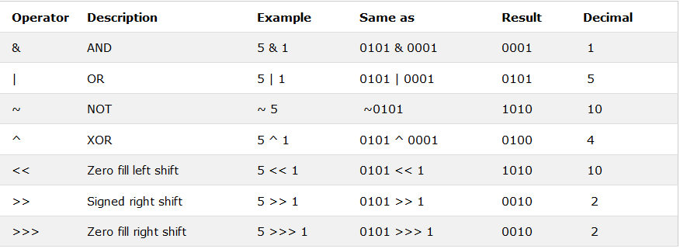
JavaScript Bitwise Operators

Slide 8
JavaScript Data Types
JavaScript Strings
JavaScript Numbers
JavaScript Booleans
JavaScript Arrays
JavaScript Objects
The typeof Operator

Slide 9
JavaScript Functions

Slide 10
JavaScript Objects

Slide 11
JavaScript Events
Onchange
Onclick
Onmouseover
Onmouseout
Onkeydown
Onload

Slide 12
JavaScript String Methods
length
indexOf()
lastIndexOf()
search()
slice()
substring()
substr()
replace()
toUpperCase()
toLowerCase()
concat()
trim()
charAt()
charCodeAt()
split()

