Slide 1
CSS Introduction

Slide 2
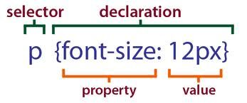
•CSS Syntax

Slide 3
CSS SELECTOR
Tag selector
Class selector
Id selector

Slide 4
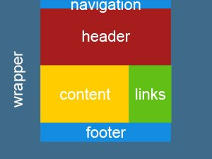
CSS Divisions

Slide 5
Styling Backgrounds
background-color
background-image
background-repeat
background-attachment
background-position

Slide 6
Styling Text
Text Color
Text Alignment
Text Decoration
Text Transformation
Text Indent
letter-spacing
line-height
Word Spacing
text-shadow

Slide 7
Styling Fonts
font-style
font-weight
font-size
font-family

Slide 8
•Styling Links
a:link
a:visited
a:hover -
a:active

Slide 9
•Styling Lists
list-style
list-style-image
list-style-position
list-style-type

Slide 10
Styling Tables
vertical-align
border
border-collapse
border-spacing
caption-side
empty-cells
table-layout

