Slide 1
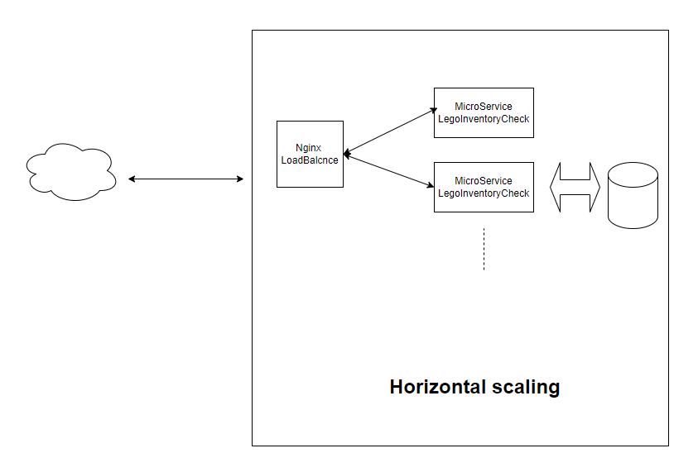
Docker Swarm Load Balance Rest API

Slide 2
Question 0
Which sets can the user brickfan35 build with their exisiting inventory of pieces?
swagger get /api/LegoInventory/GetUserCatalogueCapability
Paramaters :
userName: brickfan35
ignoreColor: false

Slide 3
Question 1
The user landscape-artist doesn't have the right pieces to build the set tropical-island but would like to collaborate with other users on the build. Which users could they combine their collection with to have the complete piece requirements for the build?
swagger get /api/LegoInventory/CheckUserSetHelpers
Paramaters :
userName: landscape-artist
userSet: tropical-island
ignoreColor: false

Slide 4
Question 2
The user megabuilder99 is interested in creating a new custom build but they want to make sure other people could complete it with their current inventories. What is the largest collection of pieces they should restrict themselves to if they want to ensure that at least 50% of other users could complete the build?
swagger get /api/LegoInventory/CustomItemsWithTargetUserRate
Paramaters :
rate: 50

Slide 5
Question 3
(HARD) The user dr_crocodile wants to expand the number of sets they can build with their current inventory and are prepared to be flexible on the colour scheme. They are happy to substitute any colour in a set as long as all the pieces of that colour are substituted, and that the new colour isn't used elsewhere in the set. For example, a building with white walls, a red roof and a green flag could be built with red walls, a blue roof and a green flag. What new sets can dr_crocodile build by allowing colour substitutions?
Paramaters :
userName: dr_crocodile
ignoreColor: true

Slide 6
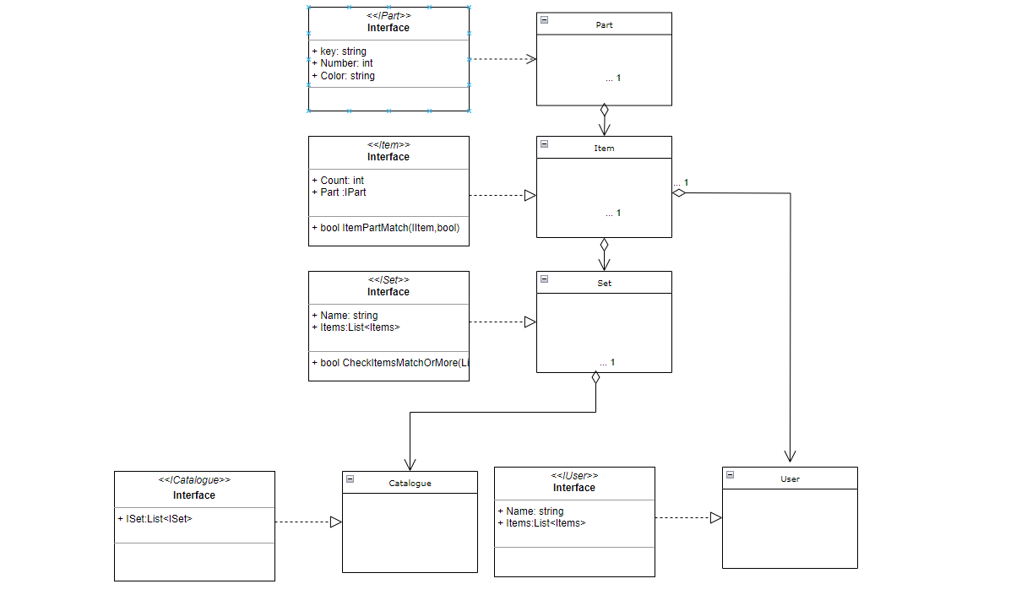
Digest UML

