Slide 1
Predicting Critical Success with Film Script Features
Cody Braun

Slide 2

FILM CRITICAL SUCCESS
Studios schedule films likely to garner critical success during awards seasons and dump the rest on audiences over the summer
Notes:
- As opposed to using reporting, which generally requires time and means that somebody has already been scammed

Slide 3
DATA
Scraped approximately 2,000 scripts from several sites and paired them with Rotten Tomatoes data
Notes:
Getting site copy with a couple of crawlers- automatically scraping email spam, had less luck with FB, craigslist, etc.
originally this was supposed to be my whole role in the project
build as large a corpus as possible for learning and testing
Yielding some idea of the graph of these sites
I’m learning about machine learning

Slide 4
FEATURES
Script length
TF-IDF vector (using up to trigrams)
Metadata, including genre and year of release
Notes:
Getting site copy with a couple of crawlers- automatically scraping email spam, had less luck with FB, craigslist, etc.
originally this was supposed to be my whole role in the project
build as large a corpus as possible for learning and testing
Yielding some idea of the graph of these sites
I’m learning about machine learning

Slide 5
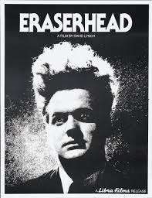
FEATURES
“Uniqueness” of a script, as determined by cosine distance from films in that year and pairwise distance from all films in the corpus
Notes:
Getting site copy with a couple of crawlers- automatically scraping email spam, had less luck with FB, craigslist, etc.
originally this was supposed to be my whole role in the project
build as large a corpus as possible for learning and testing
Yielding some idea of the graph of these sites
I’m learning about machine learning

Slide 6
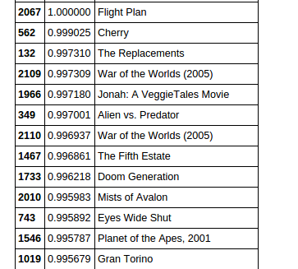
UNIQUENESS
Notes:
Getting site copy with a couple of crawlers- automatically scraping email spam, had less luck with FB, craigslist, etc.
originally this was supposed to be my whole role in the project
build as large a corpus as possible for learning and testing
Yielding some idea of the graph of these sites
I’m learning about machine learning

Slide 7
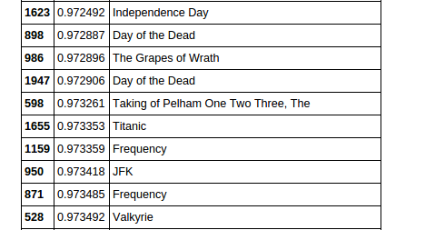
UNIQUENESS
Notes:
Getting site copy with a couple of crawlers- automatically scraping email spam, had less luck with FB, craigslist, etc.
originally this was supposed to be my whole role in the project
build as large a corpus as possible for learning and testing
Yielding some idea of the graph of these sites
I’m learning about machine learning

Slide 8
FEATURES
Sentence count
Sentence length
Lexical complexity: set of all words in script / bag of all words in script
Notes:
Getting site copy with a couple of crawlers- automatically scraping email spam, had less luck with FB, craigslist, etc.
originally this was supposed to be my whole role in the project
build as large a corpus as possible for learning and testing
Yielding some idea of the graph of these sites
I’m learning about machine learning

Slide 9
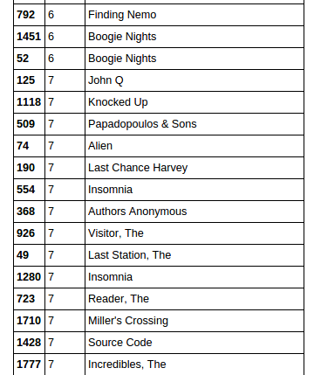
SENTENCE LENGTH
Notes:
Getting site copy with a couple of crawlers- automatically scraping email spam, had less luck with FB, craigslist, etc.
originally this was supposed to be my whole role in the project
build as large a corpus as possible for learning and testing
Yielding some idea of the graph of these sites
I’m learning about machine learning

Slide 10
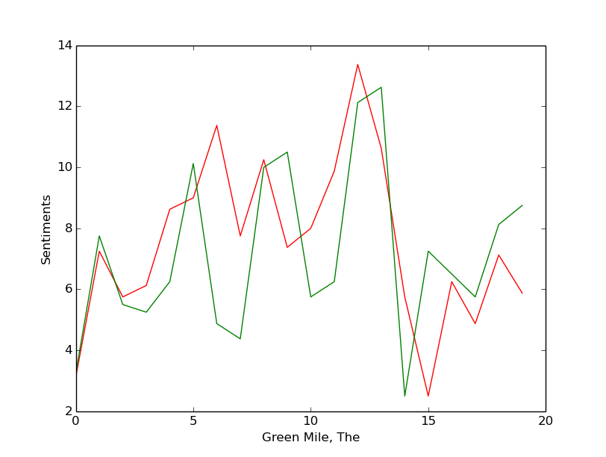
FEATURES
Plot, as determined by sentiment analysis at 20 points throughout script
Notes:
This is a fake USAA site it’s the first thing phishing site I crawled

Slide 11
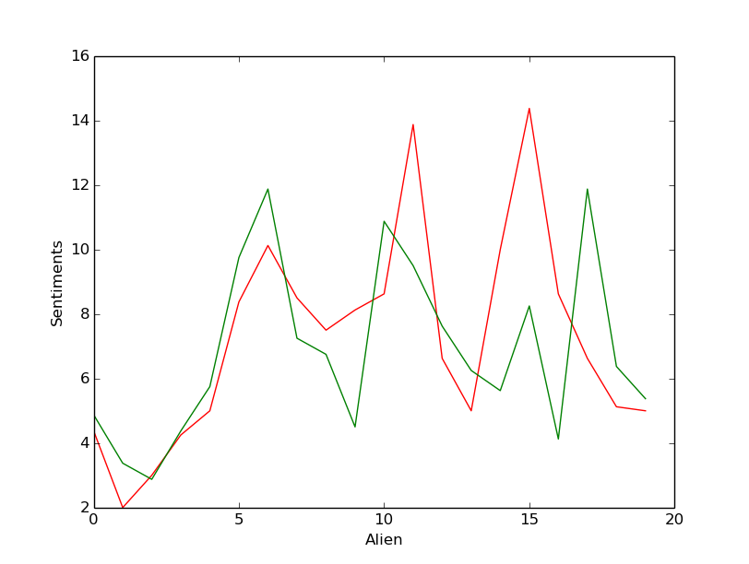
FEATURES
Notes:
All of this is stored in a MySQL db
Got 100,000s of results
Fine tuning whitelist?
Grabbing safe and unsafe sites
Each step out from this seed has still been pretty full of shady websites, which means we’re getting exponentially more “bad” copy at every level

Slide 12
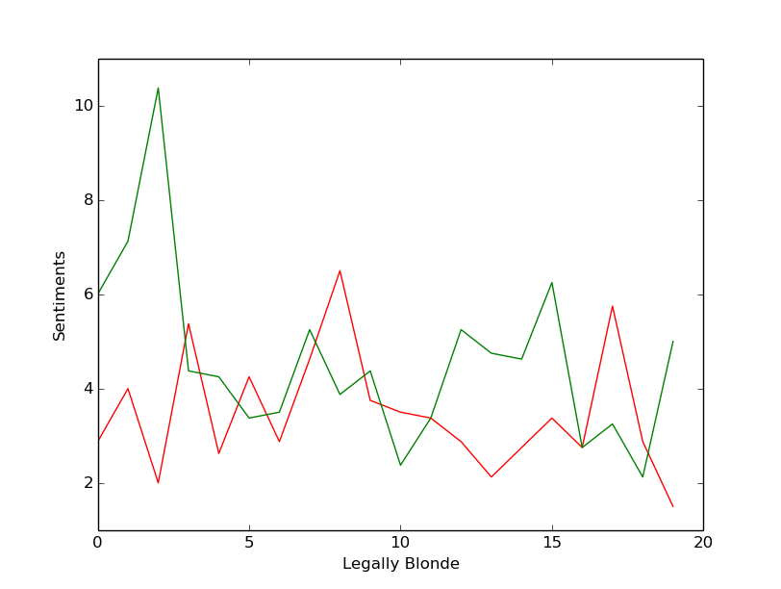
FEATURES
Notes:
All of this is stored in a MySQL db
Got 100,000s of results
Fine tuning whitelist?
Grabbing safe and unsafe sites
Each step out from this seed has still been pretty full of shady websites, which means we’re getting exponentially more “bad” copy at every level

Slide 13
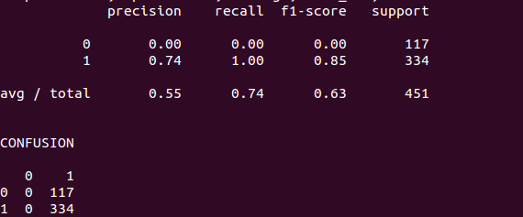
CLASSIFIER
Getting any results with NB or SVM took very careful tweaking of parameters

Slide 14
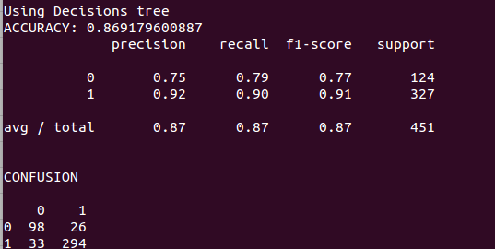
CLASSIFIER
Neural network (RBM) with decision trees had much better performance

Slide 15
CONCLUSION
Sort of surprised to get close to 90% accuracy
Other research
Room for improvement

