Slide 1
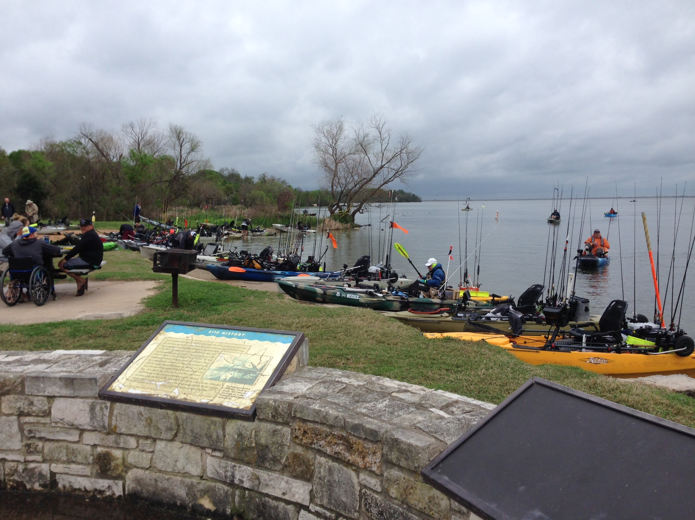
Data Challenge
Javier Franco
6-April-2016

Slide 2
Content
Background
The Need
Business Case
The Data
The Tools
The Method
The Challenges
The Results
What Now

Slide 3
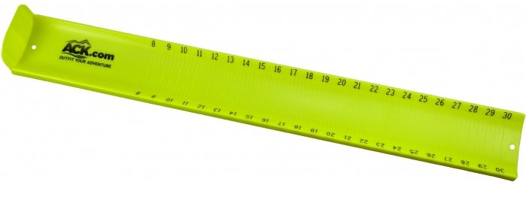
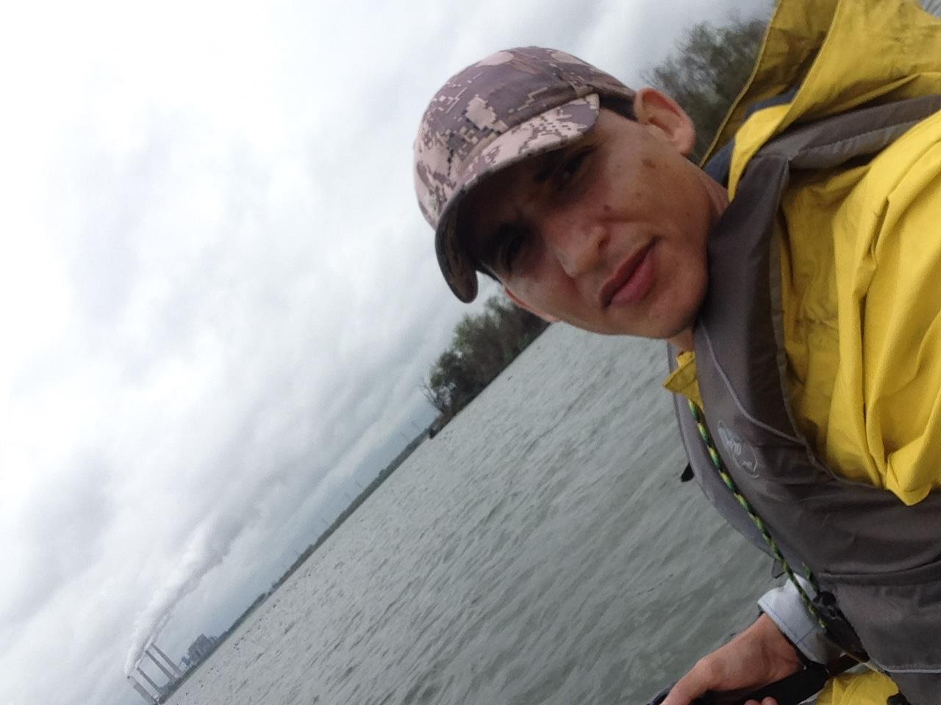
Background
Participated in my first kayak fishing tournament.
Tournament:
5 fish limit
7am – 2:30 pm fishing time
Winner with total fish length wins
Fish length determined by using Hawg Trough
Fisherman to provide evidence via digital photos

Slide 4
The Need
Issue:
Took ~2 hrs after the tournament was complete to verify the tournament winners.
Last thing I wanted after being awake since 4 am was to sit around and wait
The Need:
Automate the retrieval of fish lengths from thousands of images

Slide 5
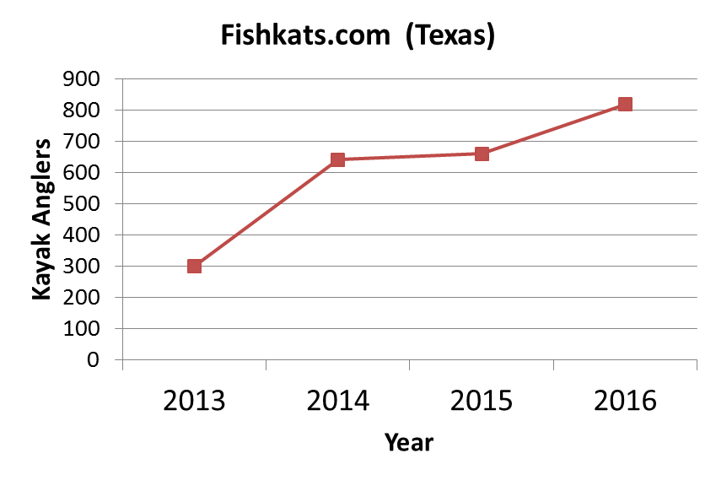
Business Case

Slide 6
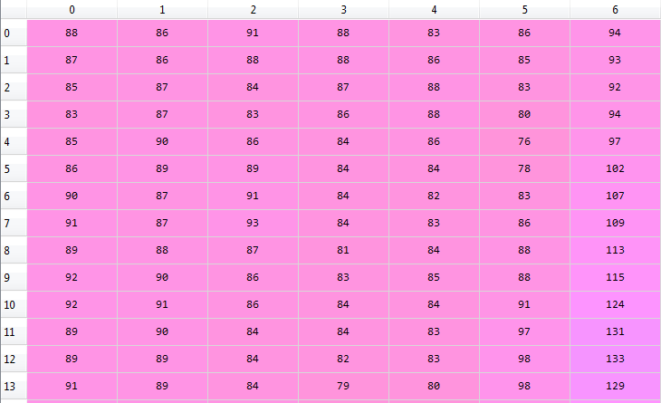
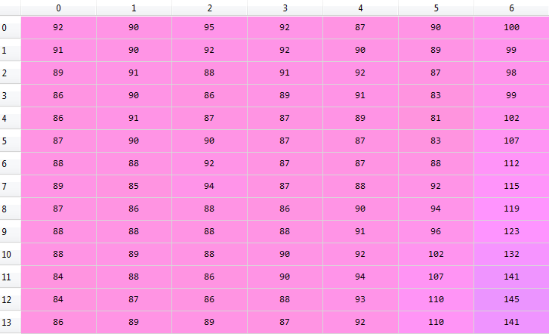
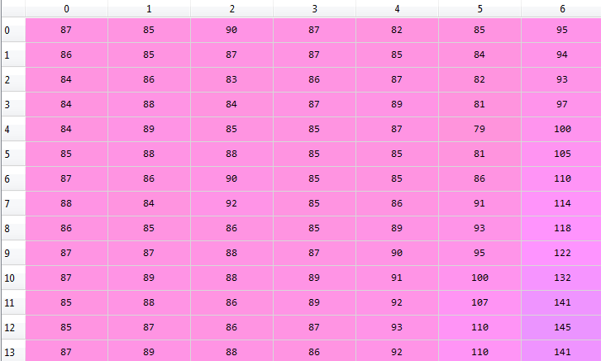
The Data
Unstructured
Size depends on Image Size
Image (Data) represented by RGB
Example
Image Size: 381x750
Anglers = 150
Fish/Angler = 4
Pics per Fish = 2
Data Points = 318*750*3*150*4*2 = 858,600,000
BLUE
GREEN
RED

Slide 7
The Tools
Python
Packages:
cv2
Numpy
glob

Slide 8
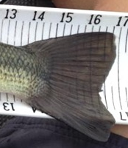
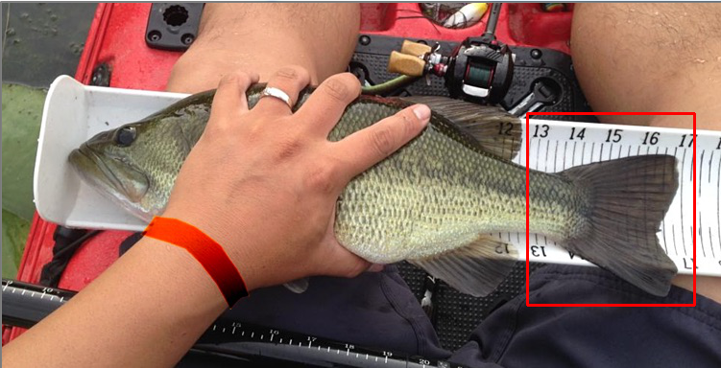
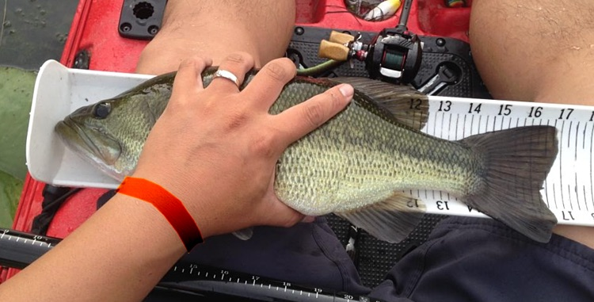
#1 - Find the Fish Tail
Load image and template
Resize
Grayscale
matchTemplate

Slide 9
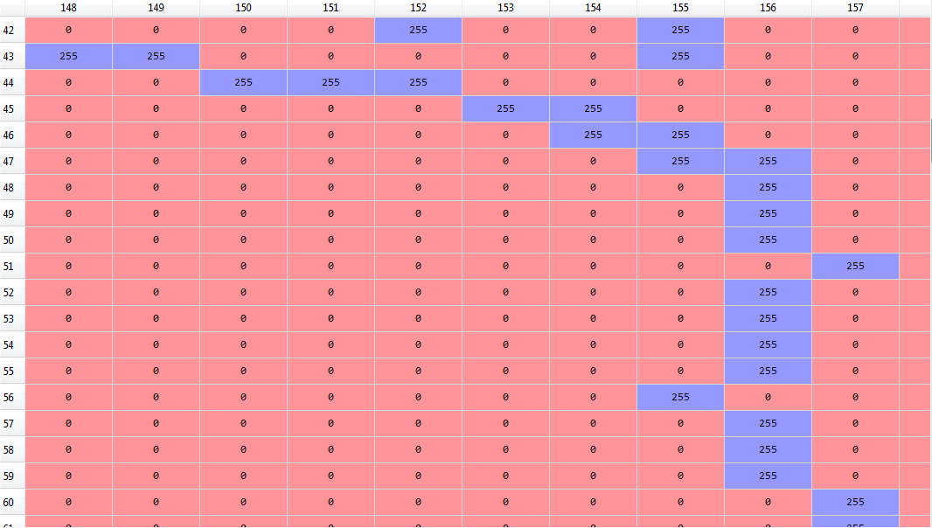
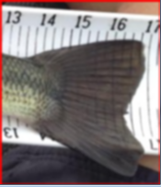
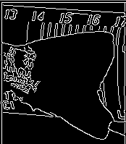
#2 - Edge of Fish Tail
Blur the found fish tail
Identify edges
Identify farthest point of the tail

Slide 10

#3 - Find the Numbers
Loop through to find numbers (14,15,16,….) using matchTemplate
ID what numbers the edge falls between
Find the fraction where the edge falls between the numbers
Add the fraction to the lower number
Number
Templates

Slide 11
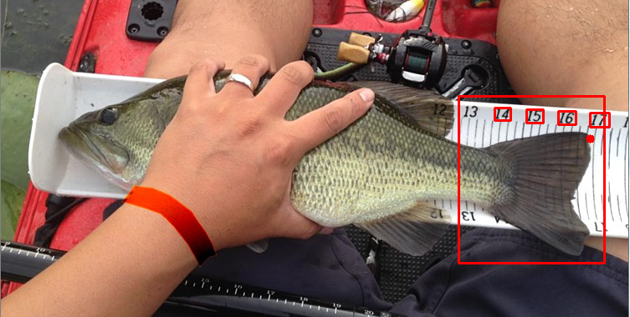
The Results
Result = 16.79”

Slide 12
The Challenges
Image resolution
Depth of fish in reference to the camera
Orientation of fish (angle)
Not all fish tales are the same
Fish tale can cover numbers

Slide 13
What Now
Make it more Robust
How can I sell it?

