Slide 1
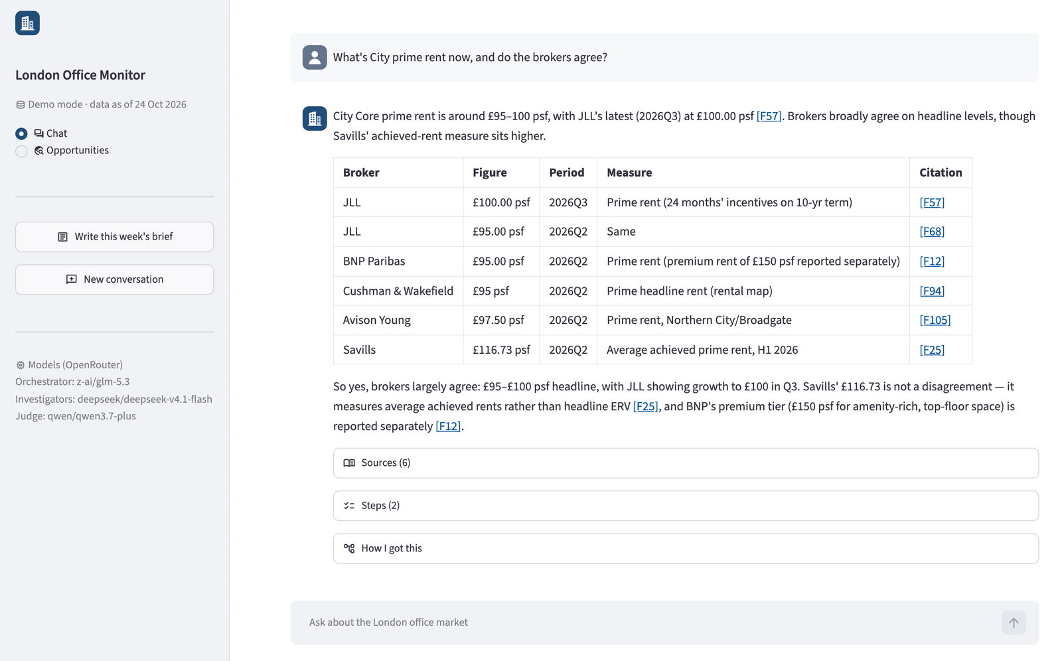



An AI research assistant for the London office market
WHAT IT IS
It saves time, keeps a lasting record of the market, and flags opportunities that fit Nan Fung.
Ask
Any market question, answered with every broker's figure and its source
Read
A weekly brief: what changed, and what it means for our buildings
Discover
Opportunities that fit our mandate. Only those the analyst approves reach the team
The working app, answering a question on City rents
Notes:
This is the London Office Monitor, a working proof of concept for the London office team. Think of it as a research assistant. It reads broker figures, property news and insolvency notices, keeps everything it reads in one place, and points out what matters to Nan Fung. The team uses it three ways: ask it a question, read the weekly brief it drafts, and discover opportunities that fit our mandate, which the analyst approves before the team sees them. On the right is the real app answering a question about City rents, with every broker's figure and a link to each source. The next three slides cover what it does for the team: time, data and opportunities.

Slide 2

Routine research now takes minutes
1 · TIME SAVING
~15 sec
Compare the brokers on any figure
Today Open six broker reports, find the figure, check each definition
Now One table with every broker's figure, each linked to its source
per answer
~1 min
Write the weekly market brief
Today Read the news across many outlets, then write it up
Now A first draft in a set format, with every figure checked
per brief
~2 min
Screen the week for opportunities
Today Read news and insolvency notices against the mandate by hand
Now Up to five leads investigated and written up as cards
per scan
Each one costs a few US cents of AI usage, under US$0.10.
Measured in test runs on 24–25 Oct 2026: answers median 13 s (16 runs), brief 31–76 s, scan 56–115 s until the cards are ready. How long the same work takes by hand is still to be measured.
Notes:
First, time. To compare what six brokers say about one figure, an analyst opens six reports, finds the figure in each, and checks how each broker defines it. The Monitor does it in about 15 seconds and links every figure to its source. The weekly brief takes about a minute to draft, and the opportunity scan about two. Each costs a few cents of AI usage. These times come from our test runs on 24 and 25 October. We have not yet measured how long the same work takes the team by hand; that is one of the things we ask the team for on the last slide.

Slide 3








A market memory that stays with the team
2 · LONG-TERM DATA MANAGEMENT
WHAT IT KEEPS, IN OUR OWN DATABASE
WHY IT MATTERS
Broker figures
Same question, same number
Rents, vacancy, yields and more
One shared record for the whole team
News and notices
Every figure is traceable
Each story with its link and date
One click opens the original source
Our own records
Knowledge stays with the team
Policies, committee notes, decisions
Past decisions stay searchable
The team's calls
It grows in value
Every approve or reject, and why
History builds; new sources plug in
Broker figures come from JLL, Savills, BNP Paribas, Cushman & Wakefield, CBRE and Avison Young. In the demo, the internal records are mock examples; real ones need an access review before loading.
Notes:
Second, data. Everything the Monitor reads is kept in our own database: broker figures with their definitions, news and insolvency notices with their links, our own policies and past decisions, and every approve or reject call with its reason. That gives the team one shared record. The same question gets the same number, every figure opens its original source, and past decisions stay searchable when people move on. The history grows as each quarter's figures are added, and licensed data sources can be added later without rebuilding it. In the demo, the internal documents are mock examples.

Slide 4
Spots opportunities that fit Nan Fung
3 · OPPORTUNITY DISCOVERY
Most London office deals trade off-market, so hearing early matters.
1
Reads
EXAMPLE FROM THE DEMO · TEST DATA
The week's news and insolvency notices
Owner under pressure
City Core
2
Matches
Administrators appointed to the owner of a 45,000 sq ft City office
Against our mandate and our buildings
Investigates
What it means for us: bought in 2018 on a five-year loan; fits our City mandate
3
Up to five leads, each double-checked
What to do next: confirm at Companies House and contact the administrator
4
You decide
Only approved cards reach the team
Approve
Reject
Off-market share: 69% of City deals (H1 2019, Bisnow) and 76% of West End volume (July 2022, Savills). The example is built on a test notice and an illustrative mandate.
Notes:
Third, opportunities. Most London office deals trade off-market, so hearing early matters. The scan reads the week's news and insolvency notices and matches them against our mandate and our buildings. It investigates up to five leads at once, and a second AI model checks each card against its evidence. The analyst approves or rejects each card, and only approved cards reach the team's Approved list. The scan also checks past decisions and tries to skip leads the analyst already rejected. It can be scheduled to run by itself every Monday morning. The card on the right comes from the demo: a test insolvency notice matched against an illustrative mandate, since Nan Fung's real criteria are not public.

Slide 5


Why not just use ChatGPT?
BUILT TO BE TRUSTED
ChatGPT
London Office Monitor
Market figures
What it finds or recalls
Checked broker figures, with sources
Numbers checked first
Not guaranteed
Always, against our stored data
Knows Nan Fung
Only what you give it
Our buildings, mandate and decisions
Team sign-off
None
The analyst approves each lead
Team memory
Personal memory only
Past decisions shape the next scan
Control over sources
Reads any site it finds
A fixed list we control
Notes:
The obvious question: why not just use ChatGPT? ChatGPT can search the web and cite sources, but any checking is the AI judging its own work, so nothing guarantees that each number matches its source. It doesn't hold our broker data, knows only what you give it, and has no approval step before something reaches the team. In the Monitor, every figure in an answer is checked against our stored data before you see it; a mismatch is rewritten or shown with a visible warning. It knows our buildings and mandate, and the analyst approves every lead before the team sees it. Those decisions are kept with their reasons, and each new scan checks them, so a lead like one the analyst turned down is dropped or explained. ChatGPT's memory, by contrast, is personal to each user. It also works from a fixed list of sources we control, so we can leave out any whose terms forbid AI use, such as Knight Frank, and broker reports are never fed to the AI.

Slide 6




What we need from the business team
WORKING TOGETHER
An AI tool is only as good as the data and know-how behind it.
Data readiness
Your know-how
Real mandate, assets and past decisions
Licences for broker reports we receive
Past figures from your spreadsheets
How each task is done today
Which brokers and measures you trust
What a good brief or lead looks like
How we'll judge it
Time and sign-off
Real questions, with the right answers
Leads you would and wouldn't pursue
How long tasks take by hand today
Analysts to try it and give feedback
Compliance sign-off on AI and data use
Secure hosting with login
Notes:
For this to work beyond a demo, we need four things from the business team. First, data readiness: our real mandate, asset details and past decisions in place of the illustrative and mock examples; licences for the broker reports the team already receives; and the past figures in the team's spreadsheets, so trends have history. Second, your know-how: how each task is done today, which brokers and measures you trust when they disagree, and what a good brief or a good lead looks like. That becomes the tool's playbooks. Third, ways to judge it: real questions with the right answers, leads you would and wouldn't pursue, and how long the work takes by hand today, so we can measure quality and time saved before anyone relies on it. Fourth, time and sign-off: a few analysts to use it and give feedback, compliance sign-off on how our data is used with AI models, and secure hosting with login. Internal documents need an access and data-residency review first, because the passages used in an answer are sent to the AI model provider.

