Slide 1
Core Java
Pilot
Anna

Slide 2
Features of Java:
Encapsulation
Inheritance
Polymorphism

Slide 3
IntelliJ
JVM: Java Virtual Machine
JRE: Java Runtime Environment
Main method
entry point for executing a Java program
public - JRE can access and execute this method.
static - so that the JVM can load the class into memory and call the main method without creating an instance of the class first.
void - it doesn’t return anything. When the main method is finished executing, the Java program terminates
String[] args - Each string in the array is a command line argument. And they can be used to pass information to the program, at runtime.

Slide 4
Variable vs Constant
Constant is a data item whose value cannot change during the program's execution.
Variable, on the other hand, changes its value dependent on the equation

Slide 5
Encapsulation
Data Types | Where to store | Example | Copy
Primitive Types | in stack | double = 3; | value
Reference Types | in heap (address in stack) | Double d = new Double(3); | copy address
Note: Every primitive type corresponds to a reference type. i.e. boolean and Boolean

Slide 6
Stack vs Heap
Stack
Heap
double d = 3
Double dd
address
3
Notes:
Whiteboard for the graph

Slide 7
Type Casting Examples:
// create double type variable
double num = 10.99;
System.out.println("The double value: " + num);
// convert into int type int
int data = (int)num;
System.out.println("The integer value: " + data);

Slide 8
Type Casting Examples:
// create int type variable
int num = 10;
System.out.println("The integer value is: " + num);
// converts int to string type
String data = String.valueOf(num); System.out.println("The string value is: " + data);

Slide 9
Type Casting Examples:
// create string type variable
String data = "10";
System.out.println("The string value is: " + data);
// convert string variable to int
int num = Integer.parseInt(data); System.out.println("The integer value is: " + num);

Slide 10
Wrapper Class
int - Integer (boxing and unboxing)
Question?
int intOne = 1;
int intTwo = 1;
Integer boxingOne = new Integer(1);
Integer boxingTwo = Integer.valueOf(1);
int sum = boxingOne + intOne;
System.out.println(intOne == intTwo);
System.out.println(intOne == boxingTwo);
System.out.println(boxingOne == boxingTwo);
System.out.println(sum);
Notes:
Answers:
true
true (when Integer comparing int using == arguments will be unboxed if necessary.)
false
2 (unboxing)

Slide 11
Why we need wrapper class?
Wrapper classes are fundamental in Java because they help a Java program be completely object-oriented.
The primitive data types in java are not objects, by default. They need to be converted into objects using wrapper classes.

Slide 12
Operators
& - bitwise AND
&& - logic AND
| - bitwise OR
|| - logic OR
! - not
Bitwise move >>>, <<< (not required to know details)

Slide 13
Iterator
for loop
do while
(difference do while loop and while loop - do the check for the first time)

Slide 14
OOP - Object Oriented programming
What is object?
What is class? - Give an example like Student class
What is constructor?
How to decide objects and classes
object is an instance of class, and class is a template of object.
class is composed by fields and methods
Initialization - when values are put into the memory that was allocated
Notes:
Give examples of class in IntelliJ

Slide 15
Stack vs Heap
Stack
Heap
One instance of Student Class
Amy
name
phone
age:18
address
name: Amy
phone: 1102
Tom
name
phone
age:22
address
name: Tom
phone: 4409

Slide 16
Object.java internal methods
Go to inheritance Graph
equals()
toString()
hashCode()
getClass()

Slide 17
equals()
What’s the difference between equals() and == ?
== checks if both objects point to the same memory location whereas . equals() evaluates to the comparison of values in the objects

Slide 18
Question1 ?
Human h1 = new Human();
Human h2 = new Human();
System.out.println(h1 == h2);
System.out.println(h1.equals(h2));
Notes:
False (reference location - address is different)
False (go to root class equals() method, it still compare two reference location - address )

Slide 19
Question2 ?
String s1 = new String(“123”);
String s2 = new String(“123”);
System.out.println(s1 == s2);
System.out.println(s1.equals(s2));
Notes:
A2:
False
True (dive into the equals and check the code there)

Slide 20
Question3 ?
String s1 = “123”;
String s2 = “123”;
System.out.println(s1 == s2);
System.out.println(s1.equals(s2));
Notes:
A3:
True
True

Slide 21
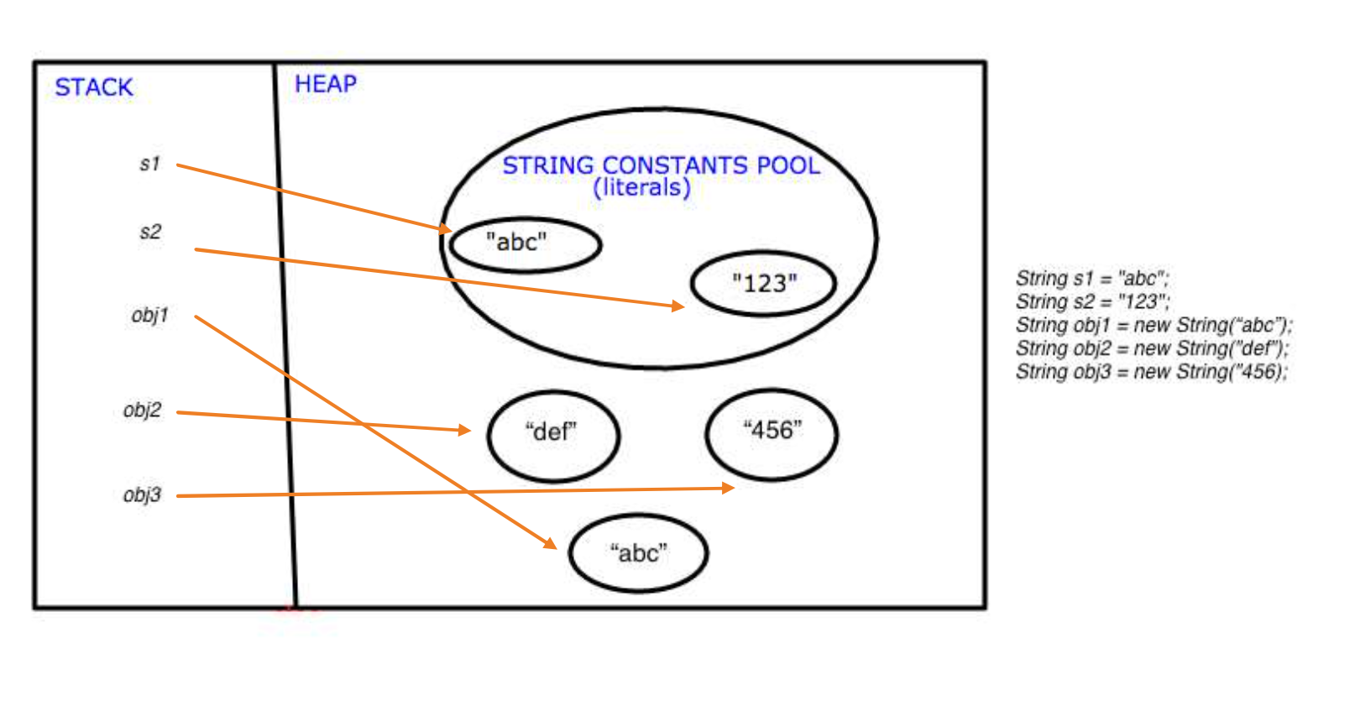
String Pool

Slide 22
Why we need String Pool?
It is created to decrease the number of string objects created in the memory. Whenever a new string is created, JVM first checks the string pool.

Slide 23
toString()
will convert object into String type.
Example:
Human human = new Human();
System.out.println(human.toString());
String name = “111”;
System.out.println(name);

Slide 24
Inheritance
What is inherit?
inherit attributes and methods from one class to another.
subclass (child) - the class that inherits from another class
superclass (parent) - the class being inherited from
Using extends as key word

Slide 25
Modifiers
public can visit from different packages and classes
private can visit only from same class (getter and setter)
protected can visit from same packages or subclassed (child)
static belongs to class and only stores in class’s memory in heap
final once give value, cannot be changed
abstract cannot be initialized (to access it, it must be inherited from another class)

Slide 26
mutable vs immutable
A mutable object can be changed after it's created, and an immutable object can’t.
In Java, everything (except for strings) is mutable by default. Strings are immutable in Java. (If you want mutable strings in Java, you can use a StringBuilder/StringBuffer object)
Inside a class, make objects immutable by making all fields final and private.

Slide 27
Polymorphism
Override
A same method as the parent class, but different implementation.
Overload
Allows a class to have more than one method with the same name, but with different parameters. (different number params or different data types)

Slide 28
Features of Java:
Encapsulation
Inheritance
Polymorphism

Slide 29
Arrays
Data types
String[]
Int[]
Two-dimension Arrays
https://leetcode.com/problemset/all/
Homework 1

