Slide 1
Core Java
Pilot
Anna

Slide 2
Build a String
String1 + String2
String builder
String Buffer
What’s the difference?

Slide 3
StringBuffer is thread-safe and synchronized whereas StringBuilder is not.
StringBuilder is faster than StringBuffer.
String concatenation operator (+) internally uses StringBuffer or StringBuilder class.

Slide 4
Abstract class vs class
has the abstract keyword in its declaration
Abstract classes usually have at least one abstract method. , i.e., methods without a body. It can have multiple concrete methods.
Abstract classes allow you to create blueprints for concrete classes. But the inheriting class should implement the abstract method.
Abstract classes cannot be instantiated.
Example: Electronic Device

Slide 5
Interface
Interface contains only abstract methods.
cannot have non-abstract methods(no body)
implement
give an example for interface

Slide 6
Exception
What is exception
an unexpected event that occurs while executing the program, that disturbs the normal flow of the code.
Why we need that
it helps maintain the normal, desired flow of the program even when unexpected events occur.

Slide 7
try and catch blocks
finally – will execute anyway
What is Throwable - is the superclass of all errors and exceptions in the Java language

Slide 8
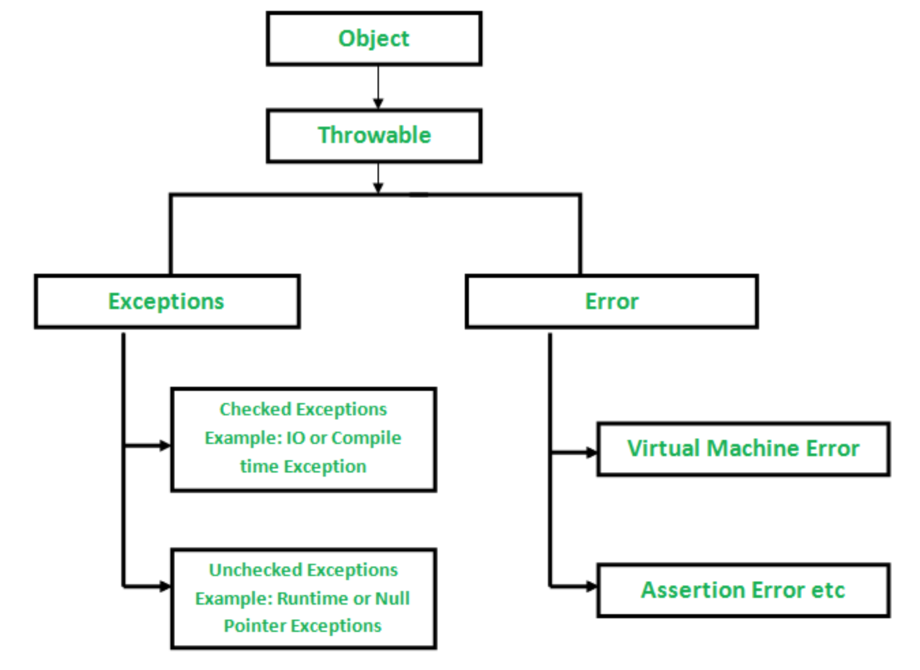
Notes:
Error: not recoverable – will be permanent failure
Checked Exception: You must specify how to handle it or throw it. Otherwise, the compile will fail
Unchecked Exception: not necessary to specify how to handle/throw it. The compile will work, but it will fail during the code execution.

Slide 9
Recursion
Recursion is the technique of making a function call itself.
This technique provides a way to break complicated problems down into simple problems which are easier to solve.
Two step:
Specify the baseline condition - stack overflow for infinite loop
Pass it into the next round

Slide 10
Homework 2 (Recursion)
Check Homework 1

