Slide 1
Core Java - Collections
Pilot
Anna

Slide 2
Java Collections
a framework that provides an architecture to store and manipulate the group of objects.
List
Set
Map
ArrayList
LinkedList

Slide 3
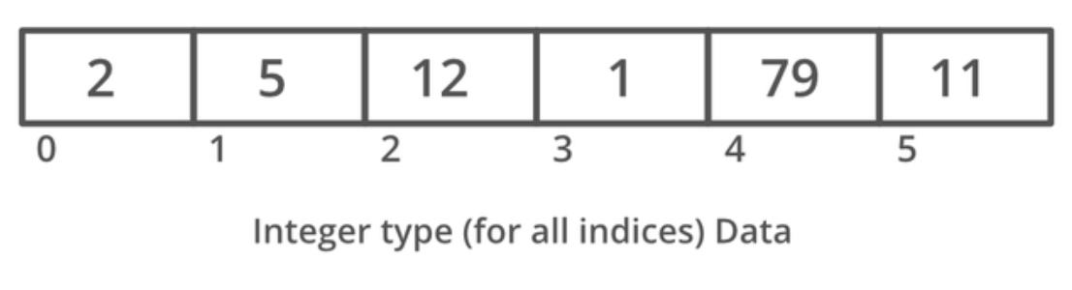
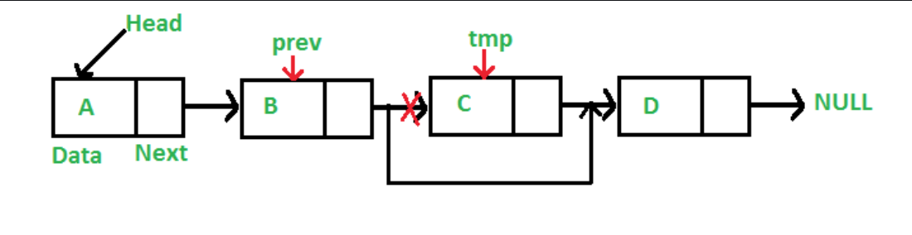
ArrayList vs LinkedList
insert data easier for linkedList, but get data easier for arrayList since it has index
Notes:
give an example for use of arrayList, and linkedList (How to build might be an interview question)

Slide 4
Set vs List - ordered or not
HashSet
if can have duplicate items
HashMap
internal data structure

Slide 5
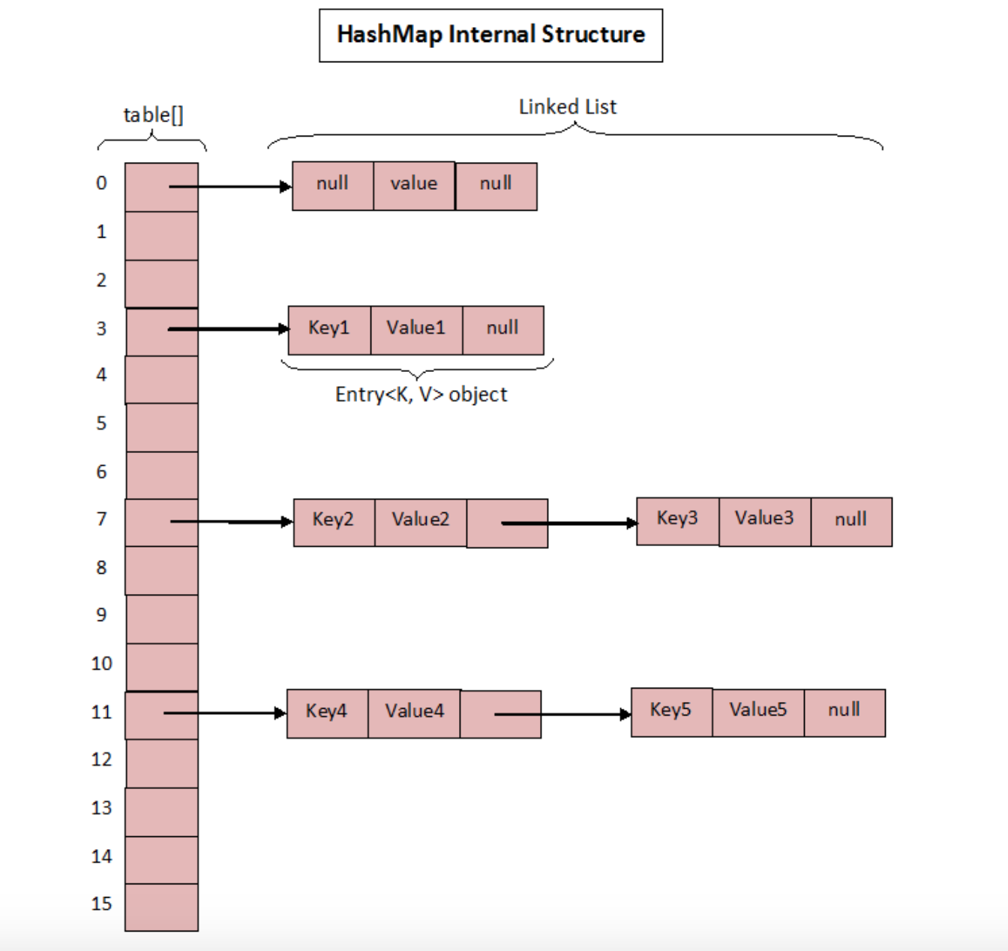

Slide 6
Sort
How to sort a list?
Collections.sort()

Slide 7
Comparator vs Comparable
Comparator is an object for comparing different objects of different classes. It provides compare() method to sort elements.
Comparable is an object to compare itself with another object. And it provides the compareTo() method to sort elements.

Slide 8
Homework 3
LinkedList Implementation
Hashmap internal implementation
Homework 2 check

