Slide 1

Pulumi
Modern Infrastructure as Code

Slide 2
What is Pulumi?
A Seattle based startup, founded by former members of the .NET, Project Midori, and Azure teams at Microsoft
A Terraform replacement that leverages established languages through an SDK
A toolset that provisions resources across multiple cloud providers and manages their configuration
A toolset that brings software development best practices (source control, reusability, abstraction of secure configurations, extensibility) to Operations and Infrastructure tasks

Slide 3
A Case for Pulumi
Simplifies repetitive tasks across multiple regions or distributed applications
Bridges divide between development and infrastructure teams
Significantly reduces time to live when provisioning new regions or environments
Brings benefits of source control to infrastructure and configuration changes
Simplifies access control management
Provides insight into infrastructure configuration, but performs cloud resource CRUD operations through a service account

Slide 4
Where Pulumi Fits
Program
Provision
Publish

Slide 5
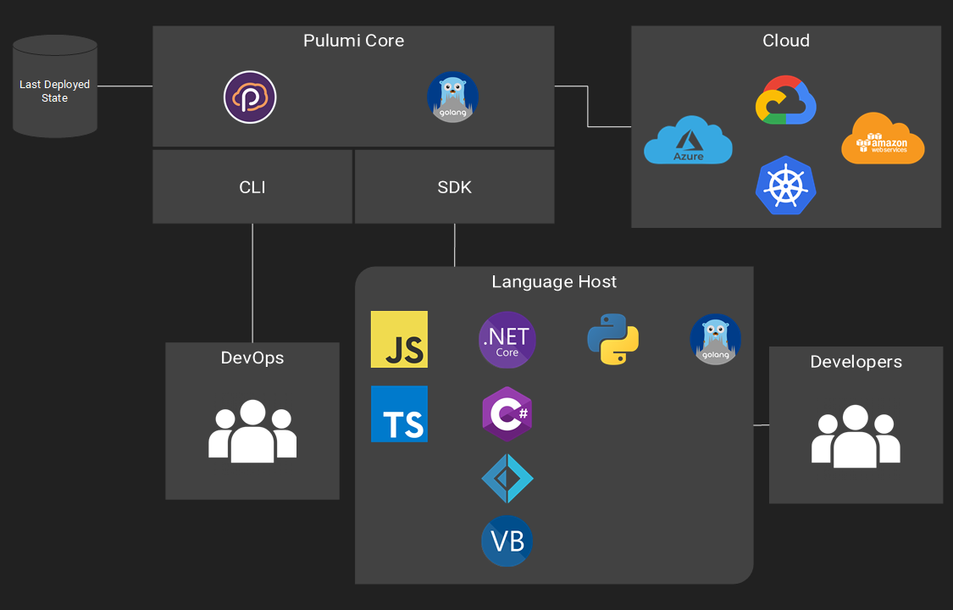
Pulumi Architecture

Slide 6
Tech Demo

