Slide 1


JavaScript Azure Functions Markup functions-demo.codyconfer.me
Cody Confer
Software Developer focus on Microsoft technologies including .NET Core, C#, Typescript and Azure.

Slide 2
What is Architecture?
Architecture is not tooling.
Architecture is not a design pattern.
Architecture is not a diagram.
Architecture is a collective effort
Architecture can be carried across tool sets
Architecture is a set of paradigms, patterns, designs and philosophies established to aid a development team in creating a solution to solve a use case or business need.

Slide 3
How to create “Good Architecture”
Democratize
Good software design flows from the bottom up.
Good software implementation flows from the top down.
Every developer has good ideas.
Everyone needs a sanity check.
Modularity – design from the ground up
Flexibility – focus on ability to pivot
Avoid optimization in design – you can’t account for everything

Slide 4
How to create “Good Implementations”
Scaffold – It’s like planning… on the fly.
Iterate – Its never right the first time.
Optimize for metrics – Is it really a problem because Billy Blogs read a medium article?
Implement with intent – Hint, intent is usually labeled “acceptance criteria”.

Slide 5
Serverless Paradigm
Runtime that abstracts the underlying infrastructure from a logic application
Generally Containerized
Generally Distributed
Self Scaling
Scales to 0 – cold starts
Runtimes are tied to a specific cloud host

Slide 6
Distributed Systems
Systems whose operating scope is greater than a single machine
Modularity
Components rewritten overtime
Independently scalable, deployable
Flexibility – new features are not constrained by old designs
Eventual Consistency – are we there yet?

Slide 7
Domain Driven Design
2003 book “Domain Driven Design” by Eric Evans
Domains
Context
Bounded Context
Model
Ubiquitous language

Slide 8
CQRS
Command Query Responsibility Segregation
Describes decoupling of logic which mutates data and logic which queries data into separated bounded contexts
Command Query Separation
Describes decoupling of logic which mutates data and logic which queries data into separate methods.
Data objects are immutable
Well suited for reactive and event-based programming
Risk of excess complexity in implementations

Slide 9
Architecture
Design Patterns – CQRS
Paradigms – Web, Serverless, Distributed
Philosophy – Domain Driven Design

Slide 10
Design
Tooling – Azure Functions, SignalR, Azure Event Hub, Redis, C#/.NET Core
Vue.js, Nuxt.js, Netlify CDN
Query data – in Query Function App
Mutate data – in Mutate Function App
Subscribe to data events – in Notify Function App

Slide 11
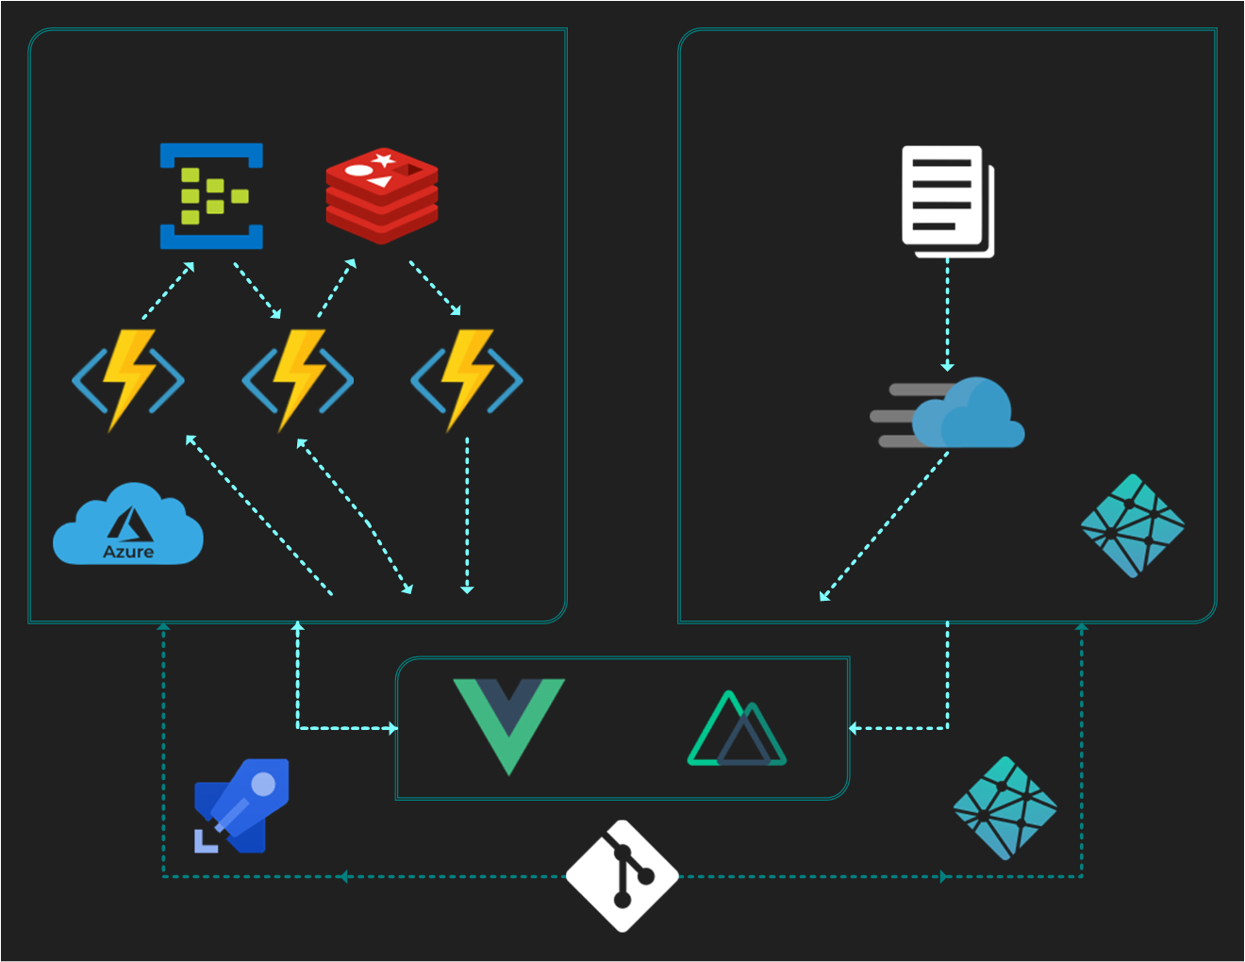
Implementation

Slide 12
Questions?
Source – github.codyconfer.me/functions-demo
Live Demo – functions-demo.codyconfer.me
GitHub – github.codyconfer.me
LinkedIn – linkedin.codyconfer.me
Spotify Playlists – music.codyconfer.me

