Slide 1
Project Overview (Progress Report 11/9-11/15) Cody Costa David loi mike tran
Goal: Implement autonomous drone navigation in AirSim using LiDAR and path planning.
Key Features:
- LiDAR-based 2D occupancy grid
- A* path planning
- PID altitude hold
- Obstacle avoidance (Local AI)
- Forward velocity control
- Real-time plotting and visualization

Slide 2
Initial Implementation
Language: Python
Libraries: airsim, numpy, scipy, matplotlib, torch (planned)
Basic Flow:
1. Connect to AirSim client
2. Takeoff and move to nominal altitude
3. Build occupancy grid from LiDAR
4. Plan path to goal using A*
5. Follow path with moveByVelocityAsync commands
6. Land at target

Slide 3
Challenges
1. AttributeError on KinematicsState: state.kinematics_estimated.pose did not exist. Use position + orientation separately.
2. Obstacle Too Close False Positives: LiDAR noise and thresholds caused false positives. Adjust OCCUPIED_THRESHOLD.
3. Random Circling: CNN corrections (untrained) and moving grid origin caused oscillations.
3A. Random Lunging (shown in gif): No CNN applied but PD velocity commands do not smoothly mesh with each other
4. Altitude Drift: Solved with PID controller for vertical velocity.

Slide 4
CNN Approach Consideration
Original plan: Use CNN to predict velocity corrections from LiDAR.
Problems: Untrained model → random outputs → circling.
Current decision: Disable CNN until baseline stable.
Future plan: Hybrid approach: A* path + trained CNN corrections.

Slide 5
Path Planning & Grid Issues
A* relies on occupancy grid.
Issues:
- Grid origin updated every loop → goal coordinates shift.
- LiDAR points occasionally mark free space as obstacles → frequent replanning.
Solutions:
- Fix grid origin at start position.
- Adjust WAYPOINT_TOL and REPLAN_INTERVAL.

Slide 6
Code Highlights
Altitude PID: vz = ALT_KP*error + ALT_KI*integral + ALT_KD*derivative
A* Planning: path = astar_grid(grid, start, goal)
LiDAR Transformation: pts_world = (R @ pts.T).T + [pos.x_val, pos.y_val, pos.z_val]
Path Following Loop: vx = (wx-px)/dist*FORWARD_SPEED, vy = (wy-py)/dist*FORWARD_SPEED, vz = altitude_hold()

Slide 7
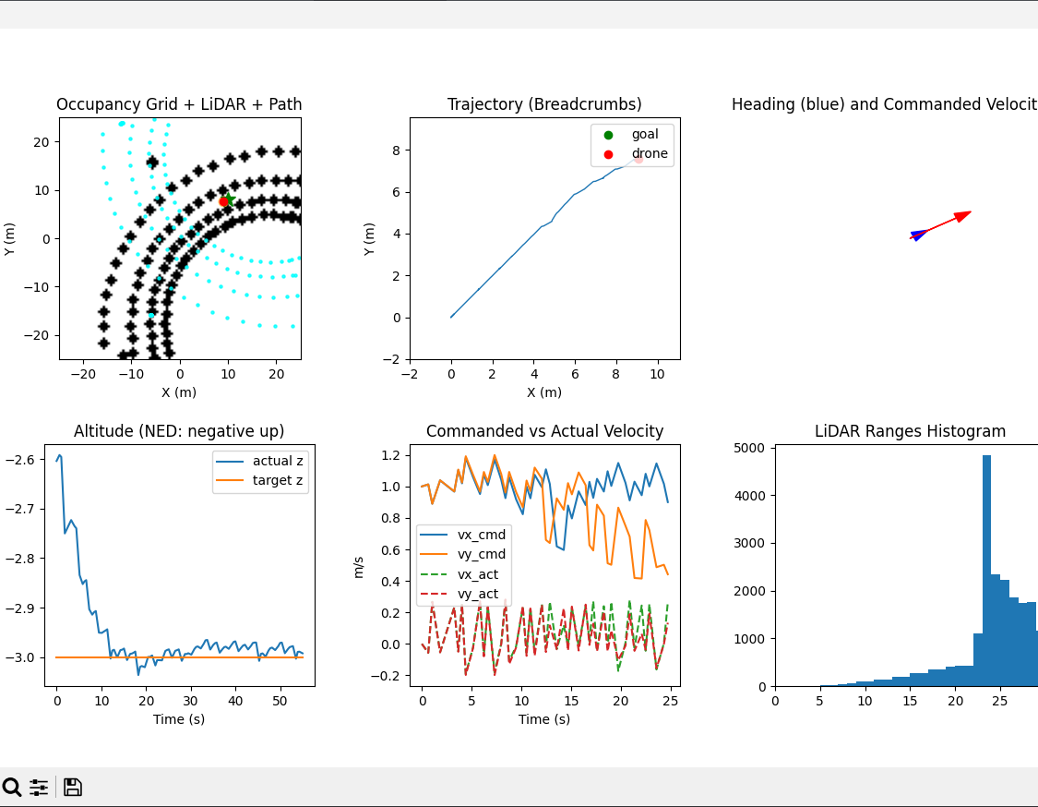
Graphical data
Ordered Top Left to Bottom Right
1. Helps visualize obstacle distribution and how the drone navigates around them
2. Confirms if navigation is stable, drifting, or circling
3. Allows you to compare what the drone thinks its heading is versus what motion command it is trying to execute
4. Checks for oscillations, instability, or poor landing/takeoff performance
5. Diagnoses flight-control mismatch
6. Detects noisy sensors, unexpected obstacles, or blind spots

Slide 8
Lessons Learned
Simulation physics and LiDAR noise can produce unexpected behaviors.
Hybrid AI + classical algorithms require careful handling of model influence.
Debugging requires live visualization of occupancy grid and drone position.
Parameter tuning (velocity, thresholds, PID) is critical for stable autonomous flight.

Slide 9
Tentative Next Steps
1. Implement fixed grid origin and waypoint tolerances.
2. Adjust LiDAR threshold and replanning interval.
3. Tune PID gains for smoother altitude.
4. Optional: Collect LiDAR/velocity dataset and train CNN.
5. Consider real-time goal adjustments via keyboard or GUI.

Slide 10
End of week 11/9 – 11/15 progress updates

Slide 11
Project Overview (Progress Report 11/16-11/22) Cody Costa David loi mike tran
Goal: Implement autonomous drone navigation in AirSim using LiDAR and path planning.
Key Features:
- LiDAR-based 2D occupancy grid
- A* path planning
- PID altitude hold
- Obstacle avoidance (Local AI)
- Forward velocity control
- Real-time plotting and visualization

Slide 12
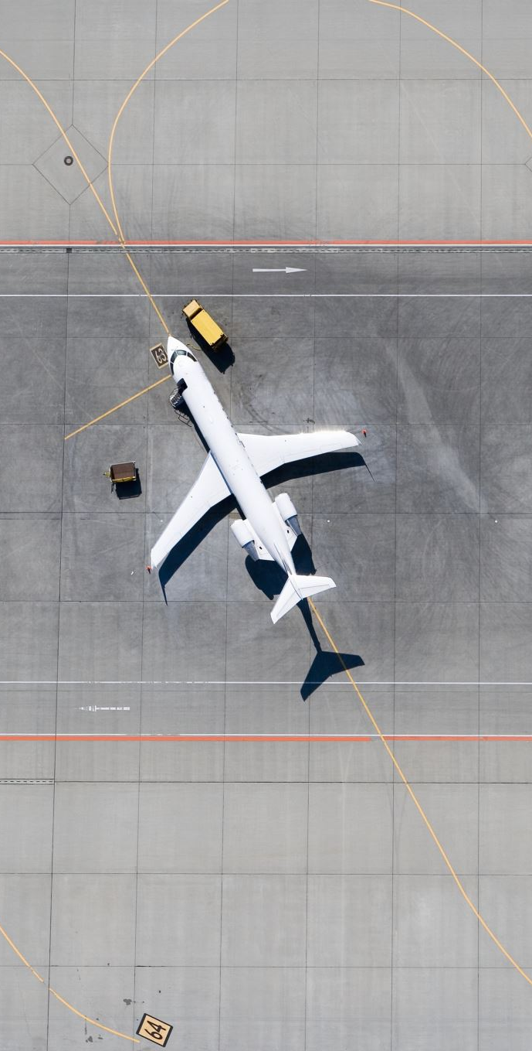
Current status
* working baseline in progress
* shifted focus from full flight control logic and path planning to just the path planning and AI components
* decided to integrate an external flight controller PX4, commonly paired with AirSim setups to reduce workload

Slide 13
New setup challenges
PX4 installation is recommended to use WSL2 (windows subsystem for linux)
common ‘easy’ install commands combined with cloning AirSim and PX4 repos caused a bit of a terminal storm, looking into clearing some of these errors and proceeding with a fresh environment setup
WSL2 install → ubuntu.sh error (FAILED: requirements.txt needed... /dev/fd/63: line 54: return: can only 'return' from a function...) → fixes (manual requirements install, script sourcing via source (example error)

Slide 14
Code bugs and potential fixes (yes ai was consulted, this stuff is hard)
# | Bug / Issue | Severity | Why it kills you in practice | One-line fix
1 | Offboard mode never started | FATAL | PX4 ignores all set_velocity_ned calls until offboard.start() is called and a persistent heartbeat exists | Add await drone.offboard.start() + dedicated 20 Hz heartbeat task
2 | Velocity axes swapped (North/East) | FATAL | In AirSim: X = East, Y = North → your vx_filt is actually East, but you send it as North → drone flies sideways/backward | Swap: VelocityNedYaw(north=vy, east=vx, ...)
3 | No persistent offboard heartbeat | FATAL | PX4 reverts to last mode after ~1–2 s without setpoints → immediate crash after your 0.2 s fly_velocity sleep | Run a background task sending setpoints at ≥10 Hz forever
4 | Lidar → grid indexing wrong | Critical | You index grid[gx, gy] but gx = x/res, gy = y/res → X and Y swapped + row/col reversed → A* plans through walls | Use grid[gy, gx] = 1 and swap x/y correctly (or transpose grid)
5 | A operates on (row, col) but you treat row=x, col=y* | Critical | Your A* start/goal use (int(x/res)+offset, int(y/res)+offset) → row = X (east), col = Y (north) → completely backwards | Either transpose the grid or swap the indices everywhere
6 | No offboard.start() before arming or immediate after takeoff | Critical | Best practice (and often required in PX4 v1.14) is to start offboard before arming | Call offboard.start() right after connection, before action.arm()
7 | Z coordinate handling inconsistent | Medium | You pass wp[2] (negative up) but never convert AirSim → PX4 NED correctly in path following | Always use negative Z for altitude in both AirSim and PX4
8 | Lidar point cloud can be empty → reshape fails | Medium | reshape(-1,3) crashes if <3 points | Guard with if len(data.point_cloud) < 3: return empty_grid (you already do this — good!)
9 | A allows diagonal moves through corners* | Minor | Classic A* corner-cutting problem → path grazes obstacles | Add corner-cutting check or inflate obstacles by 1 cell
10 | No safety altitude hold when replanning | Minor | If A* fails, you just return → velocity drops to zero → slow descent | On path failure, command hover (vz=0) explicitly

Slide 15
Code bugs and potential fixes cont.
# | Issue | Severity | Why it hurts in practice | One-line fix / improvement
1 | Diagonal moves allow corner-cutting | High | Path goes diagonally between two adjacent obstacles → lidar sees free cell but drone physically collides | Add simple corner-cutting test or inflate obstacles
2 | No tie-breaking / sub-pixel randomization | Medium | When multiple paths have same f-cost, it always prefers one direction → deterministic “stair-step” paths that look ugly and are sub-optimal | Add tiny random or cross-product tie-breaker
3 | No path smoothing / pruning | Medium | Returns every grid cell → 50+ waypoints for a 20 m move → jerky motion | Prune collinear points after reconstruction
4 | Uses list as open_set key | Very low | Works, but heapq with (f, node) is fine | No change needed (your way is actually common & safe)

Slide 16
Next milestones
refine WSL stability, get a new, working project environment set up and running with AirSim and PX4
implement some of the bug fixes into our source code files

Slide 17
End of week 11/16 – 11/22 progress updates

