Slide 1
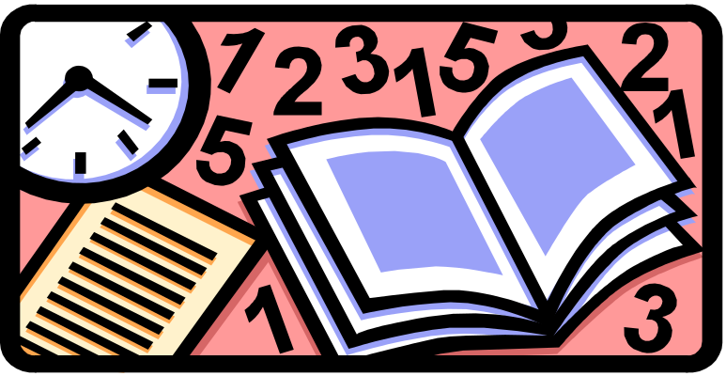
PROBABILITY

Slide 2
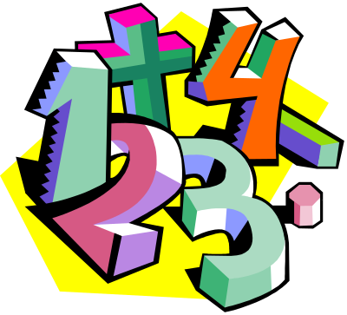
PROBABILITY
Probability is a measure of how likely an event is to occur.
For example –
  Today there is a 60% chance of rain.
  The odds of winning the lottery are a million to one.
  What are some examples you can think of?

Slide 3
PROBABILITY
Probabilities are written as:
  Fractions from 0 to 1
  Decimals from 0 to 1
  Percents from 0% to 100%

Slide 4
PROBABILITY
If an event is certain to happen, then the probability of the event is 1 or 100%.
If an event will NEVER happen, then the probability of the event is 0 or 0%.
If an event is just as likely to happen as to not happen, then the probability of the event is ½, 0.5 or 50%.

Slide 5
PROBABILITY
Impossible Unlikely Equal Chances Likely Certain
0 0.5 1
0% 50% 100%
½

Slide 6
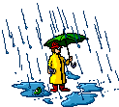
PROBABILITY
When a meteorologist states that the chance of rain is 50%, the meteorologist is saying that it is equally likely to rain or not to rain.
If the chance of rain rises to 80%, it is more likely to rain.
If the chance drops to 20%, then it may rain, but it probably will not rain.

Slide 7
PROBABILITY
What are some events that will never happen and have a probability of 0%?
What are some events that are certain to happen and have a probability of 100%?
What are some events that have equal chances of happening and have a probability of 50%?

Slide 8
PROBABILITY
The probability of an event is written:
P(event) = number of ways event can occur
total number of outcomes

Slide 9

PROBABILITY
P(event) = number of ways event can occur
total number of outcomes
An outcome is a possible result of a probability experiment
    When rolling a number cube, the possible outcomes are 1, 2, 3, 4, 5, and 6

Slide 10
PROBABILITY
P(event) = number of ways event can occur
total number of outcomes
An event is a specific result of a probability experiment
    When rolling a number cube, the event of rolling an even number is 3 (you could roll a 2, 4 or 6).

Slide 11
PROBABILITY
P(event) = number of ways event can occur
total number of outcomes
What is the probability of getting heads when flipping a coin?
P(heads) = number of ways = 1 head on a coin = 1
total outcomes = 2 sides to a coin = 2
P(heads)= ½ = 0.5 = 50%

Slide 12
TRY THESE:
1. What is the probability that the spinner will stop on part A?
B
A
C
D
What is the probability that the spinner will stop on
    An even number?
    An odd number?
3
1
2
A
3. What is the probability that the spinner will stop in the area marked A?
C
B

Slide 13
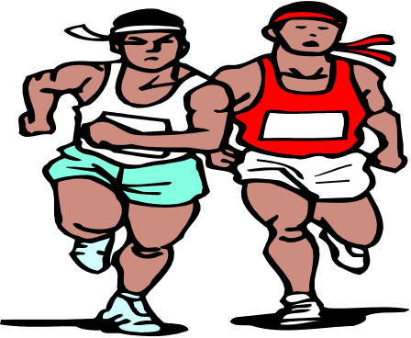
PROBABILITY WORD PROBLEM:
Lawrence is the captain of his track team. The team is deciding on a color and all eight members wrote their choice down on equal size cards. If Lawrence picks one card at random, what is the probability that he will pick blue?
Number of blues = 3
Total cards = 8
3/8 or 0.375 or 37.5%
blue
blue
green
black
yellow
blue
red
black

Slide 14
LET’S WORK THESE TOGETHER
Donald is rolling a number cube labeled 1 to 6. What is the probability of the following?
a.) an odd number
      odd numbers – 1, 3, 5
      total numbers – 1, 2, 3, 4, 5, 6
      b.) a number greater than 5
      numbers greater – 6
      total numbers – 1, 2, 3, 4, 5, 6
3/6 = ½ = 0.5 = 50%
1/6 = 0.166 = 16.6%

Slide 15
TRY THESE:
1. What is the probability of spinning a number greater than 1?
1
2
3
4
What is the probability that a spinner with five congruent sections numbered 1-5 will stop on an even number?
3. What is the probability of rolling a multiple of 2 with one toss of a number cube?

