Slide 1
Team: Binary Evolution
Architecture Review
ECE 554
Spring 2011

Slide 2
High Level View
-32bit ISA
-40bit datapath
-Superscalar (two-issue)
Except Neighborhood Instructions (more on this later)
-4 Stage Pipeline:
Fetch
Decode
Execute (Neighborhood Instructions may require multiple execute cycles)
Memory/Write Back

Slide 3
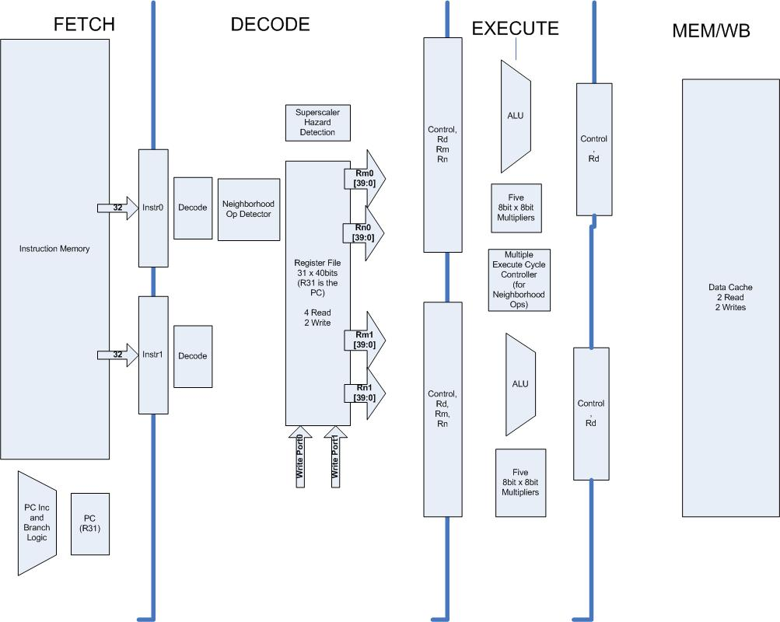
Top Level Diagram

Slide 4
Fetch
-32 bit Instructions
-Fetches two instructions at a time
-Instruction Memory:
-BRAM
-No Cache
-Instruction Memory Space:
10k Instructions (50kB Memory Space, ~20% BRAM)

Slide 5
Decode
-Decodes both instructions.
-Contains a register file with 4 read ports that allows simultaneous reads (also 2 write ports for the Write Back stage)
-Hazard detection unit detects data dependencies and appropriately stalls the dependent instruction
-Neighborhood instructions are not two-issue
-Two-issue can be turned off for performance measurement

Slide 6
Superscalar Hazard Detection
-Detects data dependency Issues
-Inserts appropriate stalling
-Appropriately updates PC so proper instructions are fetched

Slide 7
Execute
- 2 ALUs:
Logic Operations
Shifter
Adder (with bytewise option)
5 – 8x8 multipliers
-Flags updated
-Control logic to handle sequence and feedback required for Neighborhood Ops

Slide 8
WriteBack / Memory Access
-Data Cache
Normal Operation:
2 40-bit writes, 2 40-bit reads
Neighborhood Operation:
Neighborhood Write, 1 Neighborhood Read
  Write Through (for consistency with VGA)
  Size:
    As large as allowed
-Off-Chip Main Data Memory
  Specific Memory Address space for VGA controller.
-Superscalar Requirements:
  Writeback flags need to be properly saved/transferred between paths.

Slide 9
Data Cache: Neighborhood Optimization
-Two prefetching methods based on frequency of neighborhood operations (dynamically detected):
  Neighborhood prefetching if 1/64 instructions is a LDNEIGHBOR
  Spatial Locality prefetching otherwise
-Prefetching can also be set to one mode or the other or turned off for performance evaluation.
-Two access patterns: one for accessing neighborhoods and one for accessing normal sequential 40-bit chunks of data

Slide 10
Interrupts & Exceptions
-Interrupts cause instruction execution to BL to a dedicated interrupt handler address
-Specific Interrupts
-Timer Interrupt – configured with MMRs
-Mouse
-Keyboard
-Exceptions cause instruction to branch to a dedicated exception handler address
-Specific Exceptions:
-Undefined Instruction
-Memory Out of Bounds
-Stack Overflow

Slide 11
Memory Architecture
-32 Bit Instruction Memory
BRAM
-40 Bit Data Words
Cache in BRAM
Write Through (to keep VGA frame buffers updated)
External Memory (256MB Stick on Board)
-Data Memory Mapped I/O

Slide 12
VGA Controller
-Reads directly from External Memory
2 Frame Buffers
Value in Memory Location switches between buffers
-Bytes for pixel information
-Will have to handle memory conflicts with data cache miss
-Dedicated Pixel Memory Space:
  Space for two full 640 x 480 Frames
  307kB required

Slide 13
ISA
-32 40bit Registers
R31-PC
R30-LR
R29-SP
R28- Used by assembler as convention
-Addressing Modes:
Load/Store
Register + Immediate Offset
Branch
PC Relative (in signed immediate or register)
-ARM7-Like Flags
-Z(zero) C(carry) V(overflow) N(negative)

Slide 14
ISA Details
-5 bit opcodes
-Most Instructions can take a register or an immediate value
  All immediates are signed
  Immediate length depends on instruction
-All instructions are conditional based on a 4-bit condition flag
-Most instructions require a single cycle at each stage
  ex- ACCUMBYTES requires multiple execute cycles

Slide 15
Assembly Language Format
-Very Similar in structure to ISA binary:
OPCODE[_COND] <OPERANDS>
Features:
-Branch to Label pseudo instruction.
-Macro “.EQU” substitution.
-syntax allowing use of “PC”, “LR” and “SP” instead of R31,R30,R29.
Consult the provided Assembly Language Guide document for a full description.

Slide 16
Functional Simulator
- Shares Full syntax checking library with the Assembler.
- Optional Debug mode allows single stepping through code and printing of register and memory values, and breakpoints. (similar to GDB).
- Detailed simulation trace printouts.
- Compares Processor Verilog with simulation results to identify errors.

Slide 17
Demo SW Architecture
Game of Life
- Mouse for initializing board
* Track mouse location and change pixel value on click
- Keyboard for navigating user's “ship”
- Use of neighborhood op's to improve efficiency
Image Processing
- Keyboard to switch between filter options
- Use of neighborhood op's to implement image kernels

Slide 18
Assignments
Task | Ross | Cody | Eric H* | Ben | Eric W
Assembler | 2 | 1
Simulator | 2 | 1
Demo Applications | 1 | 2
Ext Memory |  |  | 2 |  | 1
VGA |  |  | 1 |  | 2
Cache |  |  | 2 |  | 1
ALU |  |  | 2 | 1 | 3
Superscalar Pipeline | 5 | 4 | 2 | 1 | 3
Mouse | 2 | 1 |  | 3
Keyboard | 1 | 2 |  | 3
*Team Leader

Slide 19
