Slide 1
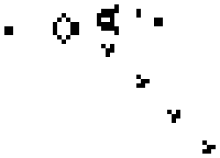
Team: Binary Evolution
Final Presentation
ECE 554
Spring 2011
Eric Harris
Cody Hanson
Ben Fuhrmann
Ross Nordstrom
Eric Weisman

Slide 2
The Birth of A Design
Project Assignment:
  “Design a non-trivial computer with an original instruction set architecture (ISA)‏”
Our Design:
  A unique superscalar processor architecture that makes “neighborhood” operations on adjacent data easy
Notes:
Easy in the sense of “fast” “easy to program”

Slide 3
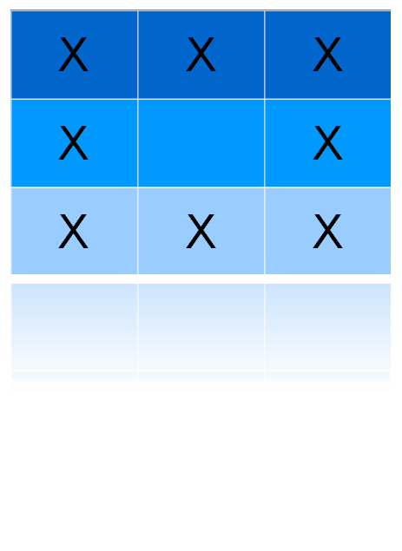
Neighborhood Processing
Neighborhood of
circled cell
Data is often analyzed and modified in “neighborhoods”
Examples:
-Image Processing
-Cellular Automata Models
Used in Math, Physics, Biology
-More novel applications
Game of Life

Slide 4
An Architecture Develops
32-bit Instruction Set Architecture (ISA)
  General purpose instructions similar to ARM7
    Every instruction conditional
    RISC-like design
  Several special instructions for neighborhood processing (SIMD-like)
40-bit datapath
Superscalar (two-issue)
  Provides the hardware bandwidth for efficient neighborhood processing
4 Stage Pipeline:
  Fetch
  Decode
  Execute
  Memory/Write Back

Slide 5
Specialized Instructions
MXMUL (Matrix Multiply)
MXADD/MXSUB (Matrix Addition/Subtraction)
ACCUMBYTES (Accumulate Matrix)
LDNEIGHBOR/STRNEIGHBOR (Load Neighborhood/ Store Neighborhood)
a | b | c |  | 1 | 2 | 3 |  | a x 1 | b x 2 | c x 3
d | e | f | x | 4 | 5 | 6 | = | d x 4 | e x 5 | f x 6
g | h | i |  | 7 | 8 | 9 |  | g x 7 | h x 8 | i x 9
a | b | c |  | 1 | 2 | 3 |  | a + 1 | b + 2 | c + 3
d | e | f | + | 4 | 5 | 6 | = | d + 4 | e + 5 | f + 6
g | h | i |  | 7 | 8 | 9 |  | g + 7 | h + 8 | i + 9
a | b | c
d | e | f | = | a + b + c + d + e + f + g + h + i
g | h | i
 |  |  |  | Memory
a | b | c
d | e | f
g | h | i

Slide 6
Adapting The Pipes
2x40-bit datapaths to support the 9-byte operations
  Most neighborhood operations require 2 40-bit registers in sequential order
Banked memory design to support unique memory access pattern
All Neighborhood instructions except ACCUMBYTES can be operated single cycle by giving the instruction both pipes

Slide 7
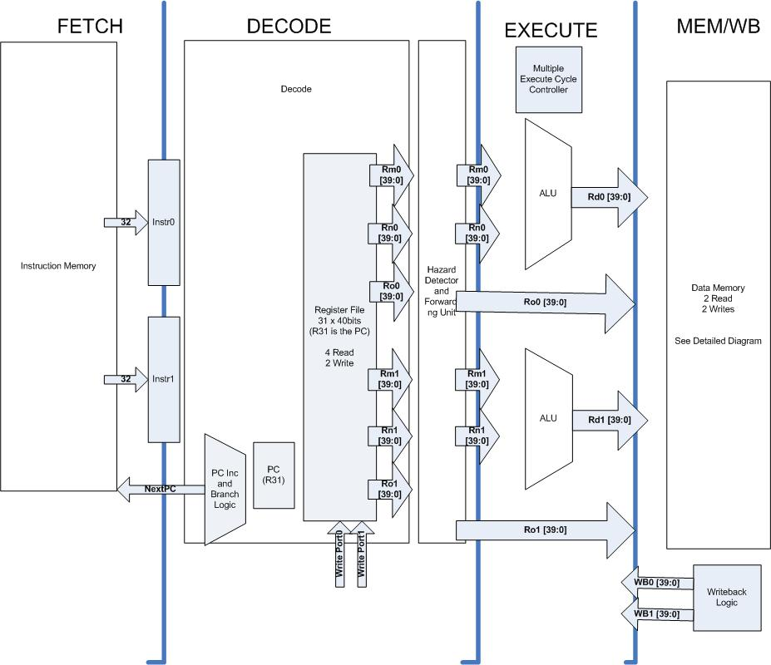
Top Level Diagram

Slide 8
Fetch and Decode
Branch assumed not taken
  Branch penalty of up to 7 instructions if the pipe needs to be flushed
In-order execution always
Forwarding from both Execute and Memory/WB to Decode

Slide 9
Memory Evolution
Two Initial Memory Architectures abandoned
  DDR DRAM w/ on-FPGA caching, because of development tool incompatibility
  5x Superclocked BRAM implementation unstable at speeds required
Banked Approach Implemented
  4x2-port true RAM
  Clocked at twice the speed of the pipe to allow 2 accesses
VGA has memory access priority and causes a 1 cycle pipeline stall (both pipes)

Slide 10
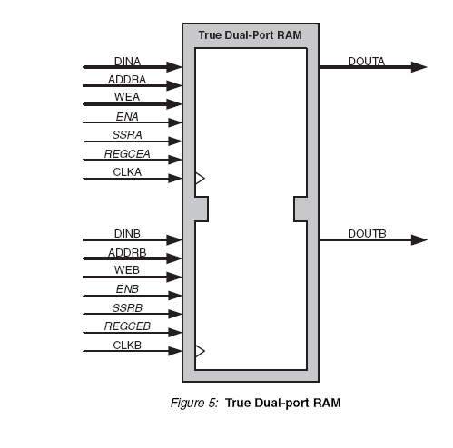
Memory Scheme
-Alignment-free by clever muxing
-4 banks 2-port BRAM
supports up to 2 words (10B) read/written per cycle
-Any 5B word may overlap in no more than 1 BRAM bank.
-Any 9B neighborhood may overlap
by no more than 3 banks.

Slide 11
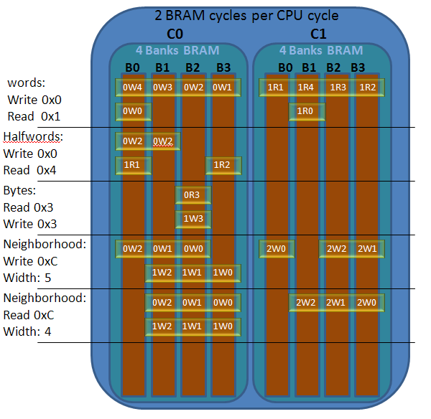
Why Banking Fits

Slide 12

Peripheral Features
-MMRs
I/O Status register (polled)
Input:
Dipswitches
Pushbuttons
Keyboard – Key release detected
Hardware pseudorandom number generator (LFSR)
Output
LEDs
VGA (Color and Grayscale Modes)

Slide 13
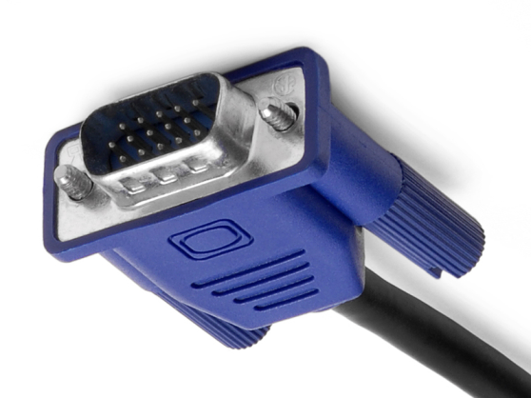
VGA
-640x480 screen resolution
-256x256 frame buffers
-Stretched to 512x480 area (clipping occurs)
-2x Horizontal and 2x Vertical
-2 fixed memory locations, switched by MMR
-Module requests 10 bytes of pixel data at a time from data memory, stalls the processor.

Slide 14
VGA Color Scheme
  1 Byte of data per pixel
  Grayscale Mode: Byte is value for R G and B channels
  Color Mode: 1 Byte is decoded to R G B independently.
    Byte Encoding: BBGGRRRD
      4 values of Blue and Green, 8 values of Red.
    Dead/Alive Bit (LSB) determines if VGA displays the pixel. Useful for Game of Life application.
  Assembler support for Grayscale/Color import into data memory.

Slide 15
Testing and Development
Verilog (pre-synth) simulation used heavily
  Designed Superscalar from ground up
Custom Built Assembler
  All code (test & application) done in assembly
Text-based Simulator
  Can dump frame buffer images with special directives
Special software written to help generate menus and put proper images in data memory load files

Slide 16
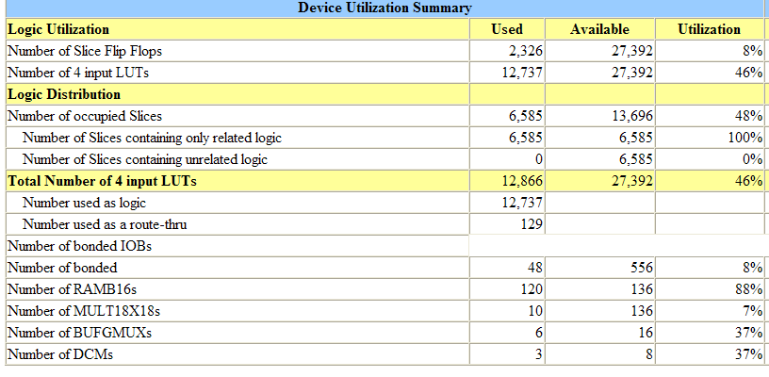
Synthesized
-Virtex II Pro V30
-Core Speed: 30 Mhz
-Memory Speed: 60 Mhz
-VGA Speed 25Mhz

Slide 17
Performance
Time to Run 1000 Generations (@ 30MHz)
No Superscalar No Neighborhood Operations 162 sec | Superscalar No Neighborhood Operations 116 sec
No Superscalar Neighborhood Operations 110 sec | Superscalar Neighborhood Operations 78 sec

Slide 18
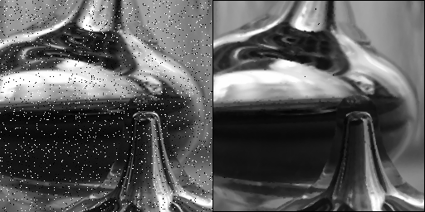
Image Processing
Median filter
  Center gets median of neighborhood
  Superb remover of Salt/Pepper Noise
Kernel Filters:
  Convolve the filter with the image:
  Multiply each neighborhood by a kernel, then center cell gets sum of the result
  Examples:
    Averaging
    Thresholding and Binarization

Slide 19
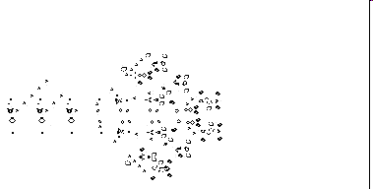
Conway's Game of Life
Rules:
1) Any live cell with fewer than two live neighbors dies
2) Any live cell with two or three live neighbors lives on to the next generation.
3) Any live cell with more than three live neighbors dies, as if by overcrowding.
4) Any dead cell with exactly three live neighbors becomes a live cell
Extensions:
Each cell can have multiple properties depending on color.
Give user ability to manipulate population during regeneration.

Slide 20
Lessons Learned
Don’t copy and paste assembly code between files
Don’t trust documentation
Don’t trust synthesis timing results
Do use version control (>770 commits)
Do have good team communication
Do get team members excited about the project
Do tell other groups/update the course wiki with tips and tricks learned

Slide 21
Questions?

