Slide 1
Team: Binary Evolution
Micro Architecture Review
ECE 554
Spring 2011
Eric Harris
Cody Hanson
Ben Fuhrmann
Ross Nordstrom
Eric Weisman

Slide 2
Notable Changes
-Data Memory architecture restructured
-No longer uses DDR
-Scaled to fit within BRAMs
-Runs on synchronous but faster clock (more later)
-Exceptions removed (for now)
-Mouse input removed (for now)

Slide 3
Current Status
Hardware:
-Superscalar pipeline synthesized
-”Fake” data memory stage used
-Branch and superscalar hardware behavior match simulation
VGA output reading and displaying data from BRAM cell
Keyboard input functional
Software:
-Simulator and Assembler in use
-Application software well under way, awaiting hardware debug

Slide 4
Current Status
Device Utilization Summary |  |  |  |  | [-]
Logic Utilization | Used | Available | Utilization | Note(s)
Number of Slice Flip Flops | 2,652 | 27,392 | 9%
Number of 4 input LUTs | 22,796 | 27,392 | 83%
Logic Distribution
Number of occupied Slices | 11,791 | 13,696 | 86%
Number of Slices containing only related logic | 11,791 | 11,791 | 100%
Number of Slices containing unrelated logic | 0 | 11,791 | 0%
Total Number of 4 input LUTs | 23,045 | 27,392 | 84%
Number used as logic | 22,796
Number used as a route-thru | 249
Number of bonded | 35 | 556 | 6%
Number of RAMB16s | 4 | 136 | 2%
Number of MULT18X18s | 10 | 136 | 7%
Number of BUFGMUXs | 2 | 16 | 12%
Number of DCMs | 1 | 8 | 12%
Includes:
-Tutorial Project VGA Module (similar in size to our module)
-Placeholder memory stage with a 10x10 grid of bytes implemented w/ FF’s

Slide 5
High Level View (Reminder)
-32bit ISA
-40bit datapath
-Superscalar (two-issue)
Except Neighborhood Instructions
-4 Stage Pipeline:
Fetch
Decode
Execute (ACCUMBYTES requires multiple execute cycles)
Memory/Write Back
Estimated Clock Frequencies:
25Mhz Core
125Mhz Data Memory BRAMs

Slide 6
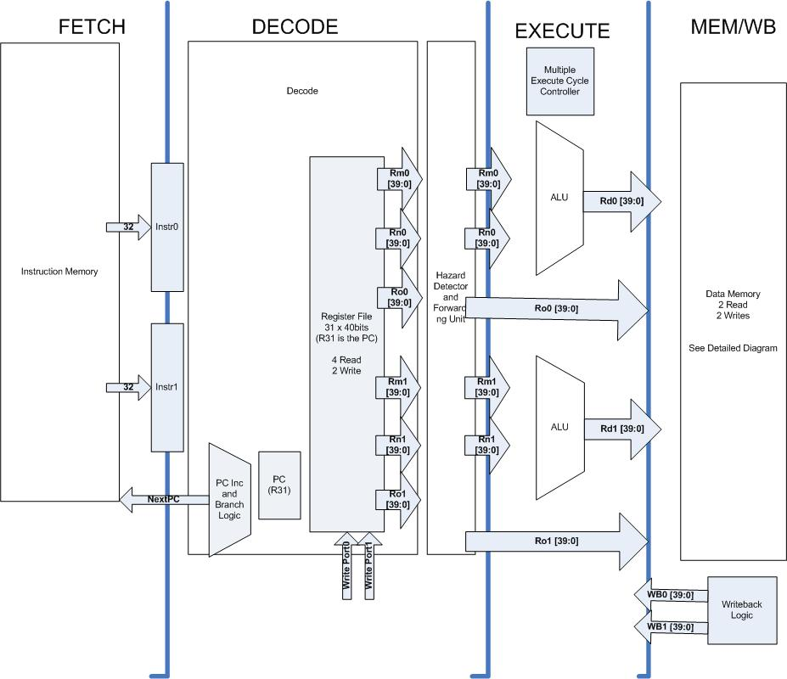
Top Level Diagram

Slide 7
Fetch
-Implemented with BRAMs
-Dual-port ROMs
-Size 1024x32bits
-Uses minimal BRAM blocks to provide for larger data memory
-Can be very easily expanded
-Always fetches two sequential instructions
-Requires branches to waste a cycle while the PC is changed
-Assumes branch not taken
module instr_mem(clk, rst, addrIn, instr0, instr1);
input clk, rst;
input [9:0] addrIn;
output [31:0] instr0, instr1;
IMEM: 32bit, word addressable
0x0000_0300 Interrupt handler begin
0x0000_03FF Interrupt handler end
0x0000_0000 Main code begin
0x0000_02FF Main code end

Slide 8
Decode
-Contains 2-write, 4-read register file
-Handles the PC and branch logic
-Detects when forwarding is required and routes the appropriate data (or stalls)
-Pipe 1 is always stalled when Pipe 0 stalls
-On stall outputs no-ops
-Halt present in MEM/WB stage changes decode stage behavior until reset

Slide 9
Decode – Neighborhood Instructions
-Outputs Rn, Rm and Ro for each pipe as well as opcodes and destination registers
-Ro contains the data value on stores and the shift type on moves
-Memory Operations
-Will issue two stores or two loads (including different sizes) at once
-Neighborhood Ops
-Instead of dual-issue, issues a single neighborhood instruction that spans both pipes.
-Since a pipe0 stall always forces a pipe1 stall, this works well
when stalling a neighborhood operation in the decode stage

Slide 10
Interrupts
On Enabled Interrupt:
-Hardware BL’s to interrupt handler
-Interrupts automatically disabled when in handler
-Handler manually return’s (and re-enables interrupts in the process)
0xFFF0_000F - Interrupt Status Register
Bit(s): Usage:
7:4 (Optional) Pushbutton (3:0) interrupt
3 Dipswitch interrupt
2 Mouse Data Ready Interrupt
1 Keyboard Data Ready Interrupt
0 Timer Interrupt
***NOTE: Write of a 0 clears the corresponding interrupt, 1's do nothing
must do this as well as read the interrupting device.ú
0xFFF0_0010 - Interrupt Enable Register
Bit(s): Usage:
7:4 (Optional) Pushbutton (3:0) interrupt
3 Dipswitch interrupt
2 Mouse Data Ready Interrupt
1 Keyboard Data Ready Interrupt
0 Timer Interrupt

Slide 11
Execute
- 2 ALUs:
Logic Operations
Shifter-control for shift direction on [1:0]Ro
Adder (with bytewise option)
Multiplier
-Flags
-checked against condition when applicable
- flags are stored properly for each alu(i.e. correct flags are selected when conditional operation no matter what alu is being used)
-All instructions except accumbytes takes 1 cycle
-Accumbytes – takes 4 cycles using 40bit adders to save area
- neighborhoodOpController controls the muxes selecting the correct data to be added (including feedback from Ex/Mem Rd) and stalls datapath

Slide 12
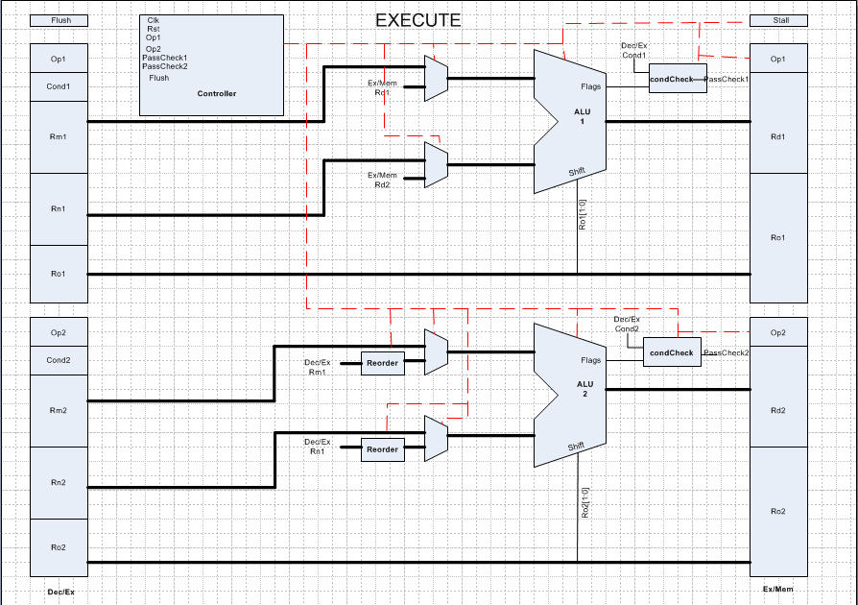

Slide 13
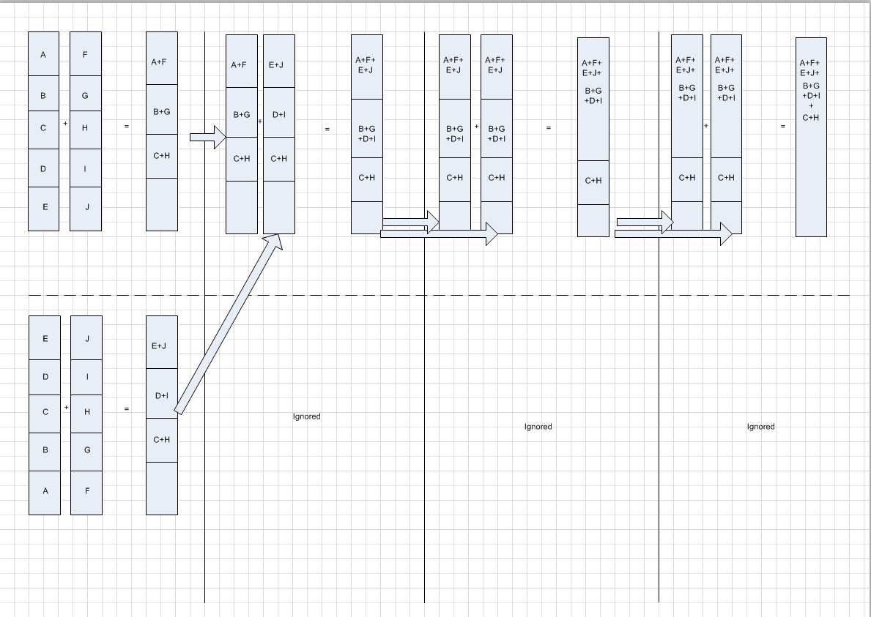
Accumbytes

Slide 14
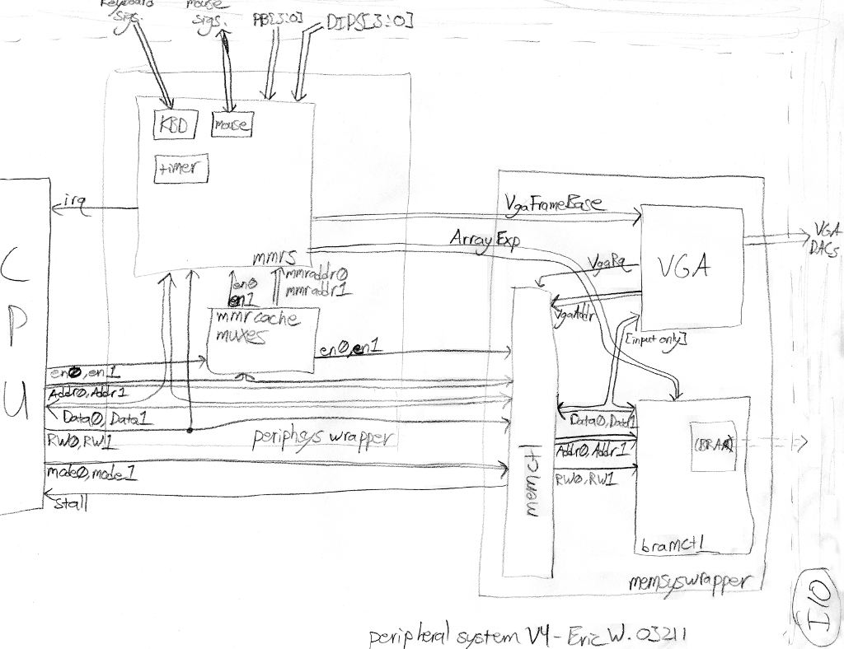
Memory/Write Back

Slide 15
Memory/Write Back
-Data Memory based on unbanked BRAMs
-BRAMs run at 5x core clock speed
-Byte addressable
- 2-port RAM style use of BRAMs
-Allows all operations to operate in a single core cycle
-VGA accesses main memory through the memory controller
-Causes a stall
-Happens infrequently and grabs 10 bytes (pixels) at a time

Slide 16
Memory/Write Back
-Data Memory access visualized
Cycle | 0 | 1 | 2 | 3 | 4 | 0
LDR | B0 | B1 | B2 | B3 | B4
LDRB | B0
STR | B0 | B1 | B2 | B3 | B4
STRB | B0
LDNEIGH | B0 B5 | B1 B6 | B2 B7 | B3 B8 | B4
STRNEIGH | B0 B5 | B1 B6 | B2 B7 | B3 B8 | B4

Slide 17
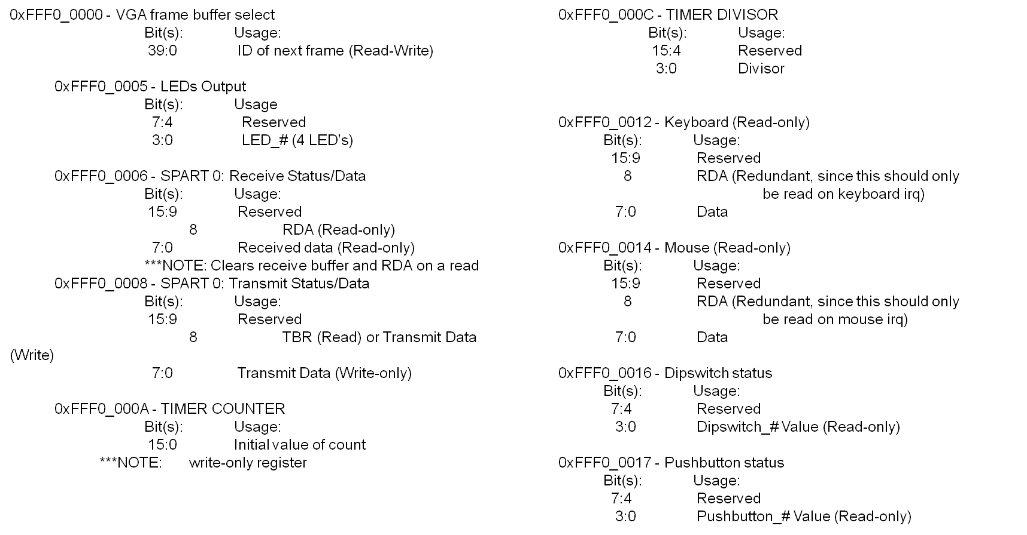
Memory/Write Back
-MMRs

Slide 18
Software
Assembler implemented
Simulator implemented
Basic game of life code complete
  Next: implement a user “ship”
  Needs to be tested on the processor
Image processing to be completed
General cellular automata will be done last

Slide 19
VGA
Modified from the vga_mult tutorial
800x520 screen resolution
Two 256x256 frame buffers
  Stretched to 512x512 area in the vga draw logic
Requests 10 bytes of pixel data at a time from data memory, stalls the processor.
To implement color, will decode single byte to 3 bytes worth of R G B values.

Slide 20
Keyboard
Converts keyboard scancode to ascii
Recognizes key release (Ignores key holds)
Supports:
  all letters and numbers
  Special characters
  enter, space, backspace, tab, and esc
  caps lock, and both shift keys
MMR status bit and rx-data register

Slide 21
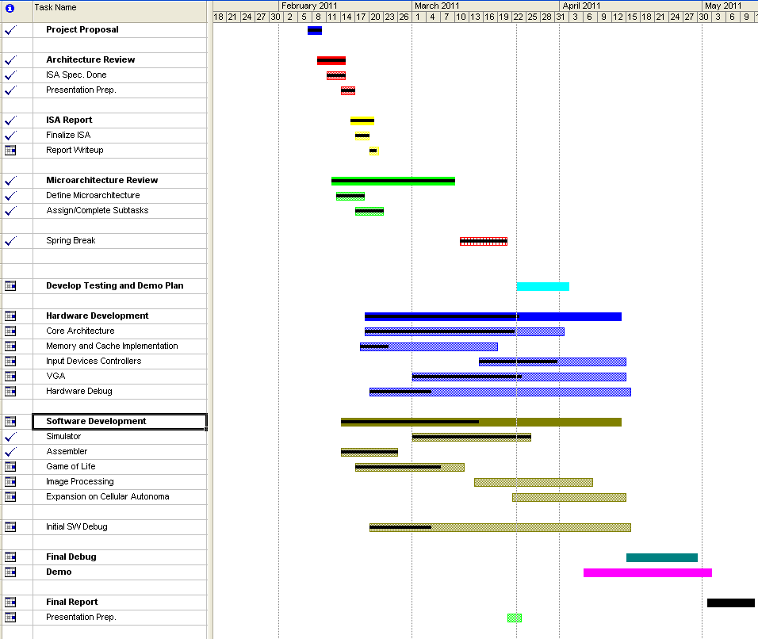
Original Gantt
Overall: On Track

Slide 22
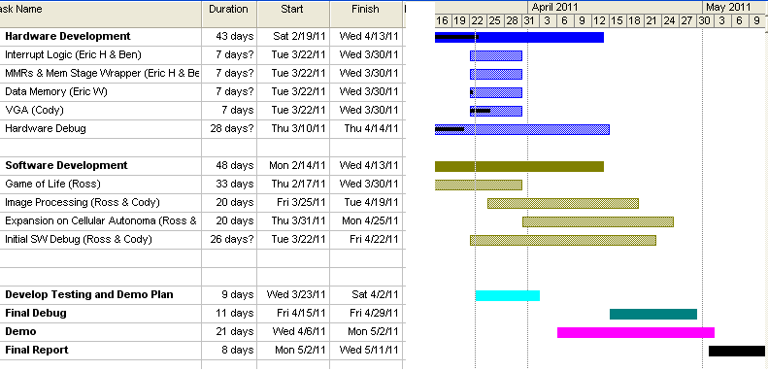
Gantt Going Forward

