Slide 1
ECE 554 Project Proposal
Spring 2011
Team: Binary Evolution

Slide 2
Team Members
(with planned specialties)
Ben Fuhrmann - Architecture
Cody Hanson - Software
Eric Harris* - Architecture
Ross Nordstrom - Software
Eric Weisman - Architecture
*Team Leader

Slide 3
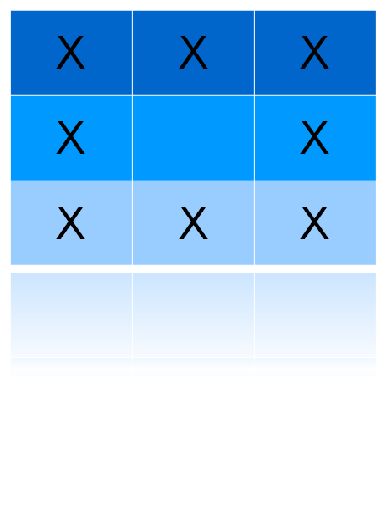
Neighborhood Processing
Neighborhood of
circled cell
Data is often analyzed and modified in “neighborhoods”
Examples:
-Image Processing
(median filter on image)
Sum the neighborhood
Divide the result by 9
Store the result in the center cell
-Cellular Automata Models
Used in Math, Physics, Biology

Slide 4
Goal
-Develop an general purpose architecture optimized for neighborhood processing
-Demonstrate the design with:
    Conway's Game of Life
      Mouse input creates Initial State
      Perhaps expand to be interactive during generations
    Other Cellular Automata
    Image Processing
      Median/Mean Filters
      Erosion/Dilation
      Edge Detection

Slide 5
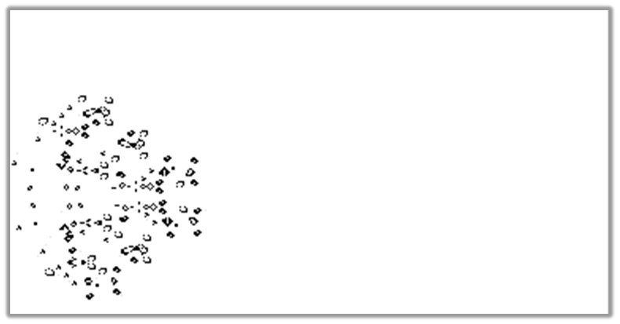
Conway's Game of Life
Rules:
1) Any live cell with fewer than two live neighbors dies
2) Any live cell with two or three live neighbors lives on to the next generation.
3) Any live cell with more than three live neighbors dies, as if by overcrowding.
4) Any dead cell with exactly three live neighbors becomes a live cell
Possible Extensions:
Each cell can have multiple properties depending on color.
Give user ability to manipulate population during regeneration.

Slide 6
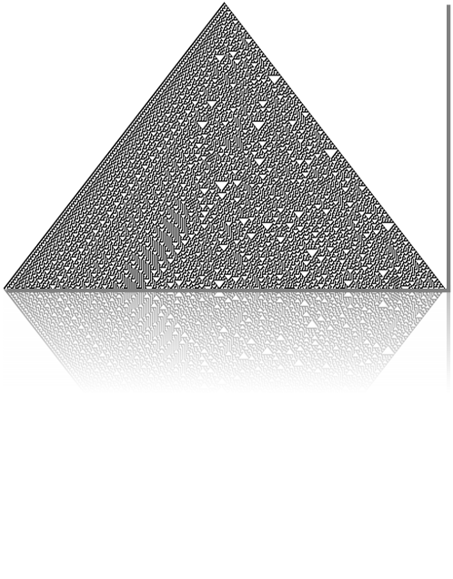
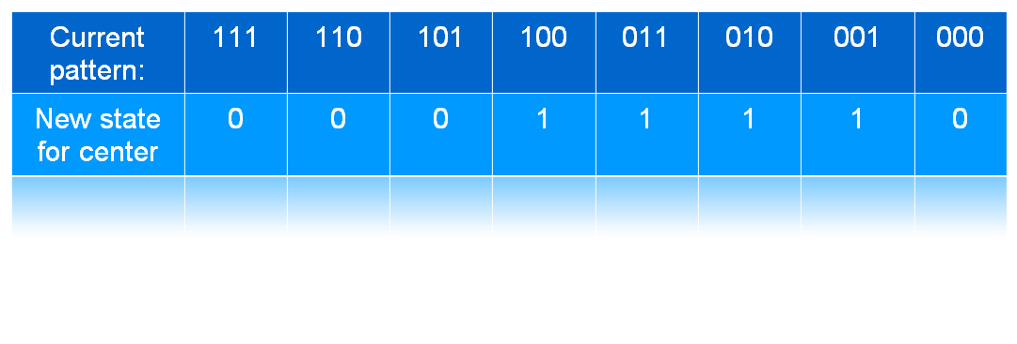
Other Cellular Automation
Conway's Game of Life is a subset of Cellular Automation
Forms the next generation of cells based on each cell's neighbors
  For neighborhoods of size 9, there are 512 (2^9) possible variations
  These variations are called “rules”
“Rule 30”:

Slide 7
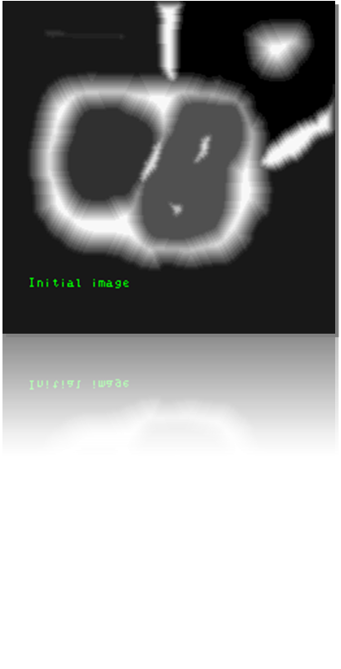
Image Processing
Median filter
  Center gets median of neighborhood
Kernel Filters:
  Convolve the filter with the image:
    Multiply each neighborhood by a kernel, then center cell gets sum of the result
  Examples:
    Laplacian – Highlights changes, so it is used to sharpen images
    Sobel – Edge detection
    More advanced edge detection:
    watershed segmentation shown left

Slide 8
Proposed Architecture - ISA
Base RISC ISA
  Base Instructions similar to MIPS or ARM
  Conditional Execution on instructions (like ARM)
  No Operand Barrel Shifting (unlike ARM)
Extended Neighborhood Pattern Instructions
  One Cycle SIMD Instructions
  Example: Sum the neighborhood of a cell
32-bit Instruction Architecture. 40-bit Data Path
Integer Only

Slide 9
Proposed Architecture - Pipe
Superscalar processor
  Takes advantage of SIMD hardware when not executing special instructions
  Not superscalar when doing SIMD instructions
4-stage pipeline
  Fetch, Decode, Execution, Write
I/O driven and software triggered Interrupts

Slide 10
Proposed Architecture – I/O
Memory
  BRAM On-Chip Memory
  Optimized for Neighborhood Access
  Harvard Architecture
Mouse
  Initialize game of life “board”
Keyboard
Monitor (VGA Controller)

Slide 11
Software Components
Simulator
Assembler
No high level compiler planned
Demo Software
  Conway's Game of Life
  Other Automata
  Image Processing Examples

Slide 12
