Slide 1
Team: Binary Evolution
Testing Demo Plan
ECE 554
Spring 2011
Eric Harris
Cody Hanson
Ben Fuhrmann
Ross Nordstrom
Eric Weisman

Slide 2
Notable Changes
-Data Memory architecture restructured (again)
-Banked BRAMs
-Runs 2x Core Speed
- VGA output is 640x480
  - 256x256 framebuffer is currently stretched Horiz 2x
  - 512x256 area.
  - Considering 2x vertical stretch, software ignoring bottom of FB.

Slide 3
Current Status
Hardware:
-Superscalar pipeline synthesized
-5x MEM stage didn’t meet timing
-VGA displaying great
-Pipe passing functional simulation (except memory operations)
-Mem stage under rapid development
Software:
-Simulator and Assembler working great!
-Application software written, awaiting working HW to test on
- Using simulator to debug in the meantime.

Slide 4
Integration Plan
1) Functionally test MEM stage
2) Test on FPGA
3) Once VGA correctly displaying frame buffer contents start software debug on board (debugging in simulator now)
4) Add features as time permits
-Interrupts
-Mouse
-More Software

Slide 5
Demonstration Plan - Hardware
-Use Game of Life to demonstrate the power of superscalar
-Disable the second pipe for comparison
-Use Game of Life implementation without neighborhood operations to show that ISA features improve performance
-Demonstrate use of peripherals

Slide 6
Demonstration Plan - Software
-Game of Life
  Run to steady state, compare with expected simulator steady state framebuffer output.
-Image Processing
  Have several bitfiles prepared ahead of time.
-Other Software

Slide 7
Potential Testing Bottlenecks
Simulator not a real-time simulator.
Long synthesis time
FPGA clocking/timing is mystical black box
FPGA board availability
Software 100% untested on hardware

Slide 8
Contingency Plans
Slow clock to repair timing issues
Abandon some software projects (image processing, expansion of cellular autonoma)
Drop interrupts and additional peripherals (mouse)

Slide 9
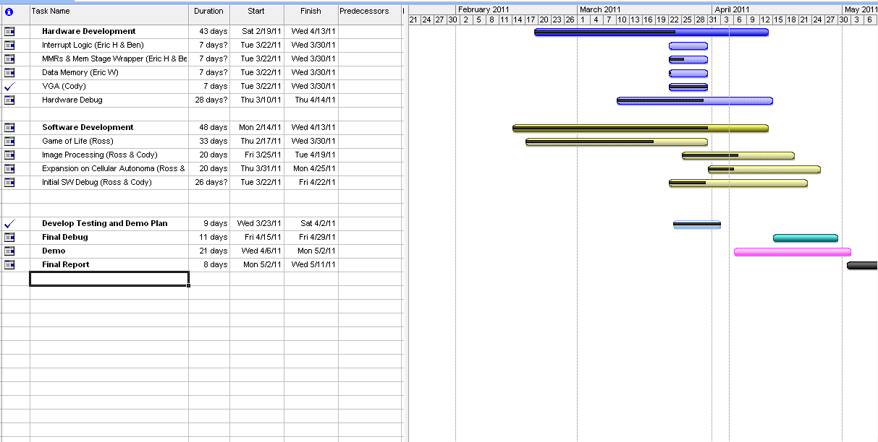
Gantt

Slide 10
BACKUP

Slide 11
High Level View (Reminder)
-32bit ISA
-40bit datapath
-Superscalar (two-issue)
Except Neighborhood Instructions
-4 Stage Pipeline:
Fetch
Decode
Execute (ACCUMBYTES requires multiple execute cycles)
Memory/Write Back
Estimated Clock Frequencies:
25Mhz Core
125Mhz Data Memory BRAMs

Slide 12
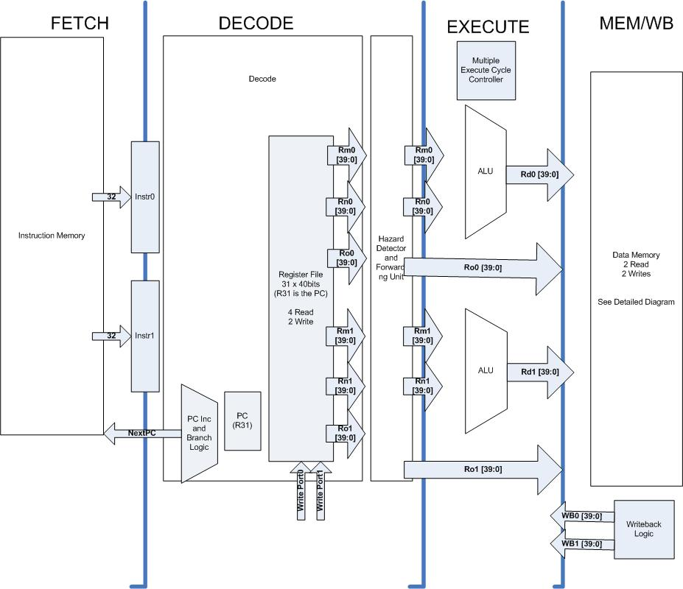
Top Level Diagram

Slide 13
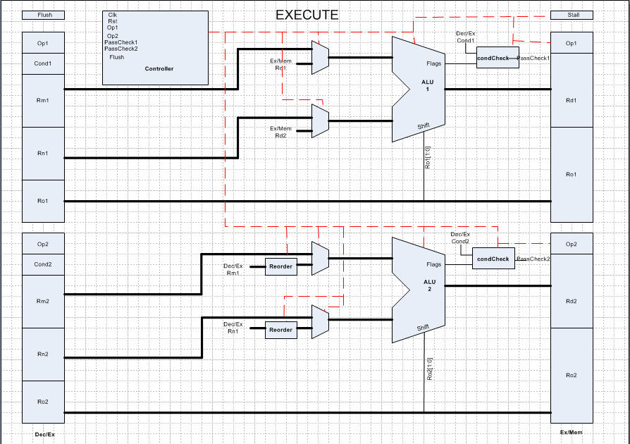

Slide 14
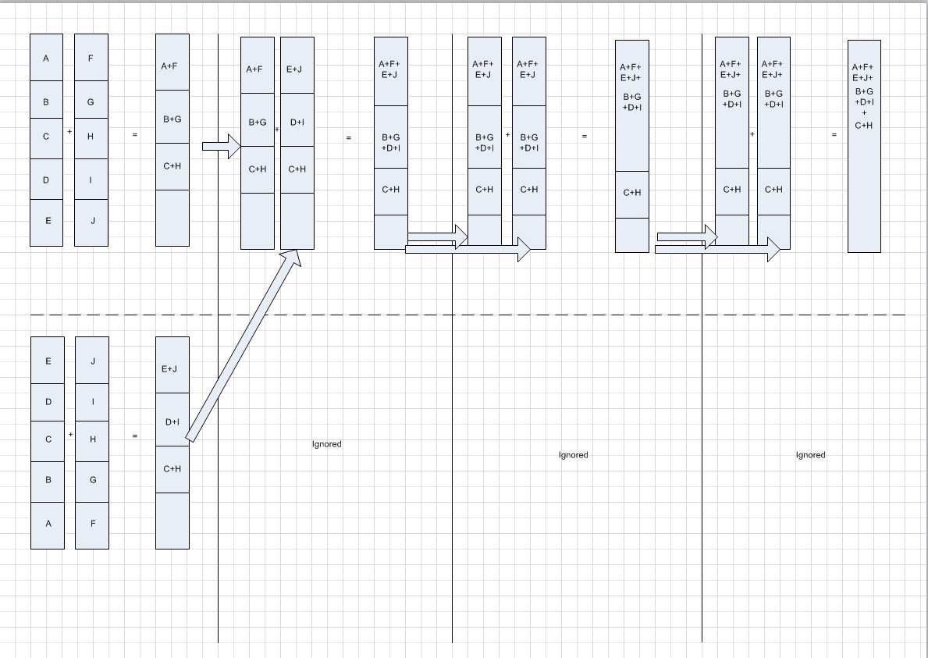
Accumbytes

