Slide 1
Lab Environment and Miniproject Assignment
Spring 2011
ECE554
Digital Engineering Laboratory
Notes:
Good afternoon everyone.
Welcome ECE 554 Digital Engineering laboratory.
In this spring 2008 semester, our web page is at
www.engr.wisc.edu/ece/courses/ece554.html
as shown here.

Slide 2
Lab Environment
Ten 1.8 GHz Core 2 Duo Workstations with 4 GB RAM and 200GB Harddrives
Design Tools
  Xilinx ISE – Integrated Software Environment
  Xilinx EDK – System Level Integration Software
  Modelsim – Simulation Environment
Instrumentation
  Hewlett-Packard Oscilloscopes – probing logic values
  Agilent Logic Analyzers – monitor data on output pins
  Xilinx Virtex2-Pro FPGA Boards

Slide 3
Lab Warnings
Do not wear static electricity generating clothing (wool sweaters)‏
Report stuff dripping from ceiling (don’t touch it).
Don’t sit or stand on backs of chairs or lab tables
Don’t probe (with oscilloscope) or touch anything on the FPGA board, except for push buttons, DIP switches, and special pins for clocks and expansion headers (left and right sides of board)‏
Do not do any wiring on the board with power on
Be sure you download the correct files to the FPGA
Carefully read all warnings in Lab Environment handout

Slide 4
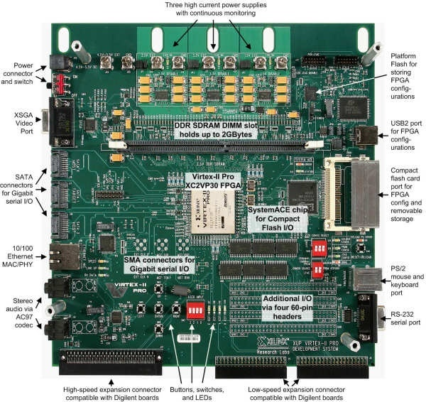
Xilinx Virtex2-Pro FPGA Board
Notes:
This slide shows a picture of the Virtex-2 Pro FPGA board, which has several features:
It can digitize PAL, SECAM, or NTSC video with up to 9-bits of resolution on the red, green, and blue channels and can output video images through a 110 MHz, 24-bit RAMDAC.
It can also process stereo audio signals with up to 20 bits of resolution and a bandwidth of 50 KHz.
256 MB of PC2100 (133MHz) DDR Memory are provided on board..
A compact flash port is available for use which enables you to store and load designs onto the FPGA and DDR Memory. The compact flash card is 512MB in size.
The XSV Board has a variety of interfaces for communicating with the outside serial ports, a USB port expansion module, PS/2 mouse and keyboard ports, and 10/100 Ethernet PHY layer interface. There are also two independent expansion ports, each with 38 general-purpose I/O pins connected directly to the Virtex FPGA.

Slide 5
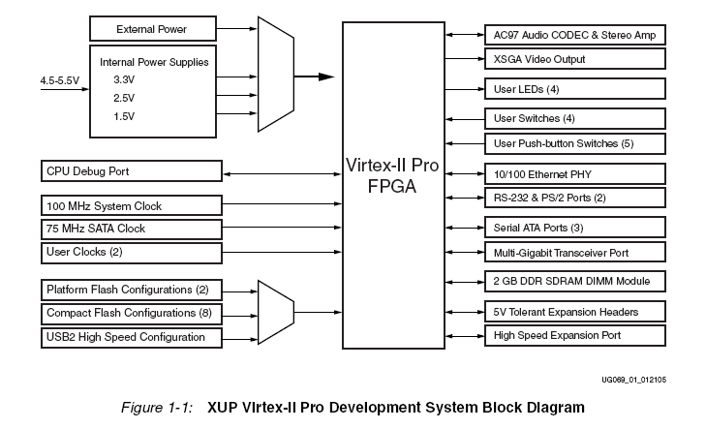
Virtex2-Pro Board
Notes:
Multiple clocks are available ranging at speeds of 25, 33, 50, 75, and 100 MHz. Additionally, the board provides 8 Digital Clock Managers (DCMs) which can synthesize additional clock frequiencies.
Video decoder that accepts NTSC/PAL/SECAM signals through an RCA jack or Svideoconnector and outputs the digitized signal to the FPGA.
RAMDAC with a 256-entry, 24-bit colormap that is used by the FPGA to output video to a VGA monitor.
Stereo codec that lets the FPGA digitize and generate 0-50 KHz audio signals with up to 20 bits of resolution.
10BASE-T/100BASE-TX Ethernet PHY that allows the FPGA to access a LAN at upto 100 Mbps.

Slide 6
Virtex2-Pro Board: Features
Xilinx Virtex FPGA (Compute)‏
256 MB DDR Memory (PC2100) (Store for Read/Write)‏
Serial Ports to PC (I/O from/to Outside World)‏
Keyboard/Mouse (PS/2) Port
VGA Output to VGA Monitor
Audio/Video Converters
See Virtex2-Pro Board Manual at:
http://www.digilentinc.com/Data/Products/XUPV2P/XUPV2P_User_Guide.pdf
Notes:
The main features of Virtex2-Pro are
1. The 256 MB main memory for storing data/programs
2. The usb/serial ports for PC interfacing
3. The PS/2 keyboard and mouse ports for user interfacing
4. The VGA output to the monitor for displaying graphic and video
5. The audio/video converter for inputting audio or video signal
6. Up to 256KB of block ram available on the FPGA

Slide 7
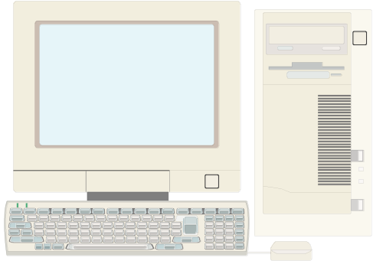
Current Setup
USB Cable
Serial Cable
Virtex2-Pro Board
machine running
HyperTerminal
USB port: Configuration download
Serial port: Miniproject
Notes:
The PCs interface to the boards using a USB and a Serial Cable.
The USB connects to the UBS-JTAG Port and is used to configure the Board.
The Serial Port is used in the miniproject to transmit data between the PC and the SPART. The Serial port has four general purpose I/O pins that connect to the CPLD pins RTS (ready to send), TD (transmit data), CTS (clear to send), and RD (receive data). During the mini-project flow control will not be used, so only the TD and RD pins will be used.

Slide 8
Miniproject Specification
For the miniproject, you will
  Design a Special Purpose Asynchronous Receiver/Transmitter (SPART) and its testbench in Verilog/VHDL
  Simulate the design to ensure correct performance
  Download the design and associated files and demonstrate correction functionality
  Prepare a report on your design

Slide 9
Miniproject Objectives
To get familiar with the lab environment prior to the class project and bench exam
To get practice using HDL in your designs
To provide the basic I/O interface to the class project
To get experience working with a partner
Notes:
The miniproject has the following objectives.

Slide 10
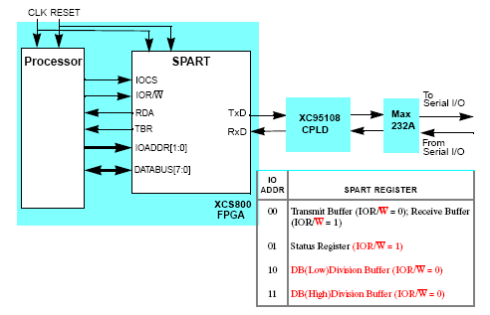
SPART Interface
Notes:
IOCS = I/O chip select. Set to one to activate the SPART
IOR/Wbar – When 1, the reading from SPART to the PROCESSOR, when 0 reading from the PROCESSOR to the SPART
RDA – Receive data available => data can be read by the processor from the SPART.
TBR – Transmit buffer ready => data can be sent from the processor to the SPART
IOADDR – I/O address of register to read or write
DATABUS – Data to be sent or received
SPART is fully synchronous with the clock – all transfers occur on a positive clock edge.
The received data on RxD is asynchronous. The transmit via TxD is also asynchronous.

Slide 11
Processor Interface
Data is sent/received across the “bidirectional” data bus
Handshaking (status) signals
  TBR: Transmit Buffer Ready (Empty)‏
  RDA: Receive Data Available
  IOCS: Chip Select
  IOR/W_: Read or Write Bar signal

Slide 12
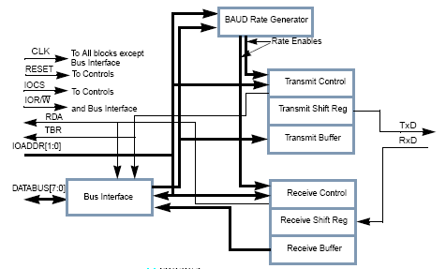
SPART Block Diagram
Notes:
The Bus Interface contains the 3-state drivers which attach the SPART to the DATABUS. In addition, it contains the multiplexer which selects the Receive Buffer or the Status Register.
The Status Register consists of RDA and TBR in positions 0 and 1, respectively. The Status Register is not actually a register, but just connections from RDA and TBR which are stored at their respective sources. The remaining six bits connected to the multiplexer for the Status Register are zeroes.
The BAUD Rate Generator (BRG) produces an enabling signal or signals for controlling the transmitter and the receiver. This is done as a multiple of the clock.

Slide 13
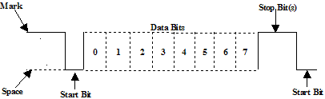
Asynch. Serial Communication
Start bit (1 bit wide)‏
Data bits (8 bits)‏
Parity(None, Even, Odd) - optional
Stop bit (1 bit wide)‏

Slide 14
Transmitting
Tx must be tested first.
Tx shifts the “LSB” out from Tx buffer first.
Tx sends “stop bit” when there is nothing to send.

Slide 15
Receiving
Receiver samples the RxD to get the beginning of the “start bit”
Use “resynchronization” to avoid “metastability” of any flip-flop

Slide 16
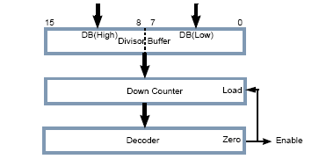
Baud Rate Generator

Slide 17
Baudrate and Sampling
We want the transmission rate to be constant for different input clocks
Baud rates of 4800 and 9600 bit per second
Sampling rate = x16 of the baud rate (bit rate)‏
Divide the clock to get the “Enable” signal (sampling rate)‏

Slide 18
Testbench
A mock processor implemented as a simple finite state machine
Receive data on the RxD from keyboard and transmit (echos) back on the TxD back to the HyperTerminal
Implement a simplified printf that can print character strings
Load Baud Rate Generator with Arbitrary value
Demonstrate ability to work at different Baud Rates using the BRG register

Slide 19
Demonstration
Show the ability to receive and transmit characters at 4800 and 9600 buad rates.
Demos done in lab on 2/2 and 2/3 at start of class.

Slide 20
Miniproject Report
Due 2/2 and 2/3 at start of class
Verilog/VHDL code for your design with clear comments
Description of the function of the SPART and each block in the design, including the testbench
Record of experiments conducted and how the design was tested
Problems encountered and solutions employed

