Slide 1
Cody Hock
Senior Project presentation

Slide 2
Idea
What

Slide 3
Components

Slide 4
Getting Data

Slide 5
PHP to MySQL
Make picture

Slide 6
Demo
Put shell command here

Slide 7
R
What
Why
Linear Regression, KNN, Decision Trees, SVM’s

Slide 8
Linear Regression
Way of specifying the relationship between the dependent variable (the value to be predicted) and one or more independent variables.
Multiple linear regression is using more than 1 independent variable.
Correlation is a number indicating how closely the relationship of 2 variables follows a straight line (Pearson’s Correlation Coefficient).

Slide 9
Linear Regression (in R)
Pros
Cons
Most common approach for modeling numeric data (many to choose from)
Can be adapted to model almost any data
Provides the estimates of the correlations between the independent and dependent variables
Makes assumptions about the data
The model’s form must be specified in advance
Does not handle missing data well
Only works with numeric inputs
Requires some knowledge of statistics to understand the model

Slide 10
Linear Regression with different inputs
Special Teams: 68.8%
Defensive Stats: 71.8%
PPG Stats: 71.43%
QB Stats: 71.05%
Rushing Stats: 71.99%
Turnovers: 59.59%
Combining: 74.06%

Slide 11
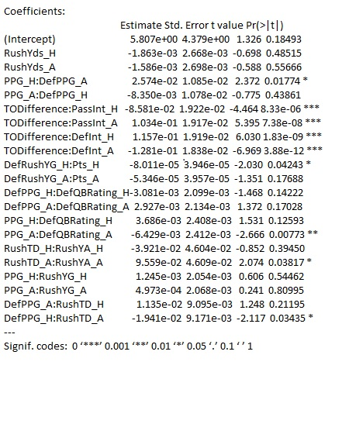

Slide 12
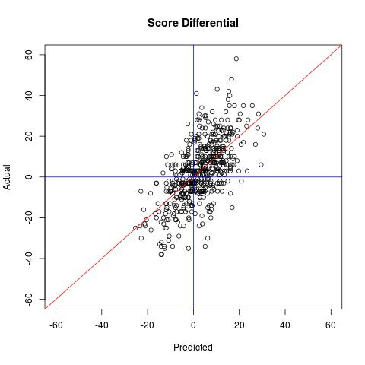
Accuracy: 74.06%

Slide 13
K-Nearest Neighbors
Classifiers are defined by the characteristic of classifying unlabeled examples by assigning them to the class of the most similar labeled (K) examples.
“If a concept is difficult to define, but you know it when you see it, then nearest neighbors must be appropriate.” ~ Brett Lantz
Identifies “K” records in the training data that are most similar and assigns to the class of the majority of the neighbors.
In general, it is not well suited for identifying a boundary.

Slide 14
K-Nearest Neighbors (in R)
Pros
Cons
Simple and effective
No assumptions about the underlying data distribution
Fast training phase
Does not produce a readable model – limits ability to find relationships among features
Slow classification phase
Requires large amount of memory
Non numeric and missing data require additional processing

Slide 15
K-Nearest Neighbors
Accuracy: 71.99% with k = 7
 | Predicted
Observed | -1 | 1 | Row Total
-1 | 137 | 83 | 220
1 | 66 | 246 | 312
Column Total | 203 | 329 | 532

Slide 16
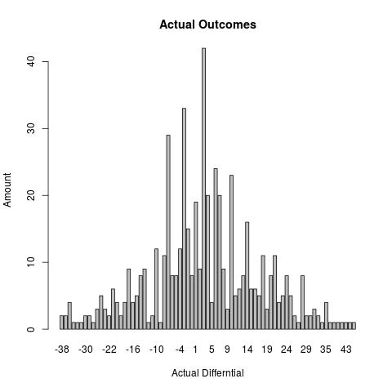
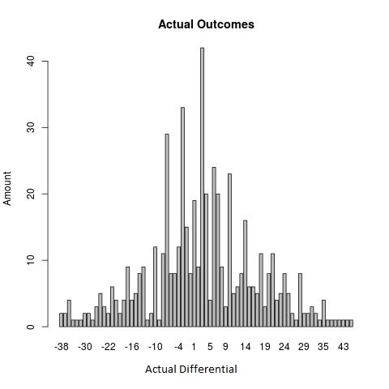
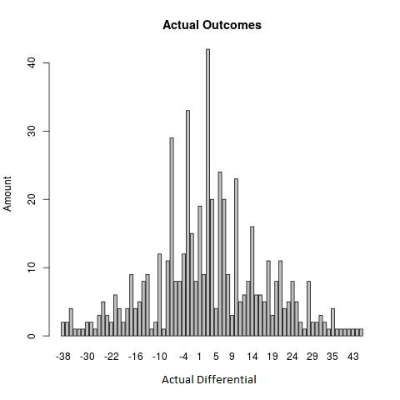

Slide 17
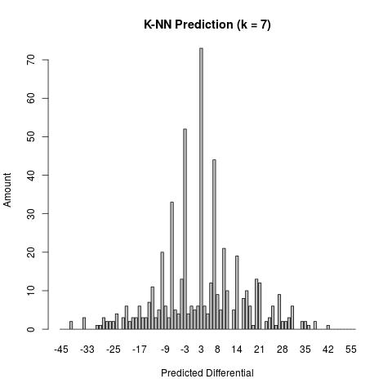
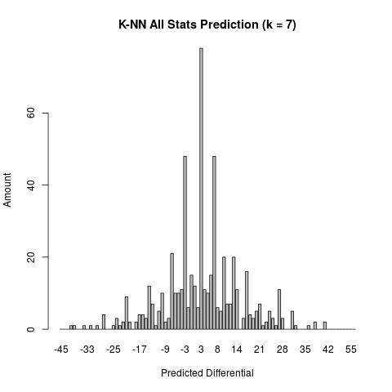
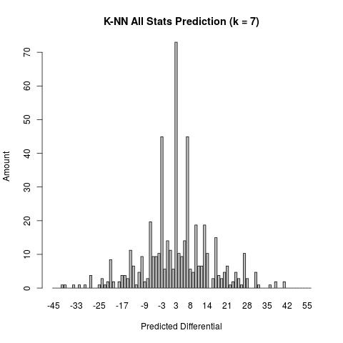
Accuracy: 71.99%
Accuracy: 71.43%
(Approx. 2x amount of variables)

Slide 18
Decision Trees
Builds a model in the form of a tree”
Comprises a series of logical decisions with Decision Nodes that indicate a decision to be made on that attribute
Branches split from decision nodes indicating the decision’s choice
Leaf Nodes denote the result following the combination of decisions
A decision tree is essentially a flow chart to follow.
Recursive Partitioning (divide and conquer) is used to split the data into smaller subsets of similar classes.
Possible terminations:
All of the examples at that node have the same class
No remaining features to distinguish the examples
The tree has grown to the predefined size limit

Slide 19
Decision Trees (in R)
Pros
Cons
Classifier that does well on most problems
Learning process can handle numeric or nominal features
Uses only most important features
For small trees, the model is simple to interpret
More efficient than more complex models
Biased toward splits on features having large number of levels
Easy to overfit or underfit the model
Small changes in training data can result in large changes of decision logic
Large trees become difficult to interpret

Slide 20
Decision Trees
Accuracy: 70.49% with trials = 7
 | Predicted
Observed | -1 | 1 | Row Total
-1 | 123 | 97 | 220
1 | 60 | 252 | 312
Column Total | 183 | 349 | 532

Slide 21
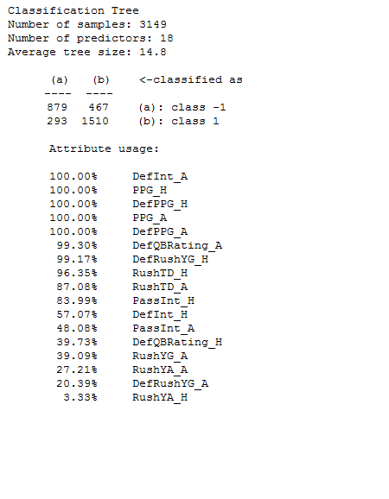
Decision Trees

Slide 22
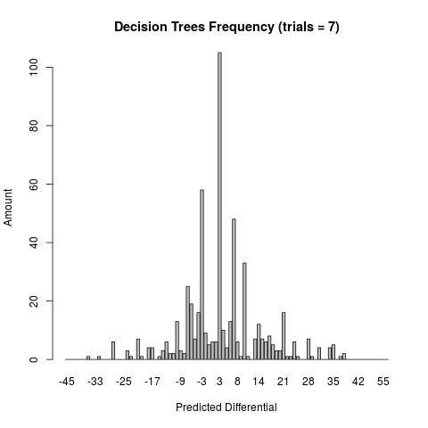
Accuracy: 70.49%

Slide 23
Support Vector Machines
As surface that defines a boundary between points plotted in a multidimensional space according to their values.
Hyperplane is the boundary in the multidimensional space which leads to fairly homogeneous partitions of the data.
Maximum Margin Hyperplane (MMH) creates the greatest separation between two classes.
Support Vectors are the points from each class that are the closest to the MMH (each class must have at least 1).
Uses the support vectors for classification and generally ignores those points farther from MMH.

Slide 24
Support Vector Machines (in R)
Pros
Cons
Can be used for classification or numeric prediction
Not overly influenced by noisy (meaningless) data
Easier to use than Neural Networks
Recent increase in popularity for its accuracy in data mining competitions
Finding best model requires testing various combinations or parameters
Slow to train, especially if the input has a large number of features
Results in a complex black box model that is difficult (if not impossible) to interpret

Slide 25
SVM Mappings
Rfbbdot (Radial Basis – distance from origin):
73.12%
Polydot (Polynomial):
73.12%
Tanhdot (Hyperbolic Tangentsigmoid – having an “S” shape curve):
73.31%
Vanilladot (Linear):
73.31%

Slide 26

Linear Accuracy: 73.31%

Slide 27
My 4 methods
State why regression works best

Slide 28
2014 Week 14
Show spreadsheet

Slide 29
R Demo
Predict week 15

Slide 30
Thank You

