Slide 1
Cody Hock
Senior Project presentation
Fall 2014

Slide 2
NFL Predictions Using R Machine Learning algorithms
My project was to gather NFL statistics and use them to develop a way to predict the outcomes of future NFL games.
Review each component and then predict this weeks games!!!

Slide 3
Components
PHP
Scraping webpages with regex for NFL stats
Sending output of this to .csv files
MySQL
Use C# to combine smaller regex outputs
Load resulting .csv files into a DB
R
Getting the data from MySQL
Formatting proper data to be used in different algorithms
Linear Regression
K Nearest Neighbors
Decision Trees
Support Vector Machines

Slide 4
“year”_kick.csv
“year”_passdef.csv
“year”.csv
“year”_scores.csv
“year”_rushing.csv
Build.cs
MySQL
“year”_wins.csv
“year”_passing.csv
“year”_rushdef.csv

Slide 5
Demo

Slide 6
R
What
Why
Linear Regression, KNN, Decision Trees, SVM’s
2000-2011 as training set
2012-2013 as testing set

Slide 7
Linear Regression
Way of specifying the relationship between the dependent variable (the value to be predicted) and one or more independent variables.
Multiple linear regression is using more than 1 independent variable.
Correlation is a number indicating how closely the relationship of 2 variables follows a straight line (Pearson’s Correlation Coefficient).

Slide 8
Linear Regression (in R)
Pros
Cons
Most common approach for modeling numeric data (many to choose from)
Can be adapted to model almost any data
Provides the estimates of the correlations between the independent and dependent variables
Makes assumptions about the data
The model’s form must be specified in advance
Does not handle missing data well
Only works with numeric inputs
Requires some knowledge of statistics to understand the model

Slide 9
Linear Regression with different inputs
Special Teams: 68.8%
Defensive Stats: 71.8%
PPG Stats: 71.43%
QB Stats: 71.05%
Rushing Stats: 71.99%
Turnovers: 59.59%
Combining: 74.06%

Slide 10
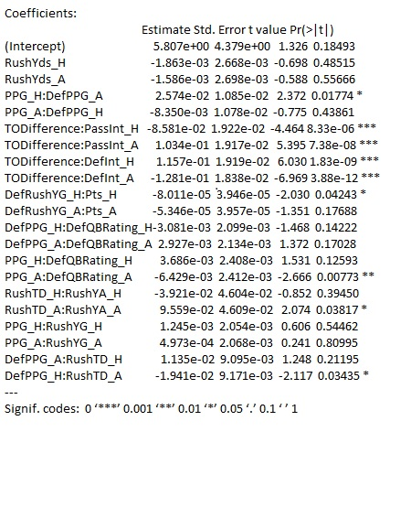

Slide 11
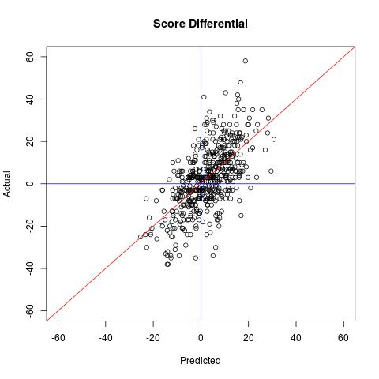
Accuracy: 74.06%

Slide 12
K-Nearest Neighbors
Classifiers are defined by the characteristic of classifying unlabeled examples by assigning them to the class of the most similar labeled (K) examples.
“If a concept is difficult to define, but you know it when you see it, then nearest neighbors must be appropriate.” ~ Brett Lantz
Identifies “K” records in the training data that are most similar and assigns to the class of the majority of the neighbors.
In general, it is not well suited for identifying a boundary.

Slide 13
K-Nearest Neighbors (in R)
Pros
Cons
Simple and effective
No assumptions about the underlying data distribution
Fast training phase
Does not produce a readable model – limits ability to find relationships among features
Slow classification phase
Requires large amount of memory
Non numeric and missing data require additional processing

Slide 14
K-Nearest Neighbors
Accuracy: 71.99% with k = 7
 | Predicted
Observed | -1 | 1 | Row Total
-1 | 137 | 83 | 220
1 | 66 | 246 | 312
Column Total | 203 | 329 | 532

Slide 15
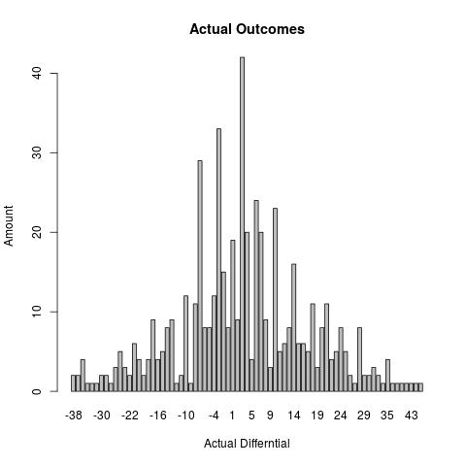
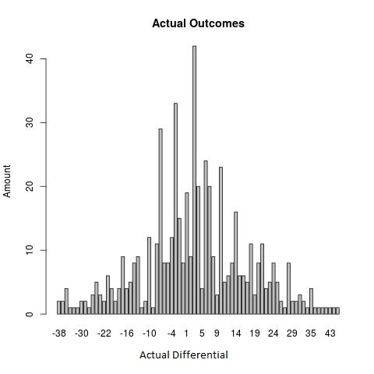
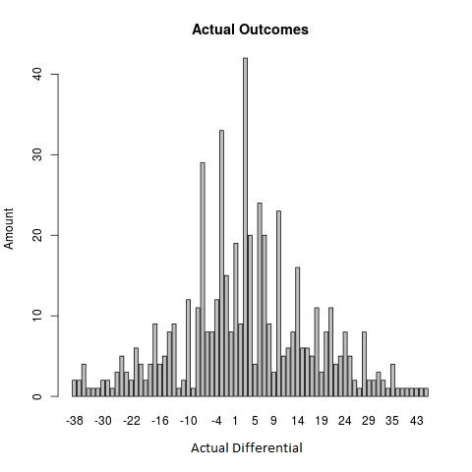

Slide 16
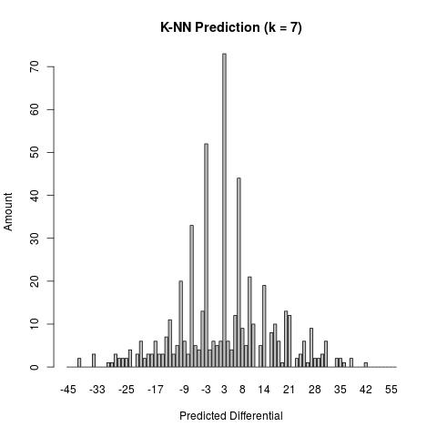
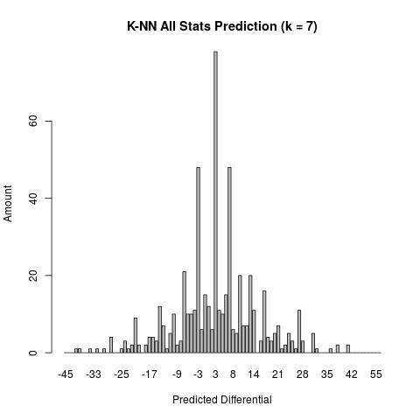
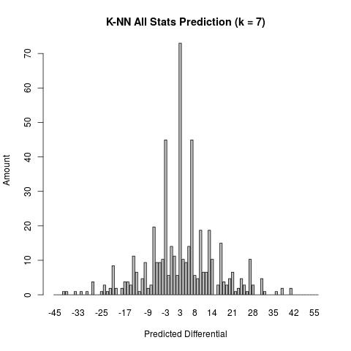
Accuracy: 71.99%
Accuracy: 71.43%
(Approx. 2x amount of variables)

Slide 17
Decision Trees
Builds a model in the form of a tree”
Comprises a series of logical decisions with Decision Nodes that indicate a decision to be made on that attribute
Branches split from decision nodes indicating the decision’s choice
Leaf Nodes denote the result following the combination of decisions
A decision tree is essentially a flow chart to follow.
Recursive Partitioning (divide and conquer) is used to split the data into smaller subsets of similar classes.
Possible terminations:
All of the examples at that node have the same class
No remaining features to distinguish the examples
The tree has grown to the predefined size limit

Slide 18
Decision Trees (in R)
Pros
Cons
Classifier that does well on most problems
Learning process can handle numeric or nominal features
Uses only most important features
For small trees, the model is simple to interpret
More efficient than more complex models
Biased toward splits on features having large number of levels
Easy to overfit or underfit the model
Small changes in training data can result in large changes of decision logic
Large trees become difficult to interpret

Slide 19
Decision Trees
Accuracy: 70.49% with trials = 7
 | Predicted
Observed | -1 | 1 | Row Total
-1 | 123 | 97 | 220
1 | 60 | 252 | 312
Column Total | 183 | 349 | 532

Slide 20
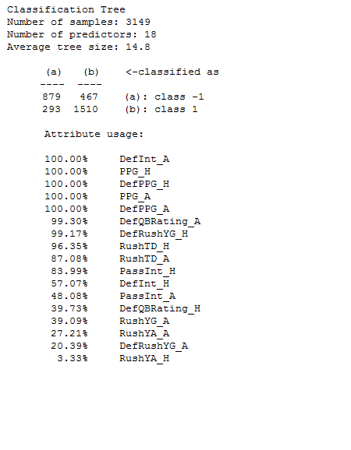
Decision Trees

Slide 21
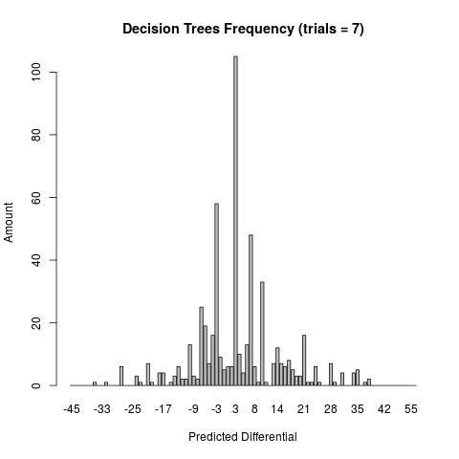
Accuracy: 70.49%

Slide 22
Support Vector Machines
As surface that defines a boundary between points plotted in a multidimensional space according to their values.
Hyperplane is the boundary in the multidimensional space which leads to fairly homogeneous partitions of the data.
Maximum Margin Hyperplane (MMH) creates the greatest separation between two classes.
Support Vectors are the points from each class that are the closest to the MMH (each class must have at least 1).
Uses the support vectors for classification and generally ignores those points farther from MMH.

Slide 23
Support Vector Machines (in R)
Pros
Cons
Can be used for classification or numeric prediction
Not overly influenced by noisy (meaningless) data
Easier to use than Neural Networks
Recent increase in popularity for its accuracy in data mining competitions
Finding best model requires testing various combinations or parameters
Slow to train, especially if the input has a large number of features
Results in a complex black box model that is difficult (if not impossible) to interpret

Slide 24
SVM Mappings
Rfbbdot (Radial Basis – distance from origin):
73.12%
Polydot (Polynomial):
73.12%
Tanhdot (Hyperbolic Tangentsigmoid – having an “S” shape curve):
73.31%
Vanilladot (Linear):
73.31%

Slide 25

Linear Accuracy: 73.31%

Slide 26
Comparisons in 2014
Home Team: 118-89-1
Microsoft Cortana: 135-73
ESPN’s Cris Carter: 145-63*
My Linear Regression: 146-62*

Slide 27
Away Team | Home Team | Vegas Line (MGM Mirage) | Result | Predicted | Payout
Dallas Cowboys | Chicago Bears | Cowboys 3.5 | -13 | -6 | YES
Pittsburgh Steelers | Cincinnati Bengals | Bengals 2.5 | -21 | 3 | NO
St. Louis Rams | Washington Redskins | Rams 3.0 | -24 | -1 | NO
New York Giants | Tennessee Titans | Giants 3.5 | -29 | -3 | NO
Carolina Panthers | New Orleans Saints | Saints 9.5 | -31 | 14 | NO
New York Jets | Minnesota Vikings | Vikings 4.0 | 6 | 11 | YES
Baltimore Ravens | Miami Dolphins | Dolphins 3.0 | -15 | 2 | NO
Indianapolis Colts | Cleveland Browns | Colts 3.5 | -1 | -2 | YES
Tampa Bay Buccaneers | Detroit Lions | Lions 10.5 | 17 | 12 | YES
Houston Texans | Jacksonville Jaguars | Texans 7.0 | -14 | -11 | YES
Buffalo Bills | Denver Broncos | Broncos 9.0 | 7 | 7 | YES
Kansas City Chiefs | Arizona Cardinals | Chiefs 2.5 | 3 | 1 | YES
Seattle Seahawks | Philadelphia Eagles | Seahawks 2.0 | -10 | 4 | NO
San Francisco 49ers | Oakland Raiders | 49ers 8.5 | 11 | -8 | NO
New England Patriots | San Diego Chargers | Patriots 4.5 | -9 | -4 | NO
Atlanta Falcons | Gotham City Packers | Packers 13.0 | 6 | 14 | NO
Win/Loss
11-5
Spread
7-9

Slide 28
R Demo
R-Studio

Slide 29
Grading
Feature | Points
Program can index multiple pages for data collection | 2
Regular Expressions gather the data required for the project (this is the foundation of the project) | 15
Program can parse the results from each Regex into a .csv file for use later on | 5
Refactoring code in PHP (1 per method) | 3
C# program can parse all of the separate .csv files into the two that are needed for each year | 5
Create and manage my own MySQL database (1 database, 2 tables) | 3
Can load the .csv files into the proper tables in my NFL database (1 per table) | 2
Points reserved for R | 25
A | B | C | D | F
52 - 60 | 45 - 51 | 38 - 44 | 31 - 37 | ☹

Slide 30
Thank You
Wikipedia
Stack Overflow
Sean Forman, President, Sport Reference LLC
Michigan Technological University CRAN (Comprehensive R Archive Network)
The University of Toronto CRAN (Comprehensive R Archive Network)
Brett Lantz, author, Machine Learning with R
Jared P. Lander, author, R for Everyone
Microsoft Cortana, NFL Predictor
MGM Mirage, NFL Odds
ESPN

