Slide 1
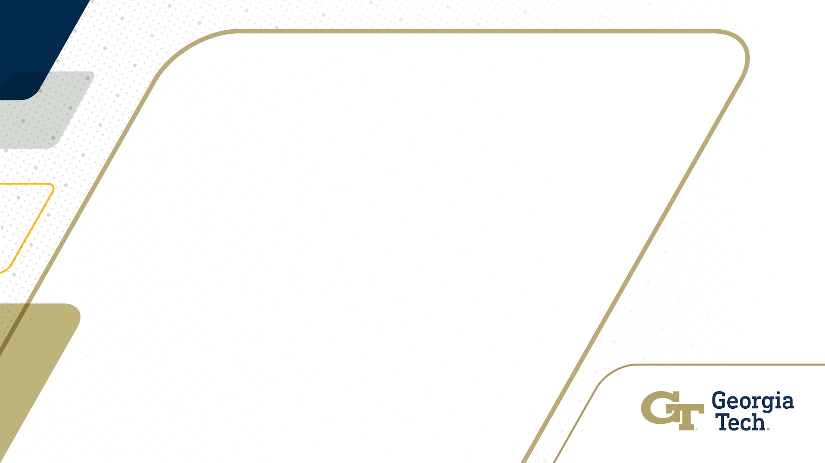
Combination and Benchmark of RL Models
Dane Wang, Cody Houff, Etienne Sudre

Slide 2
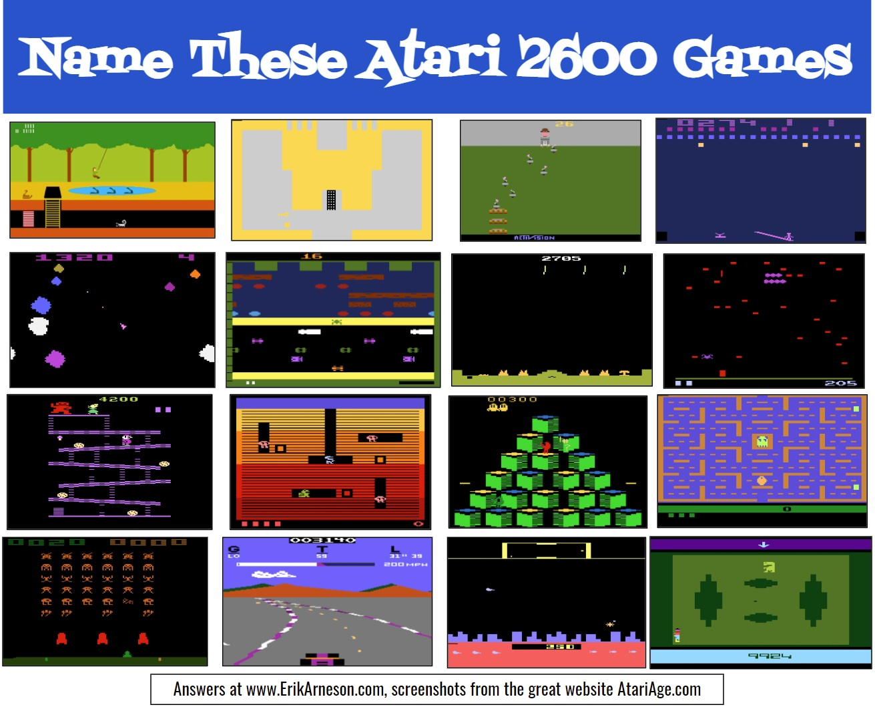
Motivation
Deep Reinforcement Learning has grown in popularity and so has the number of new algorithms
We want to study and test some classic and advanced algorithms and then create our own intelligent agents based on existing state of the art models.

Slide 3
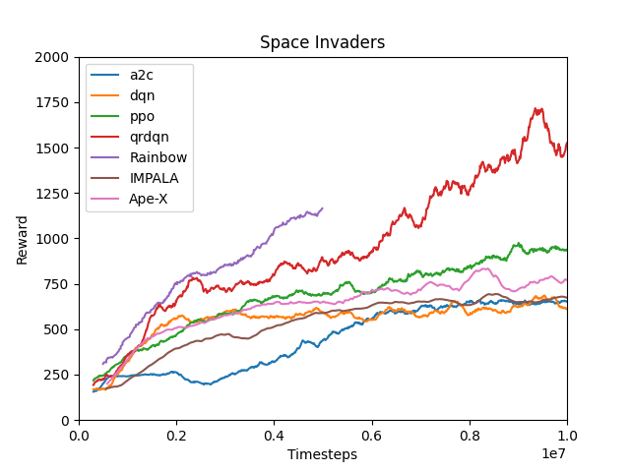
Existing Algorithms Benchmark
Compare base Deep Reinforcement algorithms with cutting-edge algorithms
Evaluate the performance based on the score of Space Invaders

Slide 4

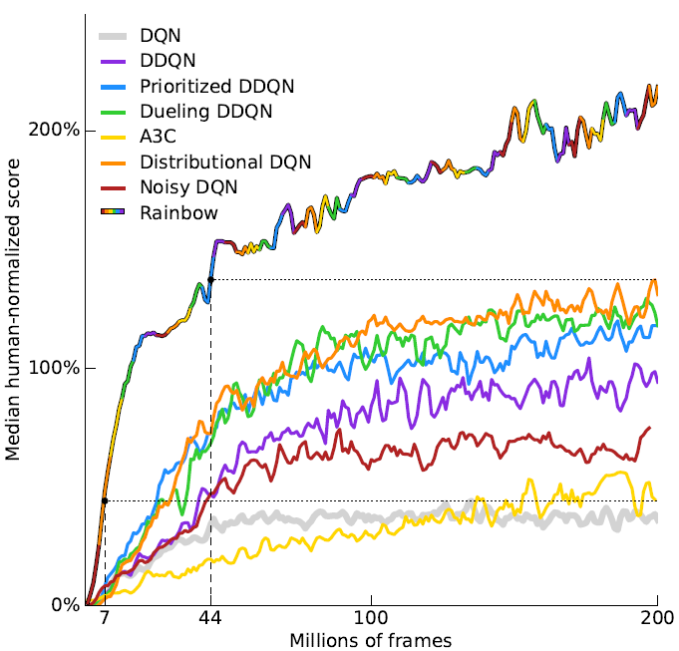
Rainbow
Algorithm combines 6 Improvements in Deep Reinforcement Learning and outperforms all base DQN models. [1]
Double DQN
Dueling DQN
Multi-step DQN
Prioritized Replay DQN
Distributional DQN
Noisy Nets DQN

Slide 5
Improvements in Deep Reinforcement Learning
Double DQN - Decouple the value estimation and action selection process
Dueling DQN - Split Q value into two parts V (depend on state) and A (depend on action) [2]
Multi-step DQN - Consider future N step when calculating the loss [3]
Prioritized Replay - Store past predictions and reuse them by priority for learning
Distributional DQN - Return the distribution of Q value instead of the expected value
Noisy Nets DQN - Add noise to Neural network for exploration instead of ε-greedy exploration [4]

Slide 6
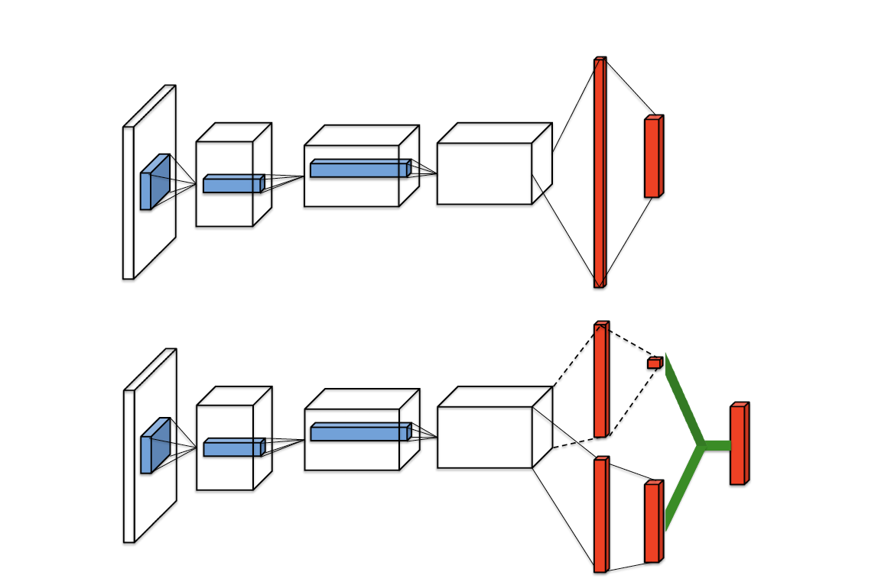
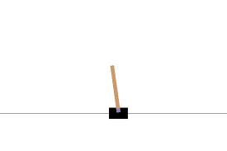
Customized Agents
DDQN, Dueling DQN, Multi-Step DQN are chosen for Customized Agents
Combine two out of these three algorithms and test them on Cartpole
DDQN
How it select action with Q network and predicate Q value with target network
Dueling DQN
How it calculate V and A with Its network structure
Multi-Step DQN
How it calculate loss based on several steps ahead

Slide 7
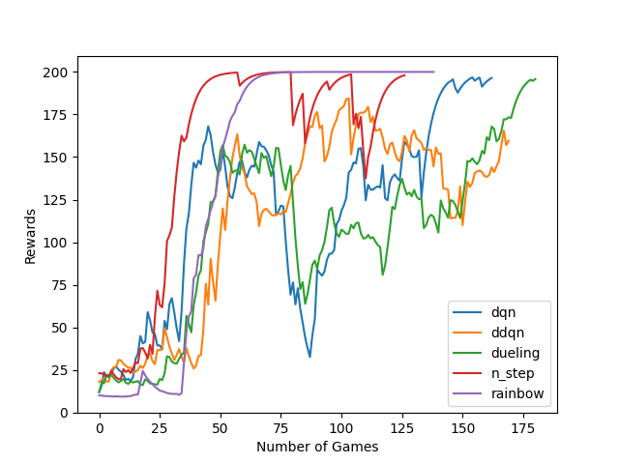
Result
Rainbow has the smoothest and most stable learning curve
Multi-step DQN has the quickest rise but still has some variation after it converges.
Other three algorithms didn’t converge within the given frames.

Slide 8
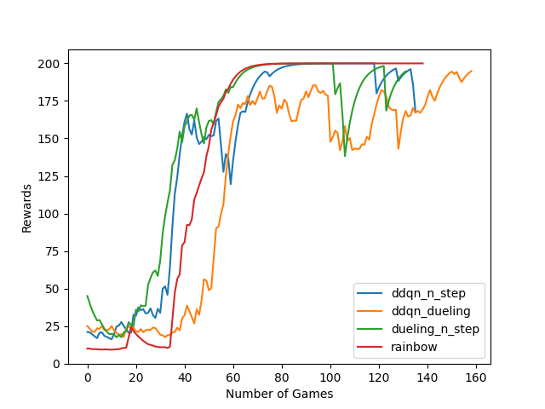
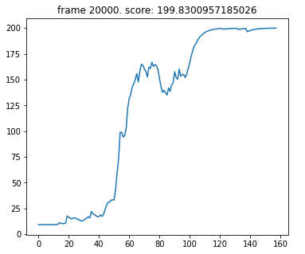
Result
Both agents includes Multi-step DQN has a quick learning speed
None of customized agents is as stable as Rainbow after the convergence.

Slide 9
Result
Both agents includes Multi-step DQN has a quick learning speed
None of customized agents is as stable as Rainbow after the convergence.

Slide 10
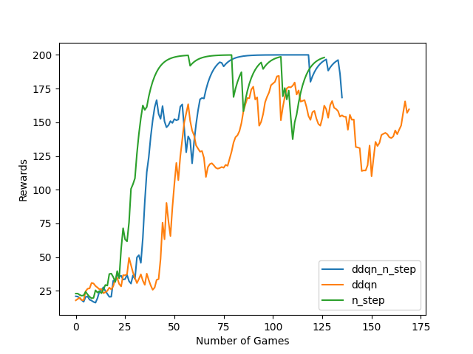
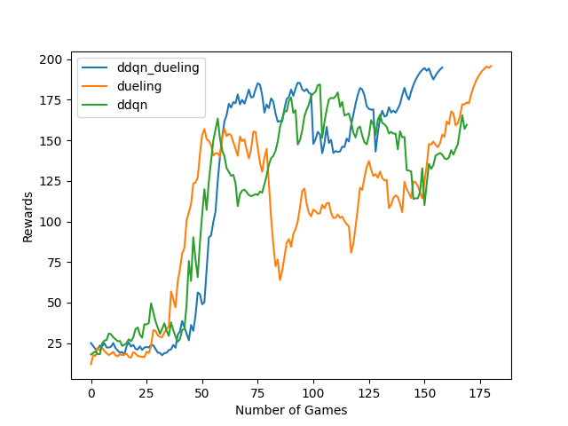
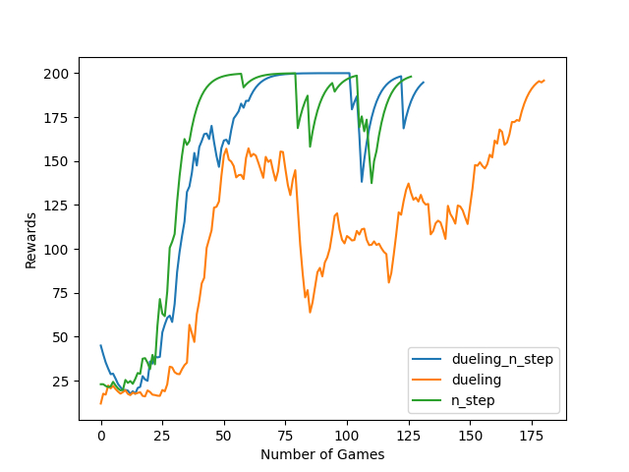
Result

Slide 11
Conclusion
Multi-step DQN works really well in the early state or a relatively simple environment.
Dueling DQN’s and DDQN’s performance may be limited with our test environment.
Noisy Nets would help create a smooth learning curve, especially after the convergence.

Slide 12
Thanks For Listening

Slide 13
References
[1] M. Hessel et al., "Rainbow: Combining Improvements in Deep Reinforcement Learning." arXiv preprint arXiv:1710.02298, 2017.
[2] ML - Wang, Ziyu, et al. "Dueling network architectures for deep reinforcement learning." arXiv preprint arXiv:1511.06581 (2015).
[3] Sutton, R.S. Learning to predict by the methods of temporal differences. Mach Learn 3, 9–44 (1988). https://doi.org/10.1007/BF00115009
[4] M. Fortunato et al., "Noisy networks for exploration", Proc. Int. Conf. Learn. Represent., pp. 1-18, 2018.

