Slide 1
CSCI 212
FINAL EXAM
By
GROUP #3
Adam Amer, Timothy Liu,
Cody McKinney, and Nathan White

Slide 2

TABLE OF CONTENTS
INTRODUCTION
OUR GOAL
ICD and ADD
RESULTS and DATA
SOURCE CODE

Slide 3




Introduction and contributions
As well as discord contact information.
Documentation and testing. Helped with code and logic for the leader bot. Mostly focused on Lab 6 material and understanding the svm model.
Adam Amer
Helped with the implementation and algorithm for the follow bot. Responsible for collecting results and testing the various methods.
Timothy Liu
Drafted the original code for obstacle avoid and follow and wrote the increase and decrease speed methods in assembly. Wrote the ICD and ADD for the final report.
McKinney
Implemented the measure distance method and created a multithreading process to handle and receive input at the same time from the user. Responsible for design and structure of all methods for our final code.

Slide 4
OUR GOAL
Aside from the given leader and follower bot attributes we really strived to create a program that would allow the user to turn on obstacle avoid, or follow, and allow the bot to roam until the user wished to turn it off. This was achieved by Nathan creating threads to handle and receive input at the same time.

Slide 5
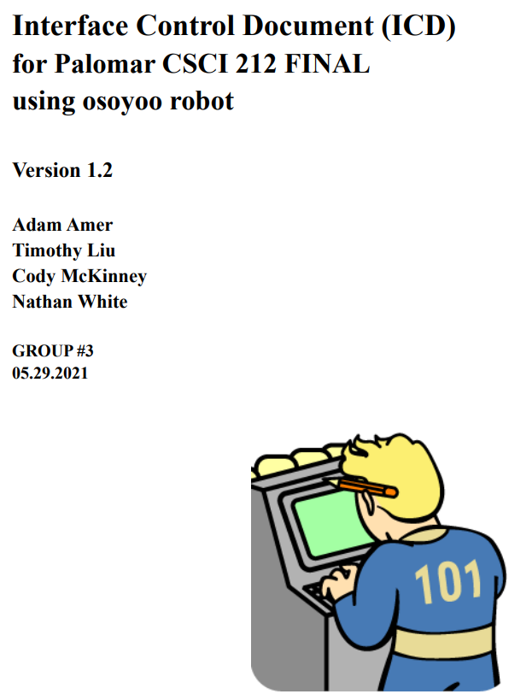
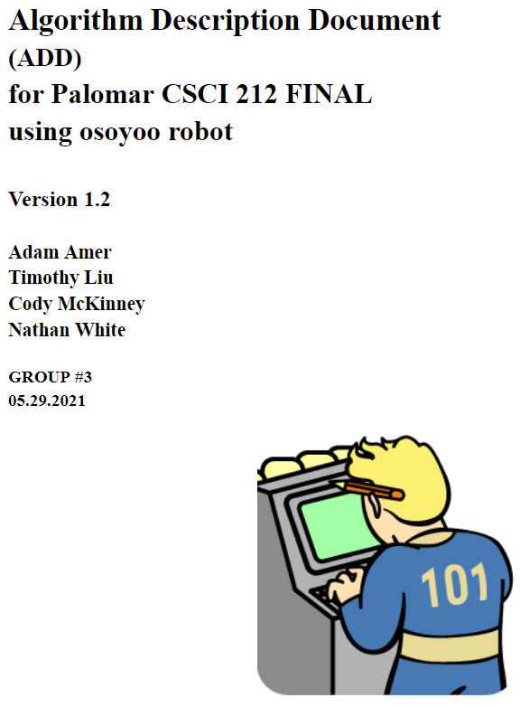
Interface Control Document
and Algorithm Description Document

Slide 6
Results and Data
4 videos
All 4 Bots Avoiding an Obstacle
Bots Driving Different Speeds Showcasing Acceleration / Deceleration
Obstacle Avoid and Follower
Follower Bot behind Controlled Bot

Slide 7
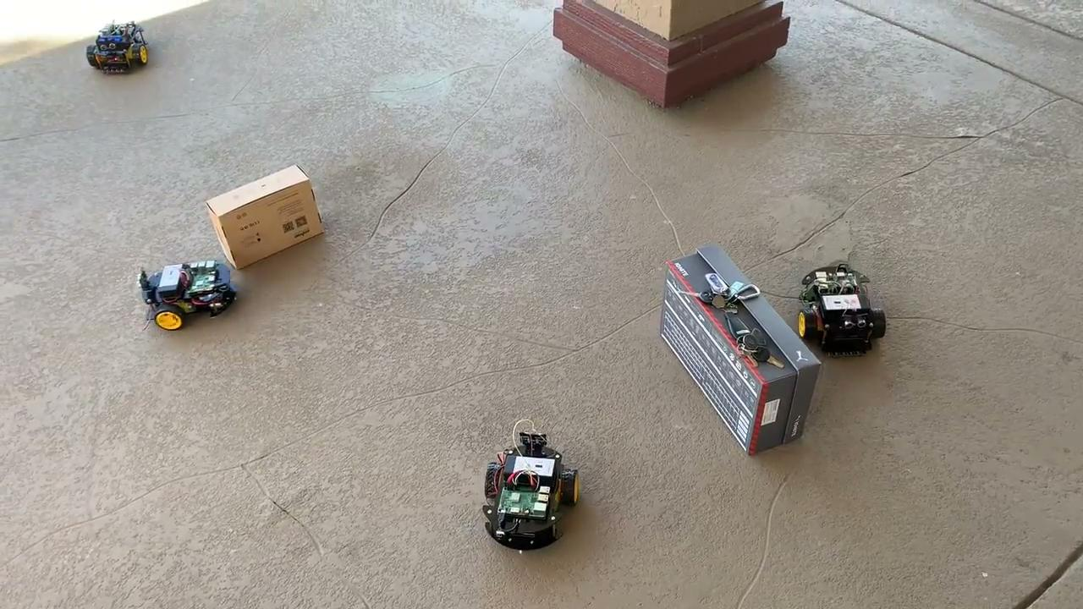
All 4 of our Robots Avoiding

Slide 8
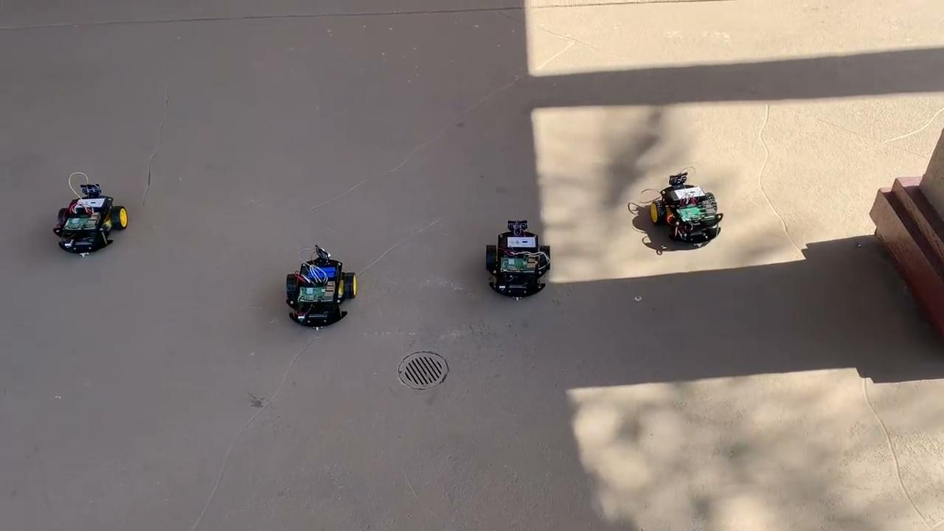
Acceleration / Deceleration

Slide 9
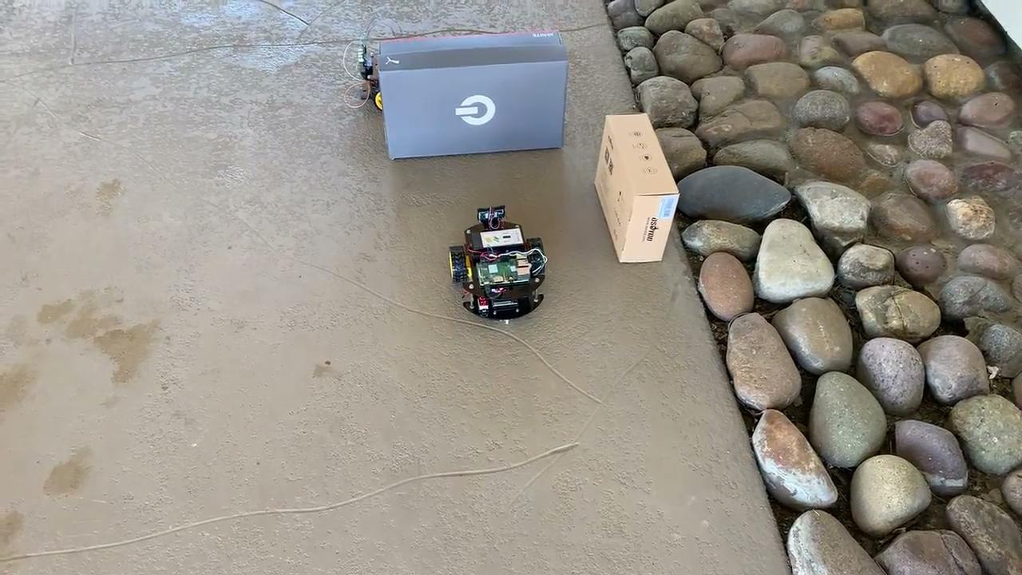
Leader Avoid and Follower

Slide 10
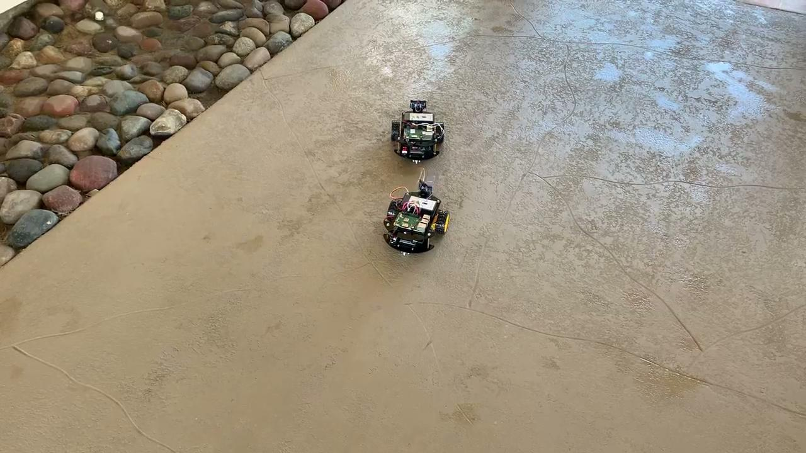
Following a Controlled Robot

Slide 11
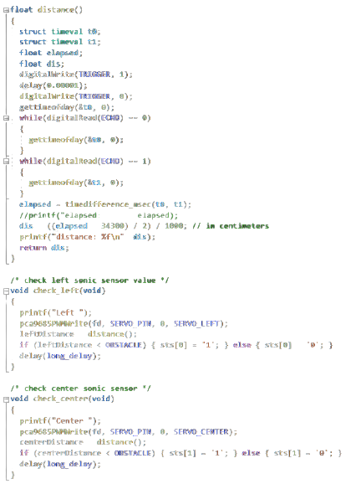

Source Code

Slide 12
THANK YOU PROFESSOR & CLASS

