Slide 1
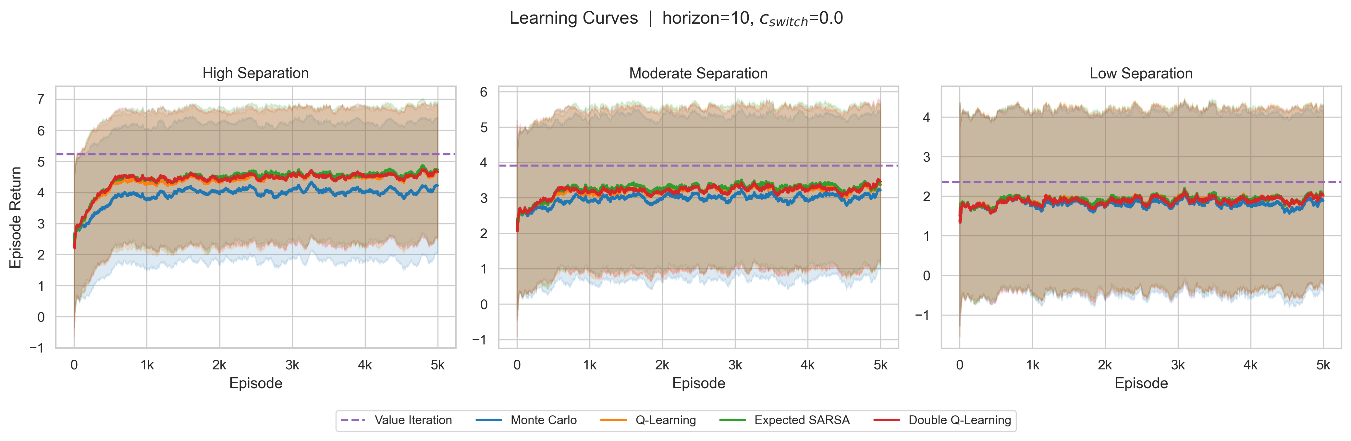
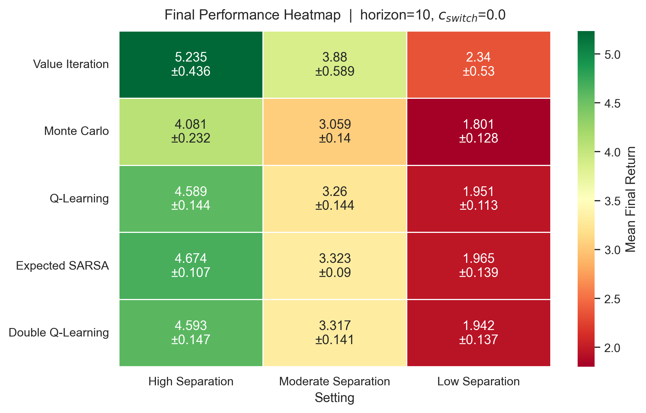
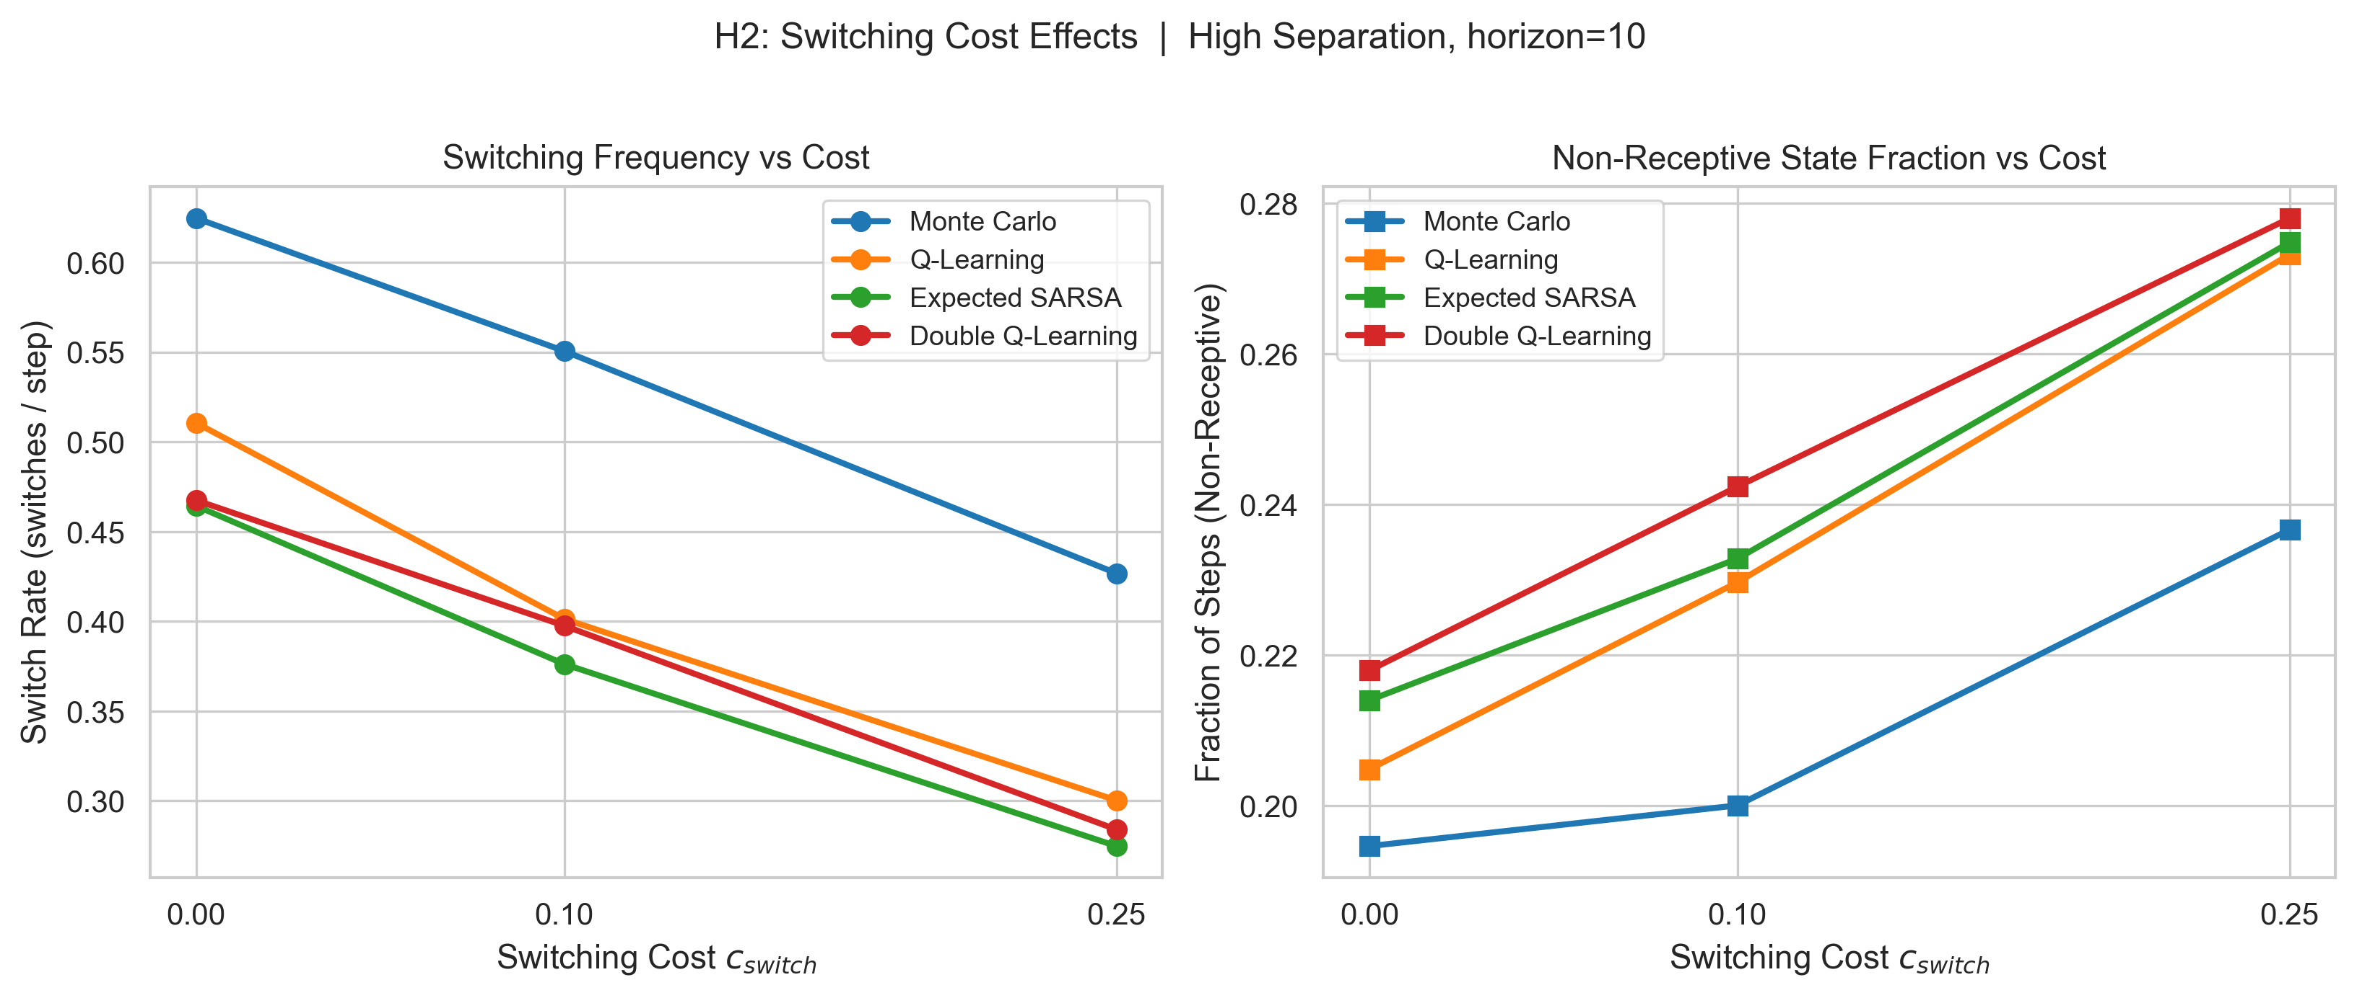
Adaptive Multi-Site
Stimulation Control
Using RL in an MDP
Learning sequential stimulation policies under
state-dependent EEG response dynamics
Fatih Karatay and Cody Moxam
EN.705.741.8VL Reinforcement Learning
Locked-results draft • 7 April 2026
Locked run: H=10, c_switch=0.0 figures now anchor the main story
Notes:
[Sources] User-provided locked results package: rl-locked-results.zip (fig1_learning_curves_h10_c0.0.png, fig2_performance_heatmap_h10_c0.0.png, fig5_switching_vs_cost_high_h10.png). Prior visual structure reference: Adaptive_Multi_Site_RL_Final_Presentation (4).pptx. [/Sources]

Slide 2
Problem framing
Motivation
Why this is a reinforcement learning problem rather than a bandit
The agent selects among four stimulation sites S1–S4 over a finite horizon.
Immediate reward depends on the current patient responsiveness state and the EEG response it induces.
Responsiveness changes over time: repeated stimulation can push the patient from baseline to receptive to non-receptive.
Because actions change future state occupancy and future reward, the task is sequential control.
Optimal behavior is not simply “choose the best site.”
It is “sequence sites to accumulate reward while avoiding state degradation.”
State flow
baseline → receptive → non-receptive
switching promotes recovery
Representative reward logic
favorable = +1 | neutral = 0 | unfavorable = -1
switch cost ∈ {0, 0.1, 0.25}
Notes:
[Sources] Content synthesized from the user-provided prior draft and deck, updated to the locked result framing. Prior content reference: Final_RL_Project_Submission_v2 (2).docx and Adaptive_Multi_Site_RL_Final_Presentation (4).pptx. [/Sources]

Slide 3
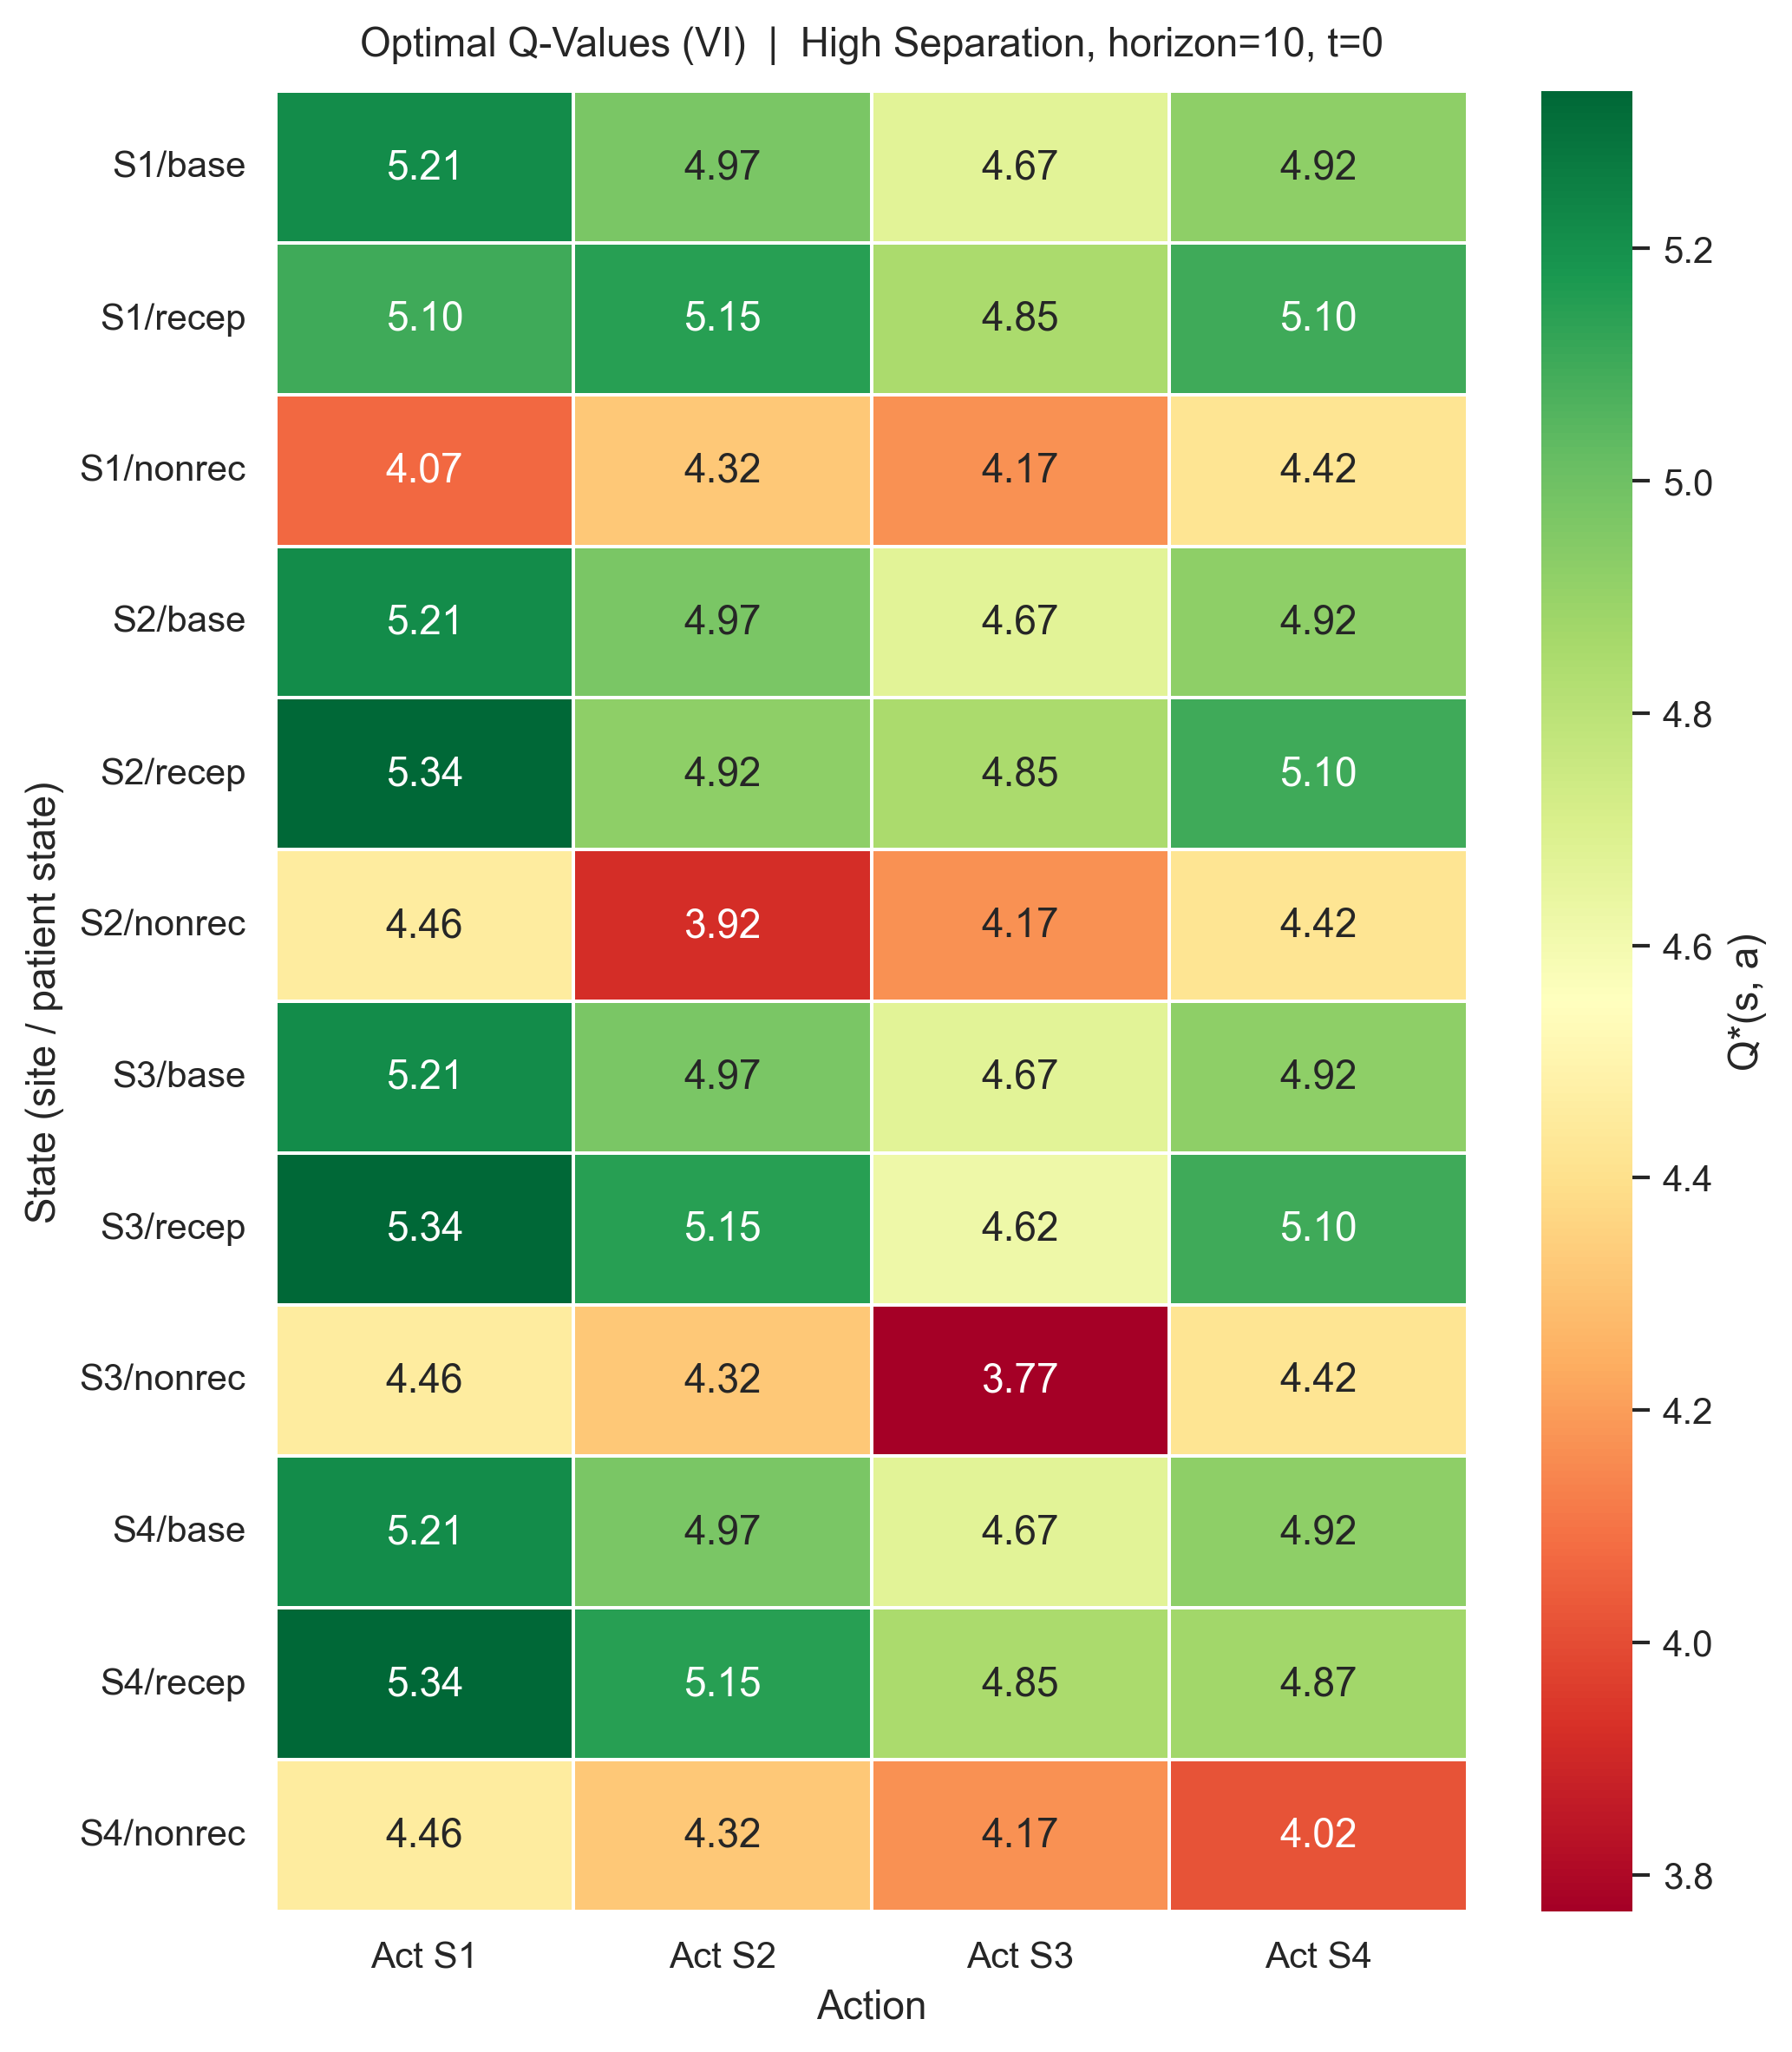
MDP formulation and experimental design
Methods
Finite-horizon, fully observed environment with 90 total configurations
MDP components
State
(current site, patient state, t)
Actions
{S1, S2, S3, S4}
Patient states
{baseline, receptive, non-receptive}
Observation
EEG ∈ {favorable, neutral, unfavorable}
Reward
+1 / 0 / -1 with optional switch cost
Experiment grid
Separation settings: high, moderate, low
Episode horizons: H = 5 and H = 10
Switch cost: 0, 0.1, 0.25
Algorithms: MC, Q-Learning, Expected SARSA, Double Q, Value Iteration
Model-free results averaged over 10 random seeds
Q* at t=0 (high separation, H=10): the optimal value surface is state-dependent, not static.
Notes:
[Sources] User-provided locked results package: fig6_qvalue_heatmap_high_h10.png. Experiment design and MDP structure updated from the user-provided prior draft and deck. [/Sources]

Slide 4
Learning performance improves with reward separability
H1
Representative learning curves for H=10 and c_switch=0.0
High separation: TD methods converge quickly to strong positive return; Monte Carlo lags; Value Iteration is the upper bound.
Moderate separation: the same ranking persists but compresses downward, showing the environment is still learnable but less informative.
Low separation: all methods flatten near 1.8–2.0 while the benchmark sits around 2.34.
Locked-run takeaway:
clearer reward structure improves both convergence and final performance.
Notes:
[Sources] User-provided locked results package: fig1_learning_curves_h10_c0.0.png. Performance claims are read from the locked run figures and aligned with the companion draft. [/Sources]

Slide 5
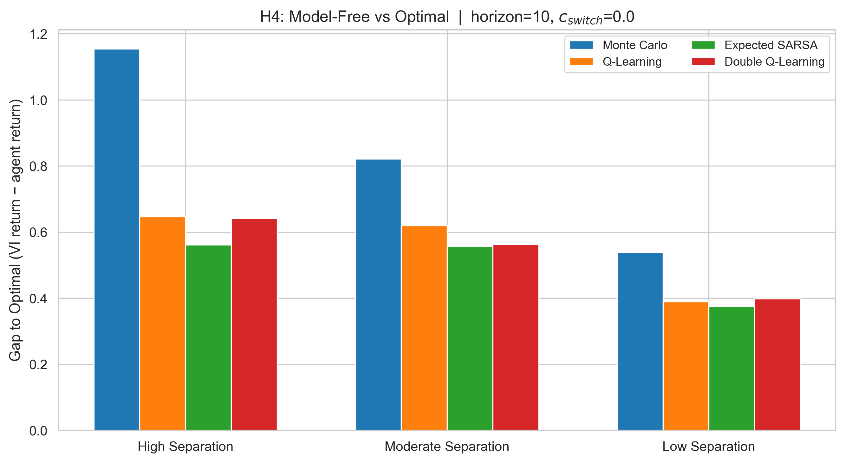
Cross-setting performance and gap to optimal
H1 / H4
Heatmap and benchmark-gap view at H=10, c_switch=0.0
Value Iteration reaches 5.235 / 3.880 / 2.340 in the high / moderate / low settings.
Expected SARSA is the strongest model-free method across all three settings: 4.674 / 3.323 / 1.965.
Its optimality gap is the smallest across the board (≈0.56, 0.56, 0.38), while Monte Carlo remains furthest from optimal.
Notes:
[Sources] User-provided locked results package: fig2_performance_heatmap_h10_c0.0.png, fig7_algorithm_gap_h10_c0.0.png. Numerical annotations are taken from the heatmap values and the locked-run benchmark-gap chart. [/Sources]

Slide 6
Switching cost shapes policy behavior
H2
Representative high-separation tradeoff at horizon=10
As c_switch increases, switch frequency falls for every algorithm.
But non-receptive occupancy rises at the same time: less switching can mean more state degradation.
High-separation examples: Q-Learning drops from ~0.51 to ~0.30 switches/step as c_switch rises 0 → 0.25.
Expected SARSA falls from ~0.46 to ~0.27 and Double Q-Learning from ~0.47 to ~0.28 over the same range.
This supports H2 and reveals a real control tradeoff, not just a myopic penalty effect.
Notes:
[Sources] User-provided locked results package: fig5_switching_vs_cost_high_h10.png. Bullet values are taken from the locked run switching-cost curves. [/Sources]

Slide 7
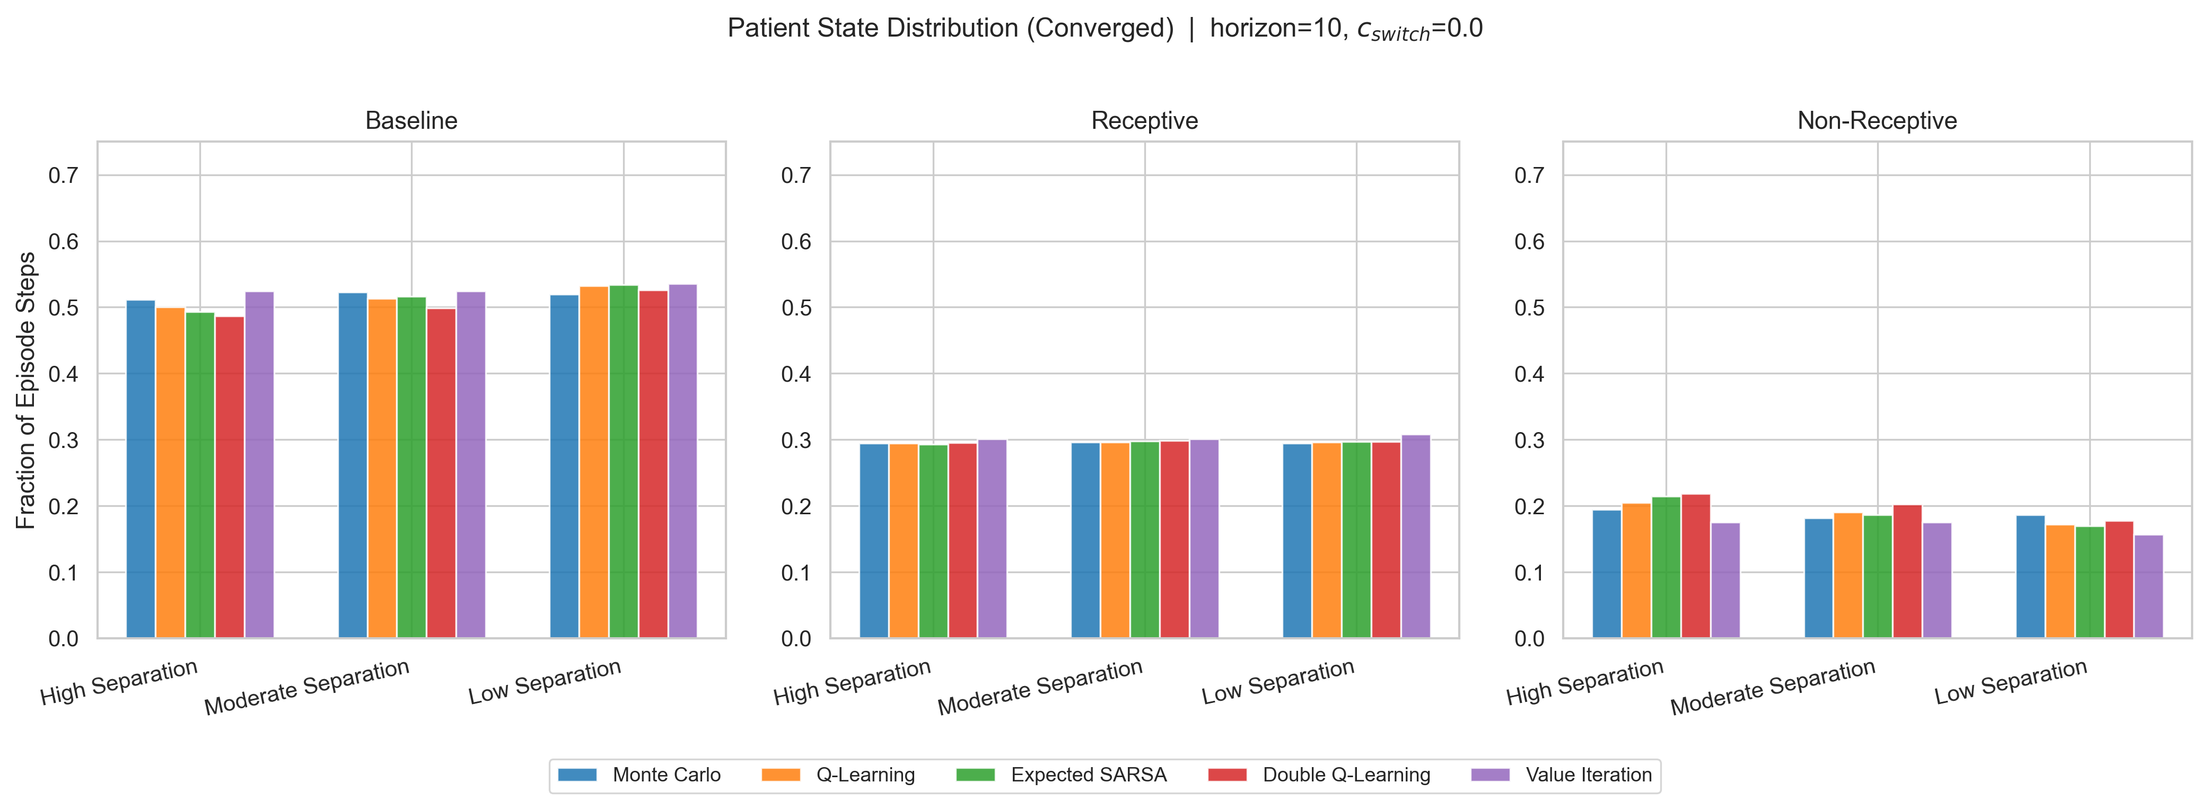
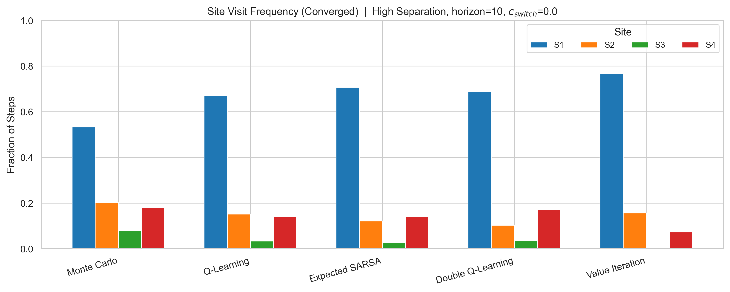
Agents learn state-aware sequential behavior
H5
Occupancy patterns and site choice explain how reward is sustained
Across algorithms, baseline + receptive occupancy remains roughly 0.79–0.84 of episode time, while Value Iteration spends the least time in the non-receptive state.
High-separation policies concentrate heavily on S1. Value Iteration is most aggressive (~77% on S1), while Monte Carlo remains more diffuse (~53% on S1).
The good policies do not simply hammer one action forever—they manage the state trajectory.
Notes:
[Sources] User-provided locked results package: fig3_patient_state_dist_h10_c0.0.png, fig4_site_freq_high_h10_c0.0.png. State-occupancy and site-frequency claims are summarized from the locked run figures and derived notes. [/Sources]

Slide 8
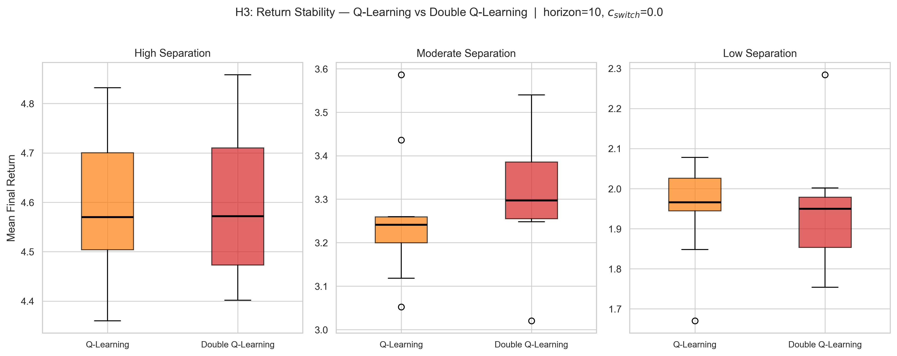
Algorithm comparison and stability
H3
Representative H3 diagnostic plus overall hypothesis assessment
Hypothesis
assessment
H1
Supported
Higher separability improves convergence
and final return.
H2
Supported
Increasing switch cost reduces switching
frequency.
H3
Mixed
Double Q does not show a robust universal
stability win in this run.
H4
Supported
Value Iteration remains a useful upper-bound
benchmark.
H5
Supported
Policies learn sequential state-aware
behavior.
Locked-run read: moderate separation favors Double Q slightly, but the high and low settings remain very similar.
Notes:
[Sources] User-provided locked results package: fig8_h3_variance_h10_c0.0.png. Hypothesis statuses are based on the locked-run figures and the updated draft interpretation. [/Sources]

Slide 9
Takeaways and limitations
Conclusion
What the locked run demonstrates and what remains simplified
Key takeaways
Limitations and next steps
The project successfully turns stimulation-site selection into a genuine reinforcement learning problem.
State-dependent responsiveness creates temporal coupling between current actions and future rewards.
Expected SARSA is the strongest model-free method in the locked run, but Value Iteration stays meaningfully higher.
Reward separability and switching cost jointly determine how easy the control problem is to learn.
The transition and EEG response models are stylized rather than fit to clinical data.
State and observation spaces are discrete to keep the project interpretable.
The remaining work is mainly deeper hypothesis checking, polishing, and final grading-criteria alignment—not a new project scope.
A natural extension is richer partial observability, which would recover a clinically motivated POMDP.
Bottom line
Optimal behavior is a sequence policy: choose where to stimulate now while managing how today’s action changes tomorrow’s reward.
Notes:
[Sources] Content based on the locked results package and the updated draft narrative. [/Sources]

