Slide 1
Big Data Hadoop and Spark Developer
Project: K-Means clustering for telecommunication domain
Submitted By:-
Prashant Gupta

Slide 2
Problem Statement
Background of Problem Statement
LoudAcre Mobile is a mobile phone service provider which has introduced a new open network campaign. As a part of this campaign, the company has invited users to raise a request to initiate a complaint about the towers in their locality, if they face issues with their mobile network. LoudAcre has collected the dataset of users who had raised the complaint.
Analysis to be done
The fourth and the fifth field of the dataset has latitude and longitude of users which is an important information for the company. You have to find this information of latitude and longitude on the basis of available dataset and create three clusters of users with a k-means algorithm. This will help Loudacre maximize the coverage for its users.

Slide 3


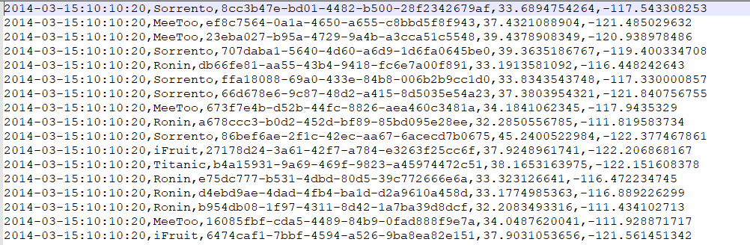

Dataset Details
Date: Format (YYYY:MM:DD:HH: MM: SS)
Area name
Complaint ID
Latitude
Longitude

Slide 4
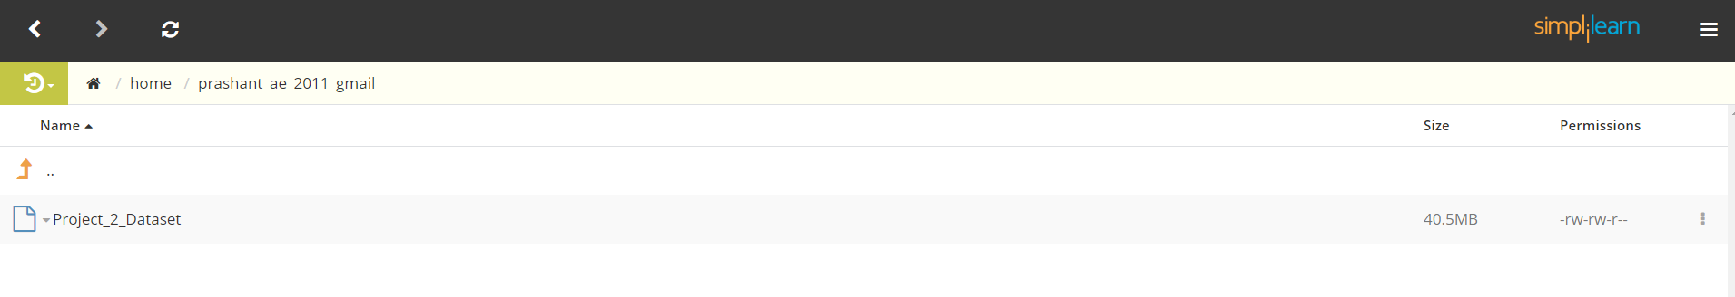
Uploading Dataset on Simplilearn labs
Loading dataset on Simplilearn labs using FTP.

Slide 5
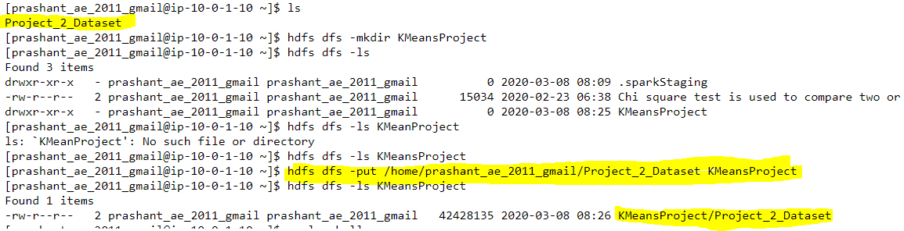
Loading Data in HDFS File System

Slide 6
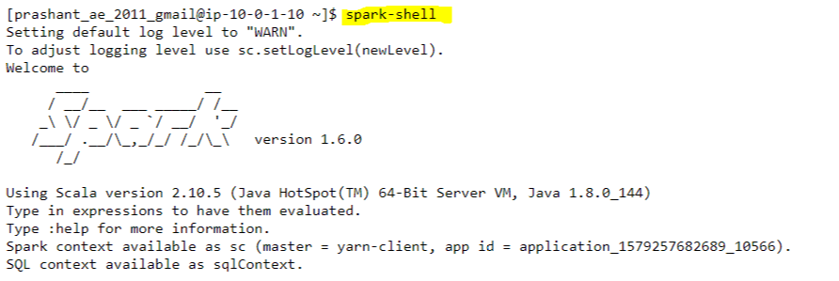
Starting Spark Shell on Simplilearn Web Console

Slide 7
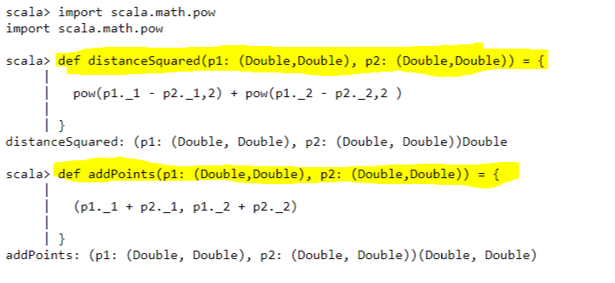
Creating Methods for calculating squared distance and sum of two points

Slide 8
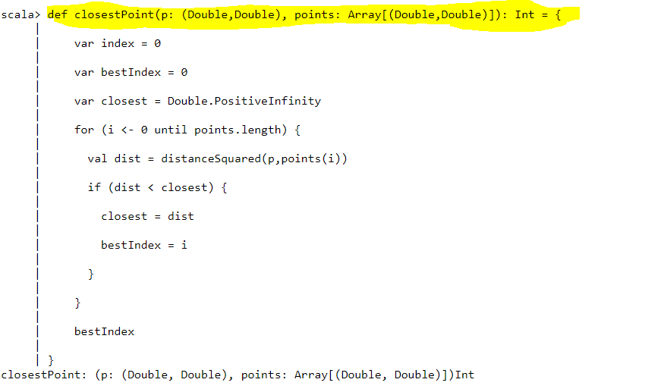
Solution

Slide 9
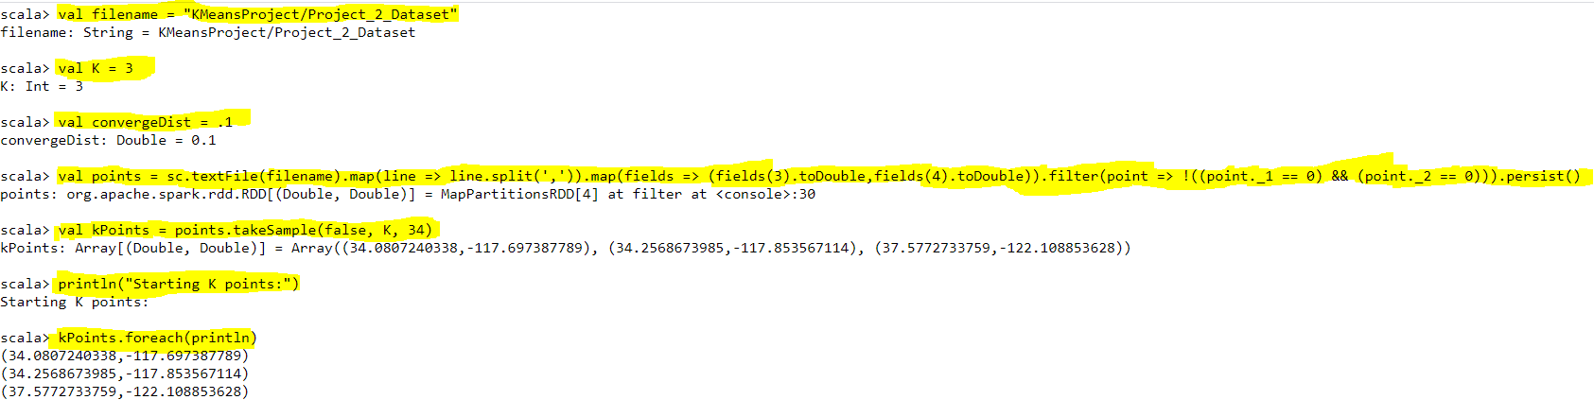

Slide 10
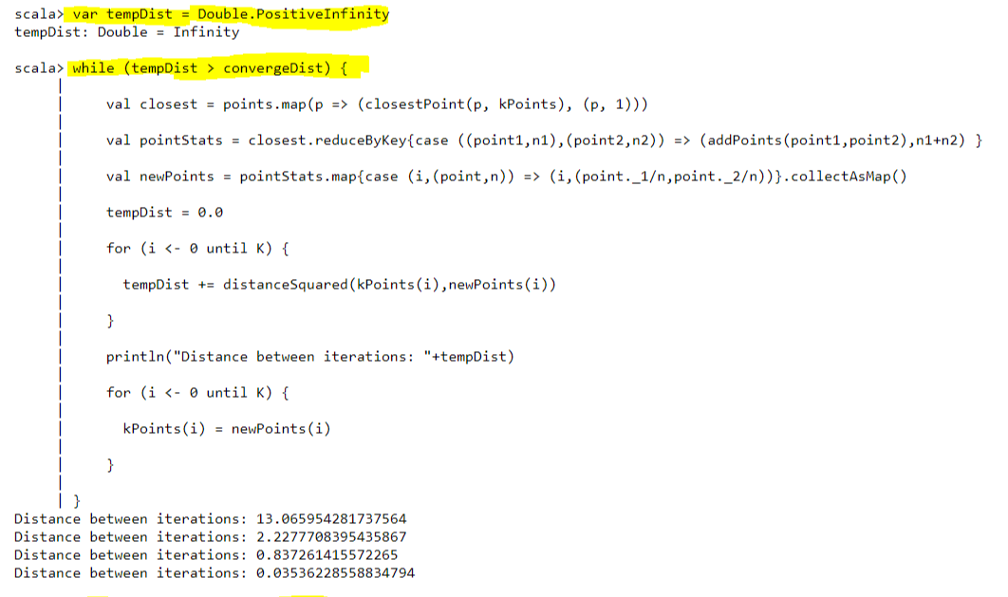

Slide 11
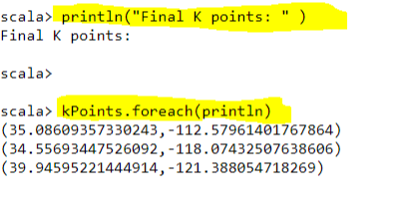

Slide 12


Conclusion
After applying K-Means algorithm to the dataset, We have generated below mentioned 3 cluster centres
35.08609357, -112.579614017
34.55693447, -118.074325076
39.94595221, -121.388054718

