Slide 1
Financial Management Chatbot
By: Cody Viscardis

Slide 2
Reasons for Chatbot Sector
Investment Advice
Debt Management Guidance

Slide 3

Chatbot Data
AdaptLLM/finance-tasks at main
Dataset for used with Finance-related NLP tasks including Text Classification and Question Answering. Sourced from Hugging Face
Financial Sentiment Analysis
Dataset for use with on classifying financial statements to help assist in financial decision making. Data reports the financial reports as positive, negative, or neutral. Source from Kaggle
Financial-Feedback-Chatbot
Dataset for use with developing a chatbot that provides financial guidance. The data consists of user inputted information like income, debt, financial assets, etc., and the goals of each user. The data also includes a chatbot response of analysis on the user info and guidance on how they can achieve their goals. Sourced from Github

Slide 4
AdaptLLM Data Example
performance graph comparison of five-year cumulative total return the following graph and table compare the cumulative total return on citi 2019s common stock, which is listed on the nyse under the ticker symbol 201cc 201d and held by 65691 common stockholders of record as of january 31, 2018, with the cumulative total return of the s&p 500 index and the s&p financial index over the five-year period through december 31, 2017. the graph and table assume that $100 was invested on december 31, 2012 in citi 2019s common stock, the s&p 500 index and the s&p financial index, and that all dividends were reinvested. comparison of five-year cumulative total return for the years ended date citi s&p 500 financials.\n\ndate | citi | s&p 500 | s&p financials\n31-dec-2012 | 100.0 | 100.0 | 100.0\n31-dec-2013 | 131.8 | 132.4 | 135.6\n31-dec-2014 | 137.0 | 150.5 | 156.2\n31-dec-2015 | 131.4 | 152.6 | 153.9\n31-dec-2016 | 152.3 | 170.8 | 188.9\n31-dec-2017 | 193.5 | 208.1 | 230.9\n\n.\n\nwhat is the price of citi in 2017? 193.5\n\nwhat is that less 100? 93.5\n\nwhat is the value of the s&p 500 in 2017? 208.1\n\nwhat is that less 100?

Slide 5
Financial Sentiment Analysis Data Example
The GeoSolutions technology will leverage Benefon 's GPS solutions by providing Location Based Search Technology , a Communities Platform , location relevant multimedia content and a new and powerful commercial model .
Sentiment: Positive
SSH COMMUNICATIONS SECURITY CORP STOCK EXCHANGE RELEASE OCTOBER 14 , 2008 AT 2:45 PM The Company updates its full year outlook and estimates its results to remain at loss for the full year .
Sentiment: Negative
The Stockmann department store will have a total floor space of over 8,000 square metres and Stockmann 's investment in the project will have a price tag of about EUR 12 million .
Sentiment: Neutral

Slide 6
Financial Feedback Chatbot Data Example
Prompt:
36-year-old engineer, been working there for 5 years, about to move back to UK for family reasons. Own a property about to sell. Non-qualified pension with EFA organisation, â‚¬120k in there (more of an investment fund rather than a pension), already an agreement with French tax authorities who wonâ€™t tax the income from salary but will tax the capital gains (but quite small). Still French resident, in the UK on 6th April 2023 for tax provisionally and physically moving back around 15th February. Significant gain on French property but should be tax-free. Can close pension when off payroll which should be end of Feb but could be end of March.
Response:
Thank you for providing me with the details of your financial situation. I appreciate the opportunity to offer my expert insights. Based on the information you've shared, I would like to summarize the key points of your financial situation: Positive Areas: You are a 36-year-old engineer who has been working for 5 years. You have a non-qualified pension with the EFA organization, which has a balance of €120k. You have an agreement with the French tax authorities, which will not tax the income from your salary, but only the capital gains. You are expected to make a significant gain on your French property, which should be tax-free. Negative Areas: You are moving back to the UK for family reasons and will no longer be a French resident. You will be taxed provisionally in the UK on April 6th, 2023. You will physically move back to the UK around February 15th. Your pension is more of an investment fund rather than a traditional pension. Given your situation, I would like to offer the following recommendations: …

Slide 7
Final Model Configuration
A single GRU layer each for encoder and decoder
Dropout layer with a rate of 0.2
200 Epochs
No attention mechanism
Adam optimizer with learning rate of 0.001

Slide 8
METEOR Score
Through multiple runs my model was averaging a METEOR score of: 0.2420
Range between 0.12 and 0.35

Slide 9
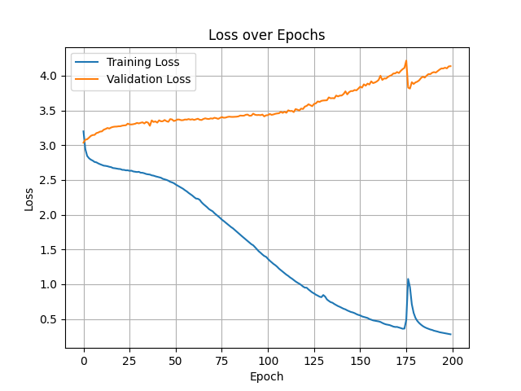
Chatbot Training Process (Overfitting)

Slide 10
Chatbot Demo

