Slide 1


CORPORATE PROFILE & BUSINESS PORTFOLIO · 2026
SAWA UNITED GROUP
مجموعة سوا يونيتد
A diversified multi-sector business group building, operating, and investing in specialized commercial platforms across the Middle East and Africa — driven by disciplined execution and a long-term value horizon.
Building Businesses. Creating Impact.
Real Estate & Investment
Food Supplies & FMCG
Car Rental & Mobility
Petroleum & Industrial
sawa-united.net
sawafood.net
masharycar.net
startwalk.net

Slide 2

CORPORATE PROFILE & BUSINESS PORTFOLIO · 2026
WHO WE ARE · CORPORATE OVERVIEW
A Diversified Holding Platform Built for Sustainable Growth
SAWA UNITED GROUP is a multi-sector enterprise dedicated to building resilient businesses, developing real-economy assets, and unlocking practical commercial opportunities across high-growth regional markets.
Our institutional architecture combines unified group governance with agile, sector-focused operating platforms. Each subsidiary is led by domain specialists with deep local market intelligence while adhering to one uncompromising group standard for transparency, reliability, and execution.
“We take care of operational precision and asset quality — empowering our clients and partners to build with confidence.”
15+
4
12
40+
2,500+
Years of Institutional Growth
Core Operating Business Sectors
Connected Regional & Export Markets
Delivered Ventures & Projects
People Across Our Ecosystem
* Verification Note: Within the Group’s energy & industrial arm (START WALK), operational heritage extends back to 2002 — representing 24+ years of specialized field execution.
SAWA UNITED GROUP — Corporate Business Portfolio
02 / 18
sawaunited.net | +20 101 122 5592

Slide 3
CORPORATE PROFILE & BUSINESS PORTFOLIO · 2026
STRATEGIC COMPASS · VISION & MISSION
Vision, Mission, Strategic Pillars & Core Values
Our Vision
Our Mission
To stand as a premier regional business group connecting key markets and scaling high-performing platforms that generate enduring economic value across vital real-economy sectors.
To build and operate specialized platforms in real estate, food distribution, mobility, and petroleum supply — delivering dependable quality, transparent terms, and mutually rewarding long-term partnerships.
BUILD
OPERATE
INVEST
Establish and scale sector-focused commercial platforms backed by modern operational systems.
Manage supply chains, fleets, and assets with rigorous reliability, safety, and on-time delivery.
Deploy capital and capabilities into tangible, high-conviction opportunities built for lasting value.
01
02
03
04
Disciplined Execution
Radical Transparency
Curated Quality
Enduring Partnerships
Translating vetted opportunities into measurable outcomes on schedule and to specification.
Complete clarity and accountability across pricing, documentation, and operational reporting.
Pre-vetting every property, food product, vehicle, and industrial supply source prior to market.
Cultivating multi-year commercial relationships anchored in mutual trust and shared growth.
SAWA UNITED GROUP — Corporate Business Portfolio
03 / 18
sawaunited.net | +20 101 122 5592

Slide 4
CORPORATE PROFILE & BUSINESS PORTFOLIO · 2026
OUR BUSINESS ECOSYSTEM · GROUP STRUCTURE
Four Focused Sectors. One Institutional Standard.
SAWA UNITED operates through four specialized platforms spanning core pillars of the real economy — creating commercial, logistical, and operational synergies across markets.
SAWA UNITED GROUP
Strategic Governance · Shared Standards · Cross-Market Network
01
sawa-united.net
02
sawafood.net
03
masharycar.net
04
startwalk.net
Real Estate & Property Investment
Food Supplies & FMCG Distribution
Automotive & Mobility Solutions
Petroleum Products & Industrial Supply
SAWA UNITED Real Estate
SAWA FOOD & Sawa Select
MASHARY CARS
START WALK
Curated residential, commercial, and land opportunities in Egypt and Morocco with end-to-end advisory through handover.
Regional sourcing and wholesale network connecting 120+ trusted food brands with 1,400+ retail partners across 5 markets.
Modern daily, monthly, and corporate car rental fleet across Egypt, UAE, and Morocco featuring zero-upfront Pay on Delivery.
EGPC-registered petroleum & lubricants operator established in 2002, serving 384+ clients across Egypt and export markets.
Ecosystem Synergy: Energy & lubricants power fleets & industry → Logistics & mobility connect regional food trade → Real estate anchors commercial & residential assets.
SAWA UNITED GROUP — Corporate Business Portfolio
04 / 18
sawaunited.net | +20 101 122 5592

Slide 5
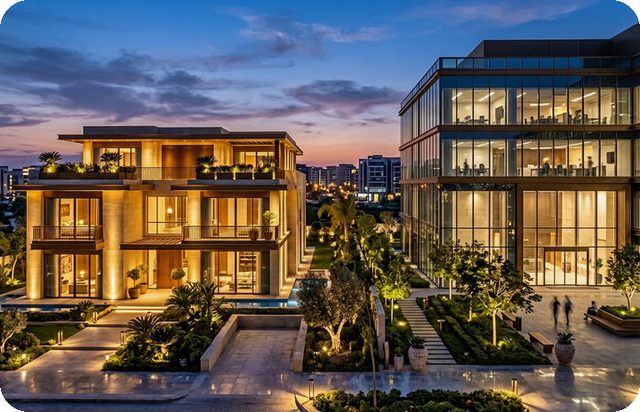
CORPORATE PROFILE & BUSINESS PORTFOLIO · 2026
SECTOR 01 · REAL ESTATE & INVESTMENT
Real Estate & Property Advisory — SAWA UNITED
sawa-united.net
“We select the property before we present it — your home & investment in Egypt, even from abroad.”
SAWA UNITED’s real estate platform delivers a structured, transparent acquisition journey. Every residential, commercial, and land opportunity is vetted prior to listing, supported by dedicated advisors guiding domestic and international buyers through handover.
✦ Standalone villas & gated residential community acquisitions
✦ Premium apartments & turnkey serviced apartments
✦ Prime-frontage commercial spaces & administrative offices
✦ Strategic investment land plots in high-appreciation corridors
✦ Remote cross-border advisory, comparison & scheduled site visits
Egypt & Morocco
Active Real Estate Platform Markets
Client & Investor Value Proposition
5 Prime Hubs
New Cairo · New Capital · North Coast · Alexandria · Maadi
Eliminates market noise through pre-verified listings, structured comparative data, and single-point advisory support from initial inquiry to final handover.
4-Step Journey
Discover → Compare → Consult Advisor → Visit & Handover
SAWA UNITED GROUP — Corporate Business Portfolio
05 / 18
sawaunited.net | +20 101 122 5592

Slide 6

CORPORATE PROFILE & BUSINESS PORTFOLIO · 2026
SECTOR 02 · FOOD SUPPLIES & DISTRIBUTION
Regional Food Distribution — SAWA FOOD
sawafood.net
“Better food, brought closer — connecting trusted makers to regional markets.”
Sawa Food operates an integrated regional sourcing, wholesale, and retail distribution ecosystem across MENA, partnering directly with committed manufacturers while offering its curated flagship line, Sawa Select.
✦ Bulk wholesale food & fresh produce supply for commercial buyers
✦ Multi-country regional brand distribution & market entry execution
✦ Direct retail supply coverage across 1,400+ partner stores & outlets
✦ Manufacturer onboarding to scale high-quality food products across MENA
✦ Sawa Select line: Premium Black Tea, Pure Ghee & Long Grain Rice
250+
Curated Food & Staple SKUs
Partner & Market Value Proposition
120+
Trusted Food Brand Partners
Protects product continuity, shelf availability, and quality consistency through vetted manufacturing partners and responsive end-to-end regional logistics.
1,400+
Retail Partners Across 5 Markets
SAWA UNITED GROUP — Corporate Business Portfolio
06 / 18
sawaunited.net | +20 101 122 5592

Slide 7

CORPORATE PROFILE & BUSINESS PORTFOLIO · 2026
SECTOR 03 · AUTOMOTIVE & MOBILITY
Fleet Rental & Corporate Mobility — MASHARY CARS
masharycar.net
“Move with confidence — modern individual & corporate fleets with frictionless booking.”
Mashary Cars provides daily, monthly, and corporate vehicle rental solutions across Egypt, the UAE, and Morocco, pairing a diverse late-model fleet with transparent pricing and instant WhatsApp confirmation.
✦ Daily & monthly vehicle rentals for executives, residents & travelers
✦ Corporate fleet solutions, staff transport vans & executive buses
✦ Full category spectrum: Economy, Sedan, Family, SUV, Luxury & Performance
✦ Bespoke sourcing for special-request vehicle models upon inquiry
✦ Flexible multi-destination pickup & optional chauffeur service
3 Countries
Active Fleet in Egypt · UAE · Morocco
Client & Corporate Value Proposition
6 Categories
Economy · Sedan · SUV · Family · Luxury · Van & Bus
Zero upfront online payment risk via Pay on Delivery, transparent daily/monthly rates, verified vehicle categories, and rapid human confirmation.
Pay on Delivery
Zero Upfront Online Payment Required
SAWA UNITED GROUP — Corporate Business Portfolio
07 / 18
sawaunited.net | +20 101 122 5592

Slide 8
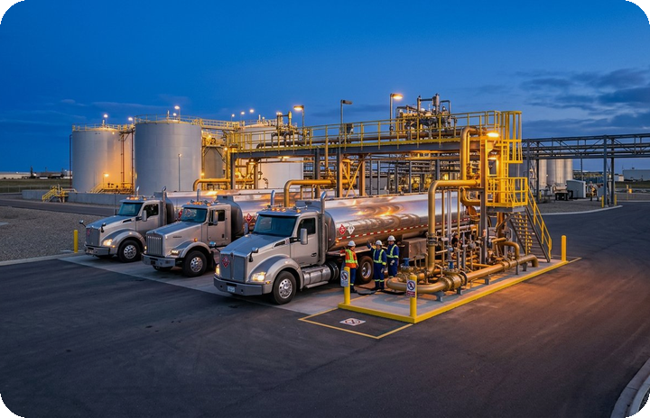
CORPORATE PROFILE & BUSINESS PORTFOLIO · 2026
SECTOR 04 · PETROLEUM & INDUSTRIAL SUPPLY
Lubricants, Fuel & Industrial Services — START WALK
startwalk.net
“Trusted since 2002 — Registered with the Egyptian General Petroleum Corporation (EGPC).”
Established in 2002 as an Egyptian LLC registered with EGPC, START WALK specializes in petroleum product transport, local and international lubricant oil distribution, facility maintenance, and industrial site supplies across Egypt and African export markets.
✦ On-site bulk fuel supply & equipped petroleum/heavy-equipment transport fleet
✦ Mobile Fuel Units engineered to minimize work-site downtime and operating cost
✦ Engine, industrial, heavy-equipment & specialty oils plus heavy-duty filters
✦ Fuel pump supply, petroleum facility maintenance & storage tank cleaning
✦ Contracting & road-works supplies: sand, gravel & asphalt mixtures
90M+ Liters
Cumulative Petroleum & Lubricant Volume
Industrial & B2B Value Proposition
25+ Trucks
Equipped Fleet Serving 384+ Clients
Single-source industrial partner combining EGPC-registered compliance, 90M+ liters of proven delivery volume, technical lubrication support, and strict HSE discipline.
24+ Years
Operating Since 2002 + 3 Export Markets
SAWA UNITED GROUP — Corporate Business Portfolio
08 / 18
sawaunited.net | +20 101 122 5592

Slide 9
CORPORATE PROFILE & BUSINESS PORTFOLIO · 2026
COMMERCIAL OFFERING · SERVICES & SOLUTIONS
Integrated B2B & B2C Solutions Across Four Sectors
Structured commercial offerings tailored to institutional enterprises, investors, retail networks, and individual clients.
Real Estate Advisory
Food Supply & FMCG
Mobility & Fleet Rental
Petroleum & Industrial
● Pre-vetted property selection & brokerage
● Commercial, office & investment land sourcing
● Cross-border acquisition support for expats
● End-to-end follow-up through handover
● Bulk wholesale staples & fresh produce supply
● 5-market regional brand distribution
● Retail shelf supply (1,400+ partner outlets)
● Private-label Sawa Select staple products
● Corporate monthly & long-term fleet contracts
● Executive luxury, SUV & economy daily rental
● Commercial vans, buses & chauffeur options
● Pay-on-delivery multi-location vehicle handover
● Work-site fuel delivery & Mobile Fuel Units
● Automotive, industrial & heavy-equipment oils
● Equipped tanker transport & tank maintenance
● Fuel pumps, filters & road asphalt supplies
Investors · Corporates · Homeowners
Distributors · Wholesalers · Retailers · Makers
Enterprises · Delegations · Individuals
Factories · Contractors · Energy · Export
SAWA UNITED GROUP — Corporate Business Portfolio
09 / 18
sawaunited.net | +20 101 122 5592

Slide 10
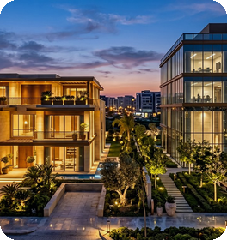


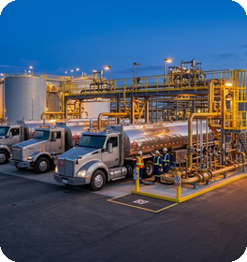
CORPORATE PROFILE & BUSINESS PORTFOLIO · 2026
TRACK RECORD · FEATURED VENTURES & ASSETS
Documented Platforms, Ventures & Asset Highlights
Active operating platforms, property offerings, and commercial product lines across the SAWA UNITED ecosystem.
Real Estate · Egypt & Morocco · 2026
Food & FMCG · MENA Region · 2024
SAWA UNITED REAL ESTATE
SAWA FOOD & SAWA SELECT
Curated residential, commercial, and land portfolio across Egypt’s premier corridors: Fifth Settlement Villa (420 m²), Golden Square Investment Land (2,000 m²), New Capital Commercial Space (380 m²), North Coast Sidi Abdel Rahman (240 m²), Smouha (165 m²), and Maadi (180 m²).
Regional food distribution platform managing 250+ curated SKUs and 120+ brands across 5 markets, anchored by the Sawa Select range (Premium Black Tea, Pure Ghee, and Long Grain Rice).
Automotive · UAE, Egypt & Morocco · 2025
Petroleum & Industrial · Egypt & Export · 2026
MASHARY CARS MOBILITY
START WALK ENERGY
Cross-market mobility platform operating modern Economy, Sedan, SUV, Luxury, and Corporate Van/Bus fleets with streamlined digital booking and zero-upfront Pay on Delivery.
EGPC-registered industrial energy platform operating since 2002 with 90M+ liters distributed, 25+ specialized trucks, 384+ clients, and active exports to Libya, Sudan, and South Africa.
SAWA UNITED GROUP — Corporate Business Portfolio
10 / 18
sawaunited.net | +20 101 122 5592

Slide 11
CORPORATE PROFILE & BUSINESS PORTFOLIO · 2026
CAPABILITIES & EXECUTION · SCALE & OPERATING MODEL
Quantified Operational Scale & Five-Stage Execution Model
Verified Operational Capacity Benchmarks
5-Stage Institutional Execution Lifecycle
Petroleum & Lubricant Volume Distributed (START WALK)
90,000,000+ Liters
Opportunity Vetting
01
Rigorous assessment of market demand, property credentials, manufacturer quality, or industrial site specifications.
Regional Food Retail Partner Network (SAWA FOOD)
1,400+ Retail Partners
Solution Structuring
02
Tailored commercial and technical scoping with transparent pricing aligned to volume, duration, or investment goals.
Group-Wide Workforce & Sector Specialists
2,500+ Professionals
Specialist Routing
03
Clear contractual alignment and immediate assignment to the dedicated sector team responsible for execution.
Industrial & Corporate Energy Accounts
384+ B2B Clients
Disciplined Delivery
Curated Food Brand & Product Portfolio
250+ SKUs / 120+ Brands
04
Controlled fleet dispatch, supply-chain logistics, or site handover adhering to strict timelines and safety protocols.
Delivered Ventures & Specialized Tanker Fleet
40+ Projects / 25+ Trucks
Post-Handover Growth
05
Ongoing technical support, account management, and replenishment turning initial transactions into lasting partnerships.
SAWA UNITED GROUP — Corporate Business Portfolio
11 / 18
sawaunited.net | +20 101 122 5592

Slide 12
CORPORATE PROFILE & BUSINESS PORTFOLIO · 2026
COMPETITIVE ADVANTAGE · WHY SAWA UNITED?
Why Leading Enterprises & Investors Partner With Us
Five institutional differentiators set SAWA UNITED apart from fragmented single-market operators:
01
02
03
Experienced Multi-Sector Leadership
Connected Regional Markets & Capabilities
Long-Term Value & Investment Mindset
15+ years of group growth combined with 24+ years of industrial energy roots enable superior cross-cycle resilience and judgment.
Active commercial corridors linking Egypt, the GCC, North Africa, and Sub-Saharan export destinations unlock rapid cross-border scaling.
Capital and operational decisions prioritize durable asset value, supply continuity, and sustainable returns over short-term gains.
04
05
Responsible, Transparent Operations
Partnerships Engineered to Last
Unambiguous pricing, pre-verified properties, EGPC regulatory registration, and customer-first terms such as Pay on Delivery.
High-retention B2B relationships across 1,400+ retailers, 120+ brands, and 384+ industrial clients built on consistent fulfillment.
SAWA UNITED GROUP — Corporate Business Portfolio
12 / 18
sawaunited.net | +20 101 122 5592

Slide 13
CORPORATE PROFILE & BUSINESS PORTFOLIO · 2026
ECOSYSTEM TRUST · PARTNERS, CLIENTS & ACCREDITATIONS
Institutional Credibility & Partner Network
In strict adherence to corporate disclosure standards, we present verified registrations and partner ecosystem metrics alongside reserved slots for authorized client logos.
Regulatory Registration
Manufacturing & Brand Network
Active Commercial Footprint
Egyptian General Petroleum Corp. (EGPC)
120+ Food Brands & Global Lubricant Makers
1,400+ Retail Partners | 384+ Industrial Clients
START WALK LLC is officially registered with EGPC since 2002 for petroleum transport, lubricants, and industrial services.
Direct distribution alliances with vetted regional food producers and local/international lubricant oil manufacturers.
Proven fulfillment across supermarkets, wholesalers, industrial factories, contracting sites, and corporate fleet accounts.
Reserved Showcase Slots — Authorized Partner & Corporate Client Logos (To Be Populated Upon Release Approval)
[ Strategic Partner Logo 01 ]
[ Industrial / Supply Partner 02 ]
[ Retail / Distribution Partner 03 ]
[ Enterprise Client Logo 04 ]
[ Real Estate Partner Logo 05 ]
[ International Partner Logo 06 ]
SAWA UNITED GROUP — Corporate Business Portfolio
13 / 18
sawaunited.net | +20 101 122 5592

Slide 14
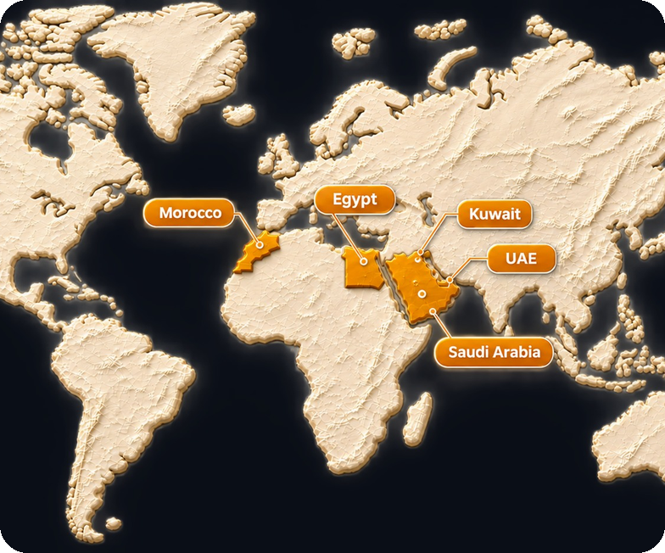
CORPORATE PROFILE & BUSINESS PORTFOLIO · 2026
GEOGRAPHIC FOOTPRINT · REGIONAL & EXPORT MARKETS
Connected Presence Across MENA & African Export Routes
SAWA UNITED operates across a connected 12-market network anchored by core MENA hubs and active African export corridors:
EG
Arab Republic of Egypt (Core Hub)
Real Estate · Food Supplies · Car Rental · Petroleum & Industrial
AE
United Arab Emirates
Group Presence · Mashary Cars Fleet · Sawa Food Network
SA
Kingdom of Saudi Arabia
Group Presence · Sawa Food Regional Distribution
MA
Kingdom of Morocco
Group Presence · Real Estate Platform · Mashary Cars Fleet
KW
State of Kuwait
Group Presence & GCC Commercial Network
JO
Hashemite Kingdom of Jordan
Sawa Food Wholesale & Retail Store Network
EXP
African Export Corridors
START WALK Petroleum & Lubricants Exports: Libya · Sudan · South Africa
SAWA UNITED GROUP — Corporate Business Portfolio
14 / 18
sawaunited.net | +20 101 122 5592

Slide 15
CORPORATE PROFILE & BUSINESS PORTFOLIO · 2026
GOVERNANCE & STANDARDS · QUALITY & COMMITMENT
Uncompromising Quality, HSE & Operational Integrity
Shared institutional standards govern every platform within SAWA UNITED to safeguard partner trust and operational continuity:
Pre-Market Vetting & Curation
Health, Safety & Environment (HSE)
Every real estate asset, food SKU, and fleet vehicle undergoes strict quality, documentation, and suitability verification prior to offering.
Strict adherence to ‘Safety First’ protocols, environmental protection, and resource efficiency across fuel transport, storage, and industrial sites.
Regulatory & Legal Compliance
Commercial Clarity & On-Time Fulfillment
Operations anchored by registered legal entities, including official registration with the Egyptian General Petroleum Corporation since 2002.
Transparent pricing structures, responsive end-to-end logistics, and accountable client support across every transaction.
Reserved Institutional Slot — Quality & Compliance Certifications
[ Reserved space for authorized ISO / Food Safety / HSE / Corporate Registration certificate numbers & seals upon formal issuance ]
SAWA UNITED GROUP — Corporate Business Portfolio
15 / 18
sawaunited.net | +20 101 122 5592

Slide 16
CORPORATE PROFILE & BUSINESS PORTFOLIO · 2026
STRATEGIC ALLIANCES · COOPERATION OPPORTUNITIES
Structured Pathways for Commercial & Investment Collaboration
We welcome institutional partners, investors, manufacturers, and corporate buyers across four dedicated engagement tracks:
01
Real Estate Co-Investment & Development
02
Regional Food Distribution & Brand Onboarding
Joint ventures, project marketing mandates, commercial off-take, and curated portfolio acquisitions with developers and investors in Egypt and Morocco.
Regional distributor appointments, bulk wholesale supply agreements, retail chain partnerships, and manufacturer onboarding into Sawa Food’s 5-market network.
03
Industrial Fuel, Lubricants & Export Supply
04
Corporate Mobility & Fleet Outsourcing
Long-term site fuel contracts, Mobile Fuel Unit deployment, industrial lubrication supply, tank maintenance, and regional export distribution partnerships.
Dedicated monthly and annual corporate vehicle leasing, executive transport, and multi-destination mobility programs across Egypt, UAE, and Morocco.
Call to Action: Share your investment mandate, distribution inquiry, or supply requirement — our specialist unit will respond directly.
SAWA UNITED GROUP — Corporate Business Portfolio
16 / 18
sawaunited.net | +20 101 122 5592

Slide 17
CORPORATE PROFILE & BUSINESS PORTFOLIO · 2026
OFFICIAL CONTACTS · DIGITAL PORTALS & DIRECT ACCESS
Official Group Portals & Direct Communication Channels
Our executive business development team and specialized sector advisors are ready to discuss partnerships, investments, and commercial supply inquiries.
Group Corporate Portal
Real Estate Platform
https://sawaunited.net
https://sawa-united.net
Food Supplies Platform
Automotive & Mobility Portal
https://sawafood.net
https://masharycar.net
Petroleum & Industrial Portal
Unified Direct Phone & WhatsApp
https://startwalk.net
+20 101 122 5592 (wa.me/201011225592)
Official Facebook Page
Sector Email (Petroleum — START WALK)
facebook.com/Sawaunited.net
info@startwalk.com
Group HQ Address & Central Email
[ Reserved Slot — Official Corporate Email & Headquarters Street Address ]
SAWA UNITED GROUP — Corporate Business Portfolio
17 / 18
sawaunited.net | +20 101 122 5592

Slide 18
SAWA UNITED GROUP
Building Businesses. Creating Impact.
Four Specialized Sectors · One Institutional Standard for Performance, Trust & Long-Term Value
sawaunited.net | WhatsApp: +20 101 122 5592
sawa-united.net
sawafood.net
masharycar.net
startwalk.net

