Slide 1
Introduction to Linux and GitHub
Dr. Sanjay HA, Mr. Prashanth BS, Mr. Sarang Parikh

Slide 2
Agenda
Linux Introduction
Flavours of Linux
Linux Features
Linux Architecture
Linux System components
Basic command Structure
Basic commands – Theory and Hands-on
Advanced Commands in Linux – Theory and Hands-on

Slide 3

Introduction to Linux
Linux is a free Unix-type operating system originally created with the assistance of developers around the world by Linus Torvalds
Developed under the GNU General Public License , the source code for Linux is freely available to everyone
Linux is a multiuser, multitasking system with a full set of UNIX-compatible tools
Main design goals are speed, efficiency, and standardization

Slide 4

Flavours of Linux

Slide 5
Flavours of Linux
Gnome – default environment of fedora, suse Linux, Redhat etc which focus on stability more than fancy effects.
K Desktop Environment (KDE) – more bells and whistles than Gnome and offers more integrated applications
XFCE – Lightweight OS
LXDE – Mid range Desktop environment for fast and powerful computers
Cinnamon – Linux Mint
MATE – gnome 2
Budgie Desktop

Slide 6
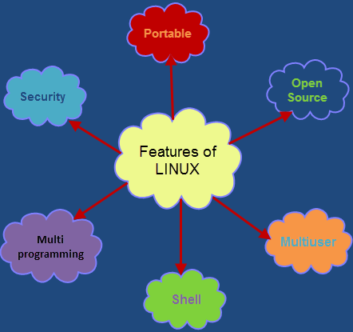
Features of Linux

Slide 7
Features of Linux
Portable: Linux operating system can work on different types of hardware as well as Linux kernel supports the installation of any kind of hardware platform.
Open Source: Source code of LINUX operating system is freely available and, to enhance the ability of the LINUX operating system, many teams work in collaboration.
Multiuser: Linux operating system is a multiuser system, which means, multiple users can access the system resources like RAM, Memory or Application programs at the same time

Slide 8
Features of Linux
Multiprogramming: Linux operating system is a multiprogramming system, which means multiple applications can run at the same time.
Hierarchical File System: Linux operating system affords a standard file structure in which system files or user files are arranged.
Shell: Linux operating system offers a special interpreter program, that can be used to execute commands of the OS.
Security: Linux operating system offers user security systems using authentication features like encryption of data or password protection or controlled access to particular files

Slide 9
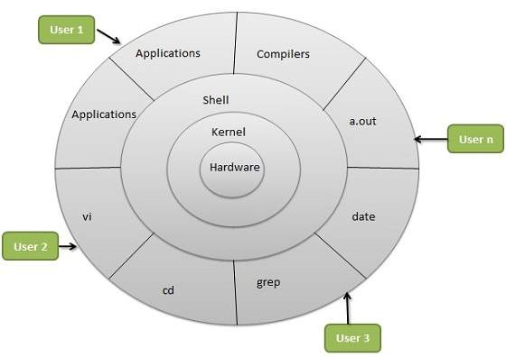
Linux Architecture

Slide 10
Linux Architecture
Kernel − The kernel is the heart of the operating system. It interacts with the hardware and most of the tasks like memory management, task scheduling and file management.
Shell − The shell is the utility that processes your requests. When you type in a command at your terminal, the shell interprets the command and calls the program that you want. The shell uses standard syntax for all commands. C Shell, Bourne Shell and Korn Shell are the most famous shells which are available with most of the Unix variants.
Commands and Utilities − There are various commands and utilities which you can make use of in your day to day activities. cp, mv, cat and grep, etc. are few examples of commands and utilities.
Files and Directories − All the data of Unix is organized into files. All files are then organized into directories. These directories are further organized into a tree-like structure called the file system.

Slide 11
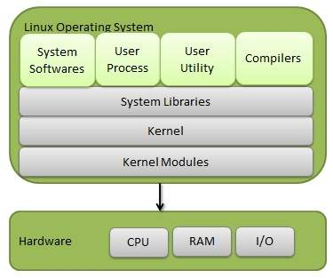
Components of Linux-OS

Slide 12
Components of Linux-OS
Like most UNIX implementations, Linux is composed of three main bodies of code; the most important distinction between the kernel and all other components.
The kernel is responsible for maintaining the important abstractions of the operating system
Kernel code executes in kernel mode with full access to all the physical resources of the computer
All kernel code and data structures are kept in the same single address space

Slide 13
Components of Linux-OS
The system libraries define a standard set of functions through which applications interact with the kernel, and which implement much of the operating-system functionality that does not need the full privileges of kernel code
The system utilities perform individual specialized management tasks
User-mode programs rich and varied, including multiple shells like the bourne-again (bash)

Slide 14
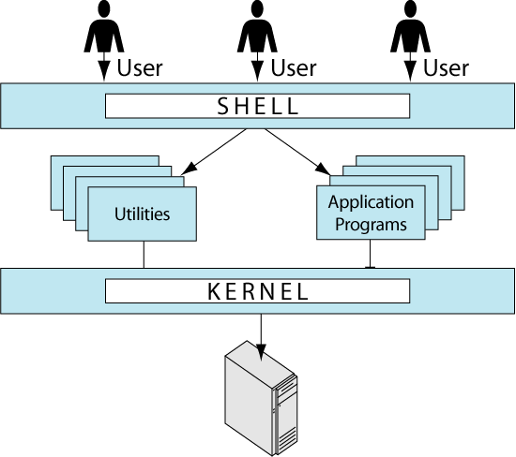
Components of Linux – Another Perspective

Slide 15
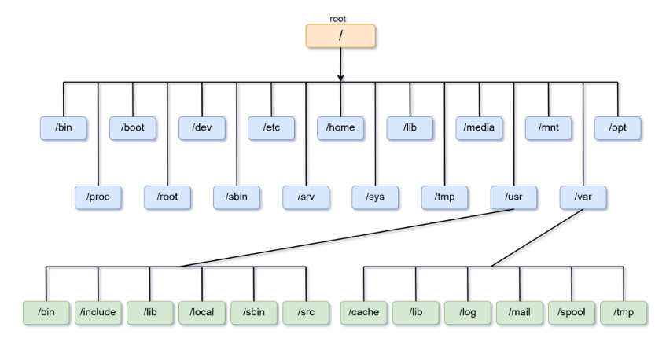
Linux Directory Structure

Slide 16
Linux Directory Structure
/ (root)
Primary hierarchy root and is the first directory and the root directory of the entire file system hierarchy.
It contains all other directories i.e. the sub directories.
Only the root user has the permissions to write here.
This is not the home directory for the root user.
/bin (user binaries)
It contains binary executables.
Binary executables of common Linux commands used by all users in single-user mode are located in this directory.
Some files present in this directory are: ls, cp, grep, ping, cat, etc.

Slide 17
Linux Directory Structure
/boot (boot loader files)
It contains boot loader files.
kernel, initrd, grub, and other files and directories are located in this directory.
e.g. vmlinux-2.7.31.25-generic, initrd.img-2.3.32.24-generic, etc.
/dev (device files)
It contains the essential files related to the devices attached to the system.
This includes terminal devices, USB, network devices and any other devices that are attached to the system.
e.g. /dev/usbmon0 , /dev/tty1 , /dev/null , etc.

Slide 18
Linux Directory Structure
/etc (configuration files)
etc stands for ‘edit to config’
This directory contains the configuration files that are required by the installed programs.
/home (home directories)This directory contains user’s home directories, containing saved files and personal settings.
Each user will have an separate directory with their username under this directory except the root user because every time a new user is created, a directory is created in the name of the user within the home directory.
e.g. /home/user , /home/sage , /home/guest , etc.

Slide 19
Linux Directory Structure
/lib (system libraries)This directory contains libraries that are essential for the binaries in /bin and /sbin
/media (removable media devices)Temporary mount directory for removable media such as CD-ROM.
/mnt (mount directory)Temporary mount directory where system administrator can mount file systems.
/opt (optional application software packages)This directory contains add-on applications from individual vendors.
/proc (process information) This directory contains information about the processes running in the system.

Slide 20
Linux Directory Structure
/root (root directory)This is the home directory for the root user.
/sbin (system binaries)
This directory contains essential system binaries.
The linux commands that are located in this directory are used by system administrator, for system maintenance and configuration purpose.
e.g. fsck , reboot , fdisk , ifconfig , init , etc.
/srv (service data)
This directory contains site-specific data served by the system, such as data and scripts for web servers, data offered by FTP servers, and repositories for version control systems i.e. server specific services related data.

Slide 21
Linux Directory Structure
/sys (system)This directory contains information about devices, drivers, and some kernel features.
/tmp (temporary files)This directory contains temporary files created by system and the users that will be rebooted when the system is rebooted.
/usr (user programs)
This directory contains read-only user data like binaries, libraries, documentation and source-code for second level programs like user utilities and applications.
/var (variable files)This directory contains files whose content is expected to continually change during normal operation of the system—such as logs, spool files, and temporary e-mail file.

Slide 22
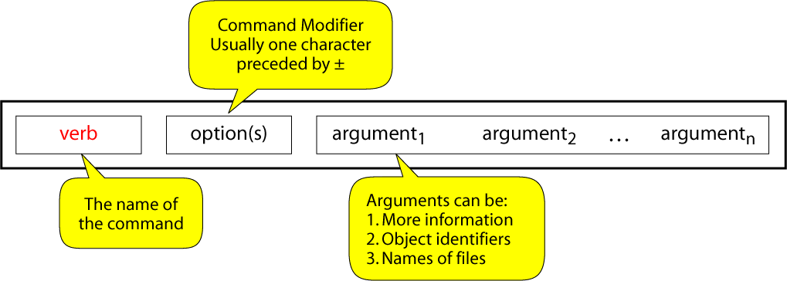
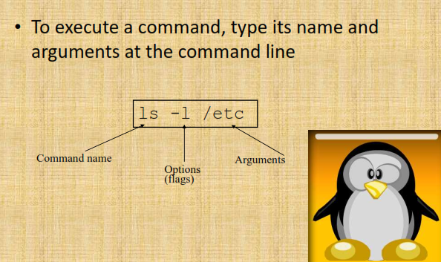
Basic Command Structure

Slide 23
Basic Commands : Hands on

Slide 24
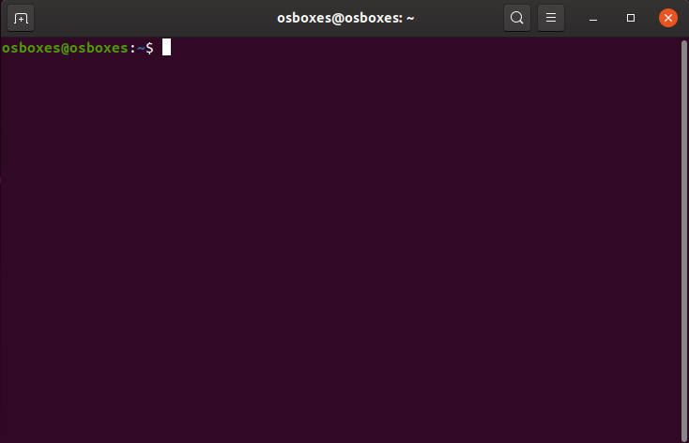
Basic Terminal

Slide 25

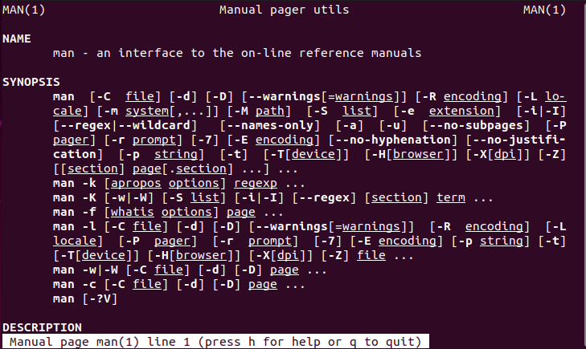
Man command

Slide 26
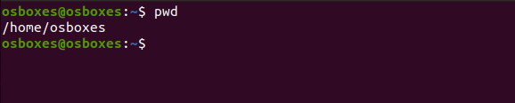
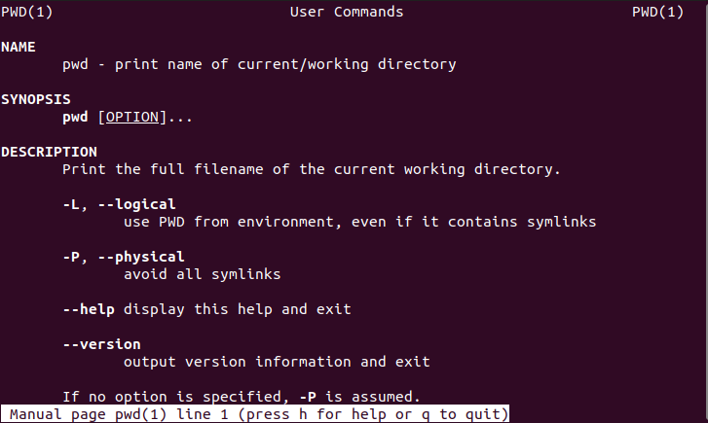
Present working directory – pwd command

Slide 27
man
Manual Pages
The first command to remember
Contains info about almost everything :-)
other commands
system calls
c/library functions
other utils, applications, configuration files
To read about man itself type: % man man
NOTE: unfortunately there’s no % man woman ...

Slide 28
which
Displays a path name of a command.
Searches a path environmental variable for the command and displays the absolute path.
To find which tcsh and bash are actually in use, type: % which tcsh % which bash
% man which for more details

Slide 29
whereis
Display all locations of a command (or some other binary, man page, or a source file).
Searchers all directories to find commands that match whereis’ argument
% whereis tcsh

Slide 30
date
Guess what :-)
Displays dates in various formats
% date
% date -u
in GMT
% man date

Slide 31
cal
Calendar
for month
entire year
Years range: 1 - 9999
No year 0
Calendar was corrected in 1752 - removed 11 days
% cal current month
% cal 2 2000 Feb 2000, leap year
% cal 2 2100 not a leap year
% cal 2 2400 leap year
% cal 9 1752 11 days skipped
% cal 0 error
% cal 2002 whole year

Slide 32
clear
Clears the screen
There’s an alias for it: Ctrl+L
Example sequence:
% cal
% clear
% cal
Ctrl+L

Slide 33
Command Grouping
Semicolon: “;”
Often grouping acts as if it were a single command, so an output of different commands can be redirected to a file:
% (date; cal; date) > out.txt

Slide 34
exit / logout
Exit from your login session.
% exit
% logout

Slide 35
shutdown
Causes system to shutdown or reboot cleanly.
May require super user privileges
% shutdown -h now - stop
% shutdown -r now - reboot

Slide 36
ls
List directory contents
Has whole bunch of options, see man ls for details.
% ls
all files except those starting with a “.”
% ls -a
all
% ls -A
all without “.” and “..”
% ls -F
append “/” to dirs and “*” to executables
% ls -l
long format
% ls -al
% ls -lt
sort by modification time (latest - earliest)
% ls -ltr
reverse

Slide 37
cat
Display and concatenate files.
% cat
Will read from STDIN and print to STDOT every line you enter.
% cat file1 [file2] ...
Will concatenate all files in one and print them to STDOUT
% cat > filename
Will take whatever you type from STDIN and will put it into the file filename
To exit cat or cat > filename type Ctrl+D to indicate EOF (End of File).

Slide 38
more / less
Pagers to display contents of large files page by page or scroll line by line up and down.
Have a lot of viewing options and search capability.
Interactive. To exit: ‘q’

Slide 39
less
less ("less is more") a bit more smart than the more command
to display contents of a file:
% less filename
To display line numbers:
% less -N filename
To display a prompt:
% less -P"Press 'q' to quit" filename
Combine the two:
% less -NP"Blah-blah-blah" filename
For more information:
% man less

Slide 40
touch
By touching a file you either create it if it did not exists (with 0 length).
Or you update it’s last modification and access times.
There are options to override the default behavior.
% touch file
% man touch

Slide 41
cp
Copies files / directories.
% cp [options] <source> <destination>
% cp file1 file2
% cp file1 [file2] … /directory
Useful option: -i to prevent overwriting existing files and prompt the user to confirm.

Slide 42
mv
Moves or renames files/directories.
% mv <source> <destination>
The <source> gets removed
% mv file1 dir/
% mv file1 file2
rename
% mv file1 file2 dir/
% mv dir1 dir2

Slide 43
rm
Removes file(s) and/or directories.
% rm file1 [file2] ...
% rm -r dir1 [dir2] ...
% rm -r file1 dir1 dir2 file4 ...

Slide 44
find
Looks up a file in a directory tree.
% find . -name name
% find . \(-name ‘w*’ -or -name ‘W*’ \)

Slide 45
mkdir
Creates a directory.
% mkdir newdir
Often people make an alias of md for it.

Slide 46
cd
Changes your current directory to a new one.
% cd /some/other/dir
Absolute path
% cd subdir
Assuming subdir is in the current directory.
% cd
Returns you to your home directory.

Slide 47
pwd
Displays personal working directory, i.e. your current directory.
% pwd

Slide 48
rmdir
Removes a directory.
% rmdir dirname
Equivalent:
% rm -r dirname

Slide 49
chmod
Changes file permissions
Possible invocations
% chmod 600 filename
-rw------- 1 user group 2785 Feb 8 14:18 filename (a bit not intuitive where 600 comes from)
% chmod u+rw filename (the same thing, more readable)
For the assignment:
% chmod u+x myshellscript (mysshellscript is now executable)
-rwx------ 1 user group 2785 Feb 8 14:18 myshellscript

Slide 50
grep
Searches its input for a pattern.
The pattern can be a simple substring or a complex regular expression.
If a line matches, it’s directed to STDOUT; otherwise, it’s discarded.
% echo “blah-foo” | grep blah
Will print the matching line
% echo “blah-foo” | grep zee
Will not.
See a separate grep tutorial.

