Slide 1
Treinamento no desenvolvimento de aplicações GIS
Banco de dados espacial PostGIS
Autor: Rodrigo Hjort (CETEC/Brasília)
Modificado em: 18/04/2013

Slide 2

Licença
Esta obra está licenciada sob uma
licença Creative Commons
http://creativecommons.org/licenses/by/2.5/br/

Slide 3
Ficha técnica
Autoria
Rodrigo Hjort
Coordenação Estratégica de Tecnologia – Brasília
Revisão
José Ronaldo Agra de Souza Filho
Coordenação Estratégica de Tecnologia – Brasília
Alisson Coelho de Morais
Superintendência de Desenvolvimento – Curitiba

Slide 4
Agenda
Conceito de banco de dados espacial
A extensão PostGIS
  Instalação e configuração
Carga de dados espaciais
  Criação de tabelas georreferenciadas
  Importação e exportação de shapefiles
Funções e operadores espaciais
Questões de performance
  Índices espaciais

Slide 5

O que é um banco de dados espacial?
Notes:
What is a Spatial Database?
PostGIS is a spatial database. Oracle Spatial and SQL Server 2008 are also spatial databases. But what does that mean; what is it that makes an ordinary database a spatial database?

Slide 6
Banco de dados convencional
Tipos de dados
texto, número, data/hora
Índices
b-tree, hash
Funções e operadores
length(), now(), +, >=

Slide 7
Banco de dados espacial
Tipos de dados espaciais
geometry, geography
Índices espaciais
r-tree, quad-tree, kd-tree
Funções e operadores espaciais
ST_Length(), ST_X(), &&, @
Notes:
The following briefly covers the evolution of spatial databases, and then reviews three aspects that associate spatial data with a database – data types, indexes, and functions.
Spatial data types refer to shapes such as point, line, and polygon;
Multi-dimensional spatial indexing is used for efficient processing of spatial operations;
Spatial functions, posed in SQL, are for querying of spatial properties and relationships.
Combined, spatial data types, indexes, and functions provide a flexible structure for optimized performance and analysis.

Slide 8
Um banco de dados espacial...
armazena e manipula objetos espaciais como qualquer outro objeto do banco de dados
Notes:
The short answer, is. . .
Spatial databases store and manipulate spatial objects like any other object in the database.

Slide 9
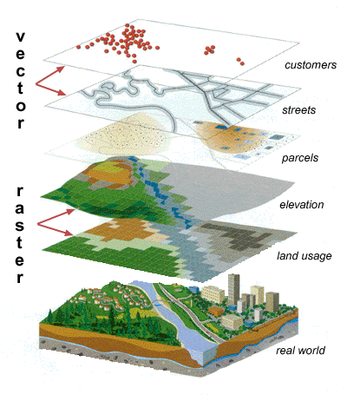
A modelagem espacial
pontos
linhas
polígonos

Slide 10

O que é o ESRI Shapefile?
formato popular de arquivo contendo dados geoespacials em forma de vetor usado em GIS
desenvolvido e regulamentado pela ESRI como um especificação aberta para interoperabilidade entre diversos fornecedores
carregam geometrias (pontos, linhas, polígonos) acompanhadas de atributos que as descrevem
http://www.esri.com/library/whitepapers/pdfs/shapefile.pdf

Slide 11
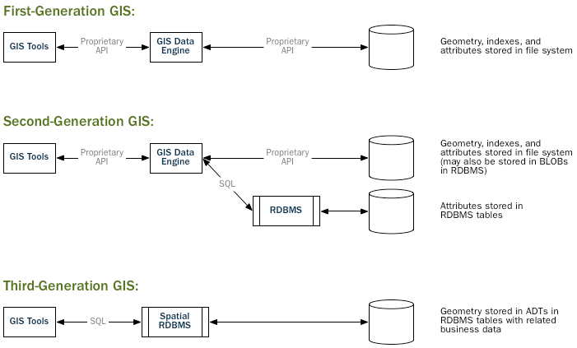
Evolução das arquiteturas GIS
Notes:
In legacy first-generation GIS implementations, all spatial data is stored in flat files and special GIS software is required to interpret and manipulate the data. These first-generation management systems are designed to meet the needs of users where all required data is within the user’s organizational domain. They are proprietary, self-contained systems specifically built for handling spatial data.
Second-generation spatial systems store some data in relational databases (usually the “attribute” or non-spatial parts) but still lack the flexibility afforded with direct integration.
True spatial databases were born when people started to treat spatial features as first class database objects.
Spatial databases fully integrate spatial data with an object relational database. The orientation changes from GIS-centric to database-centric.

Slide 12

O que é o PostgreSQL?
SGBD objeto-relacional
de código aberto
inicialmente desenvolvido na
UC Berkeley em 1986
segue padrões SQL ANSI
altamente extensível
licença BSD
“The world's most advanced open source database”
Notes:
PostgreSQL is a powerful, object-relational database management system (ORDBMS). It is released under a BSD-style license and is thus free and open source software. As with many other open source programs, PostgreSQL is not controlled by any single company, but has a global community of developers and companies to develop it.
PostgreSQL was designed from the very start with type extension in mind – the ability to add new data types, functions and access methods at run-time. Because of this, the PostGIS extension can be developed by a separate development team, yet still integrate very tightly into the core PostgreSQL database.

Slide 13

O que é o PostGIS?
PostGIS "spatially enables" the PostgreSQL server, allowing it to be used as a backend spatial database for geographic information systems (GIS)
Notes:
PostGIS turns the PostgreSQL Database Management System into a spatial database by adding support for the three features: spatial types, indexes, and functions. Because it is built on PostgreSQL, PostGIS automatically inherits important “enterprise” features as well as open standards for implementation.

Slide 14
Por que não usar shapefiles?
Porque usar SGBD é muito melhor!
Modelagem
de dados
complexa
Linguagem
SQL
Controle
Transacional
Consultas
ad hoc
Notes:
The shapefile (and other file formats) have been the standard way of storing and interacting with spatial data since GIS software was first written. However, these “flat” files have the following disadvantages:
Files require special software to read and write. SQL is an abstraction for random data access and analysis. Without that abstraction, you will need to write all the access and analysis code yourself.
Concurrent users can cause corruption. While it’s possible to write extra code to ensure that multiple writes to the same file do not corrupt the data, by the time you have solved the problem and also solved the associated performance problem, you will have written the better part of a database system. Why not just use a standard database?
Complicated questions require complicated software to answer. Complicated and interesting questions (spatial joins, aggregations, etc) that are expressible in one line of SQL in the database take hundreds of lines of specialized code to answer when programming against files.

Slide 15
Instalando o PostGIS e utilitários
# apt-get install
postgresql-9.2-postgis-2.1
pgadmin3
qgis python-qgis qgis-plugin-grass
Repositórios (ver repositorios.txt)
Aceitar a não verificação de autenticidade

Slide 16
Criando o banco modelo
# su postgres
$ createuser -P -s sa_gis
$ createdb -O sa_gis template_postgis
$ cd /usr/share/postgresql/9.2/contrib/postgis-2.1
$ psql template_postgis -f postgis.sql
$ psql template_postgis -f postgis_comments.sql
$ psql template_postgis -f spatial_ref_sys.sql

Slide 17
Criando o banco “curso”
# su postgres
# createdb curso -O sa_gis \
-T template_postgis
$ psql -h localhost -U sa_gis curso

Slide 18
Verificando as versões
SELECT version();
PostgreSQL 8.4.16 on i486-pc-linux-gnu, compiled by GCC gcc-4.4.real (Ubuntu 4.4.3-4ubuntu5.1) 4.4.3, 32-bit
SELECT postgis_version();
2.0 USE_GEOS=1 USE_PROJ=1 USE_STATS=1
SELECT postgis_full_version();
POSTGIS="2.0.1 r9979" GEOS="3.3.3-CAPI-1.7.4" PROJ="Rel. 4.7.1, 23 September 2009" LIBXML="2.7.6"

Slide 19
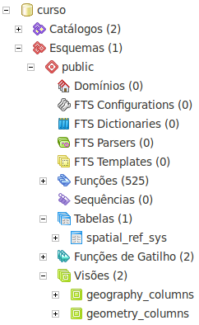
Analisando o banco “curso”
curso=> \d+
Lista de relações
Esquema | Nome | Tipo |
---------+-------------------+--------+
public | geography_columns | visão |
public | geometry_columns | visão |
public | spatial_ref_sys | tabela |
(3 registros)

Slide 20
Criando geometrias no PostGIS
CREATE TABLE geometrias (
nome varchar,
geom geometry
);
CREATE TABLE geometrias (
nome varchar
);
SELECT AddGeometryColumn(
'geometrias', 'geom', 0, 'GEOMETRY', 2);

Slide 21
Populando geometrias no PostGIS
INSERT INTO geometrias VALUES
('Ponto 1', 'POINT(0 0)'),
('Linha 1', 'LINESTRING(0 0, 1 1, 2 1, 2 2)'),
('Polígono 1', 'POLYGON((0 0, 1 0, 1 1, 0 1, 0 0))'),
('Polígono 2', 'POLYGON((0 0, 10 0, 10 10, 0 10, 0 0),
(1 1, 1 2, 2 2, 2 1, 1 1))'),
('Coleção 1', 'GEOMETRYCOLLECTION(POINT(2 0),
POLYGON((0 0, 1 0, 1 1, 0 1, 0 0)))');
SELECT * FROM geometrias;
SELECT nome, GeometryType(geom), ST_NPoints(geom),
ST_Length(geom), ST_Perimeter(geom),
ST_Area(geom), ST_Summary(geom)
FROM geometrias;

Slide 22
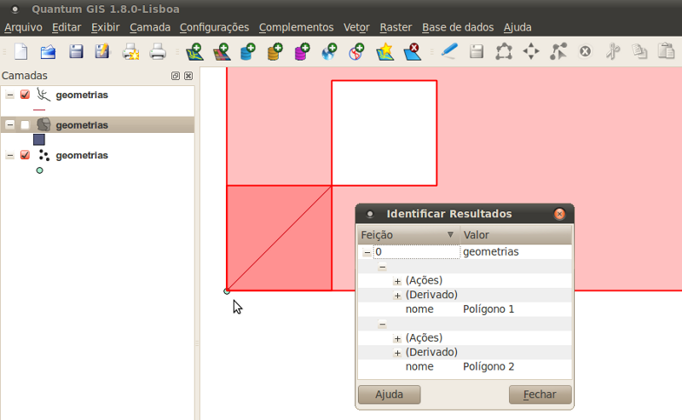
Visualizando no Quantum GIS
http://www.qgis.org/

Slide 23

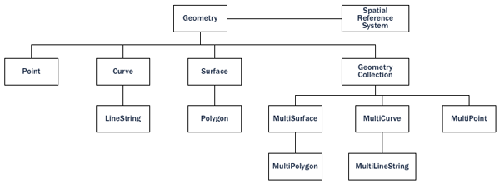
A hierarquia da geometria

Slide 24
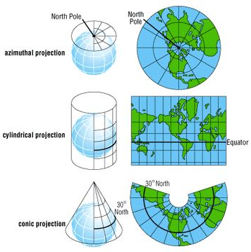
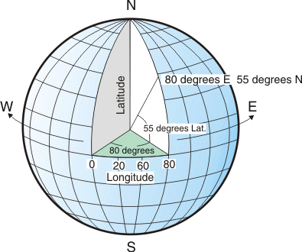
Projeções e sistemas de coordenadas
http://spatialreference.org/ref/epsg/4326/
Notes:
Projections transform the 3-D Earth into a 2-D plane. Some projections, like Mercator, attempt to preserve area while other projections like Mollweide preserve the area contained within the landmasses.
Coordinate systems are referencing systems used to describe specific locations and measure distances on maps. They provide x, y locations for features, and, within GIS, they are used to spatially register layers of features that occupy the same area. Latitude and longitude, the best known coordinate system, however, does not use a projection.
Like projections, there are many coordinate systems. Some of these coordinate systems focus locally and some globally.

Slide 25
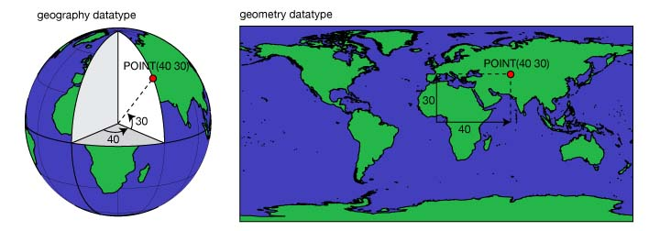
O tipo de dados geográfico
Modelo
Esférico
Modelo Plano (Cartesiano)
Notes:
The geometry datatype is used for any spatial data that lies in a flat plane. This might be, for instance, data the describes positions on a map, a plan of a building, or a local survey. The geometry datatype can also be used to store abstract or non-geospatial geometrical data, such as the shape of a component in a manufacturing process. The location of any point in the geometry datatype is described using x and y (and, optionally, z) coordinate values.
The geography datatype is specifically used to store spatial data that relates to positions on the Earth's surface, which must be described using coordinates of latitude and longitude. Operations on geography data account for the curvature of the Earth by using the ellipsoid model associated with the SRID of each item of data.

Slide 26
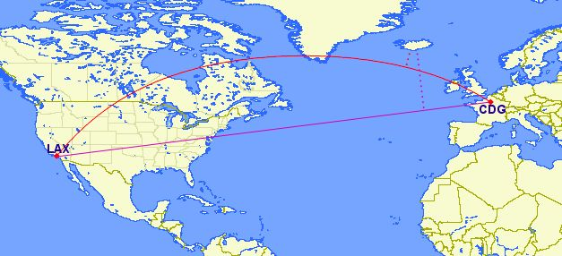
Usar geometria ou geografia?
http://www.gcmap.com/mapui?P=LAX-CDG
A que distância da Islândia passa
um voo de Los Angeles a Paris?
Notes:
How close will a flight from Los Angeles to Paris come to Iceland? Working with geographic coordinates on a cartesian plane (the purple line) yields a very wrong answer indeed! Using great circle routes (the red lines) gives the right answer.
If your data is geographically compact (contained within a state, county or city), use the geometry type with a cartesian projection that makes sense with your data.
If, on the other hand, you need to measure distance with a dataset that is geographically dispersed (covering much of the world), use the geography type. The application complexity you save by working in geography will offset any performance issues. And, casting to geometry can offset most functionality limitations.

Slide 27
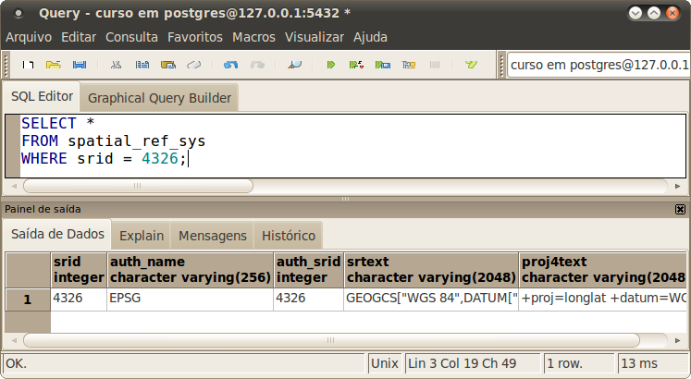
A tabela de sistemas de referências
Notes:
In conformance with the Simple Features for SQL (SFSQL) specification, PostGIS provides two tables to track and report on the geometry types available in a given database: spatial_ref_sys and geometry_columns.
spatial_ref_sys: defines all the spatial reference systems known to the database

Slide 28
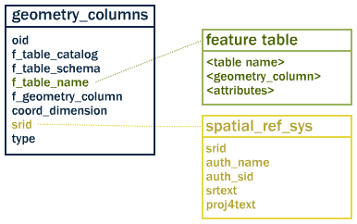
A tabela de colunas geométricas
SELECT * FROM geometry_columns;
Notes:
geometry_columns: provides a listing of all “features” (defined as an object with geometric attributes), and the basic details of those features
Populate_Geometry_Columns() function finds all the columns in the database that contain geometry and updates the geometry_columns table to include references to them.

Slide 29
Criando tabela de edifícios
CREATE TABLE edificios (
id serial NOT NULL PRIMARY KEY,
tipo char(1) NOT NULL,
nome varchar(30) NOT NULL,
sigla char(4) NOT NULL
);
SELECT AddGeometryColumn(
'edificios', 'local', 4326, 'POINT', 2);
GRANT ALL ON edificios TO public;
SELECT * FROM geometry_columns;

Slide 30
Populando dados geolocalizados
INSERT INTO edificios (tipo, nome, sigla, local) VALUES
('S', 'Sede', 'SEDE',
ST_GeomFromText('POINT(-47.869905 -15.784105)', 4326)),
('R', 'Regional Brasília', 'BSA', ST_GeomFromText('POINT(-47.872472 -15.78744)', 4326)),
('R', 'Regional Curitiba', 'CTA', ST_GeomFromText('POINT(-49.272849 -25.411505)', 4326)),
('R', 'Regional Fortaleza', 'FLA', ST_GeomFromText('POINT(-38.513370 -3.753282)', 4326)),
('R', 'Reg. Rio de Janeiro - Horto', 'RJO', ST_GeomFromText('POINT(-43.234656 -22.968657)', 4326)),
('E', 'Escritório Manaus', 'MNS', ST_GeomFromText('POINT(-60.013399 -3.124259)', 4326));
Longitude
Latitude
WGS 84

Slide 31
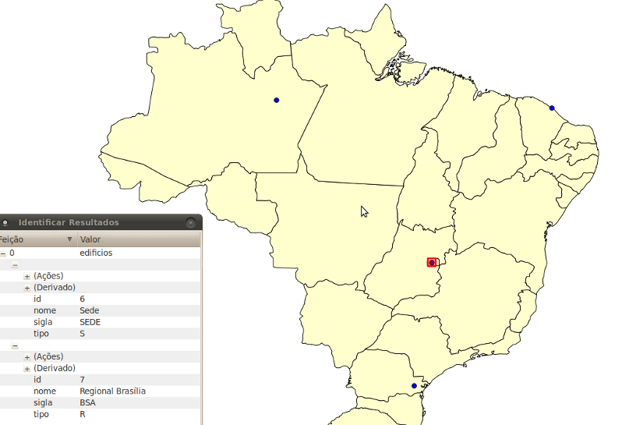
Visualizando os pontos no mapa

Slide 32
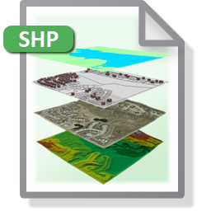

Conversão de ESRI Shapefiles
shp2pgsql
pgsql2shp
Notes:
The pgShapeLoader makes shape data usable in PostGIS by converting it from binary data into a series of SQL commands that are then run in the database to load the data.

Slide 33
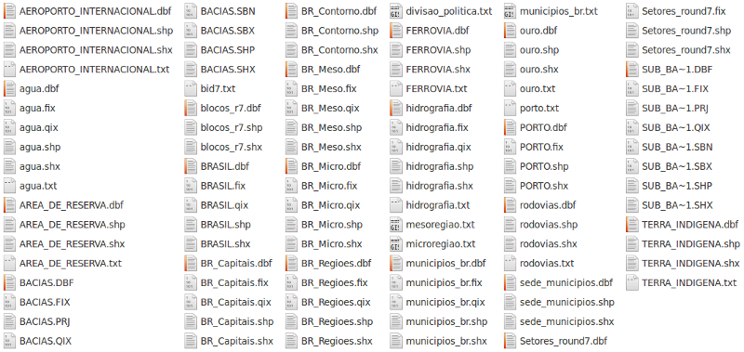
Shapefiles de exemplo
Notes:
A “shapefile” commonly refers to a collection of files with .shp, .shx, .dbf, and other extensions on a common prefix name (e.g., nyc_census_blocks). The actual shapefile relates specifically to files with the .shp extension. However, the .shp file alone is incomplete for distribution without the required supporting files.
Mandatory files:
.shp — shape format; the feature geometry itself
.shx — shape index format; a positional index of the feature geometry
.dbf — attribute format; columnar attributes for each shape, in dBase III
Optional files include:
.prj — projection format; the coordinate system and projection information, a plain text file describing the projection using well-known text format

Slide 34
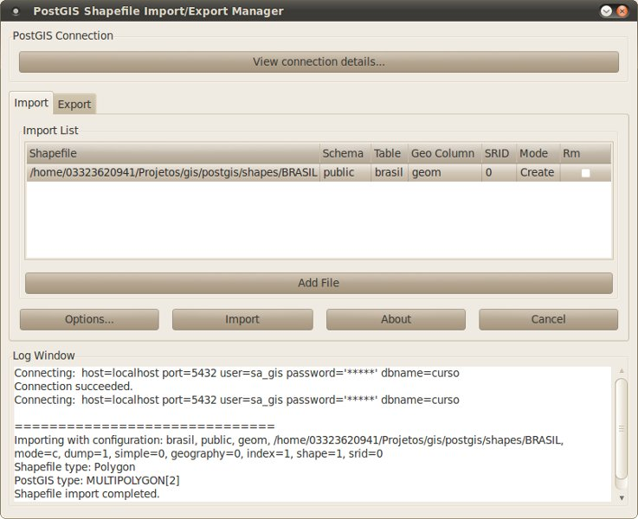
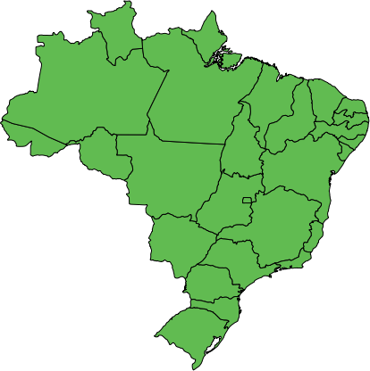
Importando divisões do Brasil
shp2pgsql-gui
(polígonos)

Slide 35
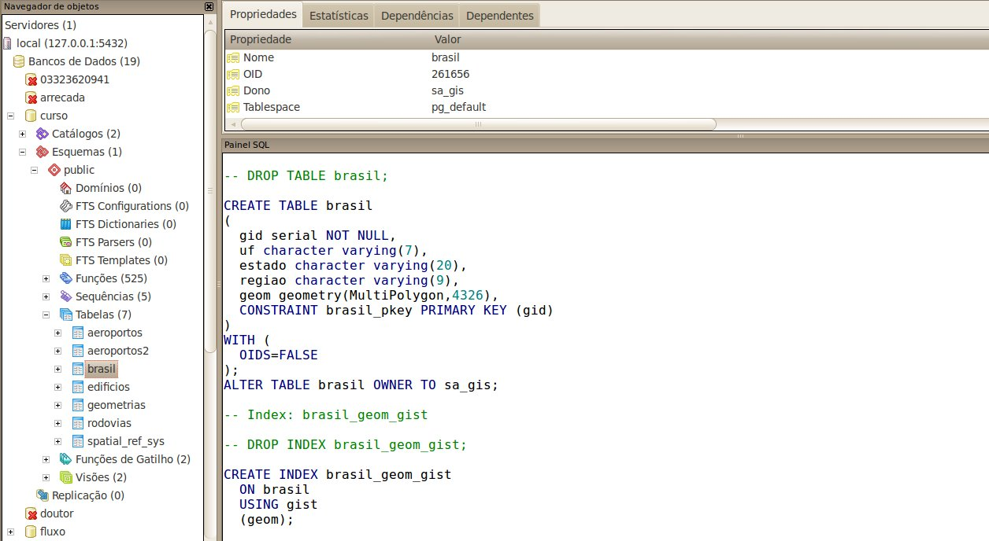
Verificando a estrutura importada
SRS: 4326 (WGS 84)

Slide 36
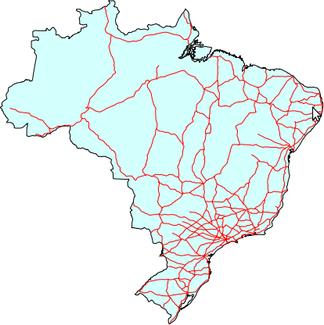
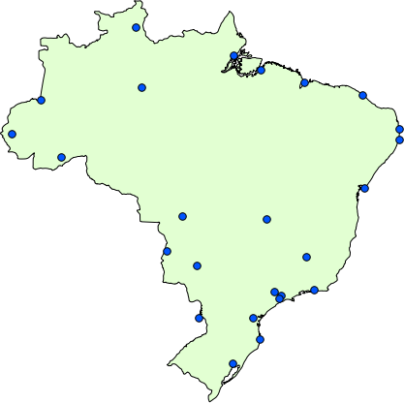
Importando rodovias e aeroportos
(linhas)
(pontos)

Slide 37
Analisando o conteúdo importado
SELECT GeometryType(geom) AS type, ST_SRID(geom) AS srid,
count(1), avg(ST_NPoints(geom)) AS npoints,
avg(ST_Length(geom)) AS length, avg(ST_Area(geom)) AS area
FROM brasil
GROUP BY GeometryType(geom), ST_SRID(geom);
SELECT GeometryType(geom) AS type, ST_SRID(geom) AS srid,
count(1), avg(ST_NPoints(geom)) AS npoints,
avg(ST_Length(geom)) AS length, avg(ST_Area(geom)) AS area
FROM rodovias
GROUP BY GeometryType(geom), ST_SRID(geom);
SELECT GeometryType(geom) AS type, ST_SRID(geom) AS srid,
count(1), avg(ST_NPoints(geom)) AS npoints,
avg(ST_Length(geom)) AS length, avg(ST_Area(geom)) AS area
FROM aeroportos
GROUP BY GeometryType(geom), ST_SRID(geom);
Notes:
type | srid | count | npoints | length | area
--------------+------+-------+----------------------+--------+-----------------
MULTIPOLYGON | 4326 | 27 | 345.0370370370370370 | 0 | 26.197975352443
type | srid | count | npoints | length | area
-----------------+------+-------+---------------------+------------------+------
MULTILINESTRING | 4326 | 423 | 15.5933806146572104 | 1.22746073844104 | 0
type | srid | count | npoints | length | area
-------+------+-------+------------------------+--------+------
POINT | 4326 | 25 | 1.00000000000000000000 | 0 | 0

Slide 38
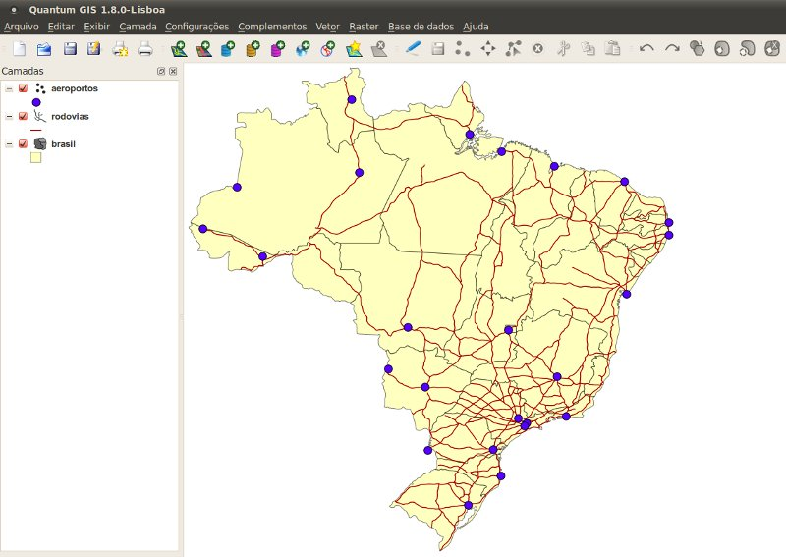
Visualizando as camadas no mapa

Slide 39
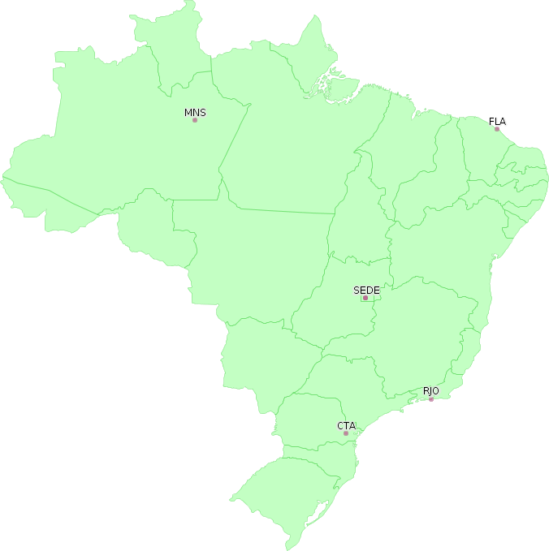
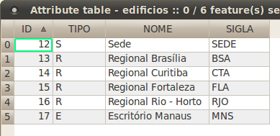
Exportando os edifícios do Serpro
shp2pgsql-gui
pgsql2shp

Slide 40
As mais de 300 funções espaciais
Construção: conversão textual (WKT e WKB)
Saída: WKT, WKB, GML, SVG, KML, GeoJSON
Atributos: recuperação e alteração de valores
Decomposição: extração de geometrias
Composição: criação de geometrias
Medidas: cálculos geométricos (distância, área)
Simplificação: uso de resoluções menores
Operadores: intersecta, contém, próximo a

Slide 41
Funções sobre pontos
Extraindo as coordenadas de um ponto
SELECT ST_X(local) AS lon, ST_Y(local) AS lat
FROM edificios;
Calculando as distâncias entre dois pontos
SELECT ST_Distance(a.local, b.local), a.sigla
FROM edificios a, edificios b
WHERE b.sigla = 'SEDE' AND b.id != a.id
ORDER BY 1;
Exportando para o formato KML
SELECT ST_AsKML(local), sigla
FROM edificios;

Slide 42
Funções sobre linhas
Selecionando os maiores trechos de rodovias
SELECT ST_Length(geom::geography)/1e3 AS km, rodovia1
FROM rodovias
ORDER BY 1 DESC LIMIT 10;
Listando as rodovias mais extensas
SELECT sum(ST_Length(geom::geography)/1e3), rodovia1
FROM rodovias
GROUP BY rodovia1
ORDER BY 1 DESC LIMIT 5;
Obtendo o número de pontos por trecho
SELECT ST_NPoints(geom), rodovia1, gid
FROM rodovias;

Slide 43
Funções sobre polígonos
Calculando a área dos maiores estados do país
SELECT ST_Area(
ST_Transform(geom, 29100))/1e6 AS km_2, uf
FROM brasil
ORDER BY 1 DESC LIMIT 5;
Obtendo o ponto centróide de cada estado
SELECT ST_AsText(ST_Centroid(geom)), uf
FROM brasil;
Obtendo a quantidade de anéis
SELECT ST_NRings(geom), uf
FROM brasil
ORDER BY 1 DESC;
http://pt.wikipedia.org/wiki/Anexo:Lista_de_unidades_federativas_do_Brasil_por_%C3%A1rea

Slide 44
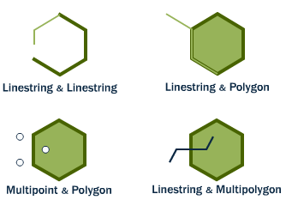
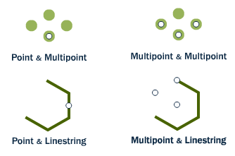
As relações espaciais: intersecção
ST_Intersects(A, B)
Notes:
Spatial databases are powerful because they not only store geometry, they also have the ability to compare relationships between geometries.
Questions like “Which are the closet bike racks to a park?” or “Where are the intersections of subway lines and streets?” can only be answered by comparing geometries representing the bike racks, streets, and subway lines.
ST_Intersects(geometry A, geometry B) returns t (TRUE) if the two shapes have any space in common, i.e., if their boundaries or interiors intersect.

Slide 45
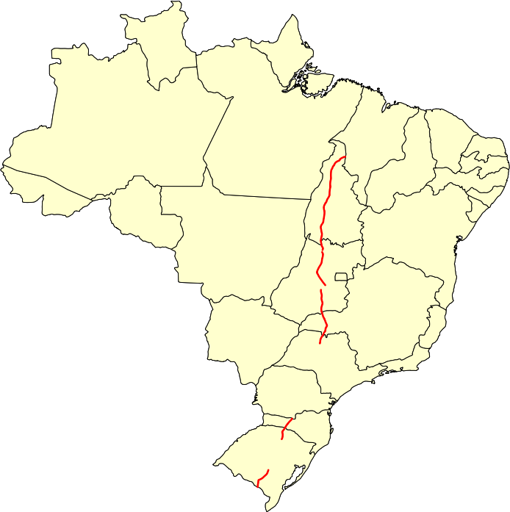
Exemplo de intersecção
Por quais estados do Brasil passa a BR-153?
SELECT uf, sum(ST_Length(r.geom))
FROM brasil b, rodovias r
WHERE rodovia1 = 'BR-153'
AND ST_Intersects(b.geom, r.geom)
GROUP BY uf
ORDER BY 2 DESC;
Notes:
curso=# SELECT uf, sum(ST_Length(r.geom)) FROM brasil b, rodovias r WHERE rodovia1 = 'BR-153' AND ST_Intersects(b.geom, r.geom) GROUP BY uf ORDER BY 2 DESC;
uf | sum
----+------------------
TO | 7.9493206922794
GO | 6.25044227122904
RS | 3.02529450890783
MG | 2.64911611552341
SC | 1.85120953981857
SP | 1.02818199605685
(6 registros)

Slide 46
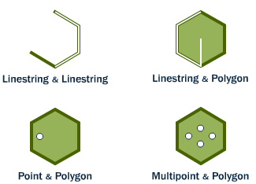
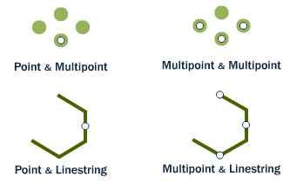
As relações espaciais: contém
ST_Contains(A, B)
ST_Within(A, B)
Notes:
ST_Within and ST_Contains test whether one geometry is fully within the other.
ST_Within(geometry A , geometry B) returns TRUE if the first geometry is completely within the second geometry. ST_Within tests for the exact opposite result of ST_Contains.
ST_Contains(geometry A, geometry B) returns TRUE if the second geometry is completely contained by the first geometry.

Slide 47
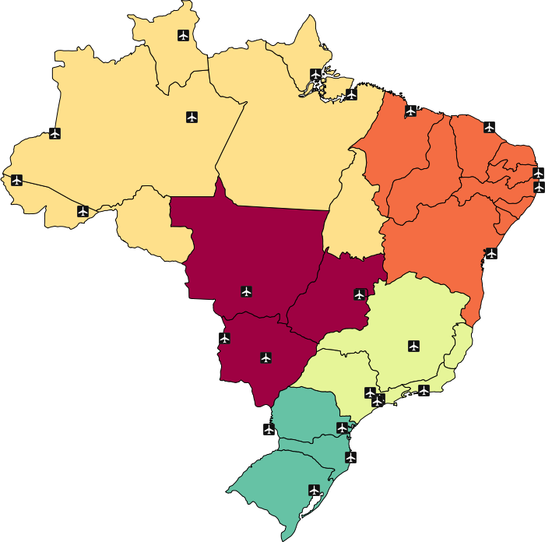
Exemplo de contém / está contido
Quais são os aeroportos internacionais da região Norte do país?
SELECT nm_nome, uf
FROM aeroportos a, brasil b
WHERE regiao = 'NO'
AND ST_Contains(b.geom, a.geom);
Notes:
curso=# SELECT nm_nome, uf FROM aeroportos a, brasil b WHERE regiao = 'NO' AND ST_Contains(b.geom, a.geom);
nm_nome | uf
------------------------+----
Presidente M\u0082dici | AC
Cruzeiro do Sul | AC
Macap | AP
Tabatinga | AM
Eduardo Gomes | AM
Val de CÆes | PA
Boa Vista | RR
(7 registros)

Slide 48
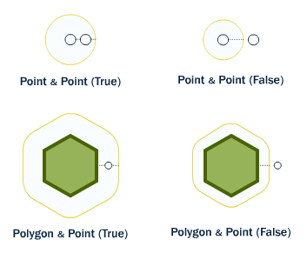
As relações espaciais: proximidade
ST_DWithin(A, B, r)
Notes:
The ST_Distance(geometry A, geometry B) calculates the shortest distance between two geometries and returns it as a float. This is useful for actually reporting back the distance between objects.
For testing whether two objects are within a distance of one another, the ST_DWithin function provides an index-accelerated true/false test. This is useful for questions like “how many trees are within a 500 meter buffer of the road?”. You don’t have to calculate an actual buffer, you just have to test the distance relationship.

Slide 49
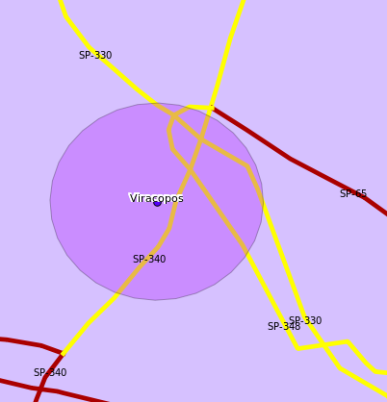
Exemplo de proximidade
Quais são as rodovias distantes de no máximo
20 km do aeroporto de Viracopos?
SELECT DISTINCT rodovia1
FROM rodovias r, aeroportos a
WHERE a.nm_nome = 'Viracopos'
AND ST_DWithin(
r.geom::geography,
a.geom::geography, 20000);
Notes:
curso=> SELECT DISTINCT rodovia1 FROM rodovias r, aeroportos a WHERE a.nm_nome = 'Viracopos' AND ST_DWithin(r.geom::geography, a.geom::geography, 20000);
rodovia1
----------
SP-340
SP-330
SP-348
(3 registros)

Slide 50
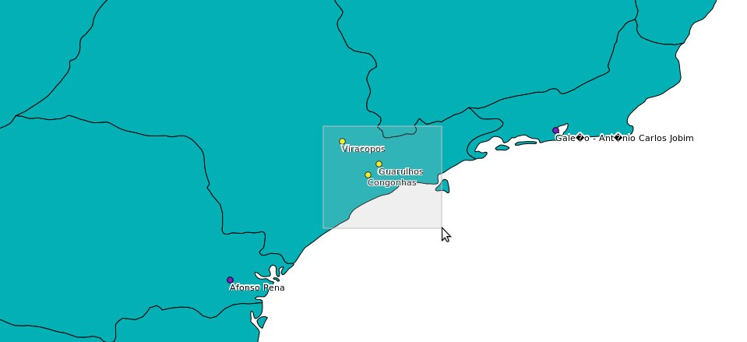
Busca por retângulos (bounding box)
SELECT nm_nome, geom
FROM aeroportos
WHERE geom && ST_MakeEnvelope(
-47.75, -22.39, -44.96, -24.87, 4326);
Notes:
curso=> SELECT nm_nome, geom FROM aeroportos WHERE geom && ST_MakeEnvelope(-47.75, -22.39, -44.96, -24.87, 4326);
nm_nome | geom
-----------+----------------------------------------------------
Guarulhos | 0101000020E6100000D06DA9E80A3C47C0219F9A8E046C37C0
Congonhas | 0101000020E6100000AD1AD189045447C0F597E9D348A037C0
Viracopos | 0101000020E6100000C2F3CD7B359147C01A49BC23C70137C0
(3 registros)

Slide 51

Os índices espaciais
Notes:
Indexes are what make using a spatial database for large data sets possible. Without indexing, any search for a feature would require a “sequential scan” of every record in the database. Indexing speeds up searching by organizing the data into a search tree which can be quickly traversed to find a particular record.

Slide 52
Exercícios
Criar banco de dados com suporte a GIS
Importar shapefile de municípios (IBGE)
Importar shapefile de mamíferos (IBAMA)
Importar dados do Censo 2010 (IBGE)
Responder as questões geoespaciais

Slide 53
Bibliografia
PostgreSQL
http://www.postgresql.org/
PostGIS
http://postgis.net/
Comunidade Planet PostGIS
http://planet.postgis.net/
Comunidade PostGIS US
http://www.postgis.us/

