Slide 1
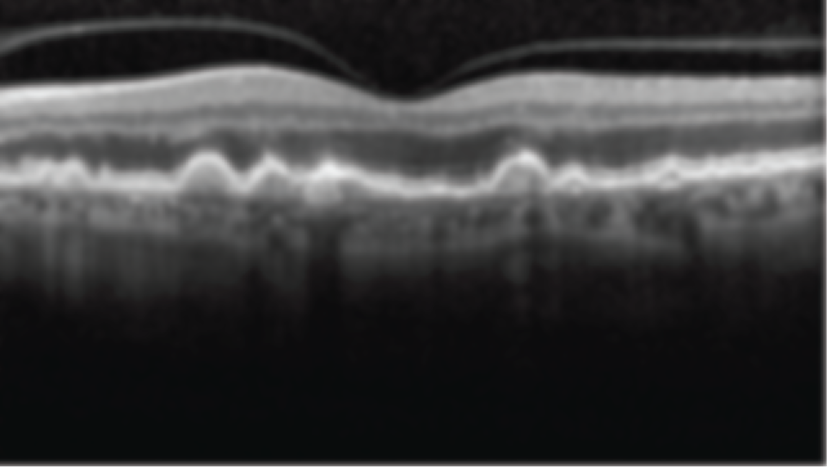
Estimating Uncertainty of Deep Neural Networks for Age-related Macular Degeneration Grading using Optical Coherence Tomography
ARVO 2020 | Online presentation
Coen de Vente¹; Mark van Grinsven²; Carlos Ciller³; Sandro De Zanet³; Agata Mosinska³; Raphael Sznitman⁴; Caroline Klaver⁵; Clara I. Sanchez¹
1. Diagnostic Image Analysis Group, Radboud University Medical Center, Nijmegen, Gelderland, Netherlands.
2. Thirona, Nijmegen, Netherlands.
3. RetinAI Medical AG, Bern, Switzerland.
4. ARTORG Center, University of Bern, Bern, Switzerland.
5. Ophthalmology, Erasmus University Medical Center, Rotterdam, Zuid-Holland, Netherlands.

Slide 2
Commercial Relationships Disclosure
Commercial Relationships Disclosure: Coen de Vente: Commercial Relationship: Code N (No Commercial Relationship)
Mark van Grinsven: Commercial Relationship(s); Thirona: Code E (Employment)
Carlos Ciller: Commercial Relationship(s); RetinAI Medical AG:Code E (Employment); Heidelberg Engineering:Code R (Recipient)
Sandro De Zanet: Commercial Relationship(s); RetinAI Medical AG:Code E (Employment)
Agata Mosinska: Commercial Relationship(s); RetinAI Medical AG:Code E (Employment)
Raphael Sznitman: Commercial Relationship(s); Haag-Streit AG:Code C (Consultant); medupdate:Code R (Recipient); RetinAi Medical: Code I (Personal Financial Interest); Bayer AG: Code R (Recipient)
Caroline Klaver: Commercial Relationship: Code N (No Commercial Relationship) | Clara Sanchez: Commercial Relationship: Code N (No Commercial Relationship)

Slide 3
Purpose
AI for eye disease screening and diagnosis works well in research labs.
Accompany decisions with certainty estimates.
Self-reported likelihood that decision is correct.
Especially necessary when:
Image is of bad quality;
Image is from different vendor, center, population than training data;
Image is ambiguous.

Slide 4
Purpose
AI for eye disease screening and diagnosis works well in research labs.
Accompany decisions with certainty estimates.
If provided, confidences are often overestimated (especially if better performing).
Need for well-calibrated uncertainty estimates.
This work: method for providing confidence scores of CNNs for AMD grading in OCT.

Slide 5
Methods

Slide 6
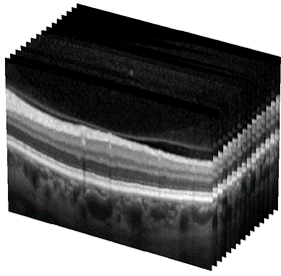

Dataset EUGENDA¹
1,264
OCT volumes
633
Patients
CIRCL
Grading
1
No AMD
2
Early AMD
3
Intermediate AMD
4
Advanced AMD: GA
5
Advanced AMD: CNV
¹ S. Fauser, D. Smailhodzic, A. Caramoy, J. P. van de Ven, B. Kirchhof, C. B. Hoyng, B. J. Klevering, S. Liakopoulos, and A. I. den Hollander, “Evaluation of serum lipid concentrations and genetic variants at high- density lipoprotein metabolism loci and TIMP3 in age-related macular degeneration,” Invest Ophthalmol Vis Sci, vol. 52, no. 8, pp. 5525–5528, 2011.

Slide 7
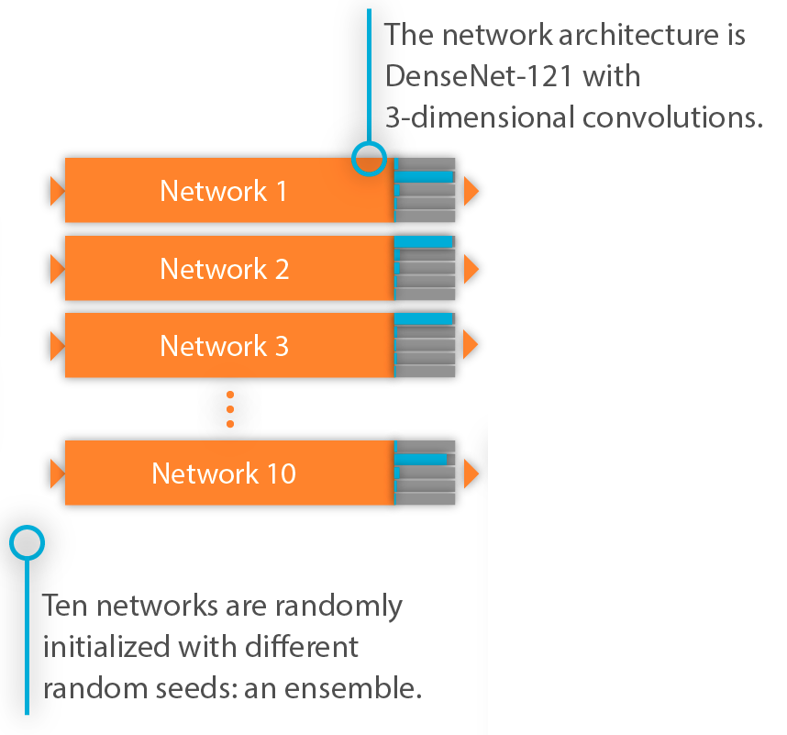
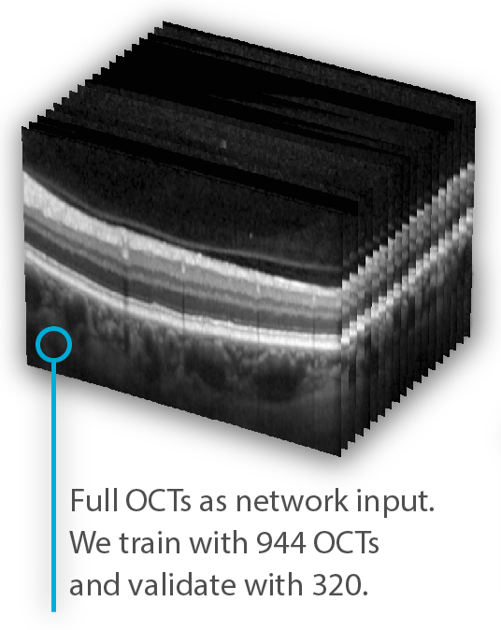
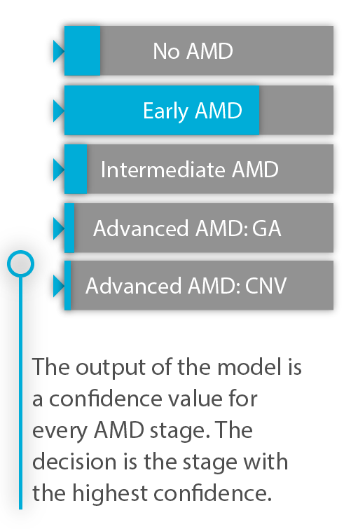
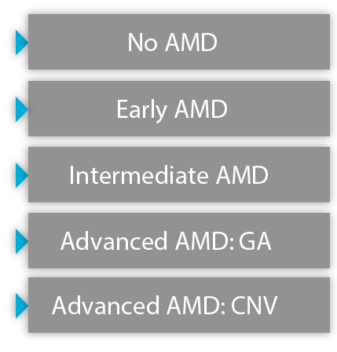
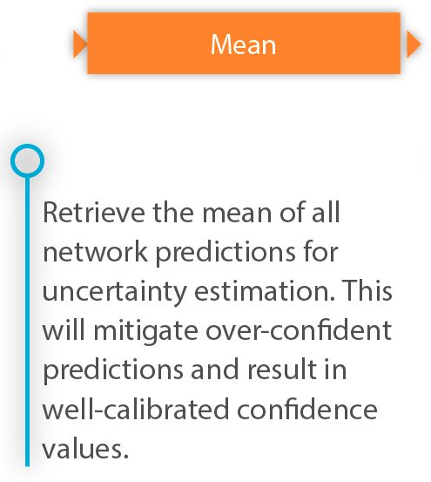
Estimating confidence

Slide 8
Results

Slide 9
Quantitative results
AUC
0.98
Weighted Cohen’s kappa
0.90
Mean uncertainty incorrect / correct baseline*
1.4
Mean uncertainty incorrect / correct our approach
1.9
* The baseline is the maximum softmax output of a single model

Slide 10
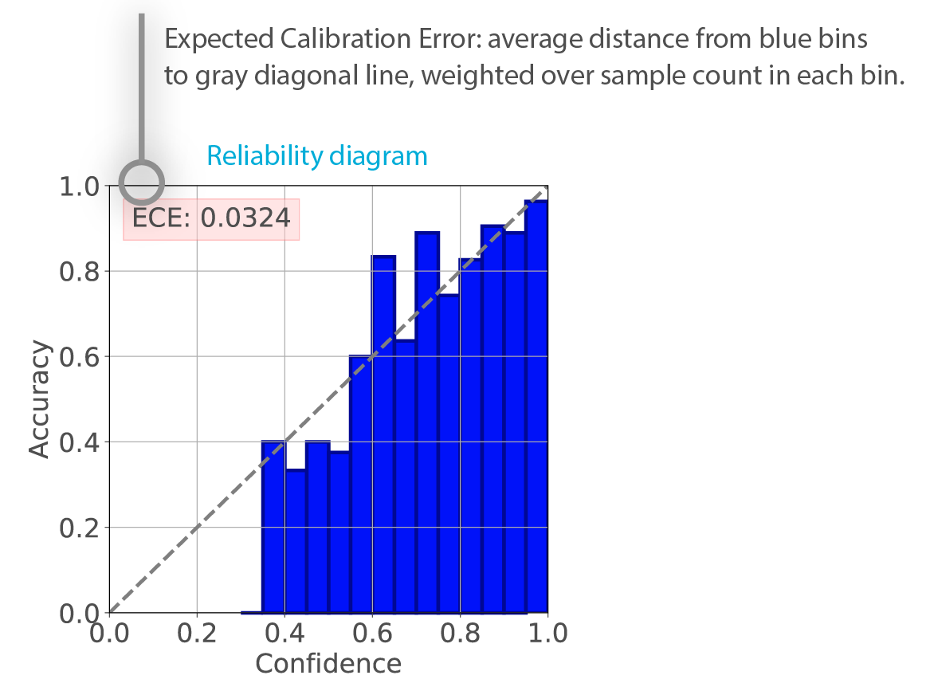
Quantitative results
ECE baseline
0.097
ECE our approach
0.032

Slide 11
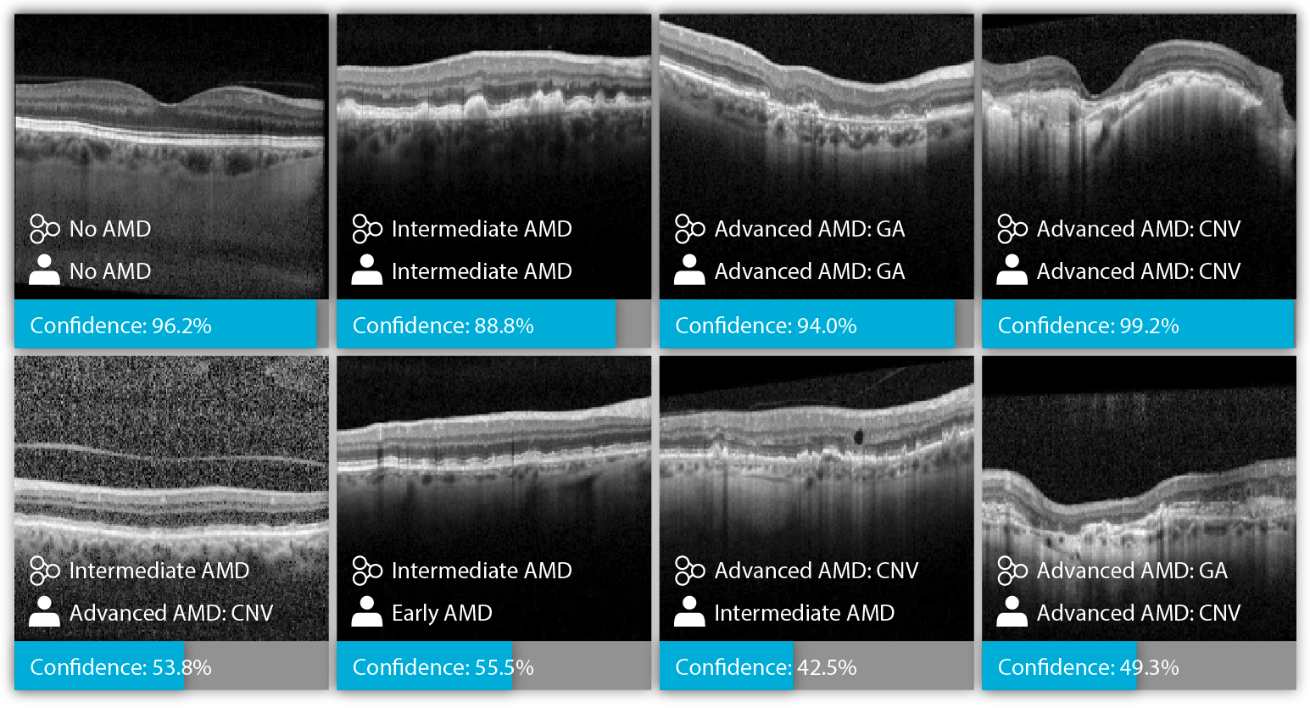
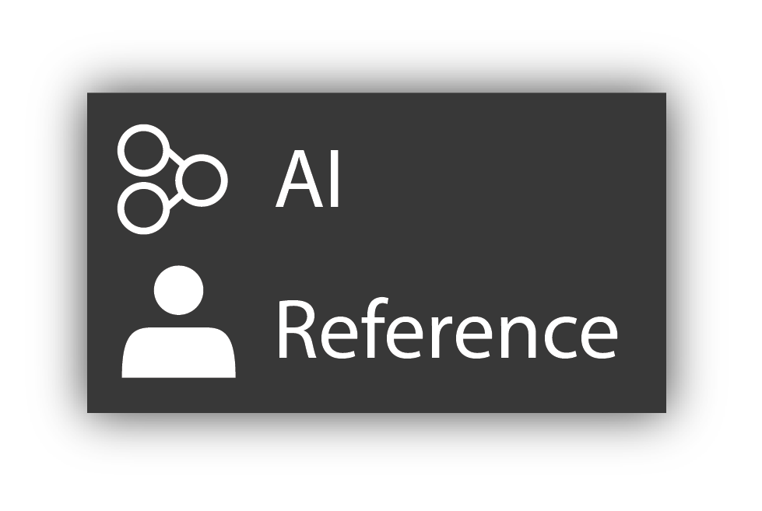
Examples
Notes:
Qualitative results of the proposed method. Each image is a single B-scan from the full OCT volume. However, the model has seen the full OCT volume to make the prediction. The prediction of the model, reference standard and the confidence of the model are shown below each image. Image a) to d) show correct and confident predictions for different AMD stages. The lower confidence in e) could be due to the high amount of noise in this image. The CNV in this OCT iamge is present in other, less noisy B-scans. In f) it is ambiguous whether the patient has intermediate or early AMD> The image in g) has no CNV, but could the model could have been confused by the small intraretinal cyst. In h) there is both GA and CNV. The correct label according to the grading protocol in this case, however, should be advanced AMD with CNV.

Slide 12
Conclusions

Slide 13
Conclusions
We present a method for improving uncertainty estimation for AMD grading in OCT, by combining the output of multiple individually trained CNNs.
This increased reliability of system confidences can contribute to building trust in CNNs for retinal disease screening.
This technique is a first step towards selective prediction in retinal disease screening, where only cases with high uncertainty predictions need to be referred for expert evaluation.

