Slide 1
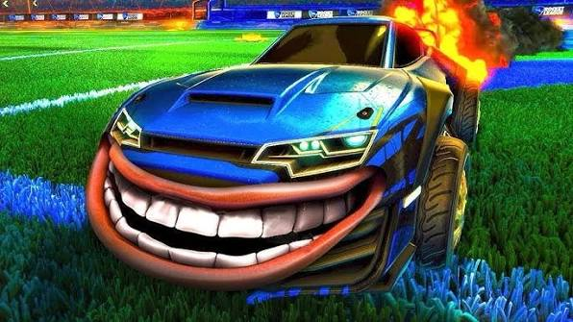
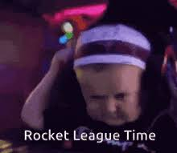
ROCKET LEAGUE PRESENTATION
WHAT A SAVE! WHAT A SAVE! WHAT A SAVE!

Slide 2
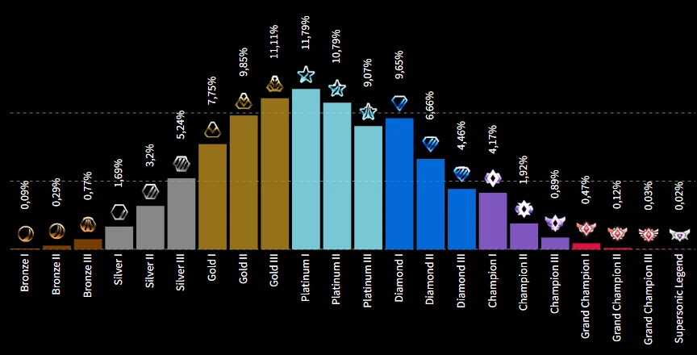
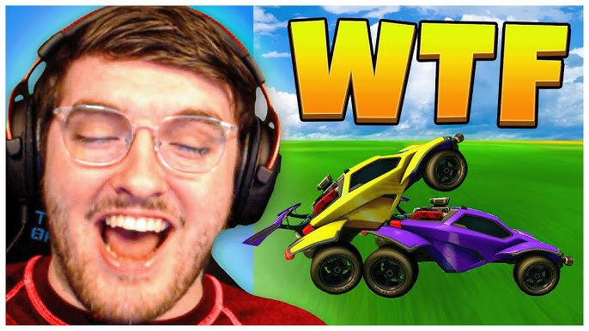
ROCKET LEAGUE RANKS
EXPLAINED
SSL / GC — Literal gods
Champion — Pretty decent humans
Diamond — Think they're good (they're not)
Platinum — "I should be higher"
Gold — Can hit the ball sometimes
Silver — Still learning boost exists
Bronze — BRYTON

Slide 3
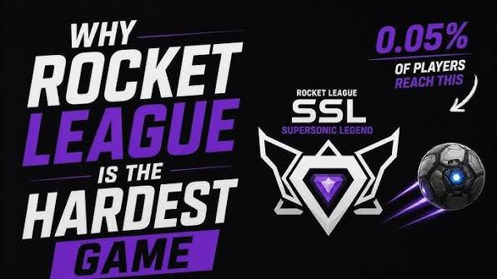
Rocket League is widely considered one of the hardest games to master because there are virtually no foundational skill transfers from other genres. It requires complete mastery of 3D spatial awareness, complex physics, and precise mechanical inputs on a controller to constantly track and predict a highly volatile ball. [1, 2, 3, 4, 5]
Community members on Reddit and across various Esports forums heavily debate its difficulty, which fundamentally stems from several key factors: [1]
No "Aimbot" or Auto-Aim: Unlike shooting games where aim assist or crosshairs help lock onto targets, you must precisely angle a moving car at supersonic speeds to hit a free-floating ball. [1, 2]
Infinite Skill Ceiling: The physics engine allows for nearly unlimited mechanical combinations, meaning players are constantly inventing new maneuvers that force the entire community to adapt and learn. [1, 2]
Unique Physics: There is no other mainstream game that functions similarly, so your hours playing other titles will not help you. [1, 2, 3]
No Passive Strategies: There are no safe camping spots or downtime; you are forced into constant, direct engagement with opponents while balancing team positioning and boost management. [1]

Slide 4
BRYTONS STATS
12
847
Goals Scored
Own Goals
(in 500 hours)
(and counting)
∞
2%
HOW MANY TIMES HES WHIFFED THE BALL
Aerial
Accuracy
(generous)

Slide 5
QUICK CHAT TRANSLATIONS
What he types vs. what he means
WHAT HE TYPES
WHAT HE MEANS
What a save!
Your so bad and missed the save
Okay.
I am uninstalling this game
No problem.
There is a HUGE problem
Calculated.
That was 100% luck
Close one!
We almost scored on ourselves again
I got it!
I absolutely do not got it

Slide 6
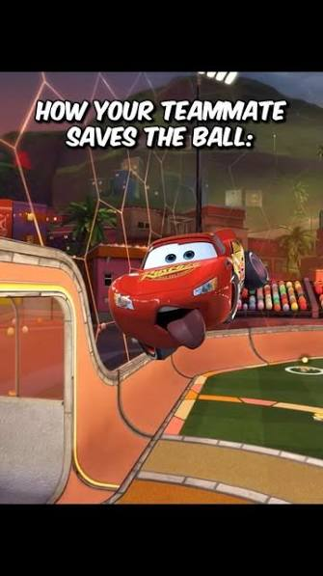
THE 5 STAGES OF PLAYING
1
DENIAL
"I'll get better,"
2
ANGER
"WHY ARE YOU HITTING IT TOWARDS OUR GOAL"
3
4
DEPRESSION
3-game losing streak. Silence in voice chat.
5
ACCEPTANCE
"He's getting married. At least that's one W."

Slide 7
HIS GAMEPLAY SUMMARIZED
🚗💨
BALL: →
HIM: ←
"I need boost"
He did not need boost.

Slide 8
OFFICIAL SCOUTING REPORT
Speed
85%
Accuracy
8%
Ball Chasing
99%
Rotation
5%
Toxicity
92%
Blaming Teammates
97%
Actual Skill
3%
Heart & Passion
100%

Slide 9
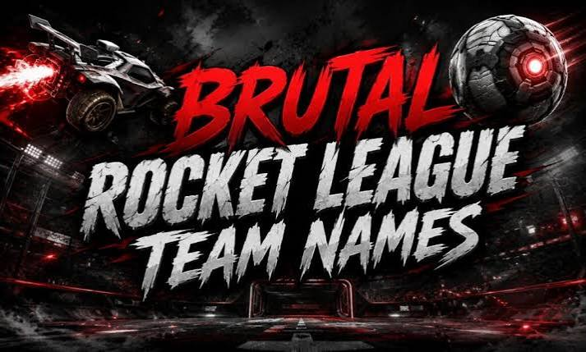
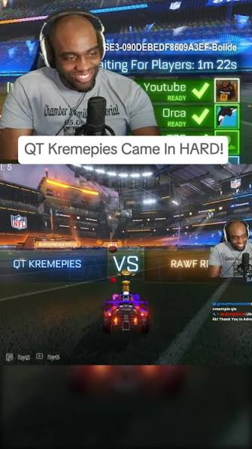
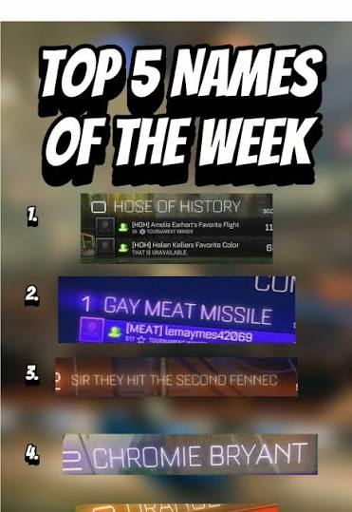
CONGRATS
!
Chat disabled for 3 seconds.

