Slide 1
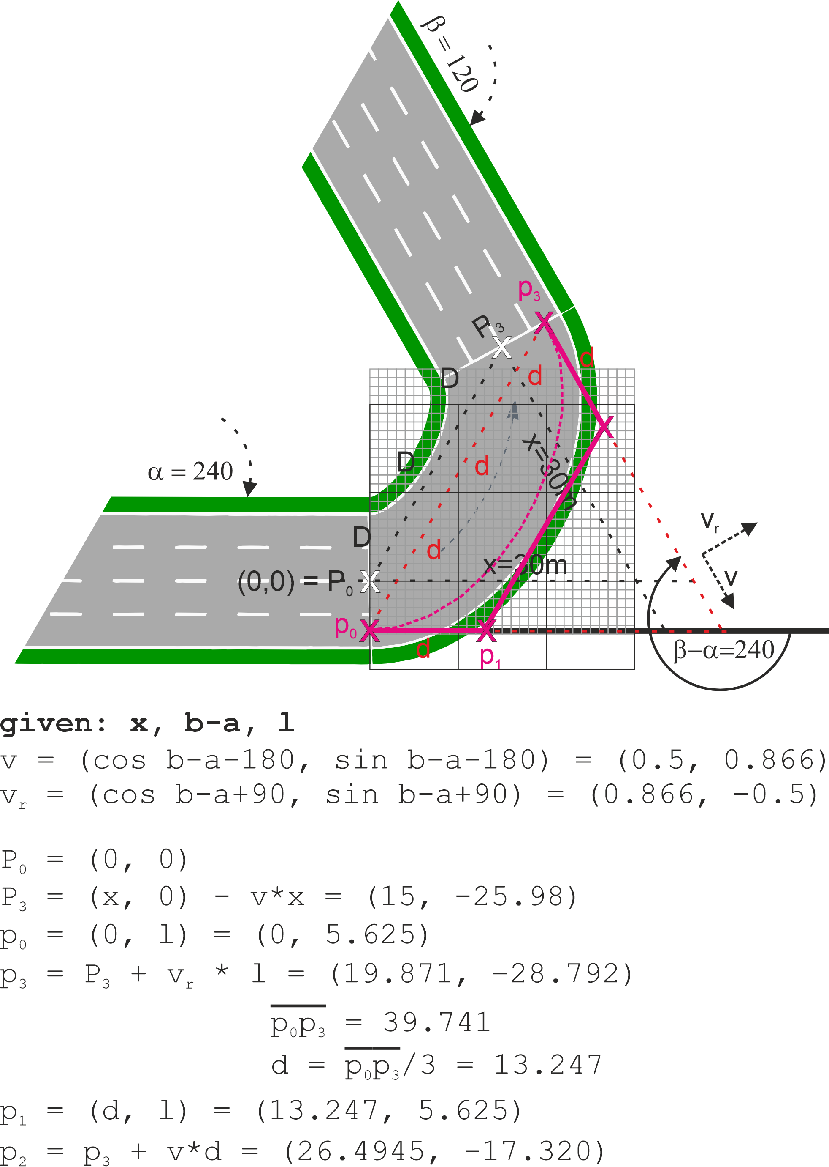
For UCD
0
b3 < 0+EPS +δ
δ
b23 >= 0+EPS +δ && < 4-EPS +δ
4-EPS
4
b2 >= 4-EPS +δ && < 4+EPS +δ
4+EPS
b12 >= 4+EPS +δ && < 8-EPS +δ
8
b1 >= 8-EPS +δ && < 8+EPS +δ
b01 >= 8+EPS +δ && < 12-EPS +δ
12
b0 >= 12-EPS +δ

Slide 2
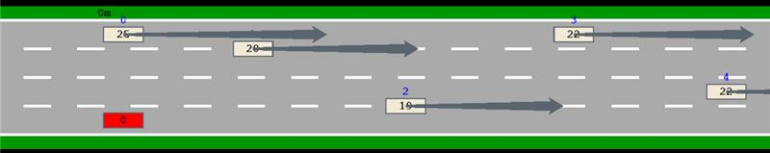
For ego-less driving/MC planning
!blamable_crash | cnt > 10
MC
MC
MC
MC

Slide 3
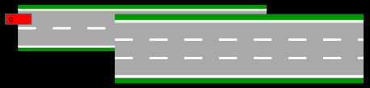


Slide 4
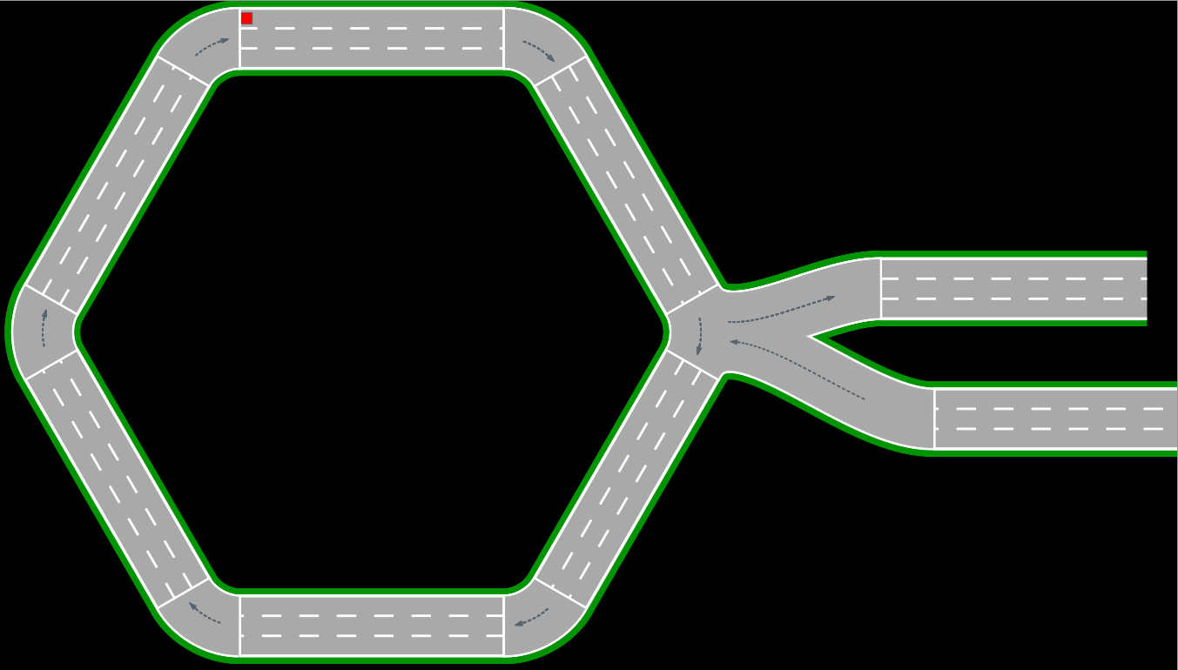

Slide 5
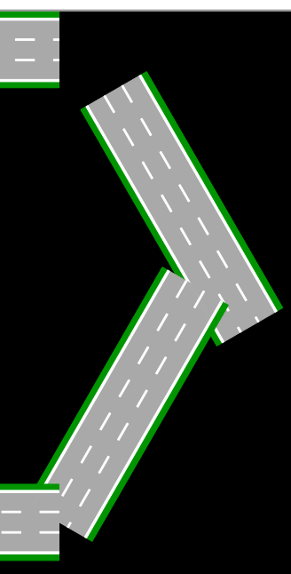
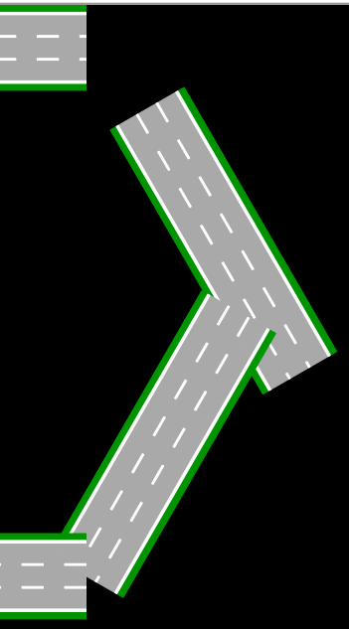
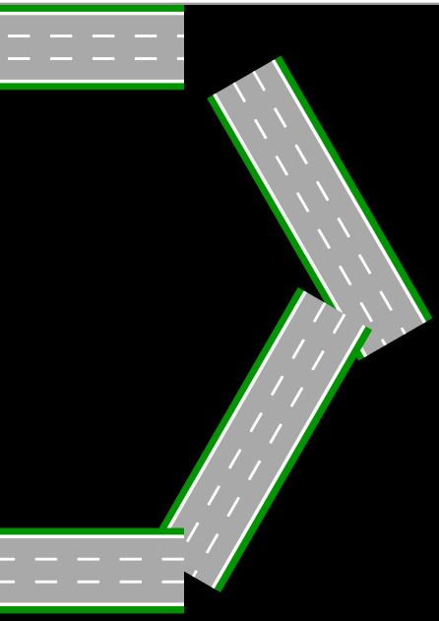
10/10
10/7.5
10/5

Slide 6
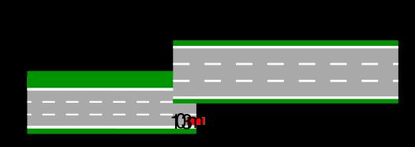
1/1
4 lanes
3/3
1/1
3 lanes
4/3

Slide 7


Slide 8
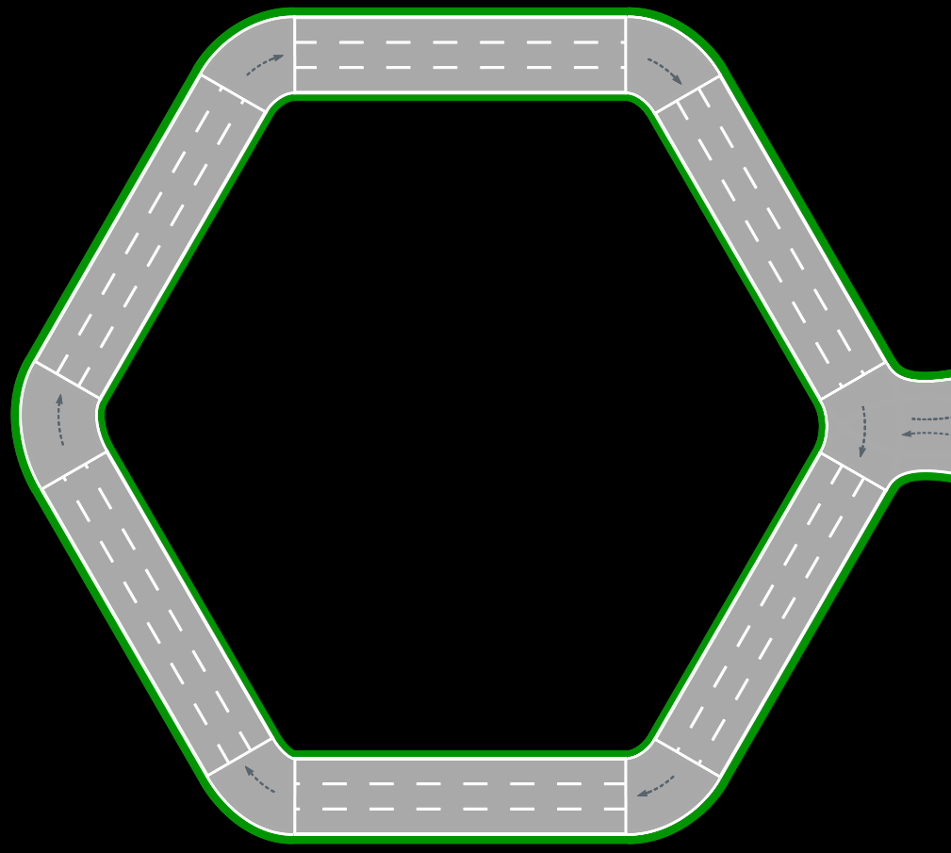
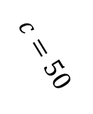
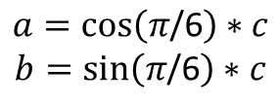













$$\left(\begin{aligned}0 \\ 0\end{aligned}\right)$$
$$\left(\begin{aligned}50 \\ 0\end{aligned}\right)$$
$$\left(\begin{aligned}x \\ y\end{aligned}\right)$$
=$\left(\begin{aligned}50 \\ 0\end{aligned}\right)$
$π$/3
$π$/6
50
$$a$$
$$c=50$$
$$\left(\begin{aligned}x+\cos\left(π\text{/6}\right)∗50 \\ y+sin\left(π\text{/6}\right)∗50\end{aligned}\right)$$
=$\left(\begin{aligned}75 \\ 43.3\end{aligned}\right)$
$$\sin\left(π\text{/6}\right)=\frac{b}{c}$$
$$\cos\left(π\text{/6}\right)=\frac{a}{c}$$
$$b$$
$$a=\cos\left(π\text{/6}\right)∗c$$
$$b=\sin\left(π\text{/6}\right)∗c$$
=$\left(\begin{aligned}50 \\ 86.6\end{aligned}\right)$

Slide 9


EGO
$$\left(\begin{aligned}x \\ y\end{aligned}\right)$$
$$\left(\begin{aligned}x′ \\ y′\end{aligned}\right)$$

Slide 11
?
EGO

Slide 13
👍

Slide 14
X m
X m
X m
X m

Slide 19
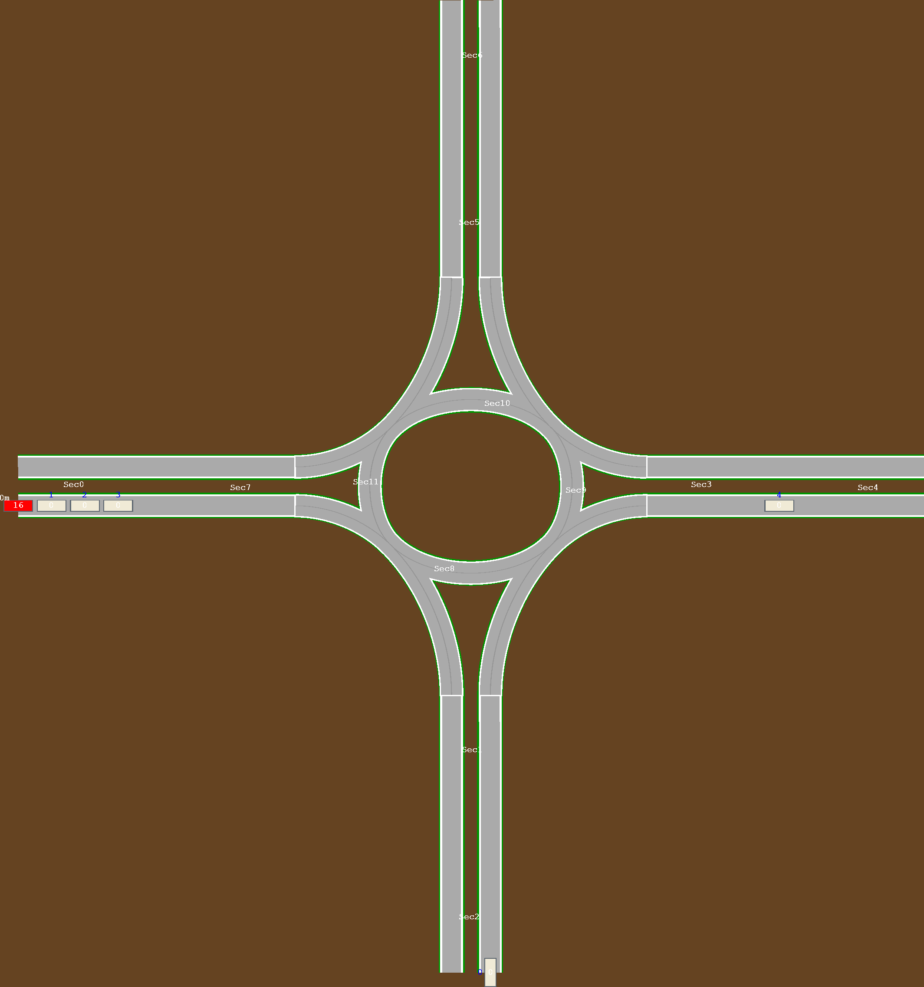
zero-length sections

