Slide 1
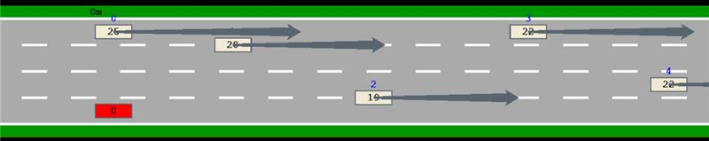
!blamable_crash | cnt > 10
MC
MC
MC
MC

Slide 2
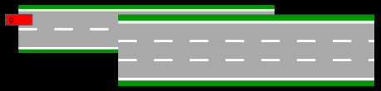


Slide 3
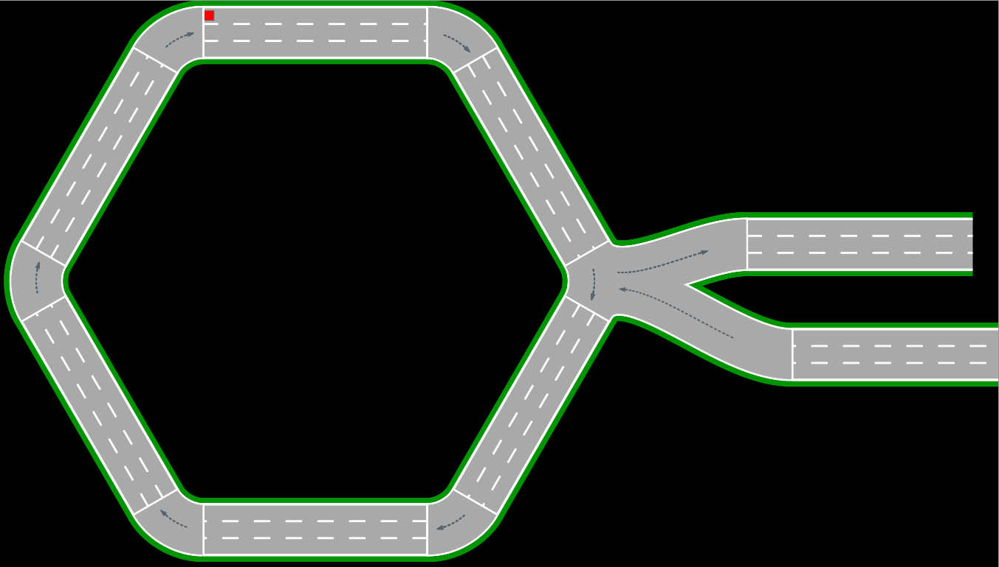

Slide 4
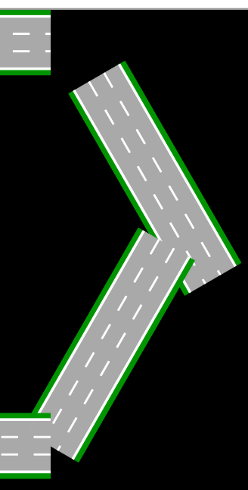
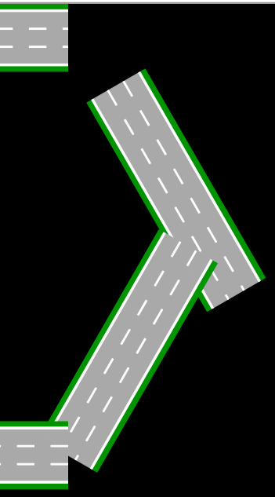
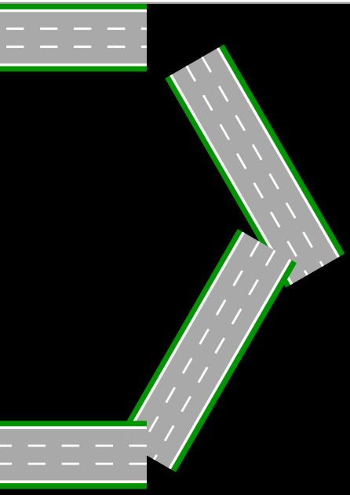
10/10
10/7.5
10/5

Slide 5
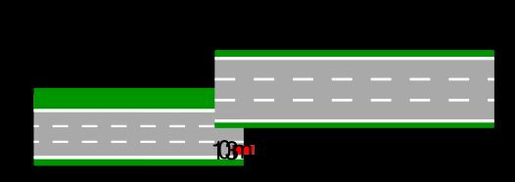
1/1
4 lanes
3/3
1/1
3 lanes
4/3

Slide 6


Slide 7
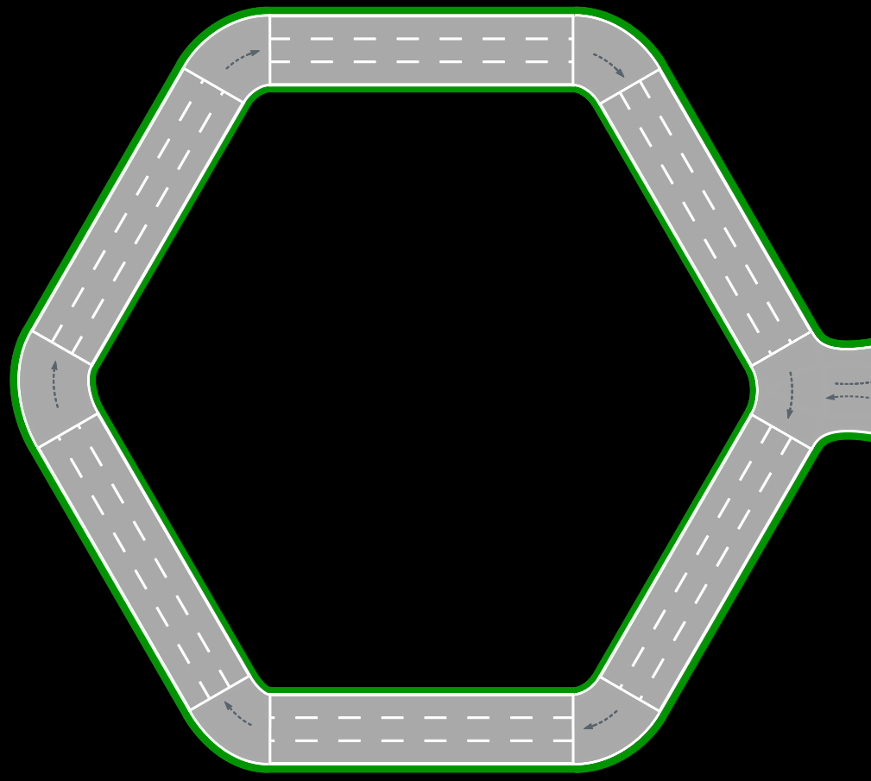
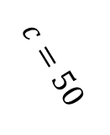
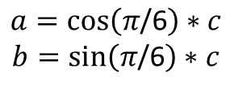













$$\left(\begin{aligned}0 \\ 0\end{aligned}\right)$$
$$\left(\begin{aligned}50 \\ 0\end{aligned}\right)$$
$$\left(\begin{aligned}x \\ y\end{aligned}\right)$$
=$\left(\begin{aligned}50 \\ 0\end{aligned}\right)$
$π$/3
$π$/6
50
$$a$$
$$c=50$$
$$\left(\begin{aligned}x+\cos\left(π\text{/6}\right)∗50 \\ y+sin\left(π\text{/6}\right)∗50\end{aligned}\right)$$
=$\left(\begin{aligned}75 \\ 43.3\end{aligned}\right)$
$$\sin\left(π\text{/6}\right)=\frac{b}{c}$$
$$\cos\left(π\text{/6}\right)=\frac{a}{c}$$
$$b$$
$$a=\cos\left(π\text{/6}\right)∗c$$
$$b=\sin\left(π\text{/6}\right)∗c$$
=$\left(\begin{aligned}50 \\ 86.6\end{aligned}\right)$

Slide 8


EGO
$$\left(\begin{aligned}x \\ y\end{aligned}\right)$$
$$\left(\begin{aligned}x′ \\ y′\end{aligned}\right)$$

Slide 10
?
EGO

Slide 12
👍

Slide 13
X m
X m
X m
X m

Slide 16
