Slide 1


DFIR Fundamentals
Zach Dayton,
DFIR Consultant

Slide 2


Digital Forensics & Incident Response (DFIR)
DFIR Introduction
Incident Response Process
Data Collection
Important Artifacts
Memory Analysis
MFT
Shellbags
EVTX
Prefetch
Business Considerations
Using Bash for Log Analysis

Slide 3
DFIR Industry
Ransomware and Ransomware As A Service growing exponentially, prices rising.
PYSA, Avaddon, Maze, Sodinokibi/REvil, etc.
Not just IR:
E-Discovery
Criminal/Civil Litigation
System Administration
Data Recovery
Negotiation/Soft skills
Tons of high-paying jobs! But very steep learning curve, significant technical skills required.
Growing market for “Purple” engagements, tabletops.

Slide 4
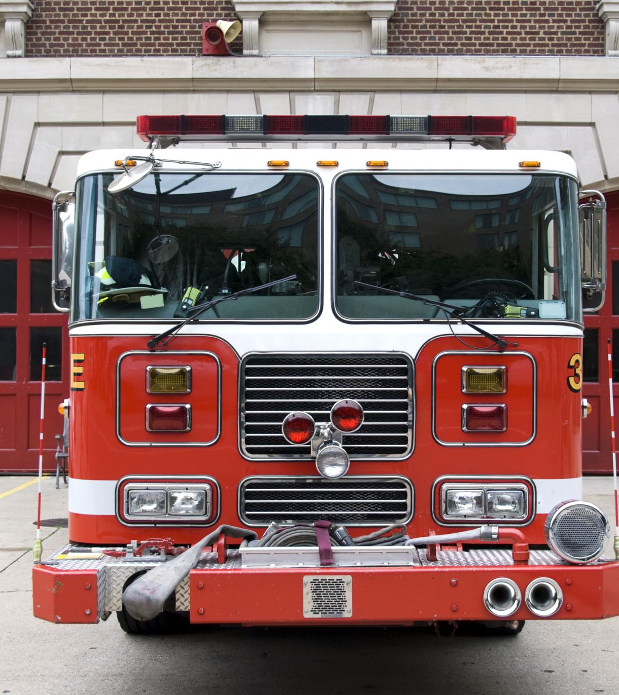
Incident Response Process
NIST/SANS 4/6 Steps of Incident Response
Preparation
Detection and Analysis/Identification
Containment, Eradication, & Recovery
Post-Incident Activity/Lessons Learned

Slide 5
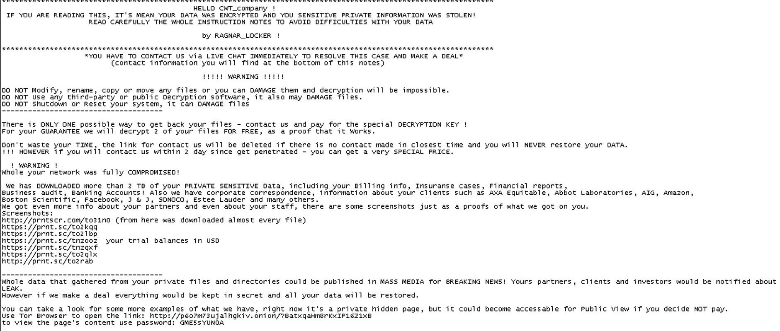

Slide 6
Data Collection
Order of Volatility
Physical (photograph, physical devices)
Memory (Hypervisor, then VM)
F-Response, Dumpit, Winpmem, FTK Imager, etc.
Triage (Notable Artifacts)
MFT, EVTX, Prefetch, Link Files, Shellbags, User directories, Jump list, etc.
Excel, Axiom/FTK, and Eric Zimmerman’s tools
Disk Image
FTK, EnCase, Axiom, etc.

Slide 7
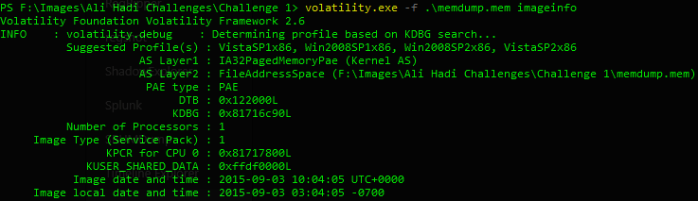
Artifacts: Memory
Capture with a tool like FTK, F-Response, etc.
Analyze with Volatility (Read The Art of Memory Forensics)
May contain tons of information
Don’t always collect (not always necessary)
Can’t always collect (easily overwritten)
Can extract command line history, open connections, pull entire files out, etc.

Slide 8
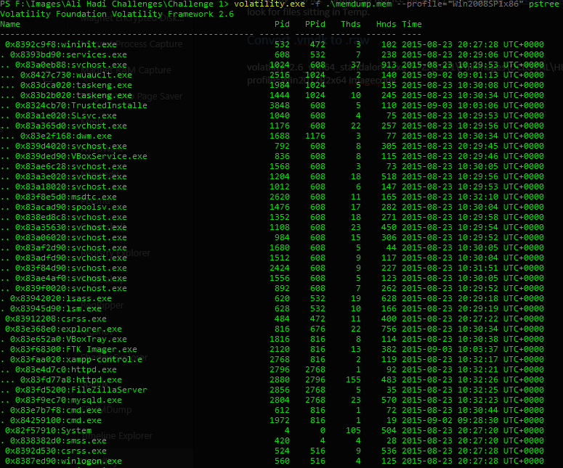
Volatility
Volatility.exe –h (show options and supported plugins)
Volatility.exe –f memdmp.mem imageinfo
Pull OS profile, use this for the rest of the plugins.
May need kdbginfo for further detail.
Volatility.exe –f memdmp.mem –profile=“Win2008SP1x86” pstree
See what processes are present, including the PPIDs.

Slide 9
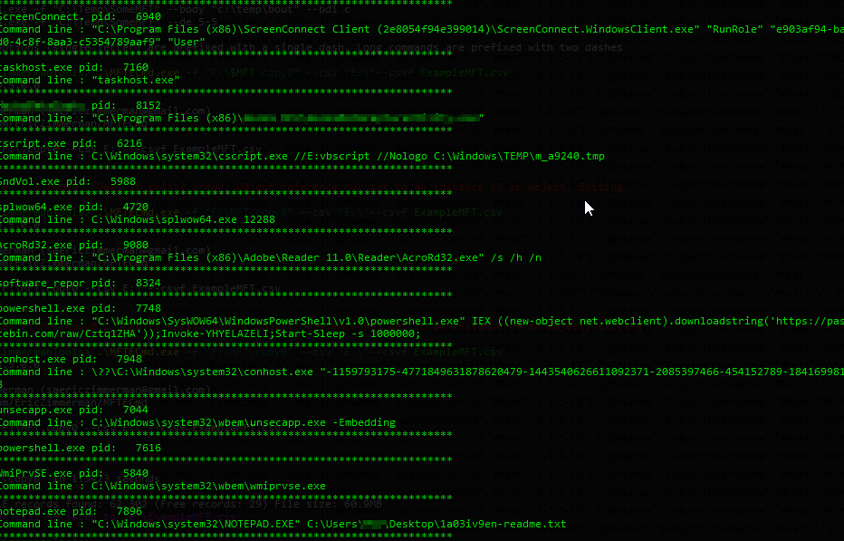

Volatility Pt. 2
volatility.exe -f .\memdump.mem --profile="Win7SP1x64" cmdline
Look at command line input.

Slide 10
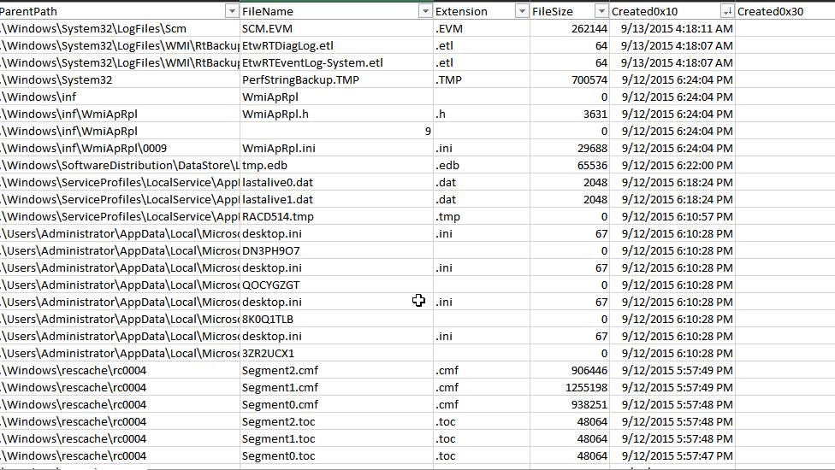
Artifacts: $MFT (Master File Table)
Only on NTFS drives.
Analyze with AnalyzeMFT, Excel, etc.
Compare MACB Timestamps
Modified
Accessed
Metadata Changed
Birth
Uncover evidence that a file once existed
Archives
Malware
Tools

Slide 11
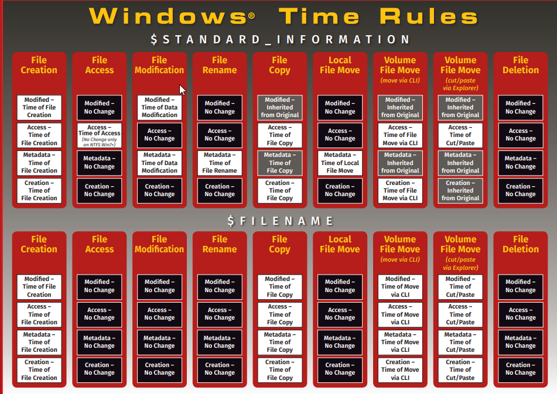

Slide 12
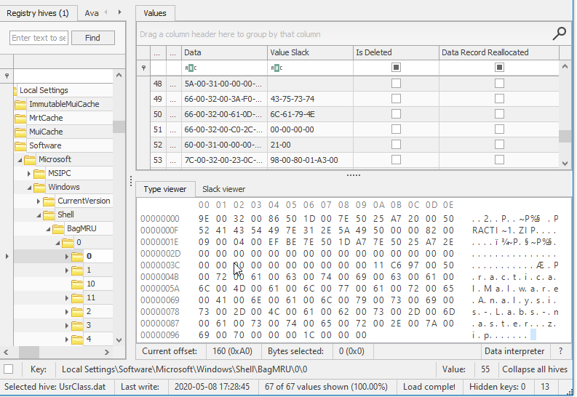
Artifacts: Shellbags
Used for evidence of Program Execution and File Use & Knowledge (FU&K)
Shows how a window looked when last used (location, size, etc.)
Use ShellBags Explorer (Eric Zimmerman Tool)

Slide 13
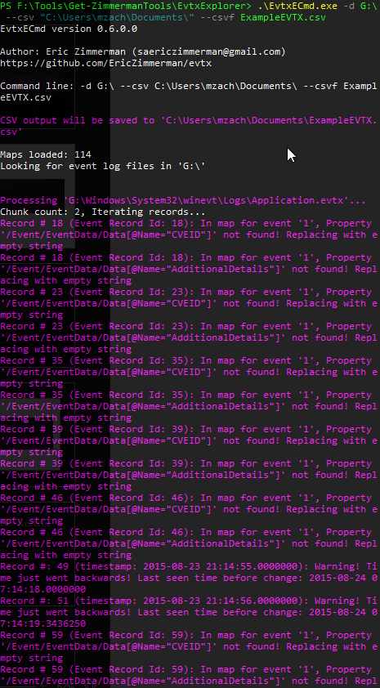
Windows .evtx Logs
Extract with EvtxExplorer:
.\EvtxECmd.exe -d G:\ --csv "C:\Users\mzach\Documents\" --csvf ExampleEVTX.csv
Review with Excel, Windows Event Viewer, or Timeline Explorer
Depending on what you’re looking for:
Login: 4624 (type 3, 10), 4625, 4672, 21, 25, 1149, etc.
Processes: 4688 (what ran, path, etc.)
CLI/Scripts: 4103, 4104, etc.

Slide 14
EVTX Examples
Successful Logons
Scheduled Tasks
Service Stopped/Started/Crashed
Logon with alternate credentials

Slide 15
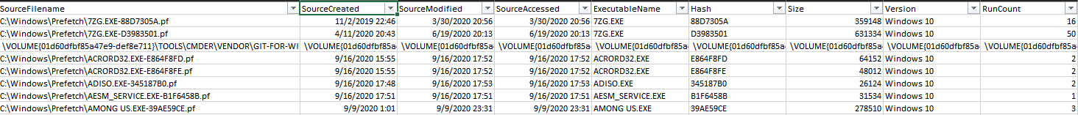
Artifacts: Prefetch
For staging data that is accessed, makes Windows feel faster.
C:\Windows\Prefetch\
Shows when a file was run, as well as a run count
Filename contains hash of path where file was executed.

Slide 16
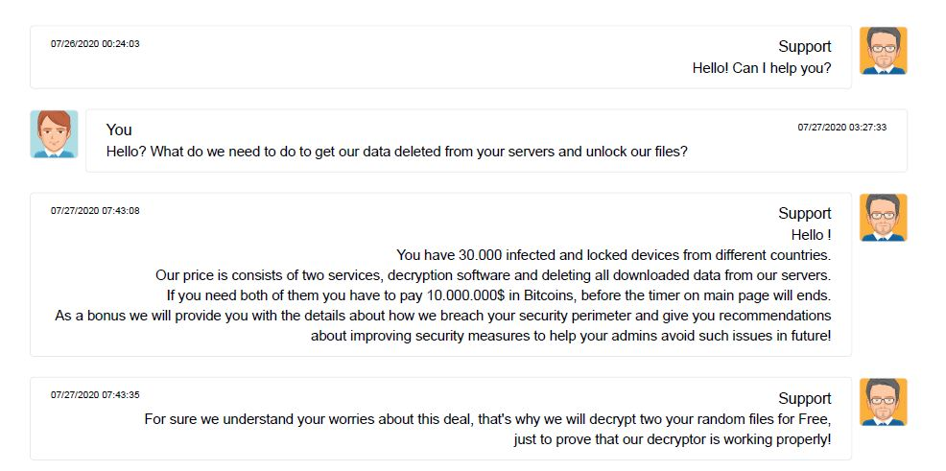
Full Thread - https://twitter.com/jc_stubbs/status/1289199296328298497

Slide 17

Business Considerations
CSIRT Team: HR, PR, Counsel, IT, Security resources, documentation, practice
Increasing costs: $8 Billion 2018, $20 Billion 2020, average demand of $133,000.
Increasing prevalence: Estimated one ransomware attack every 14 seconds.
Costs go beyond ransom demand:
Lost data/data recovery costs
Brand recognition/damage
Government fines
Getting back to business VS. a thorough investigation.
Must be conscious of communications with counsel, employees, the public, investors, and the threat actor.

Slide 18
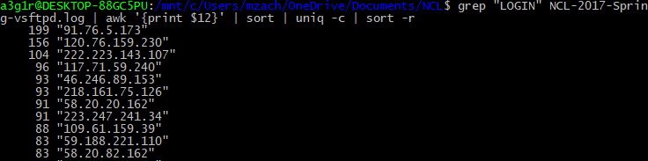
Bash Log Analysis
Grep
Grep “LOGIN” file.txt
Awk
Awk ‘ { print $12 } ‘
Sort | uniq
Sort | uniq –c
Find
find /location -name *.log -exec cat -n {} \;

