Slide 1


Kali Linux tools
A practical guide for approved labs
┌──(kali@kali)-[~]
└─$ sudo apt install kali-linux-default
Notes:
Sources: https://www.kali.org/docs/general-use/metapackages/ ; https://www.kali.org/tools/ .

Slide 2
Use this information responsibly
[!]
Everything in this talk is for education and authorized security work.
[!]
Test only systems and data you own or have written permission to assess.
[!]
Unauthorized access is illegal under the CFAA and similar laws.
Notes:
Read this slide before any tool content. Sources: https://www.kali.org/docs/general-use/metapackages/ ; https://www.kali.org/tools/ .

Slide 3
How Kali organizes its tools
Kali groups its tools into 13 metapackages, plus a menu group for system services. Each section covers two tools.
01
Information Gathering
08
Exploitation Tools
kali-tools-information-gathering
kali-tools-exploitation
02
Vulnerability Analysis
09
Social Engineering Tools
kali-tools-vulnerability
kali-tools-social-engineering
03
Web Application Analysis
10
Sniffing and Spoofing
kali-tools-web
kali-tools-sniffing-spoofing
04
Database Assessment
11
Post Exploitation
kali-tools-database
kali-tools-post-exploitation
05
Password Attacks
12
Forensics
kali-tools-passwords
kali-tools-forensics
06
Wireless Attacks
13
Reporting Tools
kali-tools-wireless
kali-tools-reporting
07
Reverse Engineering
14
System Services
kali-tools-reverse-engineering
Kali menu group
Notes:
Sources: https://www.kali.org/docs/general-use/metapackages/ ; https://www.kali.org/tools/ . The current graphical menu follows a newer ATT&CK-oriented taxonomy.

Slide 4
The Kali top 10
kali-tools-top10
01
aircrack-ng
06
NetExec
Wireless Attacks
Post Exploitation
02
Burp Suite
07
Nmap
Web Application Analysis
Information Gathering
03
Hydra
08
Responder
Password Attacks
Sniffing and Spoofing
04
John the Ripper
09
sqlmap
Password Attacks
Database Assessment
05
Metasploit Framework
10
Wireshark
Exploitation Tools
Sniffing and Spoofing
Notes:
Source: https://www.kali.org/tools/kali-meta/ . Top ten metapackage dependency list.

Slide 5
kali-tools-information-gathering
01
Information Gathering
Map assets you own
Notes:
Sources: https://www.kali.org/docs/general-use/metapackages/ ; https://www.kali.org/tools/ .

Slide 6
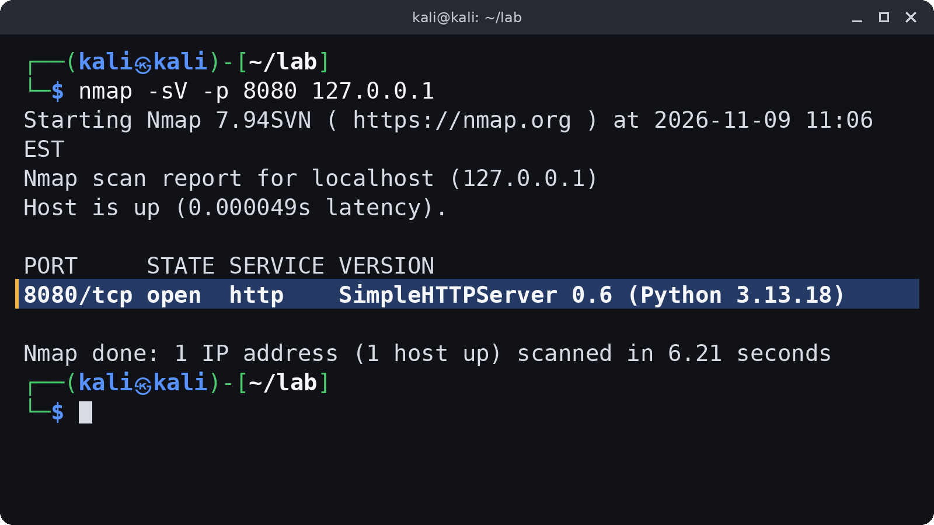
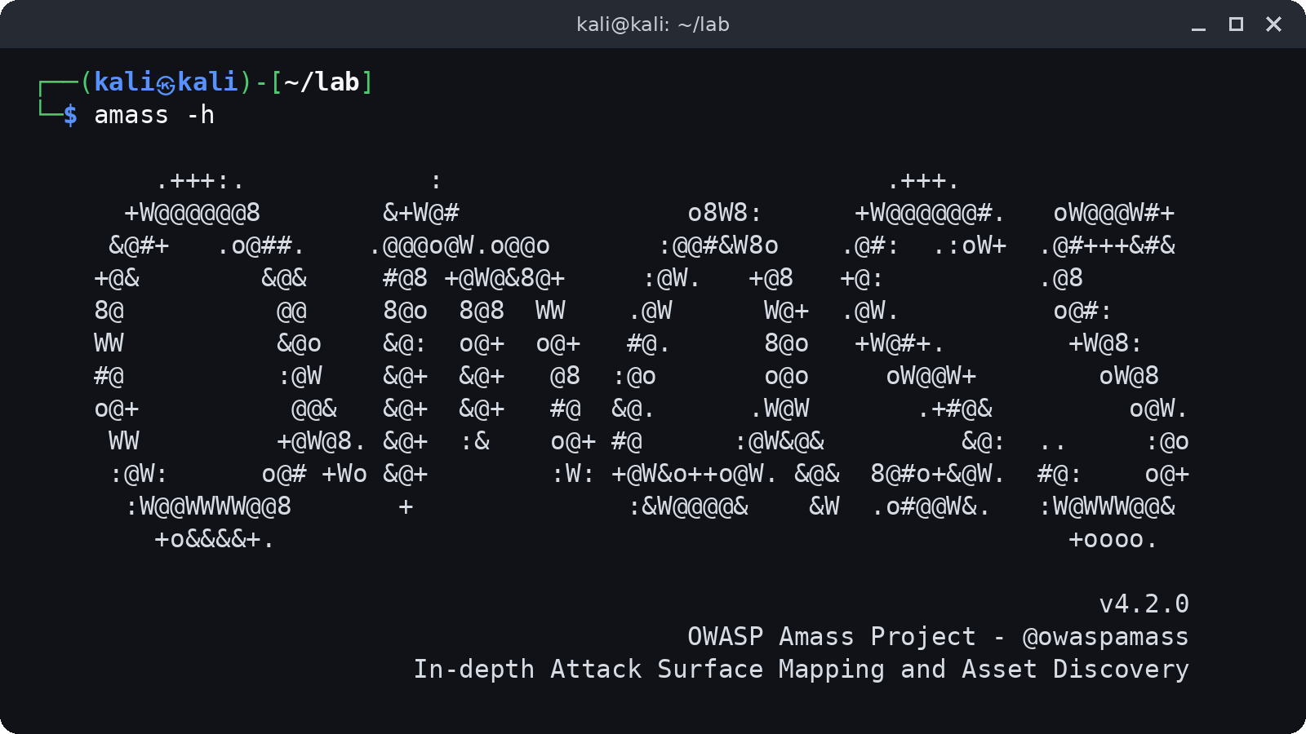
01 / kali-tools-information-gathering
Information Gathering
nmap
amass
Host and service inventory
Domain asset discovery
$ amass enum -passive -d example.org
Notes:
Sources: https://www.kali.org/docs/general-use/metapackages/ ; https://www.kali.org/tools/ . Images: nmap output captured in a local lab. amass help output captured locally.

Slide 7
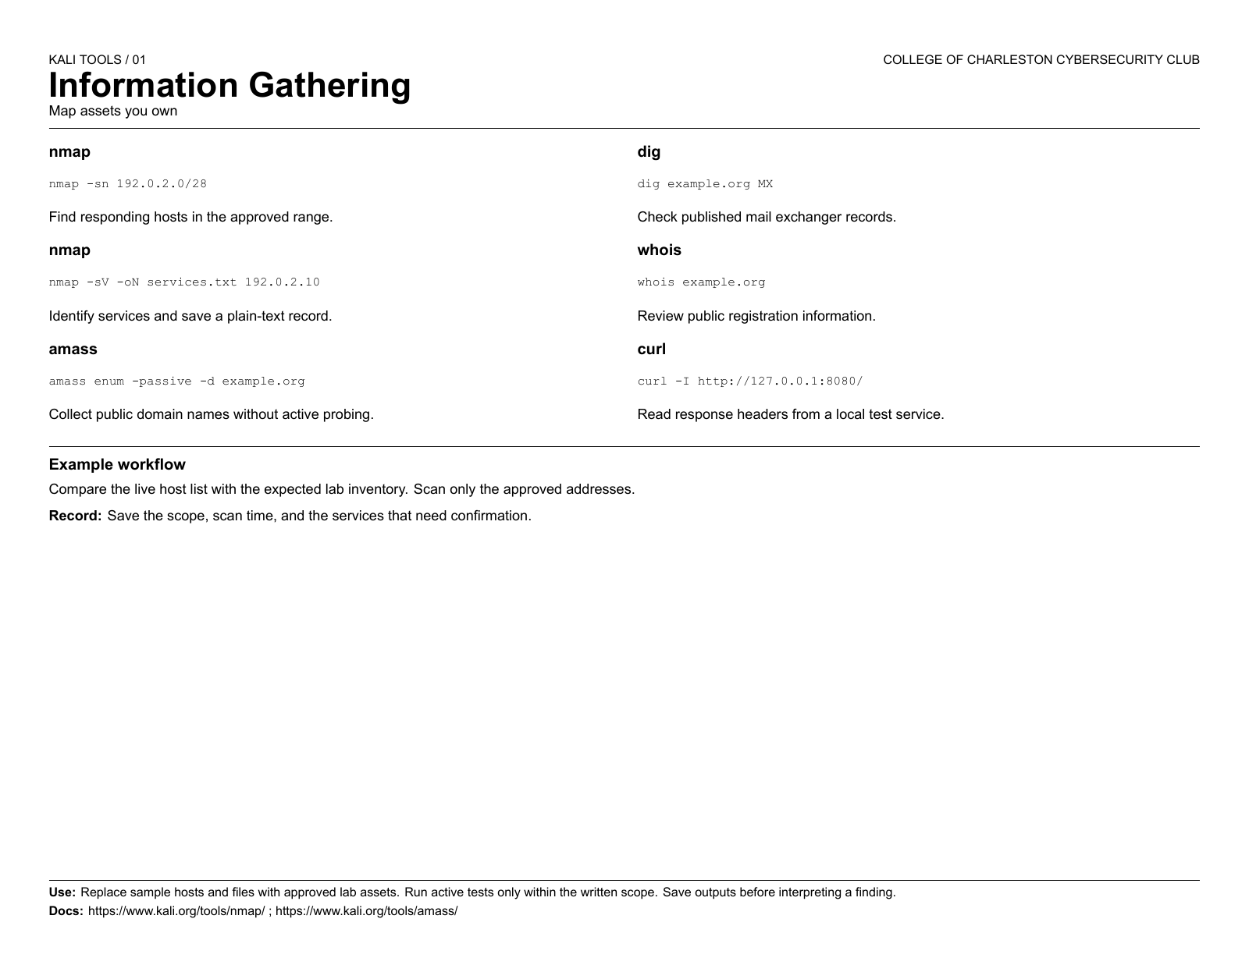

Slide 8
kali-tools-vulnerability
02
Vulnerability Analysis
Check configuration and exposures
Notes:
Sources: https://www.kali.org/docs/general-use/metapackages/ ; https://www.kali.org/tools/ .

Slide 9
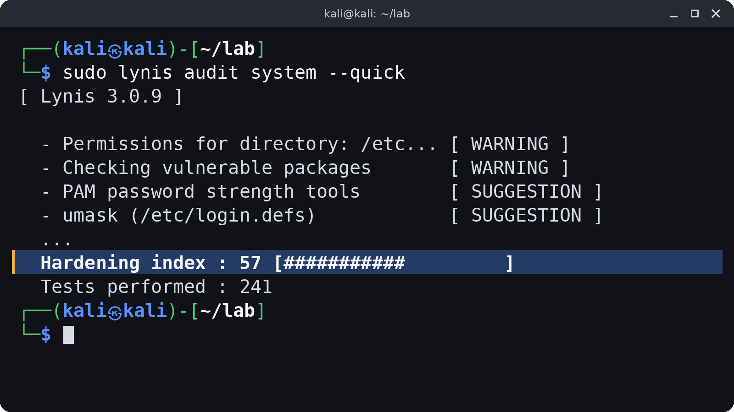
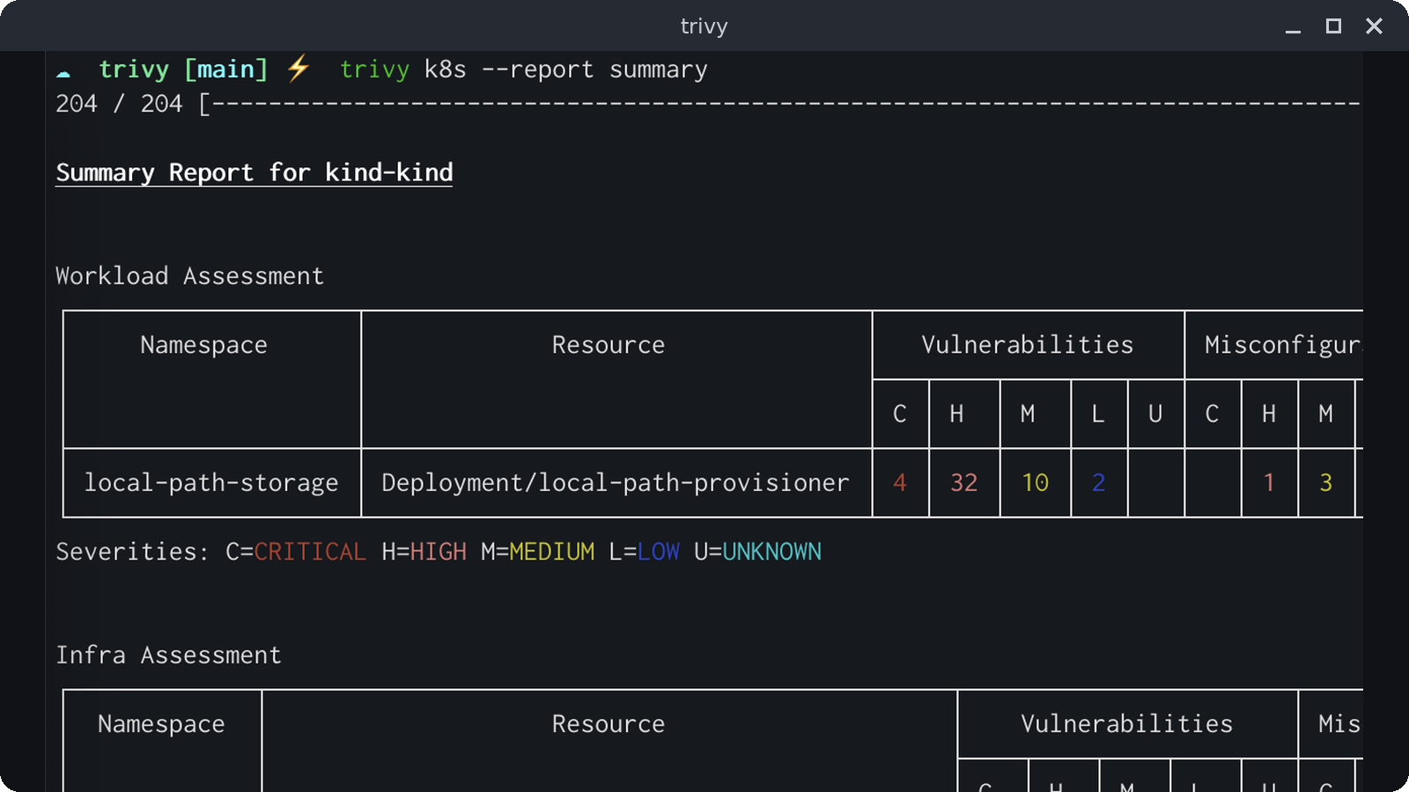
02 / kali-tools-vulnerability
Vulnerability Analysis
Lynis
Trivy
Local host audit
Image and filesystem scanning
$ trivy fs ./lab-project
Notes:
Sources: https://www.kali.org/docs/general-use/metapackages/ ; https://www.kali.org/tools/ . Images: Lynis output captured in a local lab (excerpt). Trivy screenshot from the aquasecurity/trivy README.

Slide 10
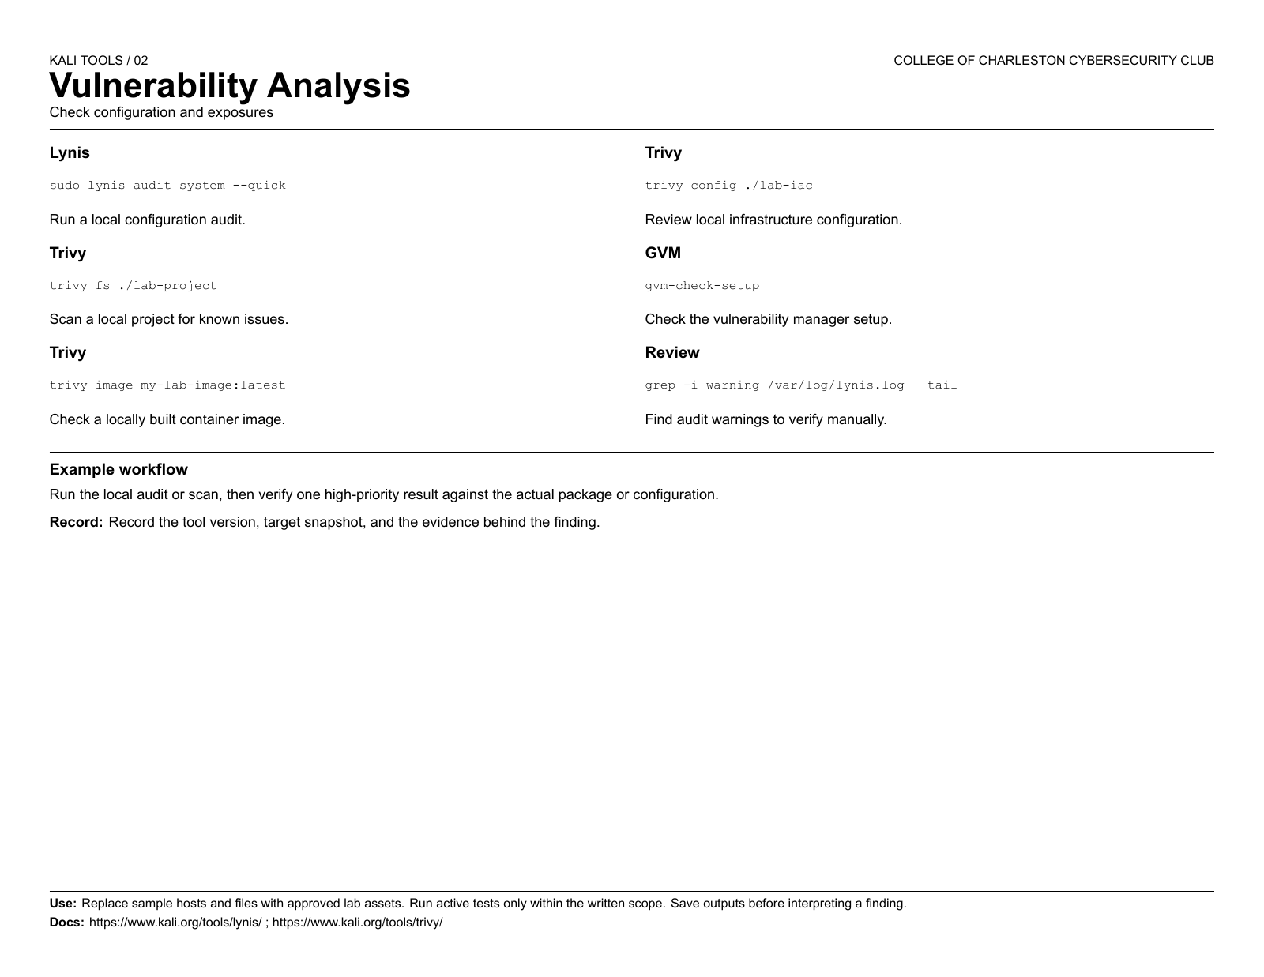

Slide 11
kali-tools-web
03
Web Application Analysis
Inspect an owned web app
Notes:
Sources: https://www.kali.org/docs/general-use/metapackages/ ; https://www.kali.org/tools/ .

Slide 12
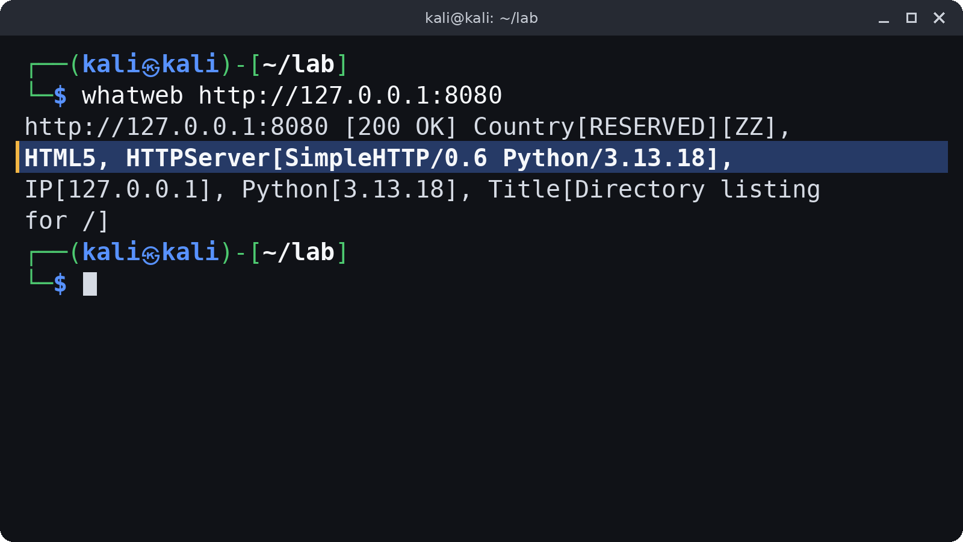
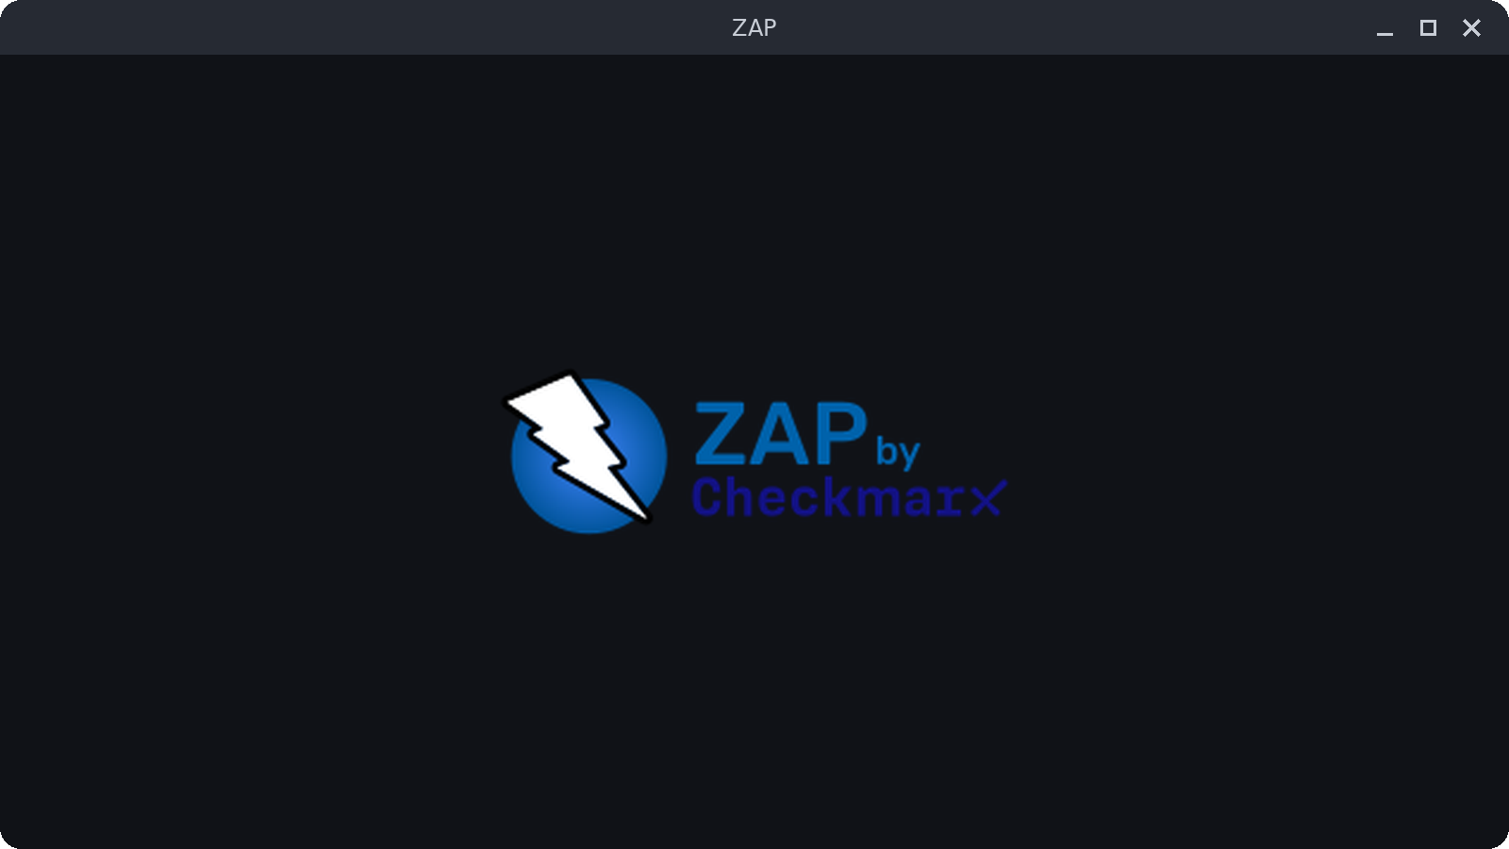
03 / kali-tools-web
Web Application Analysis
WhatWeb
OWASP ZAP
Identify web technologies
Proxy and review web traffic
Open the GUI against a local lab app
Also know: Burp Suite
Notes:
Sources: https://www.kali.org/docs/general-use/metapackages/ ; https://www.kali.org/tools/ . Images: WhatWeb output captured in a local lab. ZAP logo from the zaproxy/zaproxy README.

Slide 13
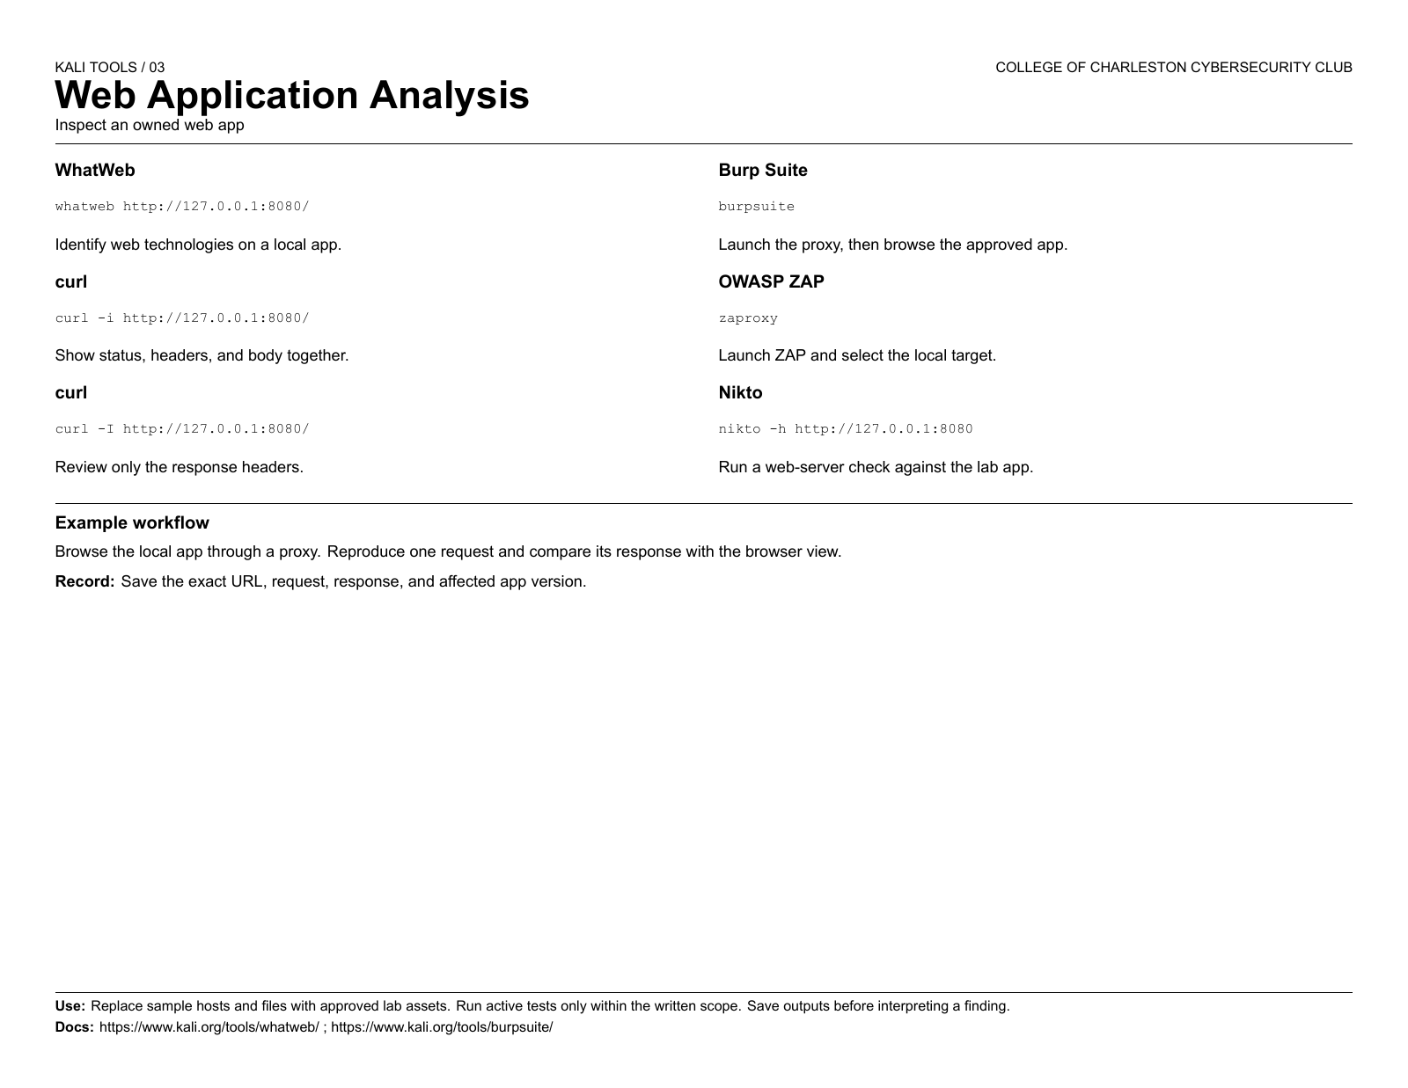

Slide 14
kali-tools-database
04
Database Assessment
Understand database exposure
Notes:
Sources: https://www.kali.org/docs/general-use/metapackages/ ; https://www.kali.org/tools/ .

Slide 15
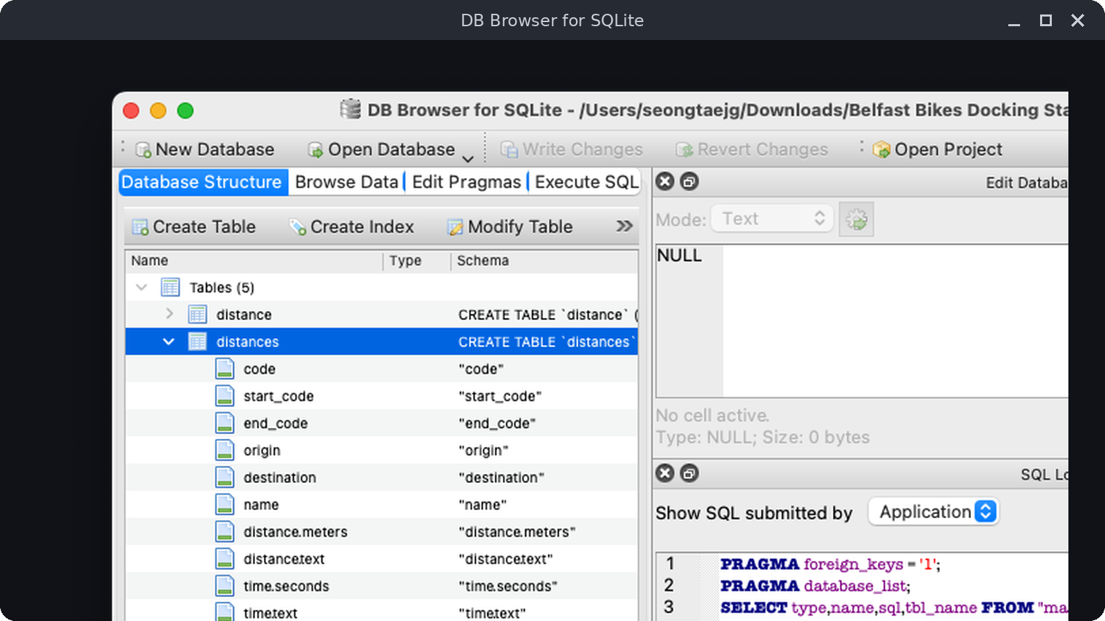
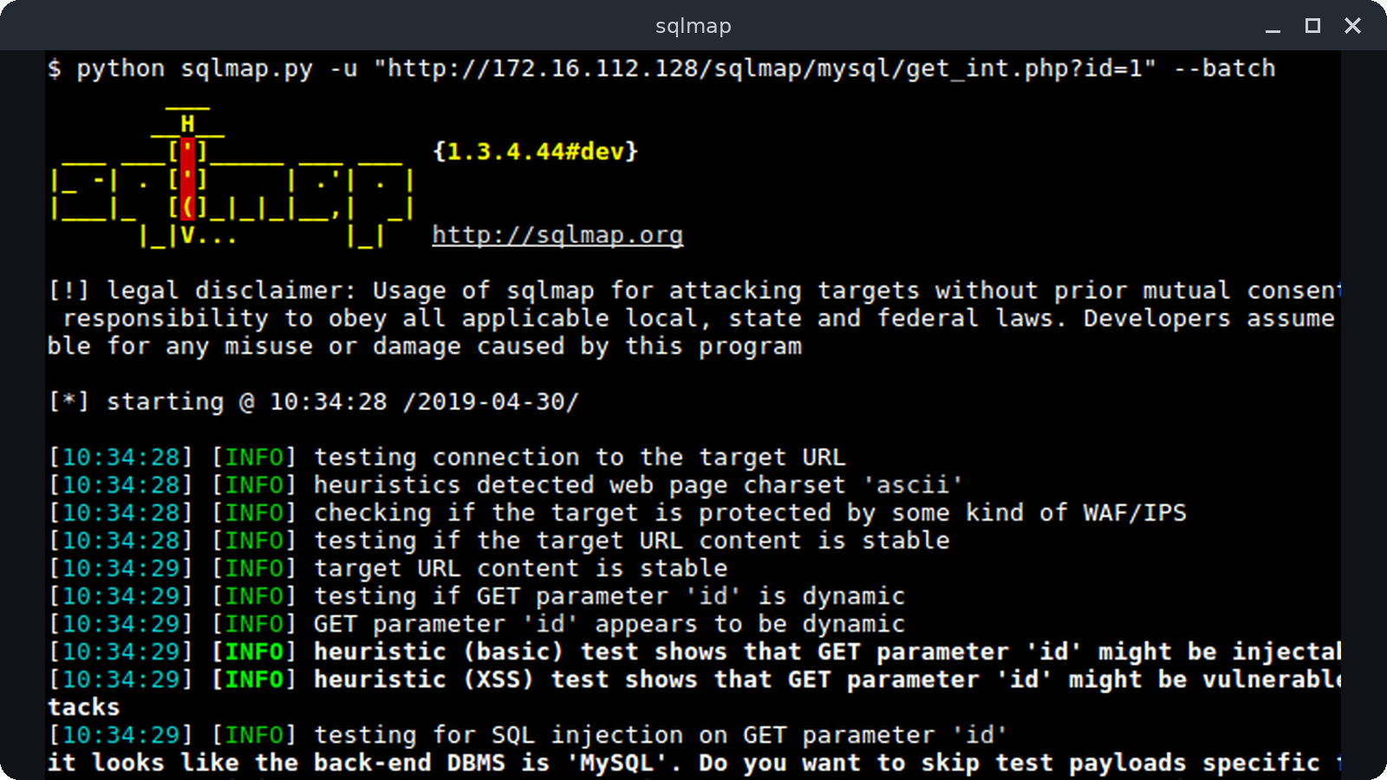
04 / kali-tools-database
Database Assessment
SQLite Browser
sqlmap
Inspect a local SQLite file
Assess SQL injection in a lab
$ sqlitebrowser ./sample.db
See the official docs. Approved labs only.
Notes:
Sources: https://www.kali.org/docs/general-use/metapackages/ ; https://www.kali.org/tools/ . Images: Screenshot from the sqlitebrowser/sqlitebrowser README. Screenshot from the sqlmap project wiki.

Slide 16
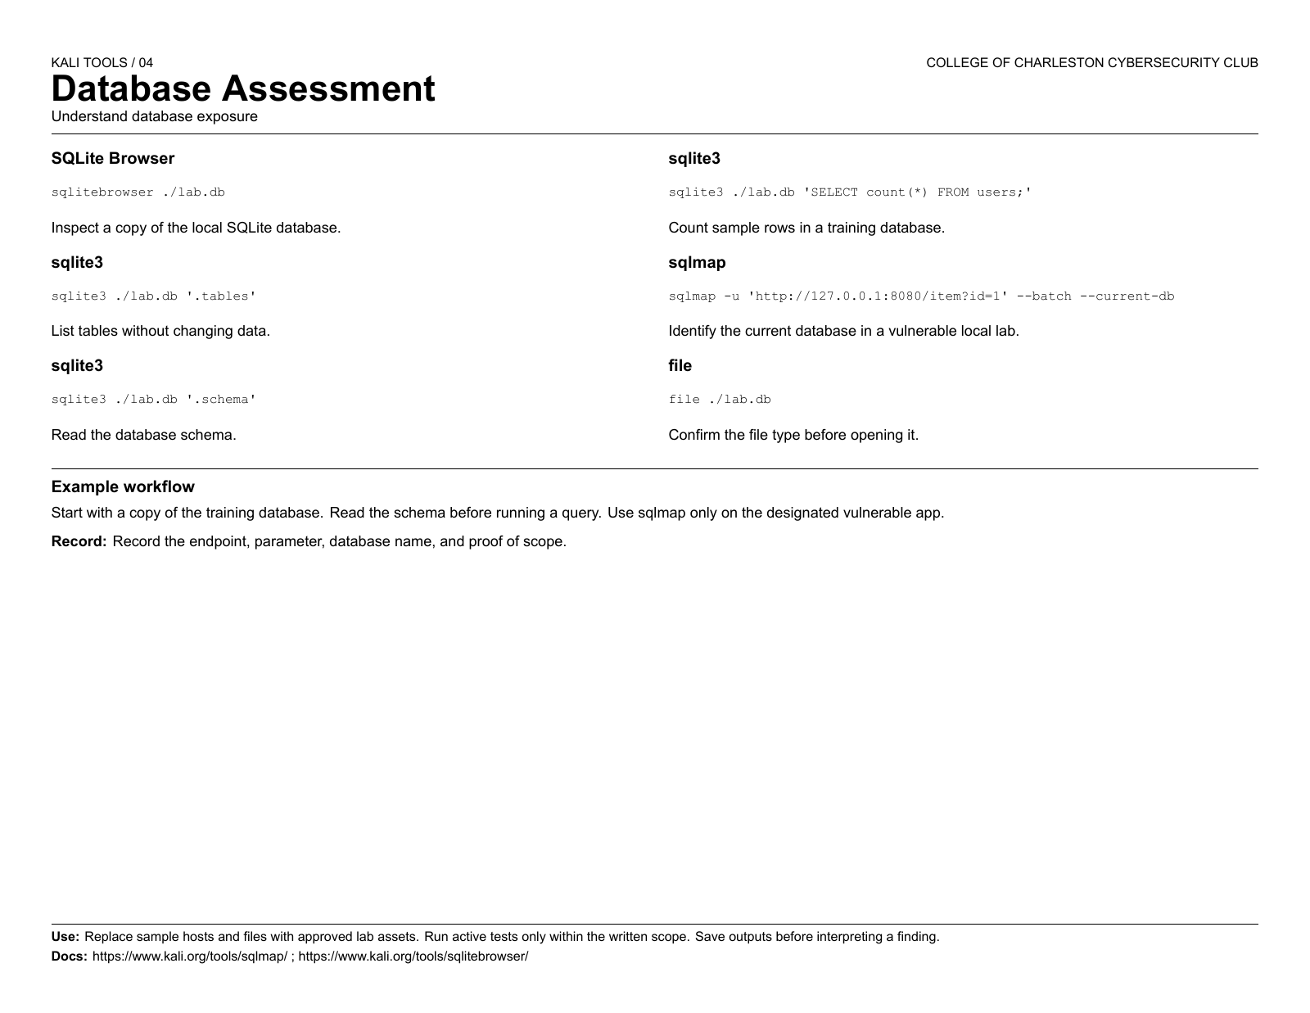

Slide 17
kali-tools-passwords
05
Password Attacks
Audit password storage
Notes:
Sources: https://www.kali.org/docs/general-use/metapackages/ ; https://www.kali.org/tools/ .

Slide 18
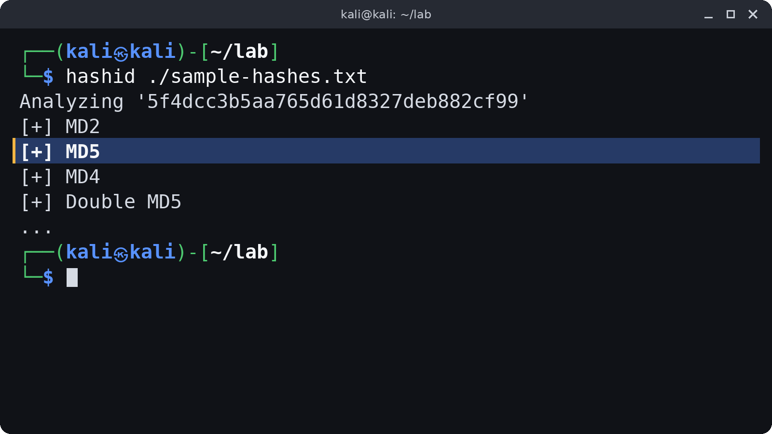
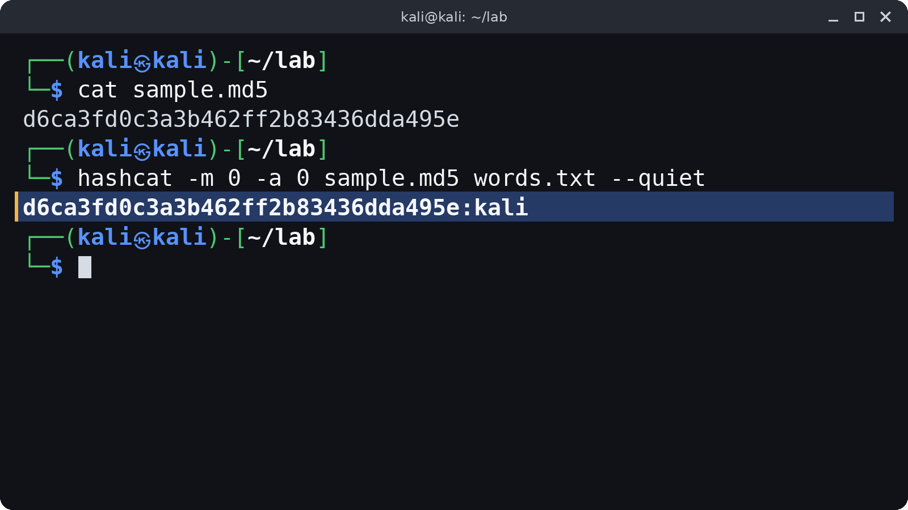
05 / kali-tools-passwords
Password Attacks
hashid
hashcat
Identify a hash format
Test approved offline hashes
Also know: John the Ripper / Hydra
Notes:
Sources: https://www.kali.org/docs/general-use/metapackages/ ; https://www.kali.org/tools/ . Images: hashid output captured in a local lab. hashcat run on a sample hash in a local lab.

Slide 19
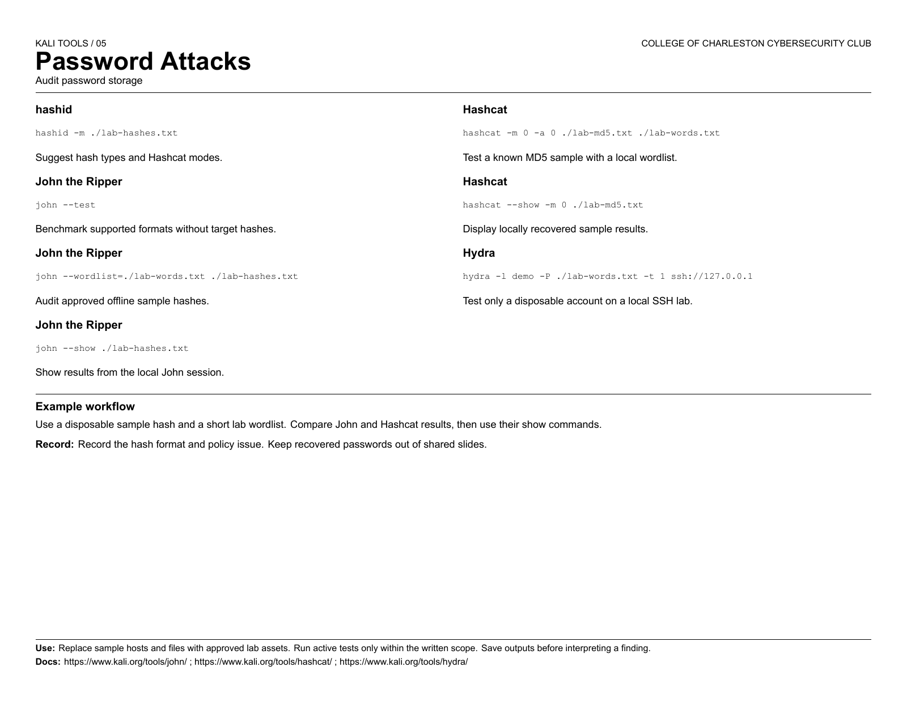

Slide 20
kali-tools-wireless
06
Wireless Attacks
Observe your own radio environment
Notes:
Sources: https://www.kali.org/docs/general-use/metapackages/ ; https://www.kali.org/tools/ .

Slide 21
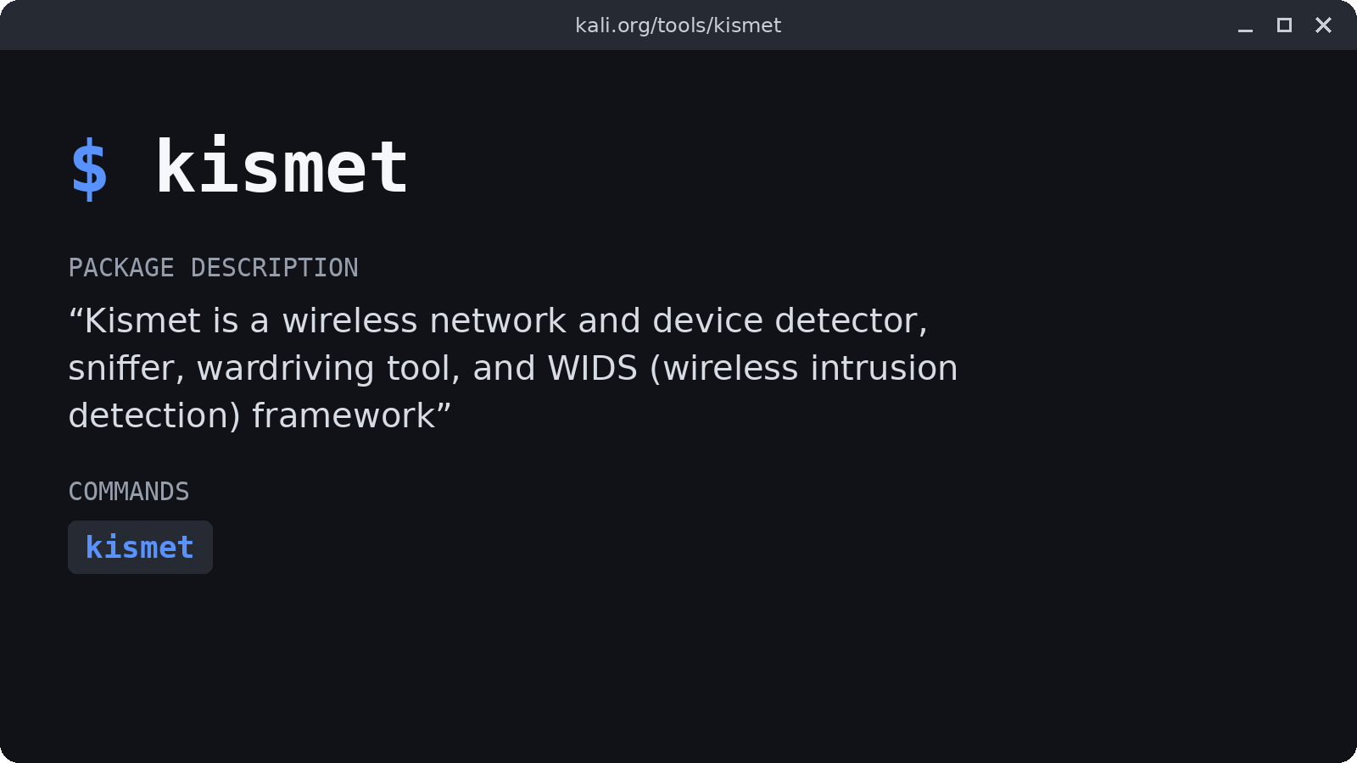
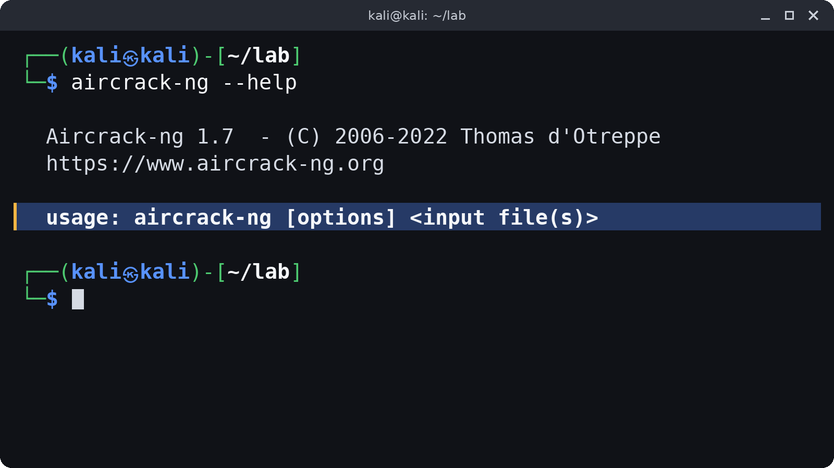
06 / kali-tools-wireless
Wireless Attacks
Kismet
Aircrack-ng
Wireless discovery and monitoring
Wireless assessment suite
Open the GUI on approved hardware
Notes:
Sources: https://www.kali.org/docs/general-use/metapackages/ ; https://www.kali.org/tools/ . Images: Description from kali.org/tools/kismet. aircrack-ng help output captured locally.

Slide 22
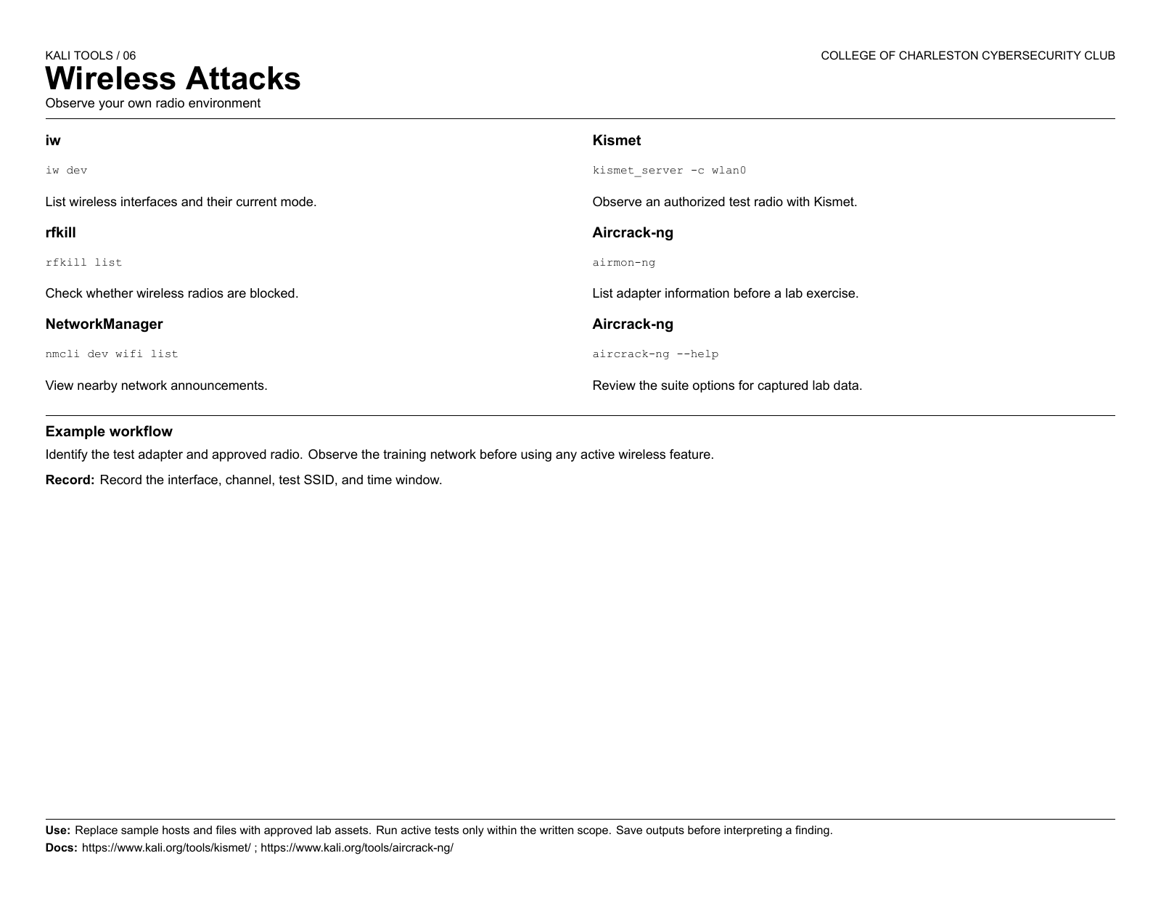

Slide 23
kali-tools-reverse-engineering
07
Reverse Engineering
Inspect a sample safely
Notes:
Sources: https://www.kali.org/docs/general-use/metapackages/ ; https://www.kali.org/tools/ .

Slide 24

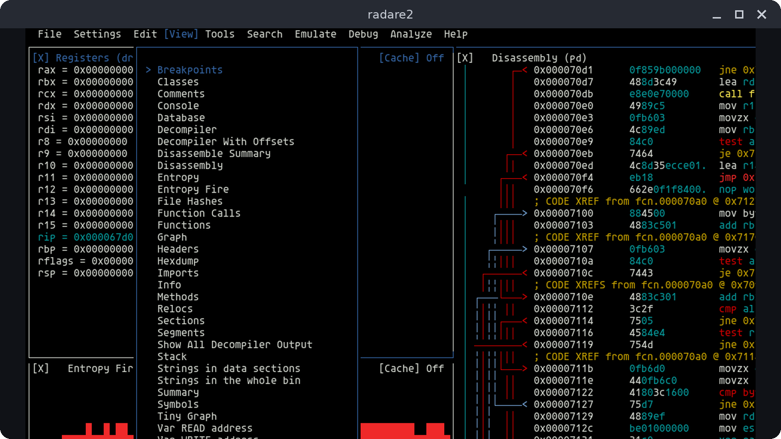
07 / kali-tools-reverse-engineering
Reverse Engineering
Ghidra
radare2
Static binary analysis
Command-line binary analysis
Import a test binary in the GUI
$ r2 -A ./sample.bin
Notes:
Sources: https://www.kali.org/docs/general-use/metapackages/ ; https://www.kali.org/tools/ . Images: Ghidra logo from the NationalSecurityAgency/ghidra repository. Screenshot from the radareorg/radare2 README.

Slide 25
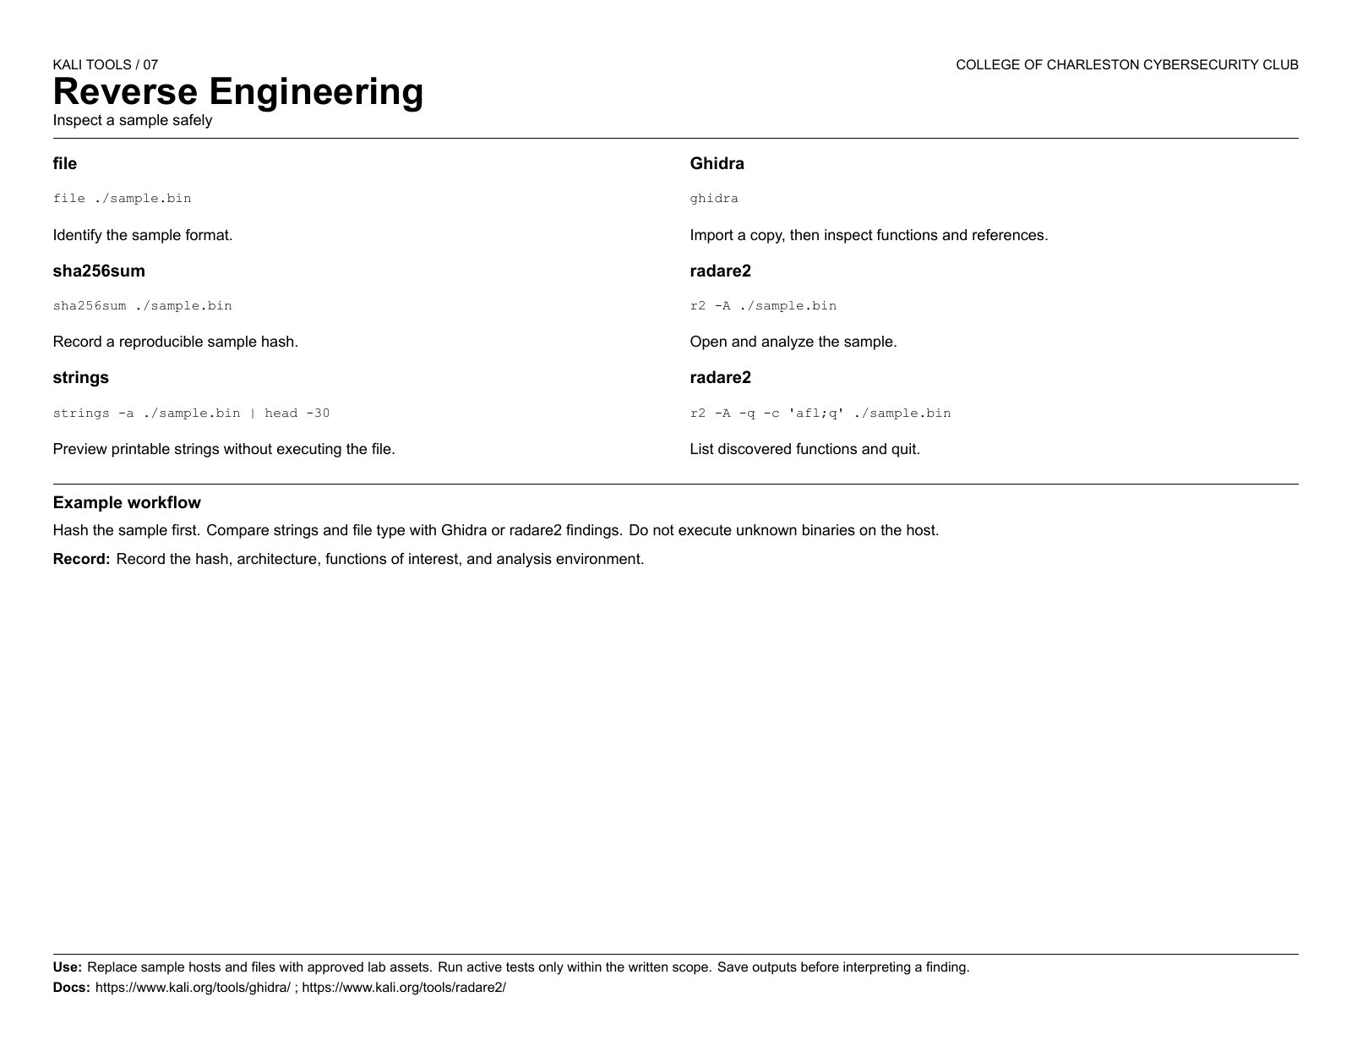

Slide 26
kali-tools-exploitation
08
Exploitation Tools
Validate findings in a lab
Notes:
Sources: https://www.kali.org/docs/general-use/metapackages/ ; https://www.kali.org/tools/ .

Slide 27
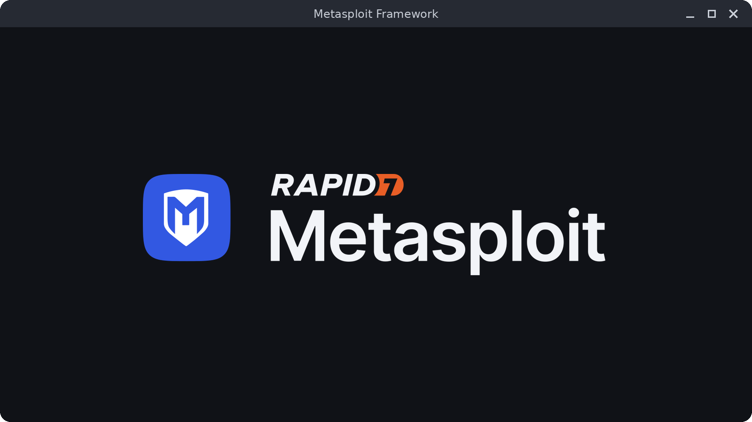
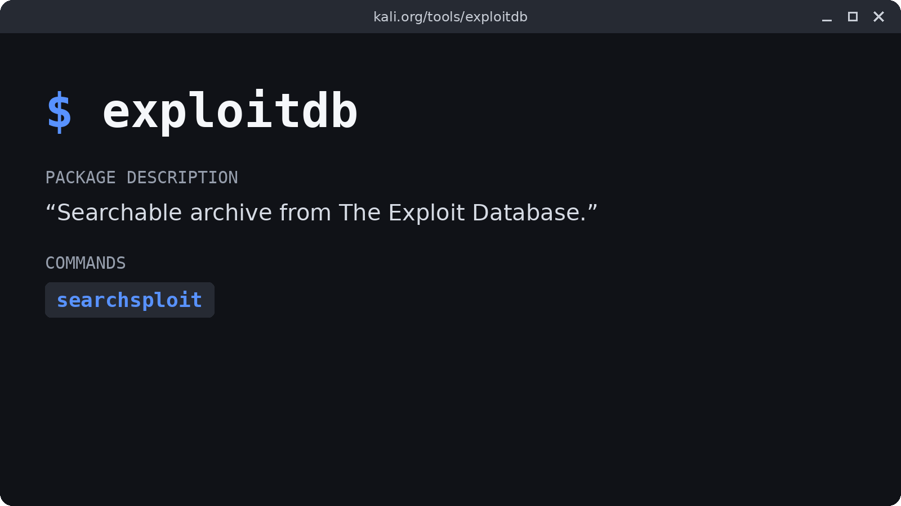
08 / kali-tools-exploitation
Exploitation Tools
Metasploit Framework
searchsploit
Controlled exploit validation
Search local exploit references
$ msfconsole -h
$ searchsploit --help
Notes:
Sources: https://www.kali.org/docs/general-use/metapackages/ ; https://www.kali.org/tools/ . Images: Metasploit logo from the rapid7/metasploit-framework docs. Description from kali.org/tools/exploitdb.

Slide 28
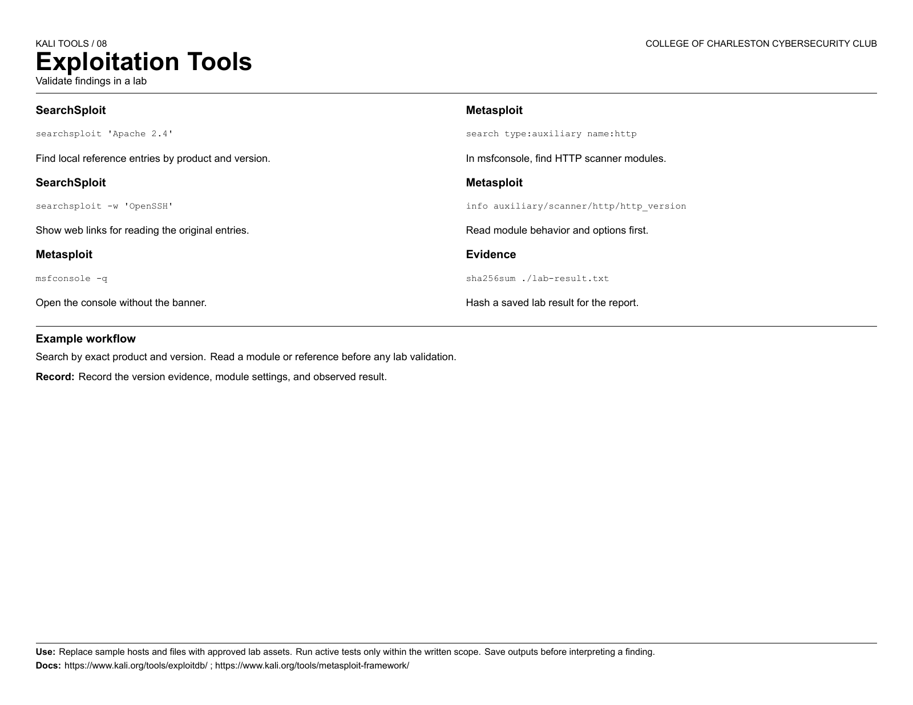

Slide 29
kali-tools-social-engineering
09
Social Engineering Tools
Study human attack paths
Notes:
Sources: https://www.kali.org/docs/general-use/metapackages/ ; https://www.kali.org/tools/ .

Slide 30
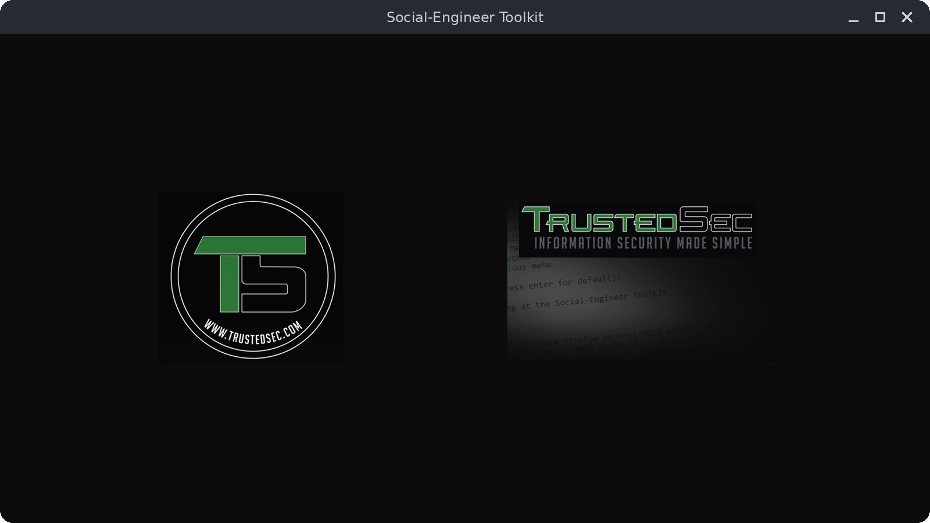
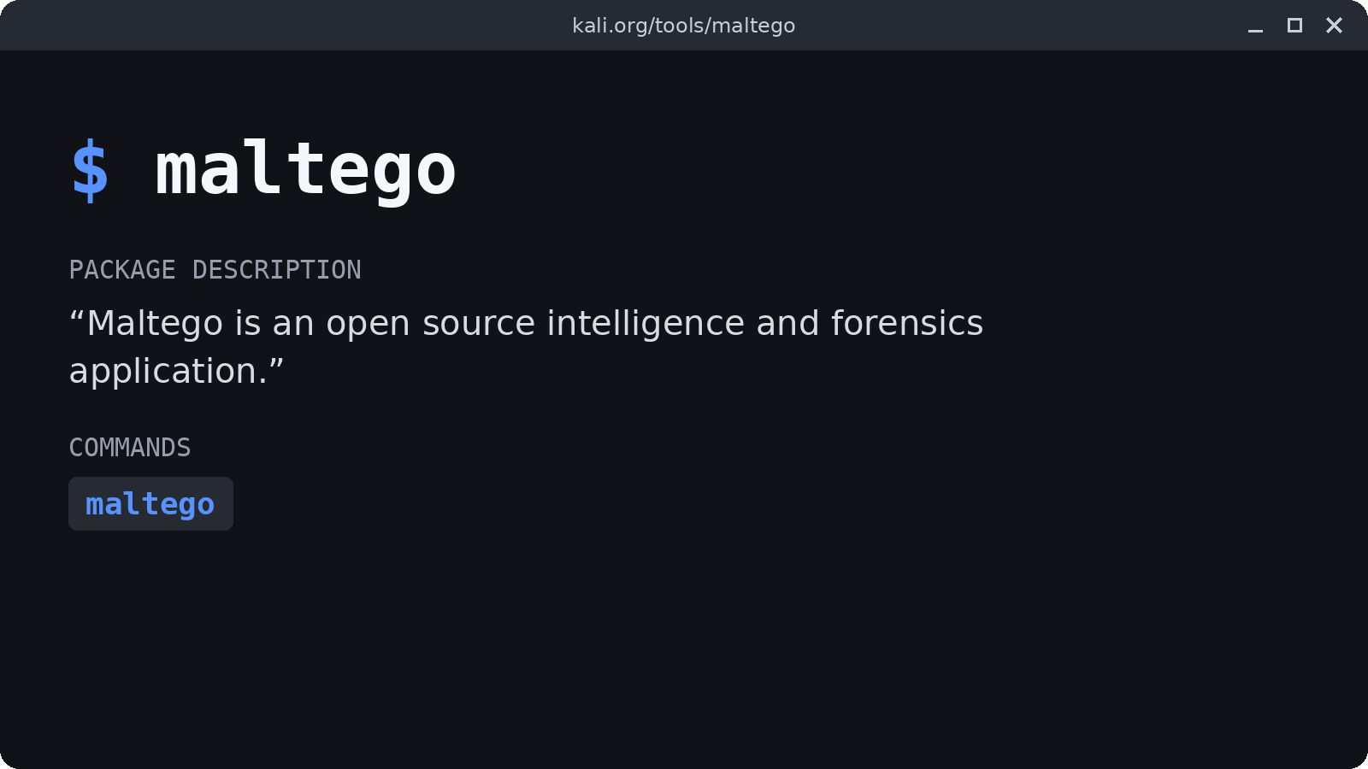
09 / kali-tools-social-engineering
Social Engineering Tools
SET
Maltego
Social-Engineer Toolkit
Relationship mapping
Approved exercises only. See the official docs.
Use public or consented data
Notes:
Sources: https://www.kali.org/docs/general-use/metapackages/ ; https://www.kali.org/tools/ . Images: TrustedSec logo from the social-engineer-toolkit repository. Description from kali.org/tools/maltego.

Slide 31
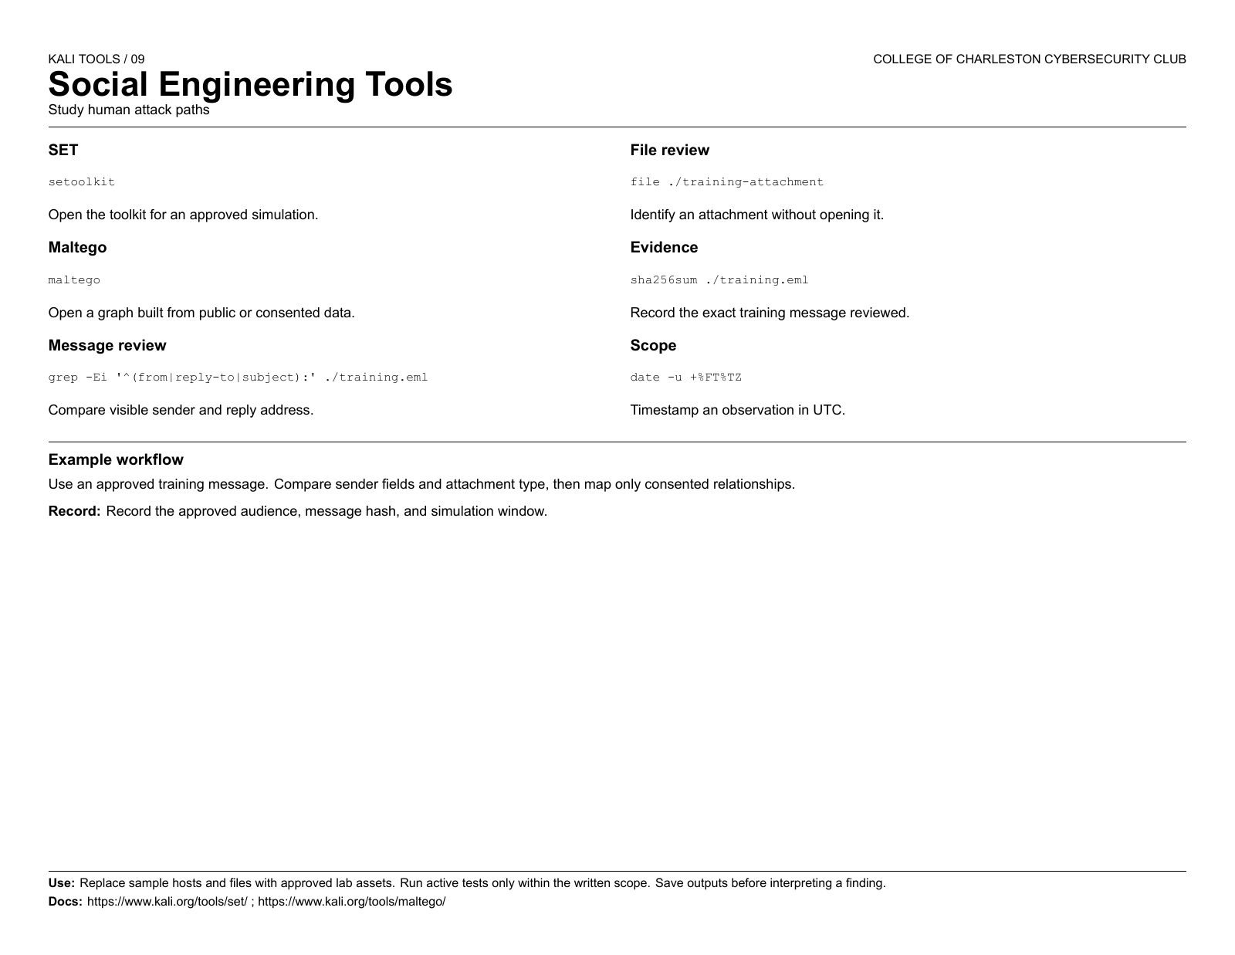

Slide 32
kali-tools-sniffing-spoofing
10
Sniffing and Spoofing
Read traffic you are allowed to capture
Notes:
Sources: https://www.kali.org/docs/general-use/metapackages/ ; https://www.kali.org/tools/ .

Slide 33

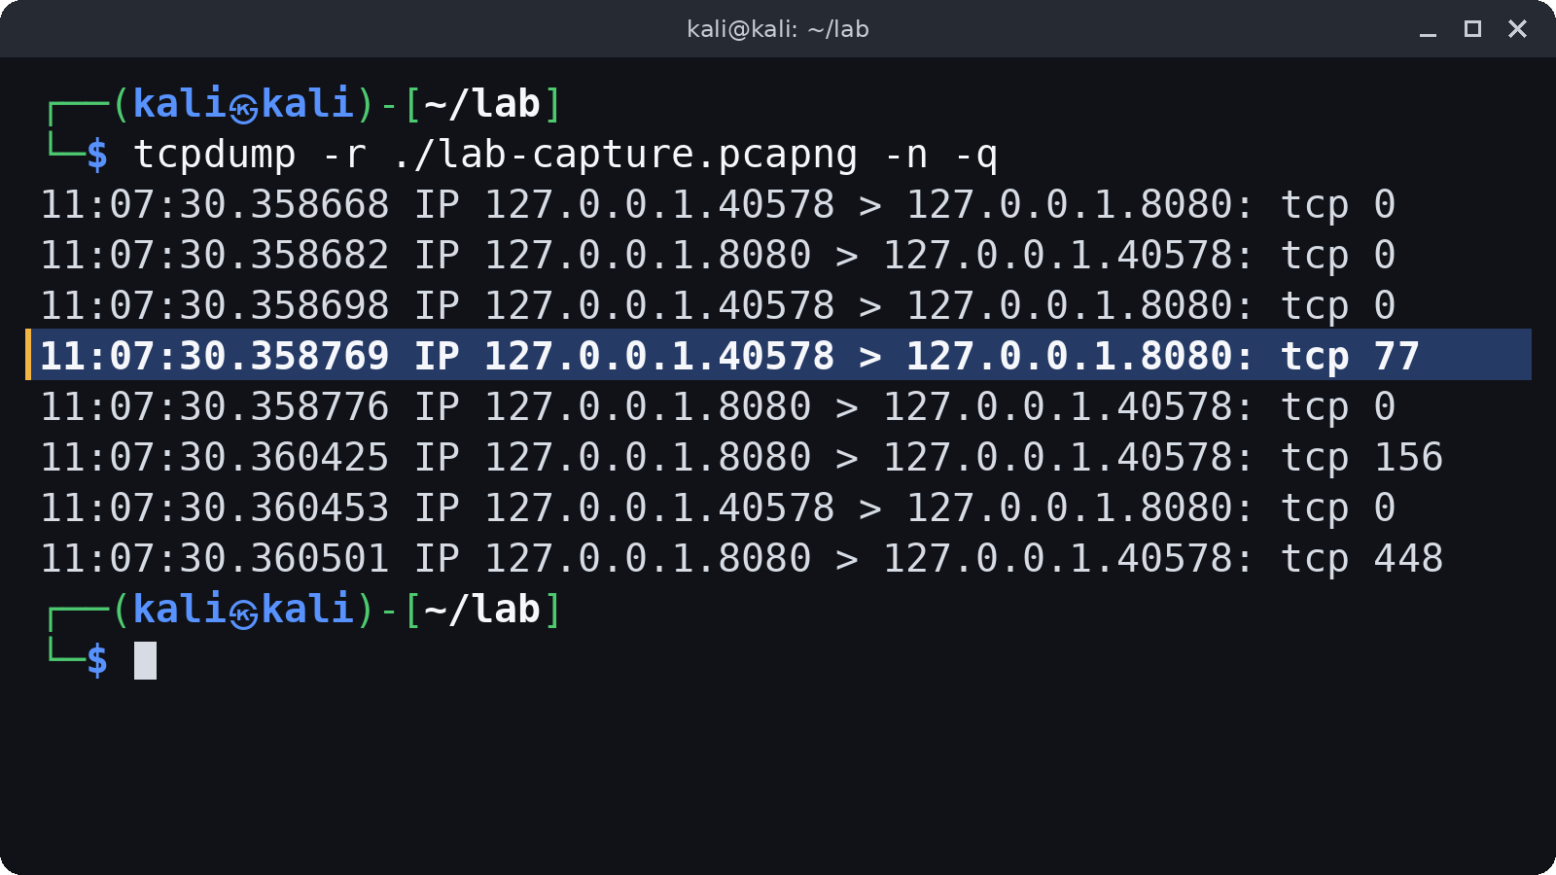
10 / kali-tools-sniffing-spoofing
Sniffing and Spoofing
Wireshark
tcpdump
Visual packet analysis
Packet capture and filtering
$ wireshark ./lab-capture.pcapng
Also know: Responder
Notes:
Sources: https://www.kali.org/docs/general-use/metapackages/ ; https://www.kali.org/tools/ . Images: Wireshark icon from the wireshark/wireshark repository. tcpdump read of a local lab capture.

Slide 34
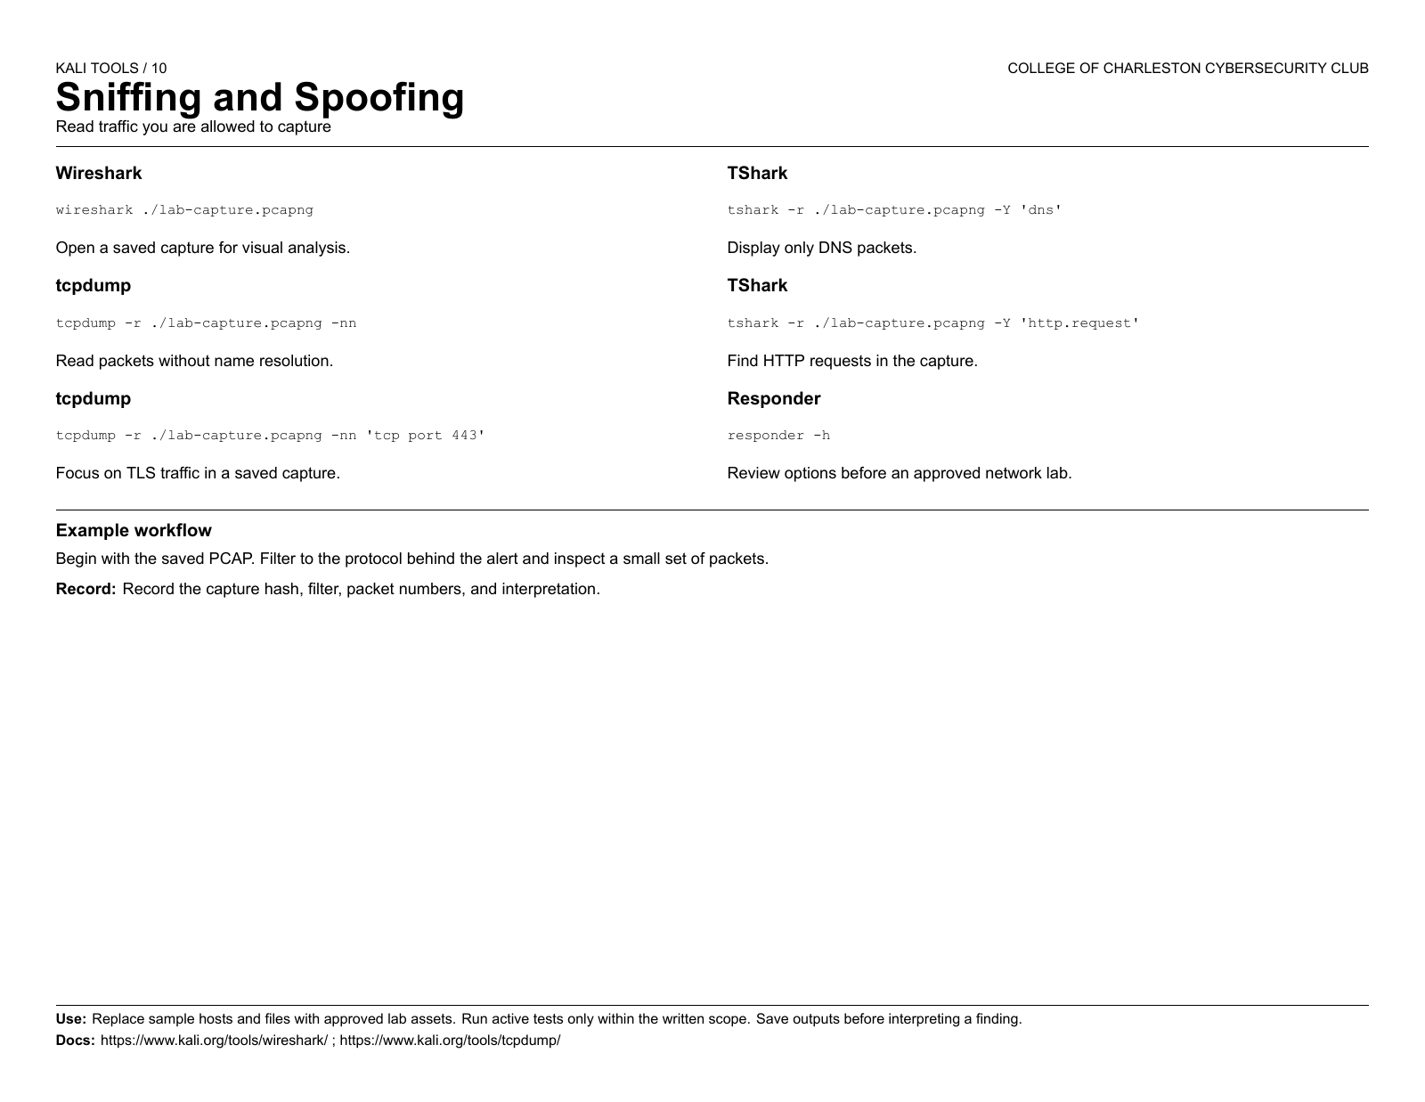

Slide 35
kali-tools-post-exploitation
11
Post Exploitation
Document access in a test environment
Notes:
Sources: https://www.kali.org/docs/general-use/metapackages/ ; https://www.kali.org/tools/ .

Slide 36

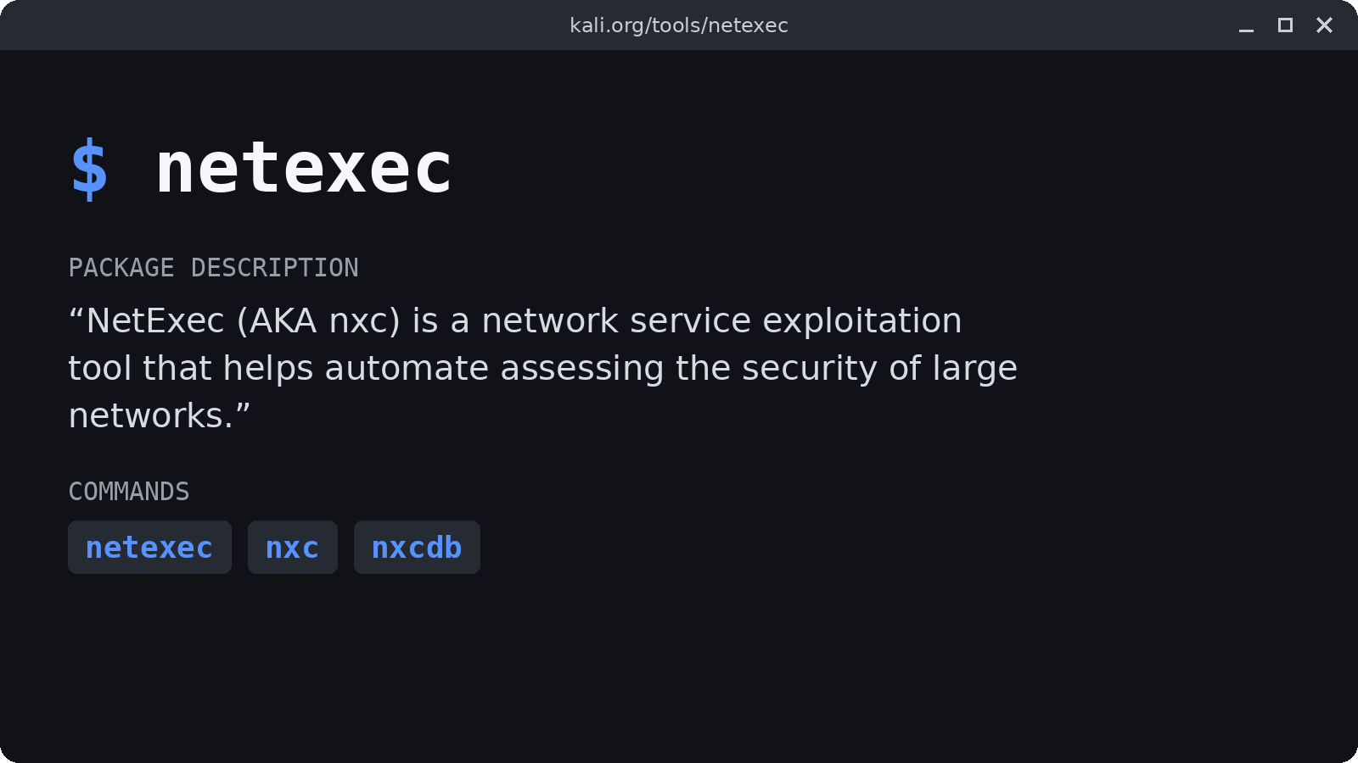
11 / kali-tools-post-exploitation
Post Exploitation
BloodHound
NetExec
Visualize directory relationships
Network assessment framework
Use approved test data. See the official docs.
$ nxc --help
Notes:
Sources: https://www.kali.org/docs/general-use/metapackages/ ; https://www.kali.org/tools/ . Images: BloodHound CE logo from the SpecterOps/BloodHound repository. Description from kali.org/tools/netexec.

Slide 37
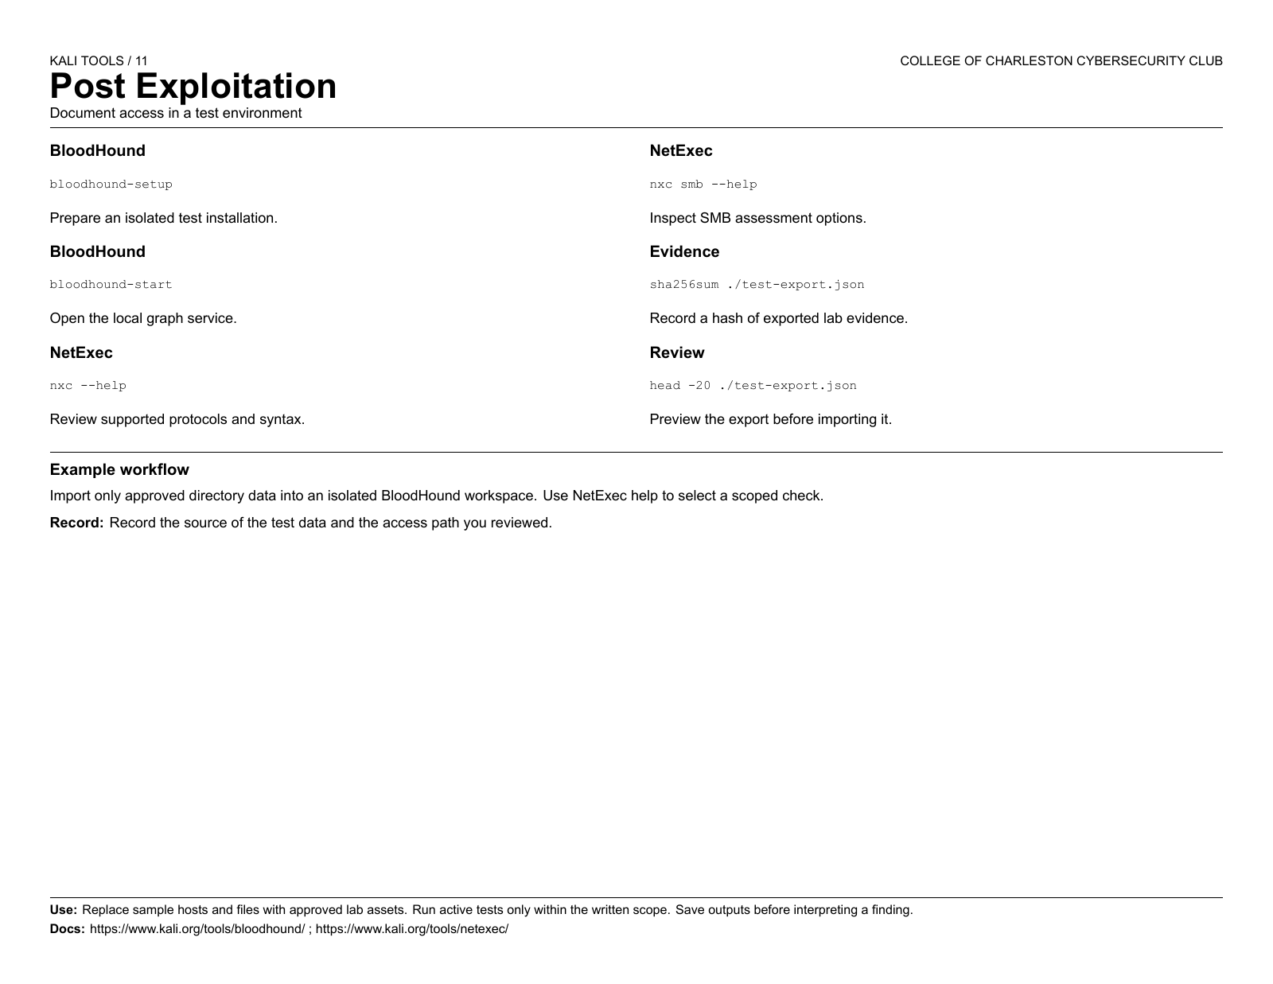

Slide 38
kali-tools-forensics
12
Forensics
Preserve and inspect evidence
Notes:
Sources: https://www.kali.org/docs/general-use/metapackages/ ; https://www.kali.org/tools/ .

Slide 39
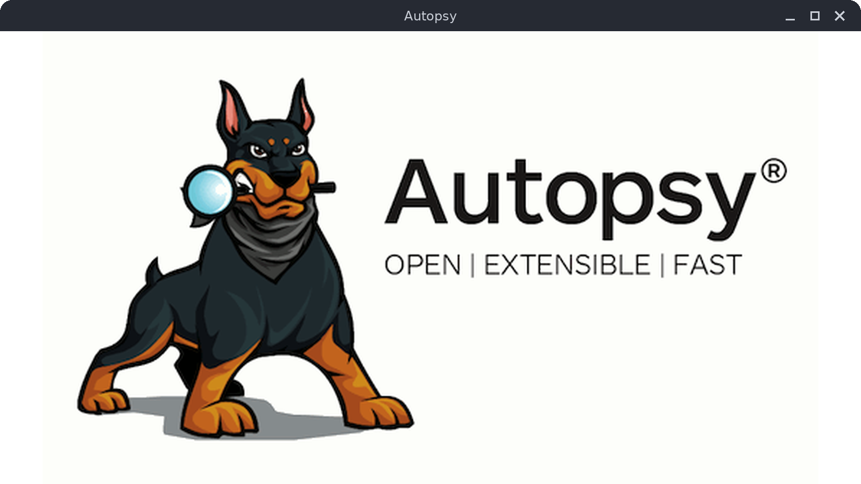
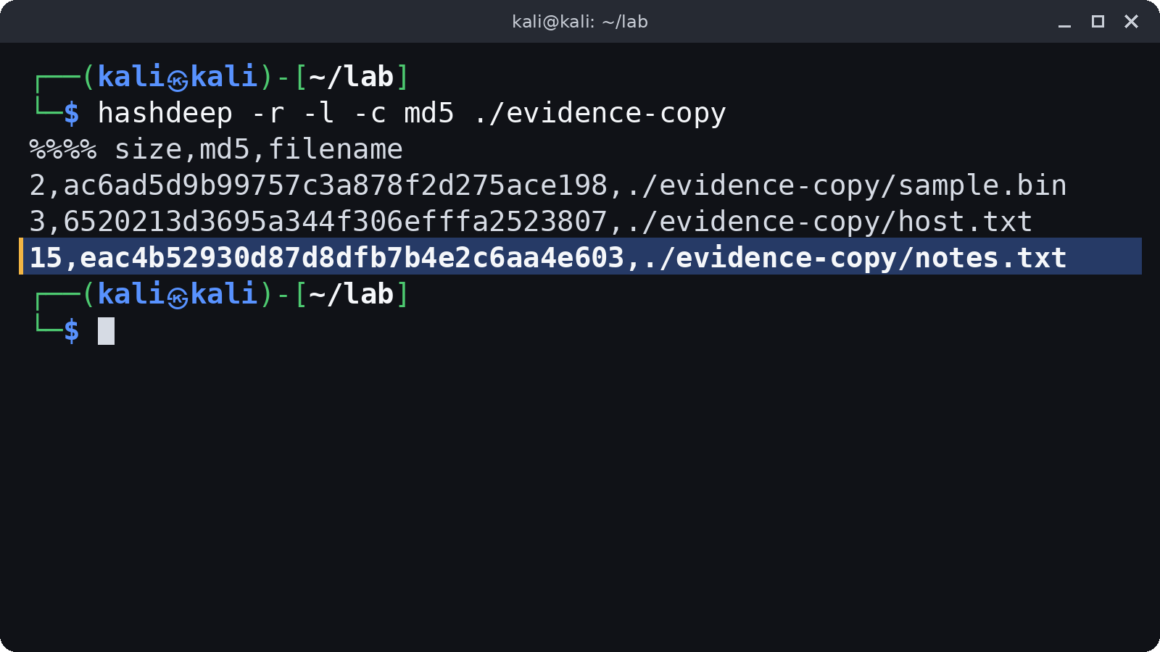
12 / kali-tools-forensics
Forensics
Autopsy
hashdeep
Case-based disk analysis
File hash inventory
Work from a forensic copy, never the original
Notes:
Sources: https://www.kali.org/docs/general-use/metapackages/ ; https://www.kali.org/tools/ . Images: Autopsy splash from the sleuthkit/autopsy repository. hashdeep output captured in a local lab.

Slide 40
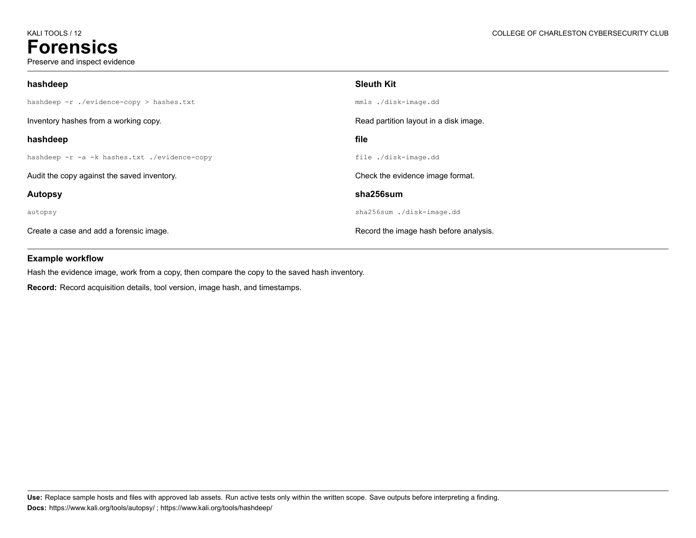

Slide 41
kali-tools-reporting
13
Reporting Tools
Turn findings into a clear record
Notes:
Sources: https://www.kali.org/docs/general-use/metapackages/ ; https://www.kali.org/tools/ .

Slide 42
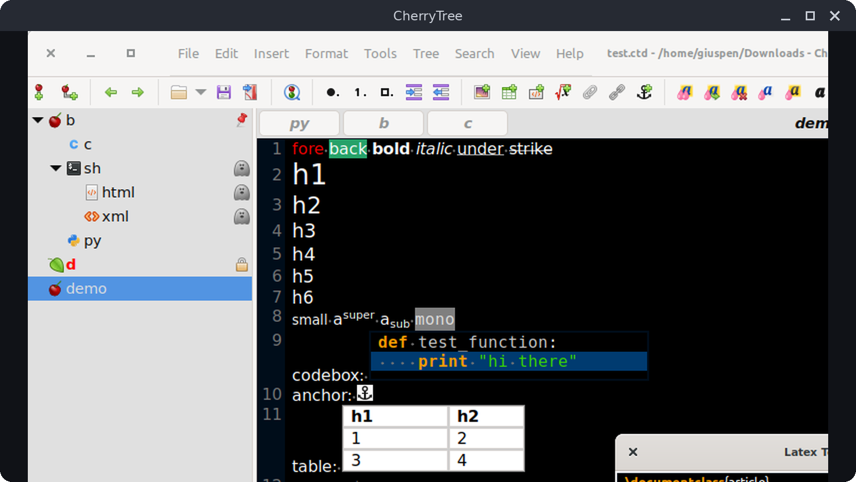
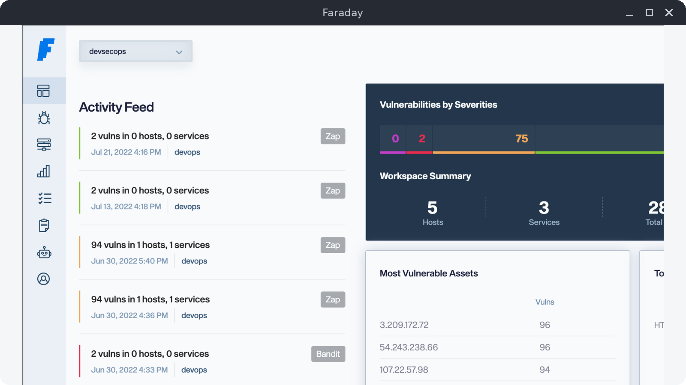
13 / kali-tools-reporting
Reporting Tools
CherryTree
Faraday
Structured assessment notes
Collaborative findings workflow
Record scope before you start
See the official docs for workspace setup
Notes:
Sources: https://www.kali.org/docs/general-use/metapackages/ ; https://www.kali.org/tools/ . Images: Screenshot from the giuspen/cherrytree README. Dashboard screenshot from the infobyte/faraday README.

Slide 43
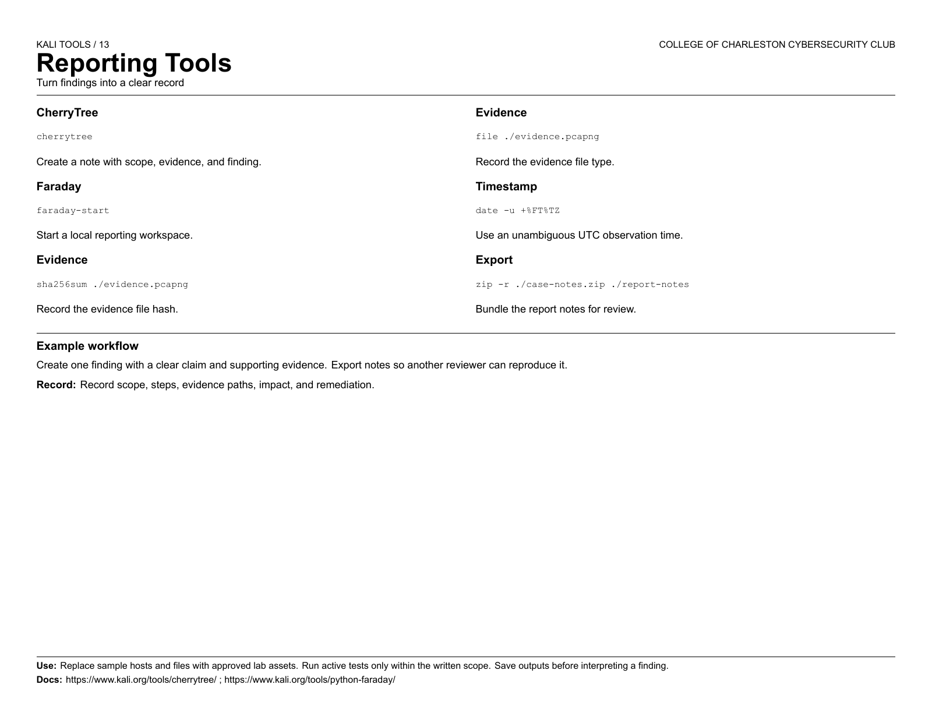

Slide 44
Kali menu group
14
System Services
Run local lab and assessment services
Notes:
Sources: https://www.kali.org/docs/general-use/metapackages/ ; https://www.kali.org/tools/ .

Slide 45
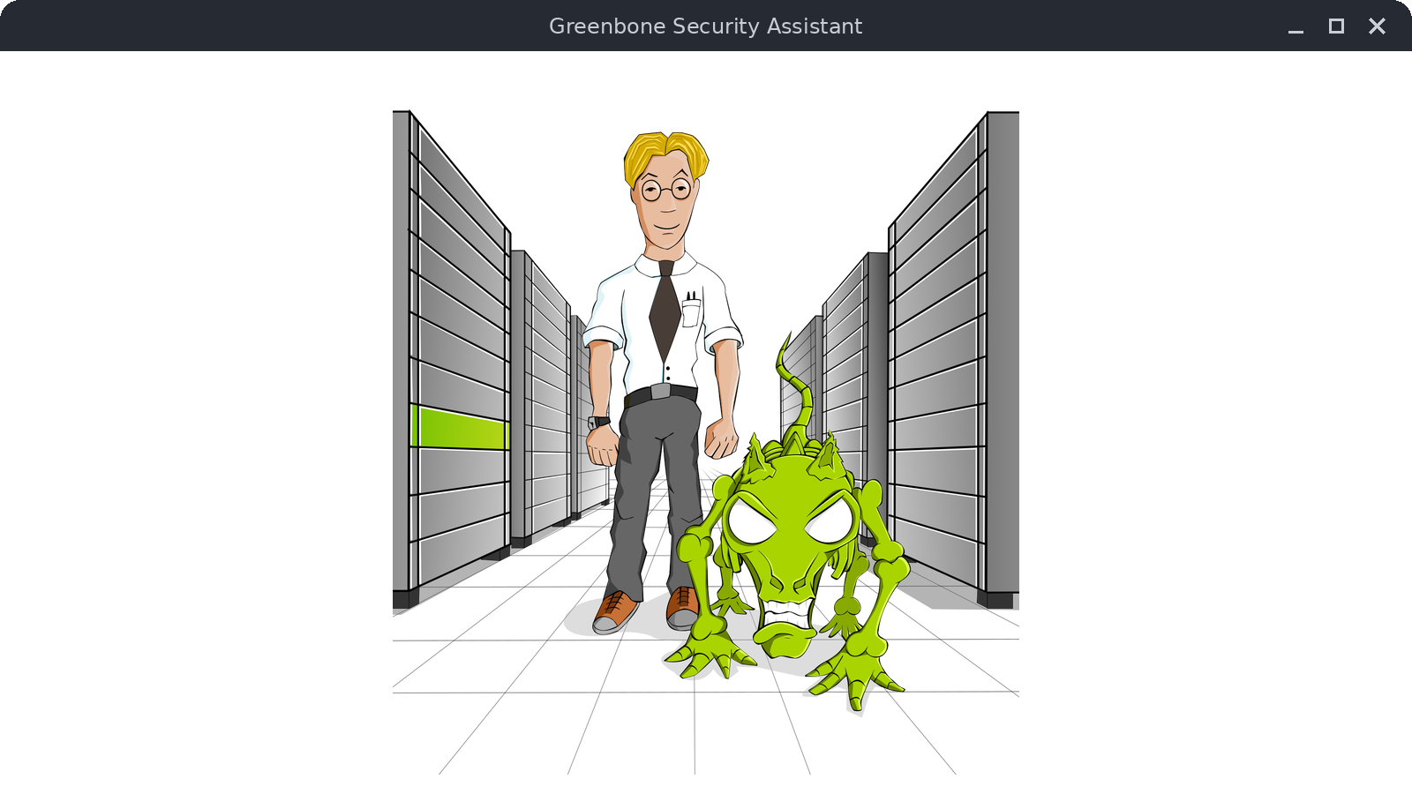
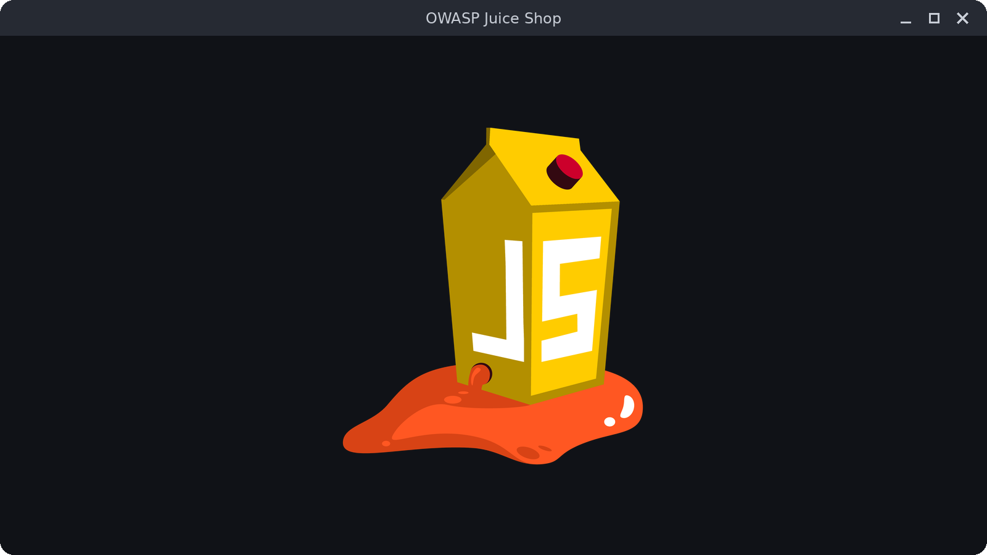
14 / system services (menu group)
System Services
GVM
OWASP Juice Shop
Vulnerability management service
Local practice web application
$ gvm-check-setup
$ juice-shop-start
Notes:
Sources: https://www.kali.org/docs/general-use/metapackages/ ; https://www.kali.org/tools/ . Images: Splash art from the greenbone/gsa repository. Juice Shop logo from the juice-shop/juice-shop repository.

Slide 46
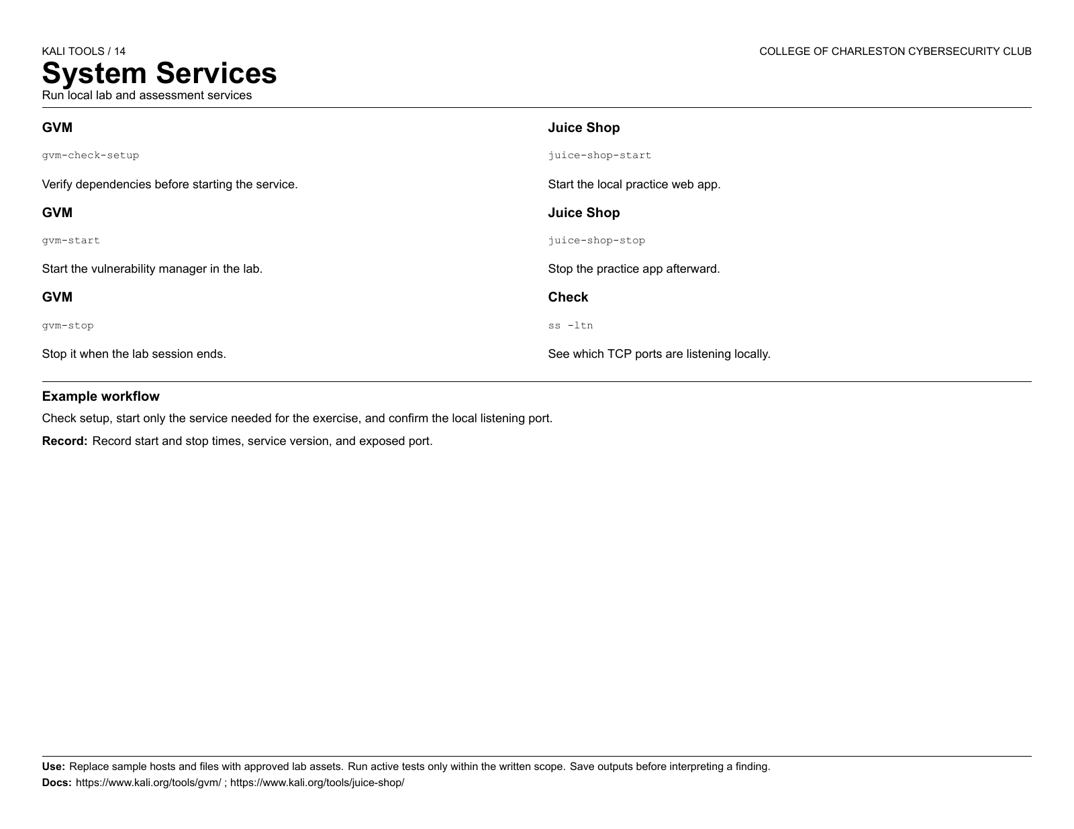

Slide 47
Choose tools by the evidence you need
1
Identify the task and data boundary.
2
Read the tool documentation and test in an approved lab.
3
Keep findings reproducible in your report.
Notes:
Sources: https://www.kali.org/docs/general-use/metapackages/ ; https://www.kali.org/tools/ .

Slide 48
Questions
Test only what you own or have written permission to assess.
Notes:
Sources: https://www.kali.org/docs/general-use/metapackages/ ; https://www.kali.org/tools/ .

