Slide 1

COLLEGE OF CHARLESTON
Cybersecurity Club
A student club for hands-on cybersecurity training and competition.
Open House • Tuesdays & Thursdays, 5:30–7:00 PM • Simons 281

Slide 2
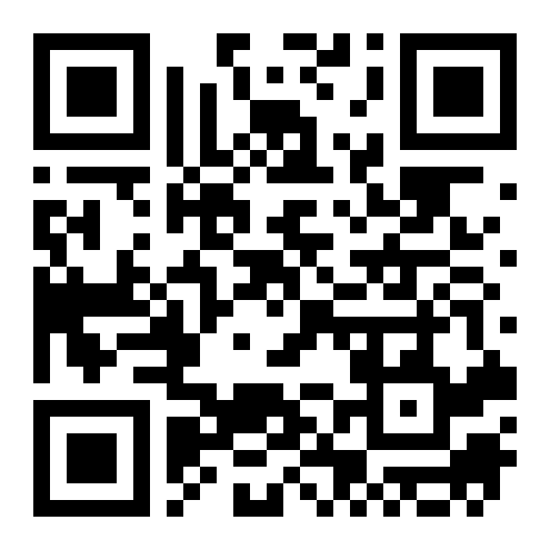
ATTENDANCE
Check in for tonight's meeting
Scan the QR code to sign in for attendance.
Requires your CofC login.
Can't scan? Go to forms.gle/ccN4CuqviXhndixq5
Scan to check in
ATTENDANCE
CofC Cybersecurity Club

Slide 3





TONIGHT'S AGENDA
What we'll cover tonight
Who we are
Officers and members.
What cybersecurity is
What the field is, briefly.
What you'll get
Skills, resume experience, and industry contacts.
Competitions
How our defense team competes.
How to get involved
No experience needed. Just show up.
Overview
CofC Cybersecurity Club

Slide 4
WHO WE ARE
Student-run leadership
TM
JC
DB
Tyler McGuire
Joe Cooney
Dr. Baza
President
Vice President
Faculty Advisor
Founded by students in the club.
Leadership
CofC Cybersecurity Club

Slide 5

THE FIELD
What is cybersecurity?
The practice of protecting networks, devices, and data from unauthorized access, while keeping information confidential, accurate, and available when it's needed.
Every organization is a target that needs defending.
Recent examples
Colonial Pipeline (2021)
SolarWinds (2020)
A single compromised password shut down fuel supply for the entire U.S. East Coast.
One breached software update compromised thousands of government and Fortune 500 networks.
What is cybersecurity?
CofC Cybersecurity Club

Slide 6
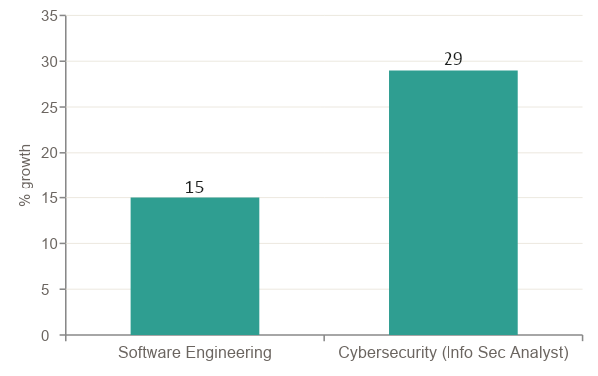



WHY IT MATTERS FOR YOU
Growing demand, strong job security
Cybersecurity is growing ~2x faster
than software engineering, with steady demand regardless of project cycles.
Security budgets keep growing as threats increase
Layoffs risk the business itself, so security headcount is hard to cut.
AI increases the need for people, not less
As attacks get more sophisticated with AI, human judgment stays essential.
Source: U.S. Bureau of Labor Statistics, 2024–34 outlook
Career outlook
CofC Cybersecurity Club

Slide 7




WHAT YOU GET
Benefits of joining now
A network of connections
Hands-on technical skills
Alumni now at CrowdStrike, Palo Alto, Rubrik, and more. Officers and alumni help with introductions to people in the field.
Linux, Active Directory, networking, scripting, log analysis: the tools employers want you to know on the job.
A resume that stands out
A running start on certifications
Competition results, defense-team experience, and concrete projects say more than a line about 'interest in security.'
Student discounts on certs like Security+ and GCIH, plus study support from people who've passed them.
Member benefits
CofC Cybersecurity Club

Slide 8



CLUB RESOURCES
We have the resources members need.
The infrastructure, connections, and budget already exist.
A strong alumni network
Real cloud infrastructure
Graduates now at CrowdStrike, Palo Alto Networks, Rubrik, and more, actively mentoring and hiring from the club.
Our own AWS-backed practice range for labs, CTFs, and competition prep.
Physical lab hardware
A real budget
Dedicated club hardware for networking, Active Directory, and hands-on builds.
Funding for competition travel, swag, food, and tools.
Club resources
CofC Cybersecurity Club

Slide 9



HOW WE'RE DIFFERENT
No lectures. No exams.
Hands-on learning, not a lecture
Show up when you can
Beginner to advanced
Gain real experience
Sessions run as hands-on labs on our own practice range, not lecture slides.
Two nights a week, zero required attendance. Come for topics that interest you.
New members pair with returning members on the range.
Backed by competition results and alumni outcomes.
Why we're different
CofC Cybersecurity Club

Slide 10







SKILL BUILDING
What you'll learn this semester
Linux & the CLI
Networking & Wireshark
Active Directory
Web & database servers
Log analysis & monitoring
Bash / PowerShell scripting
Firewalls & cloud basics
Backups & recovery
Plus one-off sessions on certifications, Git, career panels, and resume workshops.
Curriculum preview
CofC Cybersecurity Club

Slide 11



LOGISTICS
When and where we meet
Coming up next
Simons 281
Inside the Competition
Virtualization and the Command Line
Intro to the Range
College of Charleston School of the Arts
Tuesdays & Thursdays, 5:30–7:00 PM
In person or virtually via Discord
Tuesdays: competition-focused practice
Thursdays: discussion, demos & tooling
Meeting details
CofC Cybersecurity Club

Slide 12
COMPETITIVE TRACK
The Defense Team
Capture the Flag (CTF)
Solve standalone security challenges, like web, crypto, forensics, and reverse engineering, for points.
Our team plays defense: keeping simulated networks online, patched, and clean while red teams try to break in. It's the closest thing to real incident-response work you'll find as a student.
Scenario-Based Defense
Gain real-world experience • Network with employers • Two formats: CTF and scenario-based
Defend a live simulated network against active attackers over hours, like SECCDC and PCDC.
Defense team
CofC Cybersecurity Club

Slide 13


GET ON THE CALENDAR
Competition schedule
SECCDC
PCDC
NCL
Southeast Collegiate Cyber Defense Competition
Palmetto Cyber Defense Competition
National Cyber League: Individual then Team Game
February 7, 2027
April 11-13, 2027
Apr 10-12 (individual), Apr 24-26 (team)
Pico CTF
HTB CTF
TryHackMe
Beginner-friendly, self-paced CTF
Hack The Box: community events year-round
"King of the Hill" ongoing games
Date TBD
Always running
Always running
Competition schedule
CofC Cybersecurity Club

Slide 14


WHY COMPETE
What competing gives you
Gain real-world experience
Build a resume that stands out
Defend live systems under time pressure: realistic incident-response practice.
Build your resume with real competition experience instead of a line about "interest in security."
Meet new people
Learn skills you can't get in class
Teammates, alumni, and industry members you meet at competitions.
Fast troubleshooting, quick decisions under pressure, and tools most coursework never touches.
Why compete
CofC Cybersecurity Club

Slide 15



HOW A MATCH RUNS
Team organization: how we staff a competition
Every role has a clear job. New members shadow a role before owning one. The roster below is how we organize SECCDC and PCDC.
PCDC
6-person roster
SECCDC
8-person roster
Captain
Captain
Injects, phone, flex support
Injects, phone, flex support
Domain Admin
Domain Admin
Active Directory, DNS
Active Directory, DNS
Threat Hunters (2)
Threat Hunters (3)
1 Linux, 1 Windows
1 Linux, 1 Windows, 1 flex
Engineer (1)
Engineers (2)
Hardening, fixes, doubles on challenges
Hardening, fixing broken systems
Enumeration / SecOnion
Enumeration / SecOnion
SIEM monitoring, log callouts
SIEM monitoring, log callouts
Team organization
CofC Cybersecurity Club

Slide 16

ALUMNI OUTCOMES
Alumni in the industry
RC
Ross Clarke
RB
Robert Bare
PM
Patrick McCabe
CrowdStrike, CAMA Security
CAMA Security
Cybolt, Sensilla
LM
Luke McGuire
SH
Seth Hinson
MK
Margaret Kimery
Soteria
Frazier & Deeter
Rubrik
ZD
Zach Dayton
MW
Matt Walter
LT
Leo T. Pate III
Palo Alto Networks
Greymatter.io
NetSpi
Alumni outcomes
CofC Cybersecurity Club

Slide 17
BEYOND THE CLUB
Certifications & support
Certification | Exam cost | Notes
Certified in Cybersecurity (CC) | $199 | No experience required
CompTIA Security+ | $425 | Most common entry cert
Certified Ethical Hacker (CEH) | $950 | 2 years experience
GIAC Security Essentials (GSEC) | $999 | No experience required
Certifications exist for every path, including networking, security, cloud, DevOps, privacy, and audit. We help members pick a starting point and study for it together.
Student and member discounts are available on many certification exams.
Source: Forbes Advisor
Certifications
CofC Cybersecurity Club

Slide 18
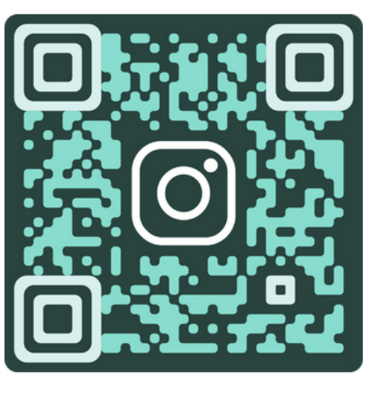
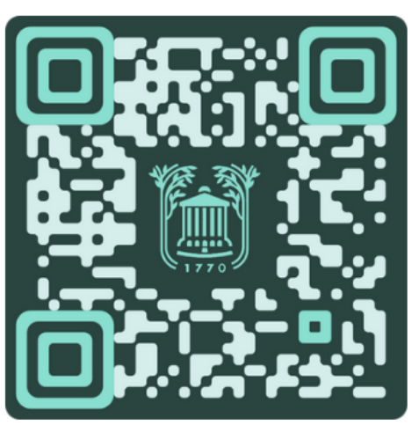


Join the club!
Come to our next meeting.
No experience required.
Instagram
Simons 281, College of Charleston
Tuesdays & Thursdays, 5:30-7:00 PM
Club Website and Discord
Join our Discord!
Follow us on Instagram for updates!
Get involved
CofC Cybersecurity Club

