Slide 1

THURSDAY SESSION · WEEK 1
Inside the Competition
What competitions look like: roles, tools, scoring, training
Tuesdays & Thursdays, 5:30-7:00 PM • Simons 281

Slide 2
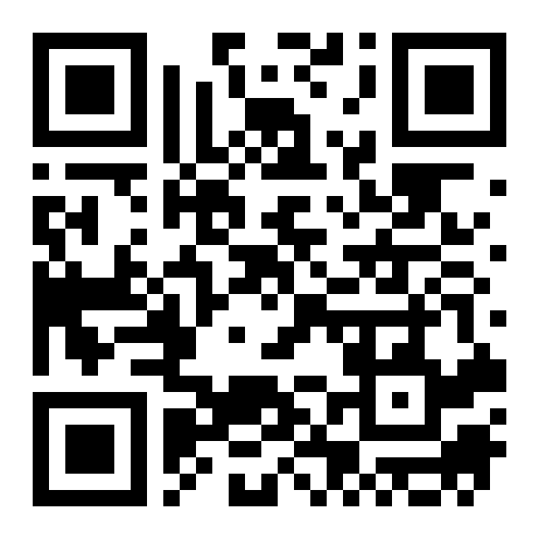
ATTENDANCE
Check in for tonight's meeting
Scan the QR code to sign in for attendance.
Requires your CofC login.
Can't scan? Go to forms.gle/ccN4CuqviXhndixq5
Scan to check in
ATTENDANCE
CofC Cybersecurity Club

Slide 3







TONIGHT'S AGENDA
From sign-in to closing ceremony
Intro to competitions
The scenario
Who's in the room
Typical schedule
Systems, services, and scoring
Tools and injects
How we practice: The Range
Agenda
CofC Cybersecurity Club

Slide 4
THE TWO COMPETITIONS
SECCDC and PCDC
SECCDC
PCDC
Southeast Collegiate Cyber Defense Competition
Palmetto Cyber Defense Competition
When
Qualifier: Feb 7, 2027 (virtual, 9 AM-5 PM EST)
When
April 11-13, 2027, Trident Technical College, North Charleston
Path
Top teams advance to in-person Regionals in Florida
Path
Sat: High School + HackWarz. Sun: Collegiate (11 teams). Mon: Pro Day
Format
Manage a fictional small business: web, email, database, and app servers, plus staff workstations
Format
Operate a company network and the business itself: emails, orders, and IT service requests
Team
Up to 8 competitors from a 12-person roster
Team
6 students per collegiate team
Access
Fully remote via Apache Guacamole, root access to jump machines
Partner
Run with the AFCEA Lowcountry Chapter
Meet the competitions
CofC Cybersecurity Club

Slide 5
COMPETITION SCENARIOS
The Scenarios
Both events wrap the technical work in a full corporate scenario. Injects arrive in-character as emails from the CEO. Your job is to act like an actual IT department.
PCDC 2026: Astra 9
SECCDC 2026: Wild West Parks Inc.
Palmetto Core Drilling Corporation mines a rare material, "Schwartz," on a distant asteroid. An experimental AI just eliminated the entire human cybersecurity team overnight. You're the new hires rebuilding it, while rival conglomerates, hacktivists, and nation-states circle.
An interstellar theme-park company running attractions across the frontier. You're hired to the engineering security team, responsible for keeping every ride, server, and guest system online against real threats.
"Your job is not just to protect the park... it is to protect the horizon."
Rudolph "Rudy" Esteves, CEO
"Welcome to Palmetto Core Drilling Corporation!"
Dark Helmet, CEO
The scenario
CofC Cybersecurity Club

Slide 6






ROLES
Who's in the room
Gold / Operations Team
White Team
Red Team
Runs, scores, and manages the entire competition.
Judges performance, enforces the rules, evaluates your reports.
Professional pentesters simulating real external attackers.
Black Team (SECCDC)
Orange Team (PCDC)
Trust
Technical support, communications, and admin assistance.
Sends injects and business requests. Effectively, "the company."
You can trust Gold, White, and officials. Never the Red Team unprompted.
Competition roles
CofC Cybersecurity Club

Slide 7



YOUR TEAM
Who's on your team, and why
PCDC
6-person roster
SECCDC
Up to 8-person roster
Captain
Captain / Co-Captain
Injects, phone, flex support, closing 5-minute debrief
Liaison to White Team, in the room at all times
Domain Admin
Domain Admin
Owns Active Directory and DNS
Owns Active Directory and DNS
Threat Hunters (2)
Threat Hunters (3)
1 Linux, 1 Windows
1 Linux, 1 Windows, 1 flex
Engineer (1)
Engineers (2)
Hardening, fixes, doubles on challenges
Hardening, fixing broken systems
Enumeration / SecOnion
Enumeration / SecOnion
SIEM monitoring, log callouts
SIEM monitoring, log callouts
Team roles
CofC Cybersecurity Club

Slide 8
TYPICAL SCHEDULE
PCDC: Collegiate Day, hour by hour
7:45 AM
Registration
8:15 AM
Blue Team briefing & opening ceremony
8:30 AM
Competition begins: initial injects, secure the network
9:15 AM
Red Team begins attacking (45 min after start)
9:15 AM - 4:00 PM
Operate the network under active attack
4:00 PM
Red Team visits Blue Teams
4:20 PM
Blue Team presentations to judges
5:05 PM
Red / Gold debrief: point of view, common mistakes
5:30 PM
Awards & closing ceremony
PCDC schedule
CofC Cybersecurity Club

Slide 9
TYPICAL SCHEDULE
SECCDC: from qualifiers to regionals
Feb 2
Test environment released for connectivity checks
Feb 3
Test environment closed
Feb 7, 8:40 AM
Pre-brief
Feb 7, 9:00 AM
Virtual qualifiers begin (fully remote, root access to jump machines)
Feb 7, 5:00 PM
Scoring ends
Feb 7, 5:15 PM
Debrief
Weeks later
Top-scoring teams advance to in-person Regionals in Florida
One student per jump machine.
SECCDC schedule
CofC Cybersecurity Club

Slide 10






OUR NETWORK
The systems you'll defend
Operating systems
Kali Linux
Ubuntu
Debian
CentOS
FreeBSD
Windows 10/11 & Server
Services in scope
DNS
Active Directory
LDAP & Kerberos
Web (HTTP/S)
Email (SMTP/POP3)
AWS (in regionals)
Databases (MySQL, MSSQL, MariaDB, PostgreSQL)
FTP & SMB
SSH, RDP & WinRM
Docker containers
Systems & services
CofC Cybersecurity Club

Slide 11
SCORING
How you're scored
Systems are checked by automated scoring accounts, which attempt ‘use’ systems.
PCDC
SECCDC
Availability
Critical services
Services checked periodically. Down too long triggers an SLA violation and lost points.
50% of possible points, based on random polling of core services.
Injects
Injects
Weighted by complexity. Late submissions still earn partial credit.
The other 50%, cumulative across all assigned tasks.
Attacks
Red Team success
Successful Red Team access costs points based on level obtained.
Deductions based on access level, data sensitivity, and persistence.
Business Operations
Incident reports
Services must be functional, not just online, to satisfy business tasks.
A thorough report can return up to 50% of a Red Team deduction.
Scoring
CofC Cybersecurity Club

Slide 12
THE WRITTEN HALF OF THE JOB
Injects and incident reports
Injects
Incident Reports
Business tasks from "the CEO," ranging from resetting a password to migrating a mail server with zero downtime. Weighted by complexity and worth as much as keeping services up, so ignoring them is never the right call.
Affected hosts, named specifically
Time frame: when access started and stopped
Observed activity and persistence method
Technical analysis (IPs, logins, malware)
Remediation steps taken
Evidence: screenshots, logs
Submit from the designated report station or portal only. Late is still partial credit, ignored is zero.
Injects & incident reports
CofC Cybersecurity Club

Slide 13







TOOLS
Tools of the trade
Wireshark
Snort
Security Onion
Metasploit
Packet capture & traffic analysis
Intrusion detection signatures
IDS, NSM, and log dashboards
Know it to recognize an attack
Passbolt
puTTY / Remmina
KeePass
Bash & PowerShell
Team password management
SSH and RDP from the laptop
Local credential storage
Scripted checks across many hosts
Tools
CofC Cybersecurity Club

Slide 14


HOW WE TRAIN FOR THIS
The Range, and how to prepare on your own
The Range
Prepare on your own time
TryHackMe.com
Our own AWS-hosted recreation of this exact environment: a mix of Windows and Linux boxes, real services, and practice injects. Thursday practice sessions run directly on the Range so the first time you see this setup isn't on competition day.
Good general-knowledge resource
HackTheBox.com
Offensive-focused, understand the attacker
OverTheWire.org / UnderTheWire.org
Bash and PowerShell command games
Come to a Thursday session to get connected.
AWS-based competitions
Practice in the same kind of cloud environment
How we practice
CofC Cybersecurity Club

Slide 15


LESSONS FROM LAST YEAR
What last year taught us
Discovery was too slow
Persistence went undetected
Losing time between finding devices and locking down accounts. We're drilling faster enumeration this year.
Red Team created users and escalated privileges via AD before we noticed.
Backups got wiped mid-match
Roles were too vague
We had persistence and backup scripts, which were too easy to find and interfere with.
This year's specific roles (Captain, Domain Admin, Threat Hunters, Engineers, SecOnion) exist because of this.
Lessons learned
CofC Cybersecurity Club

Slide 16


Next Tuesday: Virtualization & the Command Line
Every system you just saw defended started as a virtual machine someone set up themselves. Next Tuesday, you set up your own: local VMs, basic Linux navigation, and your first hands-on time with OverTheWire.
Simons 281, College of Charleston
Tuesdays & Thursdays, 5:30-7:00 PM
Questions before then? Ask in Discord
Next up
CofC Cybersecurity Club

