Slide 1

TUESDAY SESSION · WEEK 5
Remote Access Basics: SSH & RDP
How the protocols work, where they break, and how to practice both on the Range
Tuesdays & Thursdays, 5:30-7:00 PM • Simons 281

Slide 2
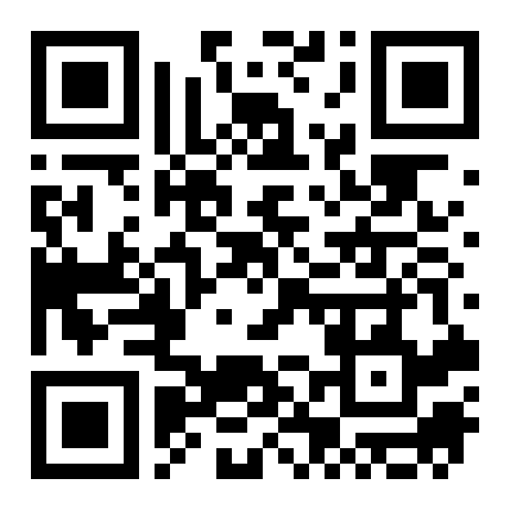
ATTENDANCE
Check in for tonight's meeting
Scan the QR code to sign in for attendance.
Requires your CofC login.
Can't scan? Go to forms.gle/ccN4CuqviXhndixq5
Scan to check in
ATTENDANCE
CofC Cybersecurity Club

Slide 3









AGENDA
Tonight's agenda
From exchange mechanics to hands-on exercises on the Range
How SSH key authentication works
Anatomy of an SSH connection
Asymmetric crypto, not a shared secret.
What happens before you see a password prompt.
SSH vulnerabilities
How RDP works
Weak keys, brute force, and regreSSHion.
NLA, encryption, and the graphical handshake.
RDP vulnerabilities
Hardening checklist
BlueKeep, exposure, and credential replay.
Concrete settings for both protocols.
Hardware option: a practice box
Exercises on the Range
Setting up a dedicated remote-access target.
Hands-on labs, SSH and RDP.
AGENDA
CofC Cybersecurity Club

Slide 4
RECAP
Quick recap: SSH and RDP basics
Covered two weeks ago, the short version
SSH
RDP
Text-only shell access, port 22. Encrypted end to end. Works everywhere via a client, servers, network gear, competition boxes.
A full graphical desktop, port 3389. Heavier bandwidth, sends screen images. Native to Windows, built in.
Tonight we go one level deeper: how each one works, and how each one fails.
RECAP
CofC Cybersecurity Club

Slide 5




DEFINITION
How SSH key authentication works
SSH key authentication proves your identity with math, not a shared secret. Your private key never leaves your machine, not even during login.
Key pair
Challenge-response
Host keys
known_hosts
A public key (shareable) and a private key (never shared), linked by math that's infeasible to reverse.
The server encrypts a challenge with your public key. Only your private key can answer it correctly.
The server has its own key pair too, so your client can verify it's talking to the real host.
Your client remembers each host's public key after the first connection, trust on first use.
SSH KEY AUTHENTICATION
CofC Cybersecurity Club

Slide 6


THE HANDSHAKE
What happens before you type a password
Five steps, and encryption starts on step two
→
→
→
→
1. TCP connect
2. Negotiation
3. Key exchange
4. Host key check
5. User authentication
Client opens a TCP connection to port 22.
Both sides agree on ciphers, key exchange method, and MACs.
Client and server derive a shared session key without sending it over the wire.
Client checks the server's key against known_hosts. This is where MITM gets caught.
Only now does the client prove who's connecting, key or password.
Everything after step 2 is already encrypted. Even a password login is protected by the channel steps 1-4 built first.
ANATOMY OF SSH
CofC Cybersecurity Club

Slide 7



WHERE IT BREAKS
SSH vulnerabilities
The protocol is sound, most real breaches come from configuration, not cryptography
Password auth & brute force
The most common way in. Automated tools try thousands of credentials against port 22.
Weak or reused keys
A key protects nothing if it's shared across machines or generated with a weak algorithm.
regreSSHion, CVE-2024-6387
Unauthenticated RCE as root from a signal-handling race condition. Disclosed July 2024, fixed in 9.8p1.
Skipped host key verification
Blindly accepting an unknown host key defeats the MITM protection SSH is built to provide.
Agent forwarding left on
Forwards your key's signing ability to every host you hop through, including a compromised one.
SSH VULNERABILITIES
CofC Cybersecurity Club

Slide 8

HOW RDP WORKS
What happens when you open a Remote Desktop session
Same idea as SSH's handshake, built for a graphical session instead
Network Level Authentication
CredSSP
RDP Security Layer
Virtual channels
Authenticates the user before a full session is created. Added in Vista/Server 2008, blocks many pre-auth attacks.
Wraps the initial credential exchange in TLS before RDP's own session even starts.
The graphical session itself is encrypted. Older systems allowed weaker fallback levels.
Clipboard, drives, and printers can be redirected into the session, useful, and a data-exfil path.
HOW RDP WORKS
CofC Cybersecurity Club

Slide 9


WHERE IT BREAKS
RDP vulnerabilities
A much larger graphical attack surface than a text shell
BlueKeep, CVE-2019-0708
A pre-authentication, wormable RCE in older Remote Desktop Services. Disclosed May 2019, affected Windows XP through Server 2008 R2.
Exposed to the internet
RDP is one of the most scanned ports on the internet. Leaving 3389 open invites automated brute force within minutes.
Pass-the-hash / credential replay
A captured hash from one Windows host can often authenticate an RDP session on another.
Legacy encryption downgrade
Without NLA and TLS enforced, a session can fall back to weaker, crackable encryption.
RDP VULNERABILITIES
CofC Cybersecurity Club

Slide 10
SIDE BY SIDE
SSH vs. RDP, attack surface
Same job, different exposure
SSH
RDP
Default port
22
3389
Authenticated before session opens
Always, transport encrypts first
Only if NLA is enabled
Most common attack
Credential brute force
Credential brute force, plus legacy RCEs
Notable CVE
regreSSHion, CVE-2024-6387
BlueKeep, CVE-2019-0708
Single best mitigation
Disable password auth, key-only
Enforce NLA, restrict via VPN or firewall
SSH VS RDP
CofC Cybersecurity Club

Slide 11
LOCKING IT DOWN
Hardening checklist
Recommended settings
SSH
RDP
PasswordAuthentication no
Require NLA
Disables password login entirely, key-only from here on.
Blocks the pre-authentication path most RDP RCEs rely on.
PermitRootLogin no
Never expose 3389 directly
Root has to log in as a normal user first, then elevate.
Put it behind a VPN or bastion, not the open internet.
AllowAgentForwarding no
Enforce account lockout
Off by default unless a specific host needs it.
Slows brute force to a crawl after a few failed attempts.
Keep OpenSSH patched
Keep Windows patched
regreSSHion shipped in a routine point release.
BlueKeep-class bugs target old, unpatched builds specifically.
HARDENING CHECKLIST
CofC Cybersecurity Club

Slide 12
HARDWARE OPTION
Setting up a remote access practice box, Part 1
1
2
3
4
Pick the hardware
Give it a static IP
Install a lightweight OS
Connect it to a common network
Any spare desktop or laptop works. It doesn't need to be powerful, just reachable.
A DHCP reservation or a manually assigned address, so the target doesn't move.
Ubuntu Server for an SSH target, Windows 10/11 for an RDP target, or both.
Same subnet as the laptops connecting in. This is about the connection, not the internet.
sudo apt install openssh-server sudo systemctl enable --now ssh sudo ufw allow 22/tcp ip addr show | grep inet
On the Ubuntu Server target: install and enable sshd, allow it through the local firewall, then confirm its address.
REMOTE ACCESS PRACTICE BOX, PART 1
CofC Cybersecurity Club

Slide 13
HARDWARE OPTION
Setting up a remote access practice box, Part 2
5
6
7
Enable Remote Desktop
Require Network Level Authentication
Allow it through the firewall
Settings > System > Remote Desktop, toggle it on, and note the PC name shown.
Same screen, under Advanced settings, leave this checked.
Windows Defender Firewall > Allow an app, Remote Desktop, for Private networks only.
Test the connection from a laptop:
SSH TARGET ssh user@192.168.1.50
RDP TARGET mstsc /v:192.168.1.51
Keep this box on the isolated network only. SSH and RDP targets set up for practice should never be reachable from outside during the session.
REMOTE ACCESS PRACTICE BOX, PART 2
CofC Cybersecurity Club

Slide 14
TONIGHT'S PRACTICE
Tonight's exercises
Four labs on the Range, working from both sides of the connection
1
Key-based SSH hardening
Generate a key, disable password auth on a Range host, verify you're locked out without the key.
2
Spot the brute force
Review a host's auth log for failed login attempts and pick out the pattern.
3
RDP connect & NLA check
Connect to a Range Windows host over RDP and confirm NLA is enforced.
4
Version fingerprint, bonus
Grab a service banner and match the version against a known CVE.
TONIGHT'S EXERCISES
CofC Cybersecurity Club

Slide 15
EXERCISE 1
Key-based SSH hardening
1
Generate a key pair
ssh-keygen -t ed25519
2
Copy it to the Range host
ssh-copy-id -i ~/.ssh/id_ed25519.pub user@range-host
3
Confirm key login works
ssh -i ~/.ssh/id_ed25519 user@range-host
4
Disable password auth
Edit /etc/ssh/sshd_config, set PasswordAuthentication no
5
Restart and verify
sudo systemctl restart sshd, then try logging in without the key
Success looks like: Permission denied (publickey) when you try without the key, and a clean login when you use it.
EXERCISE 1
CofC Cybersecurity Club

Slide 16
EXERCISE 2
Detect brute force
Somewhere in this host's log is an attack, find it
Failed password for invalid user admin from 203.0.113.44 port 51201 ssh2 Failed password for invalid user admin from 203.0.113.44 port 51203 ssh2 Failed password for root from 203.0.113.44 port 51207 ssh2 Failed password for root from 203.0.113.44 port 51210 ssh2 Accepted publickey for bob from 10.0.10.20 port 50122 ssh2
grep "Failed password" /var/log/auth.log
•
A pattern to look for: repeated attempts from the same IP, with different usernames.
•
Which line is the outlier? One connection succeeded, from a different address entirely.
•
Bonus: grab that host's SSH version banner (nc -v range-host 22) and check it against a known CVE.
EXERCISE 2
CofC Cybersecurity Club

Slide 17
EXERCISE 3
RDP connect & NLA check
Connect to a Range Windows host, then confirm what's protecting it
1
Get the host and credentials
Ask in #defense-team for a Range Windows host and login.
2
Connect from your machine
mstsc /v:<range-windows-host> (Windows), or a client like Remmina/Microsoft Remote Desktop elsewhere.
3
Check NLA on the host
System Properties > Remote, confirm "Allow connections only from computers running NLA" is checked.
4
Try a bare connection attempt
Watch what happens if NLA is off: you can reach the login screen before authenticating at all.
Why it matters: NLA is the single setting that separates a BlueKeep-class pre-auth bug from a non-issue.
EXERCISE 3
CofC Cybersecurity Club

Slide 18
WHERE THIS CAME FROM
Resources & citations
OpenSSH: protocol and usage docs
RFC 4253: SSH Transport Layer Protocol
openssh.com/manual.html
datatracker.ietf.org/doc/html/rfc4253
Qualys: regreSSHion, CVE-2024-6387
CISA advisory: BlueKeep, CVE-2019-0708
qualys.com/regresshion-cve-2024-6387
cisa.gov/news-events/cybersecurity-advisories/aa19-168a
Microsoft Learn: Network Level Authentication
Microsoft Learn: RDP security layers
learn.microsoft.com/windows-server/remote/remote-desktop-services
learn.microsoft.com/windows-server/remote/remote-desktop-services/clients/remote-desktop-security
MITRE ATT&CK: Remote Services
MITRE ATT&CK: Brute Force
attack.mitre.org/techniques/T1021
attack.mitre.org/techniques/T1110
RESOURCES
CofC Cybersecurity Club

Slide 19

NEXT SESSION
Thursday: Basic Networking & Communication
You now know how the connections themselves work. Thursday moves one layer down: IP addresses, subnets, and mapping what's on the network.
Simons 281, College of Charleston
Tuesdays & Thursdays, 5:30-7:00 PM
Questions on tonight's exercises? Ask in #defense-team
NEXT UP
CofC Cybersecurity Club

