Slide 1

THURSDAY SESSION · WEEK 7
Basic Host Hardening
Reviewing account lists, removing what does not belong, and locking down what remains
Tuesdays & Thursdays, 5:30-7:00 PM • Simons 281

Slide 2
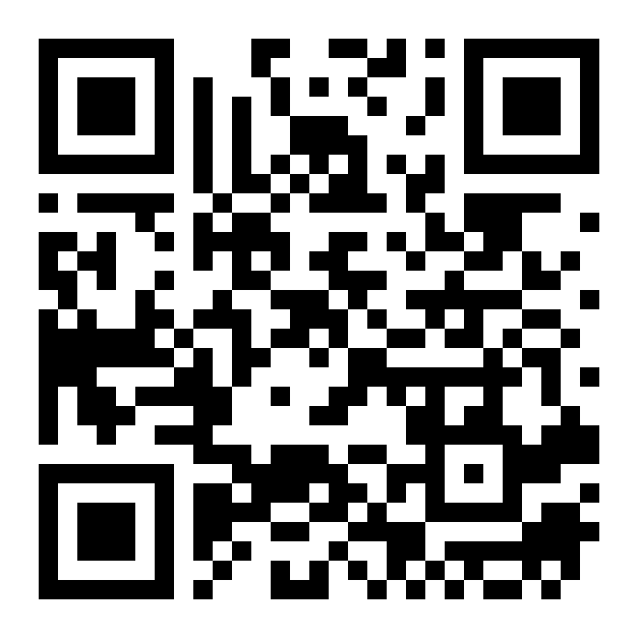
ATTENDANCE
Check in for tonight's meeting
Scan the QR code to sign in for attendance.
Requires your CofC login.
Can't scan? Go to forms.gle/ccN4CuqviXhndixq5
Scan to check in
ATTENDANCE
CofC Cybersecurity Club

Slide 3











AGENDA
Tonight's agenda
Practice on real hosts, using what Tuesday covered
Order of operations
Reviewing account lists
The sequence, straight from the club's own reference.
Who is on this host, and should they be.
Checking permissions and activity
Removing unnecessary accounts
What each account can do, and what it has done.
Delete versus disable, and when to use each.
Firewall basics
Locking down permissions
Default deny, then open only what is needed.
A working checklist, not just theory.
Finding dangerous permissions
Hardware option: the physical lab
SUID binaries and world writable files.
Auditing the shared machine from week one.
Physical vs. virtual config management
Exercises on the Range
Why one drifts and the other resets clean.
Audit, clean up, and lock down a real host.
AGENDA
CofC Cybersecurity Club

Slide 4
RECAP
Quick recap: the models and the mechanics
Tuesday covered access control models, user administration, and file permissions. Carrying forward: applying access control to a host, reviewing accounts, and locking down what doesn't belong.
RECAP
CofC Cybersecurity Club

Slide 5
WHERE TO START
Order of operations
The sequence tonight's exercises follow, straight from the club's own reference
1
Enumerate
2
Firewall
3
User management
4
Verify packages
What system is this. What users, services, and ports exist right now.
Install it, allow only what is needed.
List users, expire what is unneeded, change passwords.
dpkg --verify on Debian, rpm -Va on RHEL.
5
Update packages
6
Secure services
7
Auditd
apt update && apt upgrade, or yum/dnf.
Check configs, lock down accounts that run them.
Install it, then keep watching the logs.
Covered tonight: steps 1 and 3, plus related permissions work. Firewall, packages, and auditd come in later sessions.
Source: Linux Hardening Reference, CofC Cybersecurity Club, 2026.
ORDER OF OPERATIONS
CofC Cybersecurity Club

Slide 6

REVIEWING ACCOUNT LISTS
Does this account belong?
Duplicate UID 0
Empty password field
Recently created
Unexpected shell access
Only root should have UID 0. Any other account with it has full root access.
A blank password field in /etc/shadow means no password is required at all.
A new account nobody remembers creating is worth asking about.
A service account with /bin/bash instead of /usr/sbin/nologin can log in interactively.
awk -F: '($3 == 0) {print}' /etc/passwd # list every account with UID 0 find / -name authorized_keys 2>/dev/null # every SSH key trusted for login
Source: Linux Hardening Reference, CofC Cybersecurity Club, 2026.
ACCOUNT AUDITING
CofC Cybersecurity Club

Slide 7
REVIEWING ACCOUNT LISTS
Checking what a user can do
Group membership and granted rights, not just the account name
id username # UID, GID, and every group the user belongs to sudo -l -U username # exactly what that user can run with sudo getfacl /path/to/file # fine grained ACL entries beyond rwx
On Windows: whoami /groups and whoami /priv show group membership and privileges for the current session. Get-ADPrincipalGroupMembership checks a domain account remotely.
CHECKING PERMISSIONS
CofC Cybersecurity Club

Slide 8
REVIEWING ACCOUNT LISTS
Checking what a user is doing
Verifying user activity
who -a
Logged in users, session PIDs, and remote IPs
w
Same idea, plus what each session is running
last
Login history, including logout times
lastlog
The last login time for every account, even ones that never logged in
ps -u username
Every process currently owned by that user
On Windows, the Security event log records logons as Event ID 4624 and failed attempts as 4625. quser shows active Remote Desktop sessions.
Source: Linux Hardening Reference, CofC Cybersecurity Club, 2026.
CHECKING ACTIVITY
CofC Cybersecurity Club

Slide 9

CLEANING UP
Removing unnecessary accounts
Delete when you are sure. Disable when you are not.
userdel name
userdel -r name
usermod --expiredate 1
usermod --expiredate 2030-01-01
Removes the account. The home directory stays unless you add -r.
Removes the account and its home directory and mail spool together.
Disables the account immediately without deleting it. Easy to reverse.
Reactivates a previously expired account.
A SIMPLE RULE
If you are not sure whether an account is still needed, disable it and wait. If nobody notices or complains within a reasonable window, delete it.
Source: Linux Hardening Reference, CofC Cybersecurity Club, 2026.
REMOVING ACCOUNTS
CofC Cybersecurity Club

Slide 10
LOCKING IT DOWN
Firewall: allow only what is needed
Step two in the order of operations, right after user cleanup
Default deny, then open exactly the ports the host has to serve. Nothing else.
sudo apt install ufw -y sudo ufw allow ssh sudo ufw allow 443/tcp # https, only if this host serves it sudo ufw allow 8080/tcp # Jenkins, only if this host runs it sudo ufw enable
RHEL, CentOS, and Fedora use firewalld instead:
firewall-cmd --permanent --add-service=http firewall-cmd --reload
Source: Linux Hardening Reference, CofC Cybersecurity Club, 2026.
FIREWALL
CofC Cybersecurity Club

Slide 11
LOCKING IT DOWN
Locking down permissions, a checklist
Work through this list on every host you harden
1
Remove or disable accounts nobody can explain
2
Confirm only root has UID 0
3
Check sudoers for rules broader than they need to be
4
Fix world writable files and directories
5
Review SUID and SGID binaries for anything unexpected
6
Confirm PasswordAuthentication and PermitRootLogin are off in sshd_config
Source: Linux Hardening Reference, CofC Cybersecurity Club, 2026.
HARDENING CHECKLIST
CofC Cybersecurity Club

Slide 12
LOCKING IT DOWN
Finding dangerous permissions
Two searches that surface most of the risk on a host
SUID and SGID binaries
find / -perm -4000 -type f 2>/dev/null find / -perm -2000 -type f 2>/dev/null
Compare the output against a known baseline. A SUID binary you do not recognize is worth investigating first.
World writable files
find / -xdev -type f -perm -0002 2>/dev/null find / -nouser -o -nogroup 2>/dev/null
Any user can edit a world writable file. Files with no valid owner are often leftovers from a deleted account.
Source: Linux Hardening Reference, CofC Cybersecurity Club, 2026.
FINDING DANGEROUS PERMISSIONS
CofC Cybersecurity Club

Slide 13
TONIGHT'S PRACTICE
Tonight's exercises
Audit, harden, lock
1
Audit the account list
Pull the full account list from a Range host and flag anything that does not belong.
2
Remove or disable accounts
Act on what you flagged. Disable if unsure, delete if certain.
3
Lock down file permissions
Find and fix SUID binaries and world writable files you cannot justify.
TONIGHT'S EXERCISES
CofC Cybersecurity Club

Slide 14
EXERCISE 1
Audit the account list on a Range host
Read before you touch anything
1
Pull the account list
cat /etc/passwd
2
Check for duplicate UID 0
awk -F: '($3 == 0) {print}' /etc/passwd
3
Check for planted SSH keys
find / -name authorized_keys 2>/dev/null
4
Check last login for every account
lastlog
5
Flag anything you cannot explain
Write down the account name and note concerns
EXERCISE 1
CofC Cybersecurity Club

Slide 15
EXERCISE 2
Remove or disable unnecessary accounts
1
2
3
4
Pick one flagged account
Decide: disable or delete
Run the command
Confirm the change
Something from your list in exercise one.
Unsure, disable it. Certain, delete it.
usermod -L name, or userdel -r name.
id name should fail, or the account should show locked.
BEFORE DELETING
Check what the account owns first: find / -user name. Deleting the account does not delete its files, but you should know what is about to be orphaned.
EXERCISE 2
CofC Cybersecurity Club

Slide 16
EXERCISE 3
Lock down file permissions
Find it, decide, fix it
1
Find SUID and SGID binaries
find / -perm -4000 -o -perm -2000 -type f 2>/dev/null
2
Find world writable files
find / -xdev -type f -perm -0002 2>/dev/null
3
For each result, decide
Does this need the permission it has
4
Fix what does not belong
chmod u-s file, or chmod o-w file
When in doubt, ask before removing a permission on a host you do not fully understand yet.
EXERCISE 3
CofC Cybersecurity Club

Slide 17
WHERE THIS CAME FROM
Resources & citations
Linux Hardening Reference, 2026
useradd(8), userdel(8), usermod(8)
Tyler McGuire, CofC Cybersecurity Club
Linux man-pages
gpasswd(1), Linux man-pages
find(1), Linux man-pages
man7.org
man7.org
chage(1), Linux man-pages
ufw and firewalld documentation
man7.org
help.ubuntu.com, firewalld.org
sshd_config(5), OpenSSH manual
CIS Benchmarks, Linux and Windows
openssh.com
cisecurity.org
RESOURCES
CofC Cybersecurity Club

Slide 18


NEXT SESSION
Tuesday: System Services & Background Processes
You now know who is on a host and what they can do. Next up: what runs in the background even when nobody is logged in at all.
Simons 281, College of Charleston
Tuesdays & Thursdays, 5:30-7:00 PM
Questions on tonight's exercises? Ask in #defense-team
NEXT UP
CofC Cybersecurity Club

