Slide 1

THURSDAY SESSION · WEEK 11
Analyzing Traffic for Incidents
Wireshark on recorded traffic, hunting for credentials and scans
Tuesdays & Thursdays, 5:30-7:00 PM • Simons 281

Slide 2

ATTENDANCE
Check in for tonight's meeting
Scan the QR code to sign in for attendance.
Requires your CofC login.
Can't scan? Go to forms.gle/ccN4CuqviXhndixq5
Scan to check in
ATTENDANCE
CofC Cybersecurity Club

Slide 3









AGENDA
Tonight's agenda
The Wireshark interface
Capture vs. display filters
Three panes, and what each one is for.
Two types of filters.
Display filters
Building filters, Follow Stream
How to filter for specific traffic.
Reading a whole exchange.
Statistics: hierarchy, conversations, IO graph
Coloring rules
What the colors already tell you before you filter.
Expert Information & Export Objects
Finding unencrypted credentials
Reconstructing files from packets.
Which protocols leak, and how to spot it.
Finding scanning signatures
Exercises on the Range
What a scan looks like once it is in transit.
Practice what you’ve learned.
AGENDA
CofC Cybersecurity Club

Slide 4
RECAP
Quick recap: reading packets
Tuesday covered packet structure and a baseline for normal traffic. Carrying forward: going deeper on traffic analysis tools.
RECAP
CofC Cybersecurity Club

Slide 5



DEFINITION #1
What does analyzing for incidents mean?
Incident analysis is working backward from a capture file to answer a specific question: what happened, when, and who did it. It is not scrolling through everything. It is narrowing a huge file down to the handful of packets that matter.
You start with a file
You start with a question
You filter, you do not read
You end with an answer
A .pcap someone else captured, or your own from tonight's monitoring work.
Did someone's password leak. Was this host scanned. Rarely both at once.
Thousands of packets, a handful that matter. Filters get you there fast.
Something specific enough to write in an incident report.
WHAT IS INCIDENT ANALYSIS
CofC Cybersecurity Club

Slide 6


WIRESHARK
The Wireshark interface, three panes
Everything else builds on knowing what each one shows
Packet List
Packet Details
Packet Bytes
Every packet, one per row. Time, source, destination, protocol, and a short description. Click a row to inspect it.
The selected packet, broken into its layers. Expand Ethernet, then IP, then TCP, exactly like the diagrams from Tuesday.
The raw hex and ASCII. Click a field above and its exact bytes highlight here automatically.
The three panes stay in sync: selecting a packet updates the details pane and highlights its bytes in the hex pane.
Source: Wireshark User's Guide, Chapter 6, "The Main Window."
THE WIRESHARK INTERFACE
CofC Cybersecurity Club

Slide 7
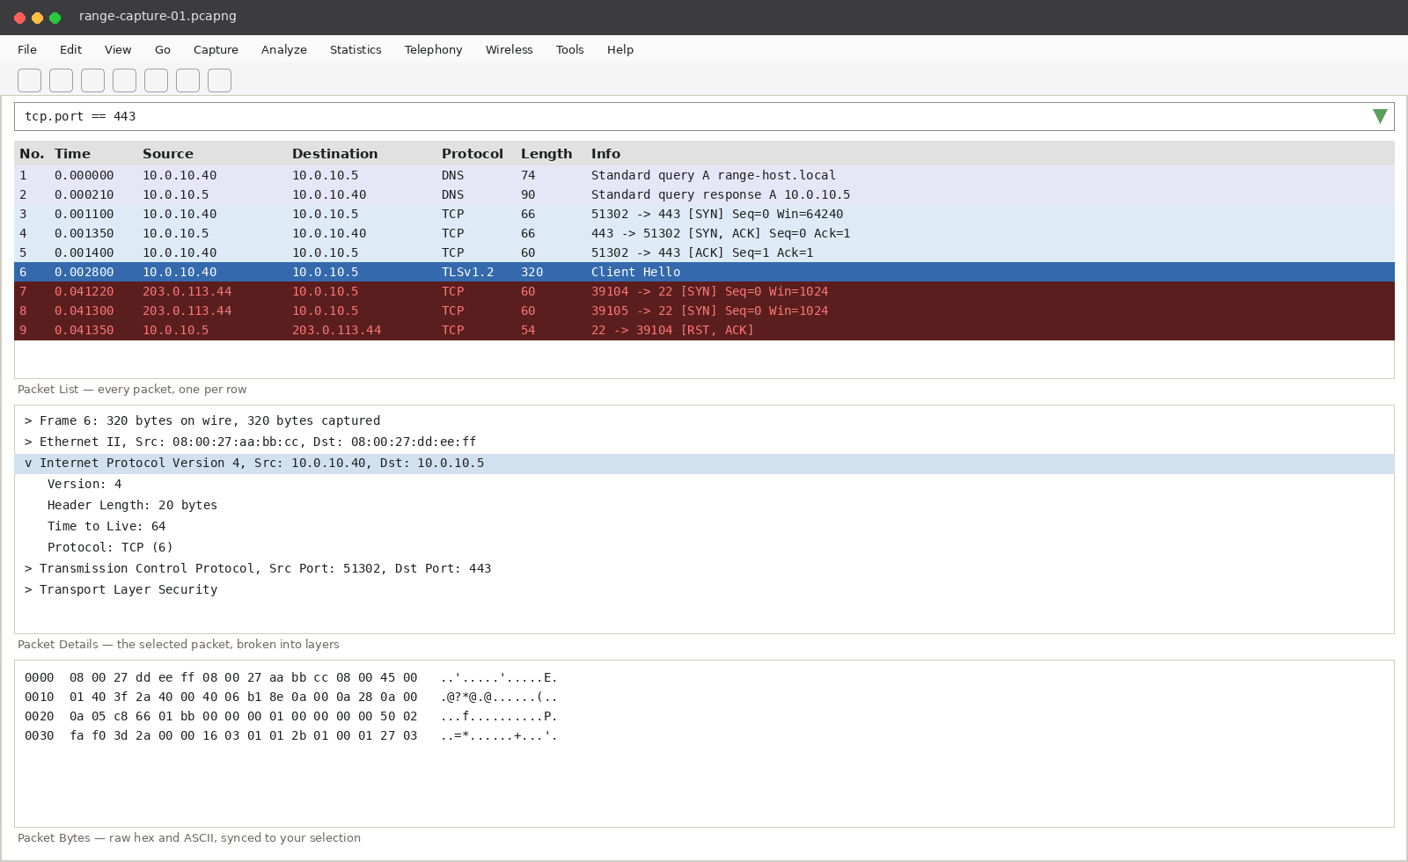
WIRESHARK
The three panes, together
WIRESHARK
CofC Cybersecurity Club

Slide 8
WIRESHARK
Capture filters vs. display filters
Two different filters, two different jobs, easy to mix up
CAPTURE FILTER
DISPLAY FILTER
When it applies
Before capture starts. Packets that do not match never get recorded.
After capture. Every packet is already saved, you are just hiding rows.
Syntax
Berkeley Packet Filter, the same syntax tcpdump uses
Wireshark's own syntax, understands protocol fields directly
Example
tcp port 443
tcp.port == 443, or http.request.method == "POST"
Where to set it
Capture > Capture Filters, or the interface list before you start
The filter bar at the top of the main window, any time
CAPTURE VS DISPLAY FILTERS
CofC Cybersecurity Club

Slide 9
WIRESHARK
Display filters, the cookbook
The ones worth memorizing
ip.addr == 10.0.10.5
Everything to or from one host, either direction
tcp.port == 443 || tcp.port == 80
Combine filters with && and ||
http.request
Only HTTP requests, not every packet in the exchange
tcp.flags.syn == 1 && tcp.flags.ack == 0
Only the opening SYN of every connection attempt
tcp.analysis.retransmission
Packets Wireshark itself flagged as resent
frame contains "password"
A blunt but effective search across raw packet bytes
DISPLAY FILTER COOKBOOK
CofC Cybersecurity Club

Slide 10
WIRESHARK
Follow TCP Stream
One conversation, reassembled, instead of packets scattered across the list
1
2
3
Right-click a packet
Follow, then TCP Stream
Read it like a transcript
Anywhere inside the conversation you care about
Wireshark reassembles every packet in that connection into one readable block
Client requests in one color, server responses in another
Why this beats reading packet by packet
A login might span a dozen packets, split across requests and responses. Follow TCP Stream puts the username and password next to each other in order, exactly like it happened, instead of asking you to piece it together.
FOLLOW TCP STREAM
CofC Cybersecurity Club

Slide 11


WIRESHARK
Building filters without typing
The right-click menu writes filter syntax for you
Apply as Filter
Prepare as Filter
Follow Stream, more than TCP
Right-click any field, choose Selected. Wireshark writes the filter and applies it immediately, replacing whatever was in the filter bar.
Same menu, but it only writes the filter into the bar without running it, so you can combine it with "...and Selected" from another field first.
The same right-click menu offers UDP Stream, HTTP Stream, and TLS Stream, each reassembling that specific protocol's conversation.
This is how experienced analysts build complicated filters fast: click a field, apply it, right-click the next field, "...and Selected," repeat.
Source: Wireshark User's Guide, Chapter 6, "Filtering Packets while Viewing."
BUILDING FILTERS
CofC Cybersecurity Club

Slide 12



WIRESHARK
The Statistics menu, the big picture first
Before you filter for one packet, see the shape of the whole capture
Protocol Hierarchy
Conversations
Endpoints
Every protocol in the capture, with a percentage. A capture that is 40% ARP is telling you something before you look at a single packet.
Every pair of hosts that talked, sorted by bytes or packets. One host touching hundreds of others is a scan, at a glance.
Every unique host in the capture, one list. Fast way to see who was even involved.
Source: Wireshark User's Guide, Chapter 8, "Statistics."
STATISTICS MENU
CofC Cybersecurity Club

Slide 13


WIRESHARK
IO Graph: traffic volume over time
Statistics > I/O Graph, the shape of the capture as a picture
A table of numbers is hard to scan for a spike. A graph is not. Statistics > I/O Graph plots packets or bytes per second across the whole capture, and lets you overlay a filtered line on top of the total.
A sudden spike
A dead period
Overlaid filters
A burst of packets far above the baseline often lines up exactly with a scan or a flood.
Traffic that should be steady but goes quiet can matter as much as a spike does.
Plot tcp.flags.syn==1 alongside total traffic to see scan activity as its own line on the same graph.
Source: Wireshark User's Guide, Chapter 8, "The IO Graphs Window."
IO GRAPH
CofC Cybersecurity Club

Slide 14
WIRESHARK
Coloring rules: information before you filter
The packet list always tells you something
Light purple / lavender
Ordinary TCP traffic. The background noise of any capture.
Light green
HTTP. Worth a second look if you did not expect web traffic here.
Light blue
UDP traffic, DNS included.
Black on red
Wireshark's own analysis flagged a problem: a retransmission, an out of order segment, a bad checksum.
Black on yellow
A warning level condition, less severe than the red rule but still worth reading.
View > Coloring Rules shows the full list, and lets you add your own.
Source: Wireshark User's Guide, Chapter 11, "Packet Colorization."
COLORING RULES
CofC Cybersecurity Club

Slide 15
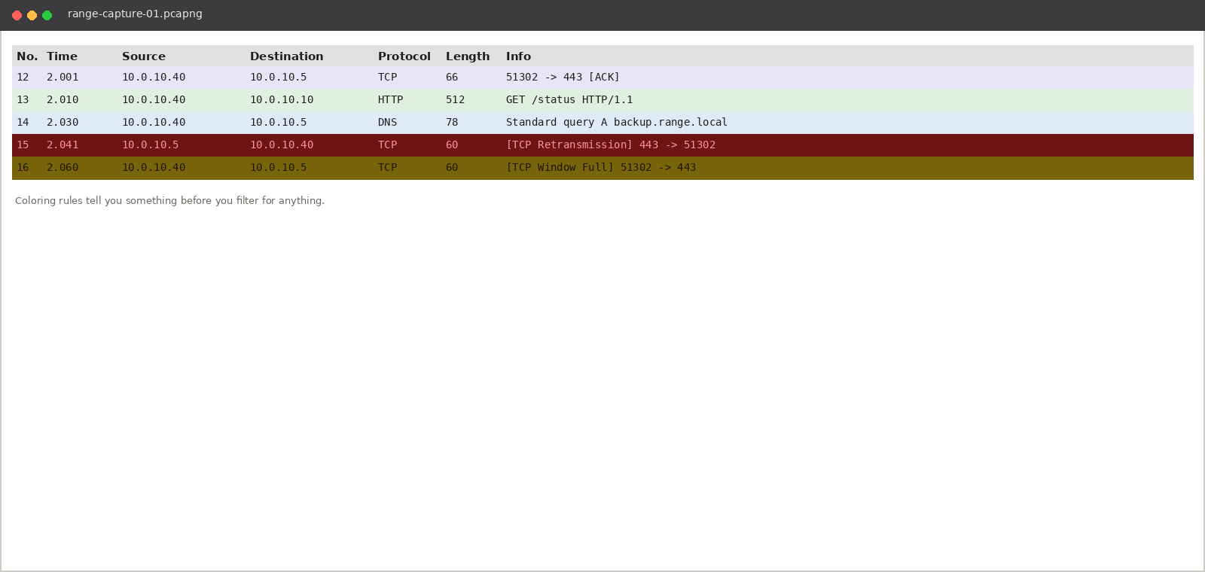
WIRESHARK
Coloring rules, on screen
WIRESHARK
CofC Cybersecurity Club

Slide 16
WIRESHARK
Expert Information: triage in one click
Analyze > Expert Information, or the colored circle bottom left of the window
Error, red
A serious problem: a malformed packet, something that violates the protocol spec outright.
Warning, yellow
Worth checking: a connection reset, a zero window, an unusual response code.
Note, cyan
Notable but often harmless: a retransmission, a duplicate ACK.
Chat, blue
Purely informational: a normal part of a protocol's ordinary flow.
Make this the first click, not the last
Sort by severity, worst first, and click an entry to jump straight to that packet. On a large capture it finds the interesting parts faster than any filter you would think to write first.
Source: Wireshark User's Guide, Chapter 7, "Expert Information."
EXPERT INFORMATION
CofC Cybersecurity Club

Slide 17
WIRESHARK
Export Objects: pulling files out of a capture
File > Export Objects > HTTP, and a few other protocols
Wireshark can list every file transferred over HTTP, SMB, TFTP, or a handful of other protocols in a capture, and save any of them to disk directly. This is how a suspicious file gets from a pcap onto an analyst's desk.
Packet #
1847
Which packet the object completed in
Hostname
invoices-portal.example.com
The server that sent it
Content Type
application/msword
What the server claimed it was
Filename
Invoice_MSO-Request.doc
The name it was saved with
Content Type is what the server claimed. A malicious server can label a Windows executable as something else entirely to slip past a quick glance.
Source: Wireshark User's Guide, Chapter 5, "Exporting Data."
EXPORT OBJECTS
CofC Cybersecurity Club

Slide 18

FINDING CREDENTIALS
Why plaintext credentials still show up
TLS is everywhere now, and yet
Legacy systems
Misconfiguration
Internal assumed to be safe
Old equipment, old firmware, and internal tools nobody has revisited since they were installed.
A service that supports encryption, running without it because nobody enforced the setting.
Traffic that never leaves a local network sometimes skips encryption on the assumption nobody is watching.
None of this requires breaking encryption. If the traffic was never encrypted in the first place, Wireshark shows it exactly as it crossed the wire, no cracking involved.
WHY PLAINTEXT STILL HAPPENS
CofC Cybersecurity Club

Slide 19
FINDING CREDENTIALS
Protocols that commonly leak credentials
Know these by name, and treat any sighting as worth checking
HTTP Basic Auth
The credential is base64 encoded, not encrypted. Trivial to decode.
FTP
Username and password sent as separate plaintext commands, USER and PASS.
Telnet
Every keystroke, including login credentials, travels unencrypted.
POP3 / IMAP without TLS
Mail credentials sent in the clear unless STARTTLS is negotiated.
SNMP v1 / v2c
The community string acts as a password, and is sent in plaintext.
PROTOCOLS THAT LEAK CREDENTIALS
CofC Cybersecurity Club

Slide 20
WORKED EXAMPLE
Finding a password in HTTP traffic
The walkthrough
1
Filter for HTTP requests
http.request
2
Look for a POST to a login page
http.request.method == "POST"
3
Follow that stream
Right-click, Follow, HTTP Stream
4
Read the form data
username=jsmith&password=Summer2026!
The whole point of the walkthrough
No cracking, no brute force. The login form simply was not using HTTPS, so the password was sitting in the capture the entire time, in cleartext.
WORKED EXAMPLE: CREDENTIALS
CofC Cybersecurity Club

Slide 21


FINDING SCANS
What a scan looks like in traffic
The pattern matters more than any single packet
One host, many destinations
Tight timing
Handshakes that never finish
A wave of resets
A single source IP showing up in far more conversations than any normal client would generate.
Connections attempted seconds or milliseconds apart, faster than a person clicking around.
Many SYNs, few completed three way handshakes. A real client finishes what it starts.
Closed ports answer a SYN with an RST. A scan against many ports produces a burst of them.
Statistics > Conversations, sorted by number of connections, usually finds this faster than any filter.
WHAT A SCAN LOOKS LIKE
CofC Cybersecurity Club

Slide 22
WORKED EXAMPLE
Spotting an nmap scan
The walkthrough
1
Open Statistics > Conversations
Sort the TCP tab by number of packets
2
Spot the outlier
One source IP with connections to dozens of destination ports on the same host
3
Filter to confirm it
tcp.flags.syn == 1 && tcp.flags.ack == 0 && ip.src == 10.0.30.10
4
Check the response pattern
A run of RST replies, one per closed port, confirms a port scan rather than normal use
10.0.30.10 is the Range's Kali box
If you see that address showing up as the source of a scan pattern in a capture, that is expected on the Range. Elsewhere, it would be the finding itself.
WORKED EXAMPLE: SCAN
CofC Cybersecurity Club

Slide 23
APPLYING IT
Reading real captures
Three snapshots, each from a different capture. Not all of them are incidents.
Read the summary
Decide as a group
Then compare
Protocol mix, conversation pattern, or a stream excerpt, whatever is shown.
Credential leak, scan, or nothing notable, before looking at the answer.
Every verdict comes with the reasoning, right or wrong.
Guessing incident every time is not the skill. Some of these are exactly what a normal day looks like.
READING REAL CAPTURES
CofC Cybersecurity Club

Slide 24
EXAMPLE 1 OF 3
Capture C: public facing web server, port 443
Credential leak, scan, or clean?
Conversations
1 destination IP, 300+ source IPs, all on port 443
TCP flags seen
Handshakes complete normally, ordinary request and response sizes
EXAMPLE 3
CofC Cybersecurity Club

Slide 25
EXAMPLE 2 OF 3
Capture A: internal file server
Credential leak, scan, or clean?
Protocol mix
94% FTP-DATA, 6% FTP
Stream excerpt
USER bwilson\r\n331 Password required\r\nPASS Cougars2026\r\n230 Login successful
EXAMPLE 1
CofC Cybersecurity Club

Slide 26
EXAMPLE 3 OF 3
Capture B: DMZ web server, port 443 inbound
Credential leak, scan, or clean?
Conversations
1 source IP, 41 destination ports on the same host, 1.8 seconds
TCP flags seen
39x SYN only, 2x completed handshake
EXAMPLE 2
CofC Cybersecurity Club

Slide 27
ANSWER KEY
The three captures, revealed
# | Capture | Verdict | Why
1 | Capture C, public web server | CLEAN | Many different clients to one server is a popular website. A scan is one source reaching many destinations, not the reverse.
2 | Capture A, internal file server | CREDENTIAL LEAK | FTP sends the username and password as two separate plaintext commands, both visible in the stream.
3 | Capture B, DMZ web server | SCAN DETECTED | One source hit dozens of ports in under two seconds with almost no completed handshakes.
ANSWER KEY
CofC Cybersecurity Club

Slide 28
TONIGHT'S PRACTICE
Tonight's exercises
Three captures on the Range, three questions to answer
1
Find the leaked credential
A provided capture has one plaintext login in it somewhere. Find it and Follow the Stream.
2
Confirm a scan
Use Statistics > Conversations to find the outlier, then filter to prove it.
3
Write it up
One paragraph: what happened, which host, and what evidence supports the finding.
TONIGHT'S EXERCISES
CofC Cybersecurity Club

Slide 29
EXERCISE 1
Find the leaked credential
One capture, one plaintext login hiding in it
1
Open the provided capture
File > Open, range-capture-01.pcapng
2
Check Protocol Hierarchy first
Statistics > Protocol Hierarchy, look for FTP, Telnet, or plain HTTP
3
Filter to that protocol
ftp, or telnet, or http.request.method == "POST"
4
Follow the stream
Right-click the packet, Follow, then the matching stream type
5
Write down what you found
The protocol, the username, and the password
EXERCISE 1
CofC Cybersecurity Club

Slide 30
EXERCISE 2
Confirm a scan
Find the outlier, then prove it with a filter
1
2
3
4
Open Statistics > Conversations
Identify the outlier
Build a filter around it
Confirm the pattern
Sort the TCP tab by number of packets, descending
One source IP touching far more destination ports than anything else in the list
tcp.flags.syn == 1 && tcp.flags.ack == 0 && ip.src == [that address]
Many SYNs, very few completed handshakes, a burst of RSTs from closed ports
EXERCISE 2
CofC Cybersecurity Club

Slide 31
EXERCISE 3
Write it up
The finding is only useful if someone else can act on it
A ONE PARAGRAPH INCIDENT NOTE SHOULD ANSWER
•
What happened. A plaintext credential, or a scan, stated plainly.
•
Which host, or hosts. Source and destination, by IP.
•
What evidence supports it. The filter or stream you used to confirm it.
•
When. The timestamp from the capture, not when you happened to find it.
Keep it factual. "Possible credential exposure on 10.0.10.40" beats "someone hacked the mail server."
EXERCISE 3
CofC Cybersecurity Club

Slide 32
WHERE THIS CAME FROM
Resources & citations
Wireshark User's Guide, Chapter 5, Exporting Data
Wireshark User's Guide, Chapter 6, Main Window & Filtering
wireshark.org/docs/wsug_html_chunked
wireshark.org/docs/wsug_html_chunked
Wireshark User's Guide, Chapter 7, Expert Information
Wireshark User's Guide, Chapter 8, Statistics & IO Graphs
wireshark.org/docs/wsug_html_chunked
wireshark.org/docs/wsug_html_chunked
Wireshark User's Guide, Chapter 11, Colorization
Wireshark Display Filter Reference
wireshark.org/docs/wsug_html_chunked
wireshark.org/docs/dfref
RFC 959: File Transfer Protocol
RFC 854: Telnet Protocol Specification
rfc-editor.org/rfc/rfc959
rfc-editor.org/rfc/rfc854
MITRE ATT&CK T1040: Network Sniffing
MITRE ATT&CK T1046: Network Service Discovery
attack.mitre.org/techniques/T1040
attack.mitre.org/techniques/T1046
RESOURCES
CofC Cybersecurity Club

Slide 33


NEXT SESSION
Coming up next
You now know how to pull an answer out of a capture instead of scrolling through one. That skill carries straight into every incident response session from here on.
Simons 281, College of Charleston
Tuesdays & Thursdays, 5:30-7:00 PM
Questions on tonight's exercises? Ask in #defense-team
NEXT UP
CofC Cybersecurity Club

