Slide 1

TUESDAY SESSION · WEEK 13
Web Infrastructure Basics: DNS
How domain name resolution works, from your laptop to an authoritative answer
Tuesdays & Thursdays, 5:30-7:00 PM • Simons 281

Slide 2
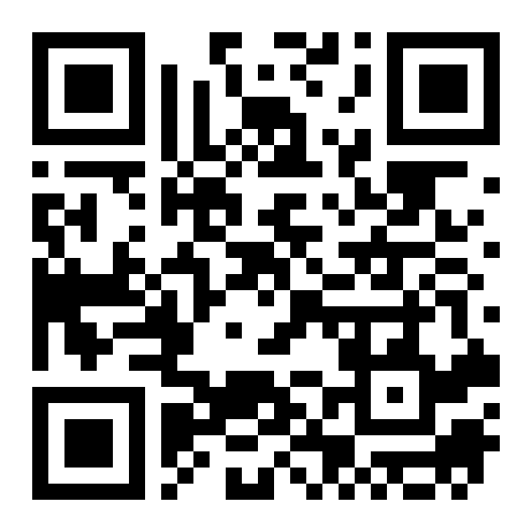
ATTENDANCE
Check in for tonight's meeting
Scan the QR code to sign in for attendance.
Requires your CofC login.
Can't scan? Go to forms.gle/ccN4CuqviXhndixq5
Scan to check in
ATTENDANCE
CofC Cybersecurity Club

Slide 3






AGENDA
Tonight's agenda
From what a name means to standing up your own zone
What is DNS?
The resolution chain
Hierarchical, distributed name resolution.
Stub resolver to root to TLD to authoritative.
Record types
Zones & zone files
A, AAAA, CNAME, MX, TXT, NS, SOA.
Where a domain's records live.
Caching & TTL
Setting up a zone
Why answers do not always hit the source.
Standing up BIND9 in a local VM.
AGENDA
CofC Cybersecurity Club

Slide 4
RECAP
Quick recap: reading a capture
Thursday covered working backward from a capture file to answer a specific question. Carrying forward: DNS, the traffic type that shows up in nearly every capture, and what happens when a hostname resolves.
RECAP
CofC Cybersecurity Club

Slide 5



DEFINITION #1
What is DNS?
The Domain Name System translates hostnames people can remember into IP addresses machines route on. It is hierarchical and distributed. No single server holds every answer.
Hierarchical
Distributed
Cached
Human-readable
A tree of authority, root at the top, the most specific answer at the bottom.
Authority is delegated per zone. No single server holds every record.
Answers are reused for a TTL window instead of asked fresh every time.
Translates a name like club.cofc.edu into an address a machine routes on.
WHAT IS DNS?
CofC Cybersecurity Club

Slide 6
THE LOOKUP PATH
The resolution chain
Five hops, most of the time answered before the third
1
Check the local cache
The stub resolver on your machine checks if it already knows the answer.
2
Ask the recursive resolver
Your ISP, or a public one like 1.1.1.1, does the rest of the work for you.
3
Root server
Points the resolver toward the right top-level domain (.edu, .com, .org).
4
TLD server
Points the resolver toward the domain's actual authoritative server.
5
Authoritative server
Holds the real record and returns the answer, which gets cached on the way back.
THE RESOLUTION CHAIN
CofC Cybersecurity Club

Slide 7
RECORD TYPES
The records worth knowing
Every zone is built from a handful of record types
Type | Name | Purpose
A | Address | Maps a name to an IPv4 address.
AAAA | Address, IPv6 | Maps a name to an IPv6 address.
CNAME | Canonical Name | Aliases one name to another name, not an address.
MX | Mail Exchange | Names the mail server for a domain, with a priority.
TXT | Text | Arbitrary text. Commonly used for SPF, DKIM, and domain verification.
NS | Name Server | Delegates a zone, or subdomain, to another authoritative server.
SOA | Start of Authority | A zone's own metadata: serial number, refresh, retry, expire.
THE RECORDS WORTH KNOWING
CofC Cybersecurity Club

Slide 8

WHERE IT ALL LIVES
Zones & zone files
A zone is a piece of the namespace one server is authoritative for
Zone
Zone file
A portion of the DNS namespace one authoritative server is responsible for.
A plain text file listing every record in that zone, one line each.
SOA record
Delegation
Every zone file starts with one: serial number, refresh, retry, expire, minimum TTL.
An NS record hands off a subdomain to a different authoritative server entirely.
ZONES & ZONE FILES
CofC Cybersecurity Club

Slide 9


WHY ANSWERS GO STALE
Caching & TTL
A cached answer is not always the current answer
TTL
Positive vs. negative caching
Time to Live, in seconds. How long a resolver may reuse an answer before asking again.
Successful answers get cached. So do NXDOMAIN failures, for a shorter window.
Where caches live
Why it matters for defenders
Your OS, your browser, your recursive resolver: the same name can be cached in four places at once.
A record change does not take effect everywhere instantly. Old answers can outlive the change that made them wrong.
CACHING & TTL
CofC Cybersecurity Club

Slide 10
PRACTICAL STEP ONE
Setting up a zone: BIND9
Standing up a real authoritative server in a local VM
1
Install BIND9
apt install bind9 bind9utils, on a Debian or Ubuntu VM.
2
Declare the zone
Add a zone block to /etc/bind/named.conf.local naming the domain and its zone file.
3
Write the zone file
SOA record first, then NS, then A records, under /etc/bind/db.yourdomain.
4
Restart and check syntax
named-checkzone yourdomain /etc/bind/db.yourdomain, then systemctl restart bind9.
5
Query it
dig @localhost yourdomain, confirm the answer matches what you wrote.
SETTING UP A ZONE: BIND9
CofC Cybersecurity Club

Slide 11
HARDWARE OPTION
A local DNS helper for the lab
Pi-hole or BIND9, watching every query the lab makes
1
Pick the hardware
A Raspberry Pi or a spare small machine, always on, on the lab network.
2
Install Pi-hole
The official install script sets up a resolver and a web dashboard together.
3
Point lab clients at it
Set it as the DNS server in the lab's DHCP settings, or by hand per machine.
4
Watch the query log
Every lookup the lab makes shows up live, a good baseline for what normal looks like.
A LOCAL DNS HELPER FOR THE LAB
CofC Cybersecurity Club

Slide 12
TONIGHT'S PRACTICE
Tonight's exercises
Query, write, and trace
1
Query a record
Use dig or nslookup on a real domain and read the answer section.
2
Write a zone file
Build a minimal zone: SOA, NS, and one A record. Load it into BIND9.
3
Trace a resolution
dig +trace a domain and read every hop from root to authoritative.
TONIGHT'S EXERCISES
CofC Cybersecurity Club

Slide 13
EXERCISE 1
Query a record
Read the answer section, not just the top line
1
Pick a domain
Any real, public domain works.
2
Query it
dig cofc.edu, or nslookup cofc.edu on Windows.
3
Read the answer section
Find the A record, and note its TTL.
4
Query it again
Run it a second time immediately. Does the TTL count down?
QUERY A RECORD
CofC Cybersecurity Club

Slide 14
EXERCISE 2
Write a zone file
Three records is enough to serve a real answer
1
Create the zone file
Start with an SOA record, serial number and all.
2
Add an NS record
Point the zone at your own server as its name server.
3
Add one A record
Give one hostname in your zone a real IP address.
4
Load and verify
named-checkzone, restart bind9, then dig @localhost to confirm.
WRITE A ZONE FILE
CofC Cybersecurity Club

Slide 15
EXERCISE 3
Trace a resolution
Every hop, from root to the final answer
1
Run the trace
dig +trace cofc.edu
2
Find the root hint
The first block of servers answering are the root servers.
3
Find the TLD referral
The next block points you at .edu's name servers.
4
Find the final answer
The last server queried is authoritative for the domain itself.
TRACE A RESOLUTION
CofC Cybersecurity Club

Slide 16
WHERE THIS CAME FROM
Resources & citations
RFC 1034: DNS Concepts and Facilities
RFC 1035: DNS Implementation and Specification
rfc-editor.org/rfc/rfc1034
rfc-editor.org/rfc/rfc1035
RFC 1912: Common DNS Operational and Configuration Errors
BIND 9 Administrator Reference Manual
rfc-editor.org/rfc/rfc1912
bind9.readthedocs.io
Pi-hole documentation
IANA Root Zone Database
docs.pi-hole.net
iana.org/domains/root/db
RESOURCES
CofC Cybersecurity Club

Slide 17

NEXT SESSION
Thursday: DNS Auditing & Configuration Check
You now know how a zone is supposed to look. Thursday is about spotting one that is not: open recursion, exposed zone transfers, and records nobody can explain.
Simons 281, College of Charleston
Tuesdays & Thursdays, 5:30-7:00 PM
Questions on tonight's material? Ask in #defense-team
NEXT UP
CofC Cybersecurity Club

