Slide 1

THURSDAY SESSION · WEEK 13
DNS Auditing & Configuration Check
Finding the misconfigurations a working zone can still hide
Tuesdays & Thursdays, 5:30-7:00 PM • Simons 281

Slide 2
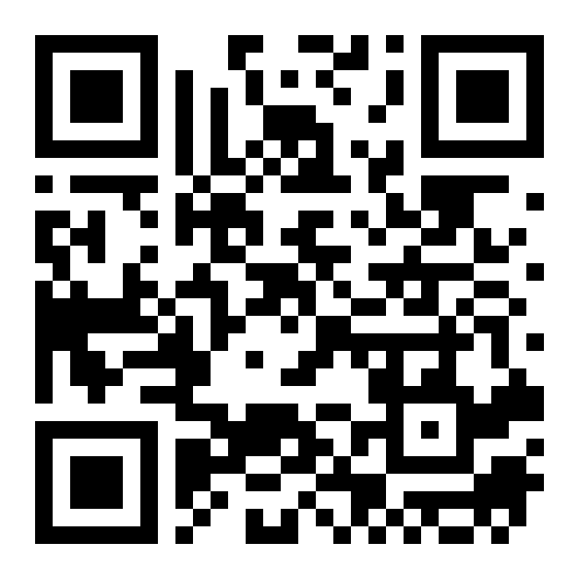
ATTENDANCE
Check in for tonight's meeting
Scan the QR code to sign in for attendance.
Requires your CofC login.
Can't scan? Go to forms.gle/ccN4CuqviXhndixq5
Scan to check in
ATTENDANCE
CofC Cybersecurity Club

Slide 3






AGENDA
Tonight's agenda
Same records from Tuesday, now looking for what is wrong with them
Common misconfigurations
Zone transfers
Open recursion, stale records, wildcard records.
AXFR, and why an open one is a problem.
Auditing a zone
Tools
What to check, in what order.
dig, host, and reading their output.
Fixing what you find
Exercises on the Range
Correcting a record without breaking the zone.
Audit, confirm, and fix a real zone.
AGENDA
CofC Cybersecurity Club

Slide 4
RECAP
Quick recap: what a zone looks like
Tuesday covered the resolution chain, record types, and standing up a zone with BIND9. Carrying forward: reading a zone with a more skeptical eye.
RECAP
CofC Cybersecurity Club

Slide 5



WHERE THINGS GO WRONG
Common DNS misconfigurations
A zone can resolve correctly and still be a liability
Open recursion
Exposed zone transfers
A resolver answering queries for anyone, not just its own network. Abused for amplification attacks.
AXFR allowed to any requester hands over the entire zone in one query.
Stale or orphaned records
Wildcard records
An A record pointing at a decommissioned host nobody remembers to remove.
A wildcard A record answers for every possible subdomain, often wider than intended.
COMMON DNS MISCONFIGURATIONS
CofC Cybersecurity Club

Slide 6
DEFINITION #1
What is a zone transfer?
A zone transfer copies every record in a zone from one name server to another. It exists so secondary servers can stay in sync with the primary. It was never meant to answer to a stranger.
AXFR
IXFR
Who should ask
Who often can
A full zone transfer. Every record, in one response.
An incremental transfer. Only what changed since the last sync.
Only a zone's own declared secondary servers, listed explicitly.
Anyone, on a misconfigured server. That is the finding.
WHAT IS A ZONE TRANSFER?
CofC Cybersecurity Club

Slide 7
READING A ZONE SKEPTICALLY
Auditing a zone: what to check, in order
1
Confirm the SOA
Serial number recent, refresh and expire values reasonable.
2
List every record
Pull the full record set. Anything nobody can explain is worth a second look.
3
Test zone transfer
Attempt an AXFR from an address that is not a declared secondary. It should be refused.
4
Check for open recursion
Query the server for a domain it has no authority over. It should refuse to help.
5
Check for wildcards
Query a hostname that should not exist. A wildcard answers anyway.
AUDITING A ZONE: WHAT TO CHECK, IN ORDER
CofC Cybersecurity Club

Slide 8
EXERCISE 1
Audit a zone on the Range
Read before you touch anything
1
Pull the full record set
dig axfr @range-dns rangedomain.local, if transfers are allowed for you.
2
Check the SOA
dig soa rangedomain.local, note the serial number.
3
List every A and CNAME record
Flag anything pointing at a host you do not recognize.
4
Write down what you found
Every record you cannot explain, by name.
AUDIT A ZONE ON THE RANGE
CofC Cybersecurity Club

Slide 9
EXERCISE 2
Confirm a zone transfer is blocked
Prove the negative, not just assume it
1
Attempt an AXFR
dig axfr @range-dns rangedomain.local from a host that is not a declared secondary.
2
Read the response
A refused transfer looks like an empty response or an explicit refusal, not a timeout.
3
Check the config
On the server, confirm allow-transfer is set to specific IPs, not any.
4
Note the finding either way
Blocked is a pass. Open is the finding.
CONFIRM A ZONE TRANSFER IS BLOCKED
CofC Cybersecurity Club

Slide 10
EXERCISE 3
Fix one misconfigured record
Change it, then prove the change is correct
1
Find the planted issue
An instructor-seeded stale record or wildcard on your assigned Range host.
2
Edit the zone file
Remove or correct the offending record.
3
Bump the serial number
Every zone file change needs a higher SOA serial, or secondaries never notice.
4
Reload and verify
rndc reload, then dig the record again to confirm the fix took.
FIX ONE MISCONFIGURED RECORD
CofC Cybersecurity Club

Slide 11
WHERE THIS CAME FROM
Resources & citations
RFC 1912: Common DNS Errors
RFC 5936: DNS Zone Transfer Protocol (AXFR)
rfc-editor.org/rfc/rfc1912
rfc-editor.org/rfc/rfc5936
CIS Benchmark: DNS server hardening
MITRE ATT&CK T1590.002: Gather DNS Information
cisecurity.org
attack.mitre.org/techniques/T1590/002
BIND 9 Administrator Reference Manual
bind9.readthedocs.io
RESOURCES
CofC Cybersecurity Club

Slide 12


NEXT SESSION
Fall break, then the Mid-Semester Practice Simulation
No meeting next Tuesday or Thursday. When we come back, everything from the first twelve weeks gets tested at once in a short practice run.
Simons 281, College of Charleston
Tuesdays & Thursdays, 5:30-7:00 PM
Questions on tonight's material? Ask in #defense-team
NEXT UP
CofC Cybersecurity Club

