Slide 1

THURSDAY SESSION · WEEK 15
Mid-Semester Practice Simulation
A short run at everything the first twelve weeks covered, all at once
No meeting this Tuesday, fall break • Simons 281

Slide 2
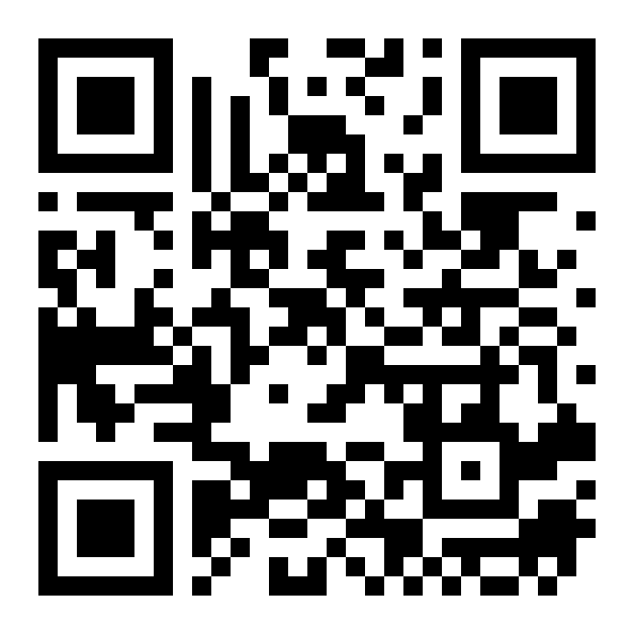
ATTENDANCE
Check in for tonight's meeting
Scan the QR code to sign in for attendance.
Requires your CofC login.
Can't scan? Go to forms.gle/ccN4CuqviXhndixq5
Scan to check in
ATTENDANCE
CofC Cybersecurity Club

Slide 3
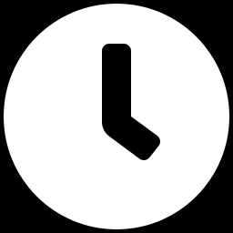
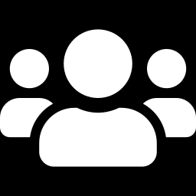
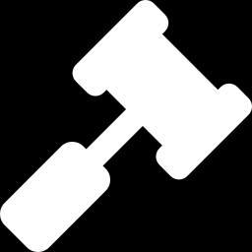
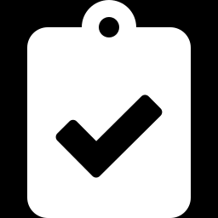
AGENDA
Tonight's agenda
Not a lecture tonight. A short, low-stakes run at the real thing
Format of the day
Team roles reminder
Thirty minutes each: setup, defend, review.
Same roles from Inside the Competition.
Rules of engagement
What to bring
Alumni play red team. Here is how that works.
What to have ready before you sit down.
AGENDA
CofC Cybersecurity Club

Slide 4
RECAP
Quick recap: twelve weeks, under pressure
Carrying forward: twelve weeks of material, put to work at once, against alumni playing the opposing side.
RECAP
CofC Cybersecurity Club

Slide 5
TONIGHT'S FORMAT
Thirty minutes each
Shorter than a real competition, same shape
1
Setup, 30 minutes
Get oriented on your assigned host, confirm access, do a fast baseline pass.
2
Defend, 30 minutes
Alumni play red team. Keep services up, respond to what you find.
3
Review, 30 minutes
Walk through what happened with the alumni who were attacking you.
THIRTY MINUTES EACH
CofC Cybersecurity Club

Slide 6
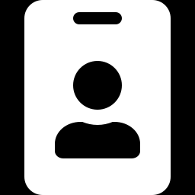
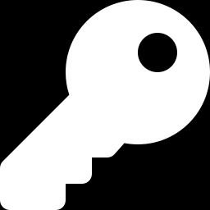
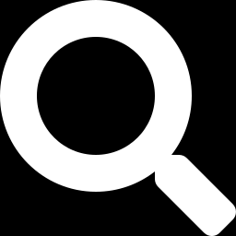
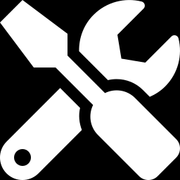
WHO DOES WHAT
Team roles reminder
The same breakdown from Inside the Competition, week one
Captain
Domain Admin
Liaison to whoever is judging tonight. Keeps the team's priorities straight.
Owns Active Directory and DNS on the hosts you are given.
Threat Hunters
Engineers
SIEM and log monitoring. Calls out what looks wrong.
Hardening and fixes. Doubles up wherever the team is stretched thin.
TEAM ROLES REMINDER
CofC Cybersecurity Club

Slide 7
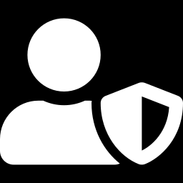
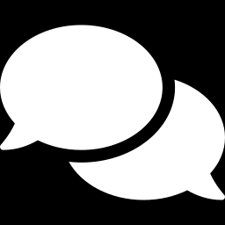
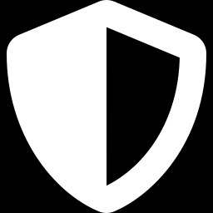
HOW TONIGHT WORKS
Rules of engagement
Lower stakes than SECCDC or PCDC, same basic shape
Alumni play red team
Scoring is informal
Former members, attacking on purpose, so you get real practice before it counts.
Nobody is ranked tonight. The point is the rep, not the leaderboard.
Questions during review
It is still live
Hold questions for the review block. Let the defend window run uninterrupted.
Real hosts, real attacks. Treat it like the thing it is practice for.
RULES OF ENGAGEMENT
CofC Cybersecurity Club

Slide 8
BEFORE YOU SIT DOWN
What to bring
1
Your SSH key
The same one from the Range, ready to go.
2
A charged laptop
Thirty minutes of active defense is not the time to hunt for an outlet.
3
Discord open
#defense-team, for anything that needs a fast answer mid-round.
4
Arrive a few minutes early
Getting oriented eats into your setup window if you start late.
WHAT TO BRING
CofC Cybersecurity Club

Slide 9
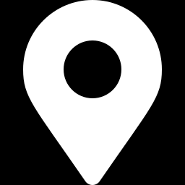
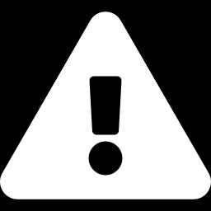
NEXT SESSION
Tuesday: Introduction to Active Directory
This session was practice. Tuesday is new material again: how Windows networks centralize identity instead of managing every host alone.
Simons 281, College of Charleston
Tuesdays & Thursdays, 5:30-7:00 PM
Questions on tonight's material? Ask in #defense-team
NEXT UP
CofC Cybersecurity Club

