Slide 1

TUESDAY SESSION · WEEK 16
Introduction to Active Directory
How Windows networks centralize identity, instead of managing every host alone
Tuesdays & Thursdays, 5:30-7:00 PM • Simons 281

Slide 2
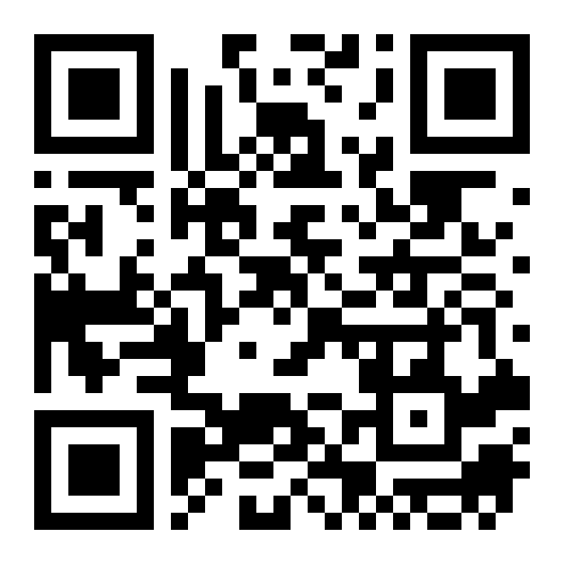
ATTENDANCE
Check in for tonight's meeting
Scan the QR code to sign in for attendance.
Requires your CofC login.
Can't scan? Go to forms.gle/ccN4CuqviXhndixq5
Scan to check in
ATTENDANCE
CofC Cybersecurity Club

Slide 3






AGENDA
Tonight's agenda
From one domain controller to a joined client
What is Active Directory?
Domains & forests
Microsoft's directory service, revisited and expanded.
How AD organizes more than one network together.
Organizational Units
The Domain Controller
Grouping users and computers to apply policy.
The server every login and lookup goes through.
AD, DNS, and Kerberos
Setting up a DC
Three pieces you have already met, working together.
Standing up a domain controller for the lab.
AGENDA
CofC Cybersecurity Club

Slide 4
RECAP
Quick recap: practice, not new material
Two weeks ago was the mid-semester simulation, putting the first twelve weeks under pressure. Carrying forward: how Windows networks centralize identity, building on DNS.
RECAP
CofC Cybersecurity Club

Slide 5


DEFINITION #1
What is Active Directory?
Active Directory is Microsoft's directory service for a network of computers. It stores users, groups, computers, and policies in one place, and uses DNS and Kerberos to make it all work.
Directory service
Domain
Forest
Trust
A structured database of every user, group, and computer on the network.
A boundary of shared identity and policy. Everything in it trusts the same controller.
One or more domains sharing a common structure at the top.
A relationship that lets users in one domain access resources in another.
WHAT IS ACTIVE DIRECTORY?
CofC Cybersecurity Club

Slide 6

SCALING UP
Domains & forests
Most organizations outgrow a single domain eventually
Single domain
Tree
One domain, one set of policies. What most small organizations, and tonight's lab, use.
Multiple domains sharing a contiguous namespace, like east.cofc.edu under cofc.edu.
Forest
Trust relationships
The full collection of domains and trees, sharing a schema and a global catalog.
Define which domains accept which other domains' logins, and in which direction.
DOMAINS & FORESTS
CofC Cybersecurity Club

Slide 7



ORGANIZING THE DOMAIN
Organizational Units
A domain with a thousand users needs a way to group them
What an OU is
Why they exist
A container inside a domain for organizing users, groups, and computers.
Group Policy applies at the OU level. Structure the OUs, and policy follows.
Typical structure
Delegated administration
By department, by location, or by machine role: workstations separate from servers.
Rights can be handed off per OU, so a help desk team can manage its own without full Domain Admin.
ORGANIZATIONAL UNITS
CofC Cybersecurity Club

Slide 8


THE PIECES WORKING TOGETHER
AD, DNS, and Kerberos
Three things you already know, now as one system
DNS finds the controller
Kerberos authenticates
Clients locate a domain controller through DNS SRV records. Without working DNS, AD does not function.
Tickets instead of passwords sent repeatedly. Covered from the client side back in week seven.
The controller enforces it
Why it breaks together
One server answering every login and lookup request for the domain.
A DNS problem looks like an AD problem. Check DNS first when logins start failing.
AD, DNS, AND KERBEROS
CofC Cybersecurity Club

Slide 9
HARDWARE OPTION
A physical domain controller for the lab
Giving the club a standard network environment to reference
1
Install Windows Server
On a dedicated physical machine, not a VM this time.
2
Add the AD DS role
Server Manager, Add Roles and Features, Active Directory Domain Services.
3
Promote it to a domain controller
Create a new forest, name the domain, set the Directory Services Restore Mode password.
4
Confirm DNS came up with it
AD DS installs a DNS server by default. Verify it is answering.
A PHYSICAL DOMAIN CONTROLLER FOR THE LAB
CofC Cybersecurity Club

Slide 10
TONIGHT'S PRACTICE
Tonight's exercises
1
Promote a VM to a DC
Stand up your own domain controller from scratch.
2
Create an OU structure
Build a small, sensible OU layout for a handful of test accounts.
3
Join a client to the domain
Confirm a second machine can authenticate against your new domain.
TONIGHT'S EXERCISES
CofC Cybersecurity Club

Slide 11
EXERCISE 1
Promote a VM to a domain controller
1
Install AD DS
Install-WindowsFeature AD-Domain-Services -IncludeManagementTools
2
Promote it
Install-ADDSForest, name your domain something like range.local.
3
Reboot
The promotion finishes with a restart into the new domain.
4
Confirm
Get-ADDomain, confirm the domain name and forest match what you set.
PROMOTE A VM TO A DOMAIN CONTROLLER
CofC Cybersecurity Club

Slide 12
EXERCISE 2
Create an OU structure
1
Plan it on paper first
Two or three OUs is enough: Staff, Workstations, Servers.
2
Create the OUs
New-ADOrganizationalUnit -Name "Staff" -Path "DC=range,DC=local"
3
Add a test user
New-ADUser, placed into the right OU on creation.
4
Confirm placement
Get-ADUser, check the DistinguishedName matches the OU you intended.
CREATE AN OU STRUCTURE
CofC Cybersecurity Club

Slide 13
EXERCISE 3
Join a client to the domain
1
Point the client's DNS at your DC
The client has to be able to find the domain through DNS first.
2
Join the domain
System Properties > Change, or Add-Computer -DomainName range.local
3
Reboot and log in
Log in with a domain account, not a local one, to prove it worked.
4
Confirm from the DC
Get-ADComputer, confirm the new machine shows up in the domain.
JOIN A CLIENT TO THE DOMAIN
CofC Cybersecurity Club

Slide 14
WHERE THIS CAME FROM
Resources & citations
Microsoft Learn: Active Directory Domain Services Overview
Microsoft Learn: Understanding AD DS Trusts
learn.microsoft.com/windows-server/identity
learn.microsoft.com/windows-server/identity/ad-ds
RFC 4120: The Kerberos Network Authentication Service
Microsoft Learn: How Domain and Forest Trusts Work
rfc-editor.org/rfc/rfc4120
learn.microsoft.com/windows-server
MITRE ATT&CK T1482: Domain Trust Discovery
attack.mitre.org/techniques/T1482
RESOURCES
CofC Cybersecurity Club

Slide 15



NEXT SESSION
Thursday: Active Directory Basics & Policy Controls
You now have a domain controller and a joined client. Thursday is about controlling what that domain lets people do: administrative rights, and Group Policy.
Simons 281, College of Charleston
Tuesdays & Thursdays, 5:30-7:00 PM
Questions on tonight's material? Ask in #defense-team
NEXT UP
CofC Cybersecurity Club

