Slide 1

THURSDAY SESSION · WEEK 16
Active Directory Basics & Policy Controls
Controlling what a domain lets people do: administrative rights and Group Policy
Tuesdays & Thursdays, 5:30-7:00 PM • Simons 281

Slide 2
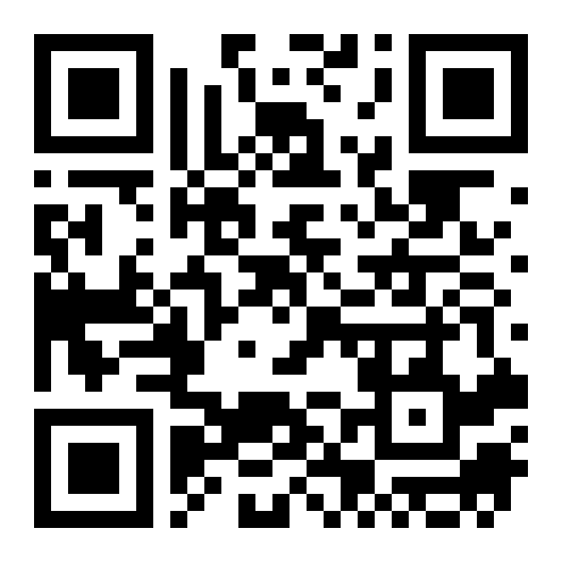
ATTENDANCE
Check in for tonight's meeting
Scan the QR code to sign in for attendance.
Requires your CofC login.
Can't scan? Go to forms.gle/ccN4CuqviXhndixq5
Scan to check in
ATTENDANCE
CofC Cybersecurity Club

Slide 3






AGENDA
Tonight's agenda
From who has the keys to pushing a setting to everyone at once
Revisiting administrative rights
What is a GPO?
Domain Admins vs. delegated rights.
Group Policy Objects, and how they apply.
Scope & inheritance
Security-relevant GPOs
Site, domain, and OU, and what wins when they conflict.
Password policy, lockout, and software restriction.
Hardware option
Exercises on the Range
Pushing a policy across the physical lab machines.
Audit rights, build a GPO, confirm it landed.
AGENDA
CofC Cybersecurity Club

Slide 4
RECAP
Quick recap: a domain controller and a joined client
Tuesday covered domains, forests, Organizational Units, and standing up a domain controller. Carrying forward: controlling what a domain lets people do.
RECAP
CofC Cybersecurity Club

Slide 5



DEFINITION #1
Revisiting administrative rights in AD
Not every admin needs every right. AD lets rights be delegated as narrowly as the job requires, instead of handing out Domain Admin by default.
Domain Admins
Delegated rights
Help desk example
Why it matters
Full control of the domain. Should be a very short list of people.
A specific right, on a specific OU, for a specific group.
Reset passwords in one OU, without touching Domain Admin at all.
A compromised delegated account is a much smaller problem than a compromised Domain Admin.
REVISITING ADMINISTRATIVE RIGHTS IN AD
CofC Cybersecurity Club

Slide 6


PUSHING SETTINGS AT SCALE
What is a Group Policy Object?
One setting, applied to every machine or user it targets, automatically
What it is
How it applies
A named collection of settings that gets linked to a site, domain, or OU.
Every affected machine checks in and pulls the current policy, no manual push needed.
What it can set
How to check it
Password rules, software restrictions, desktop settings, and far more.
gpresult /r on a client shows exactly which GPOs applied, and from where.
WHAT IS A GROUP POLICY OBJECT?
CofC Cybersecurity Club

Slide 7
WHO WINS
Scope & inheritance
GPOs apply in a specific order, and the last one processed wins a conflict
Level | Applies to | Order
Local | Just that one machine | Processed first
Site | Every machine in a physical location | Processed second
Domain | Every machine in the domain | Processed third
Organizational Unit | Just that OU, and nested OUs beneath it | Processed last, wins ties
SCOPE & INHERITANCE
CofC Cybersecurity Club

Slide 8


WORTH SETTING EARLY
Security-relevant GPOs
A short list that matters more than most others
Password policy
Account lockout
Minimum length, complexity, and history. Set once at the domain level.
How many failed attempts before an account locks, and for how long.
Software restriction
Audit policy
Block execution from paths like Temp or Downloads, a common malware landing spot.
Which events get logged. Off by default for more than you would expect.
SECURITY-RELEVANT GPOS
CofC Cybersecurity Club

Slide 9
HARDWARE OPTION
Testing a policy push on the physical lab
Seeing a GPO land on real, different hardware
1
Join the physical lab machines
Confirm each one is in the domain from last week's setup.
2
Create a test GPO
Something visible, like a desktop wallpaper or a lock screen message.
3
Link it to the lab's OU
Scope it narrowly, just the machines you are testing on.
4
Force an update and check
gpupdate /force on each machine, then confirm the change landed.
TESTING A POLICY PUSH ON THE PHYSICAL LAB
CofC Cybersecurity Club

Slide 10
TONIGHT'S PRACTICE
Tonight's exercises
1
Audit Domain Admins
Who has full control, and whether every name on the list belongs there.
2
Build a password policy GPO
Create it, set it, link it to the domain.
3
Confirm it applied
gpresult on a client, proving the policy landed.
TONIGHT'S EXERCISES
CofC Cybersecurity Club

Slide 11
EXERCISE 1
Audit Domain Admin membership
1
List the group
Get-ADGroupMember "Domain Admins"
2
Check each account
Get-ADUser for each name, note when it was last used.
3
Flag anything unexpected
An account nobody remembers adding, or one that has not logged in in months.
4
Write down your findings
Every name, and whether it belongs on that list.
AUDIT DOMAIN ADMIN MEMBERSHIP
CofC Cybersecurity Club

Slide 12
EXERCISE 2
Create and link a password policy GPO
1
Open Group Policy Management
gpmc.msc, on the domain controller.
2
Create a new GPO
Name it something clear, like "Domain Password Policy."
3
Set the policy
Computer Configuration > Policies > Windows Settings > Security Settings > Account Policies.
4
Link it to the domain
Right-click the domain, Link an Existing GPO, select the one you built.
CREATE AND LINK A PASSWORD POLICY GPO
CofC Cybersecurity Club

Slide 13
EXERCISE 3
Confirm the policy landed
1
Log into a domain client
Any machine joined to the domain from last week.
2
Force an update
gpupdate /force, do not wait for the normal refresh cycle.
3
Check what applied
gpresult /r, confirm your GPO shows up in the applied list.
4
Test the policy itself
Try setting a password that violates your new rule. It should be refused.
CONFIRM THE POLICY LANDED
CofC Cybersecurity Club

Slide 14
WHERE THIS CAME FROM
Resources & citations
Microsoft Learn: Group Policy Overview
Microsoft Learn: Delegating Administration
learn.microsoft.com/windows-server/identity
learn.microsoft.com/windows-server/identity
Microsoft Security Compliance Toolkit
CIS Benchmark: Microsoft Windows Server, Active Directory
learn.microsoft.com/windows/security
cisecurity.org
MITRE ATT&CK T1484: Domain or Tenant Policy Modification
attack.mitre.org/techniques/T1484
RESOURCES
CofC Cybersecurity Club

Slide 15


NEXT SESSION
Tuesday: Web & Database Server Setup
You have secured identity and policy. Tuesday is about standing up something worth defending: a real web server, connected to a real database.
Simons 281, College of Charleston
Tuesdays & Thursdays, 5:30-7:00 PM
Questions on tonight's material? Ask in #defense-team
NEXT UP
CofC Cybersecurity Club

