Slide 1

TUESDAY SESSION · WEEK 18
Web & Database Server Setup
Standard system administration: a web server, a database, and the account that connects them
Tuesdays & Thursdays, 5:30-7:00 PM • Simons 281

Slide 2
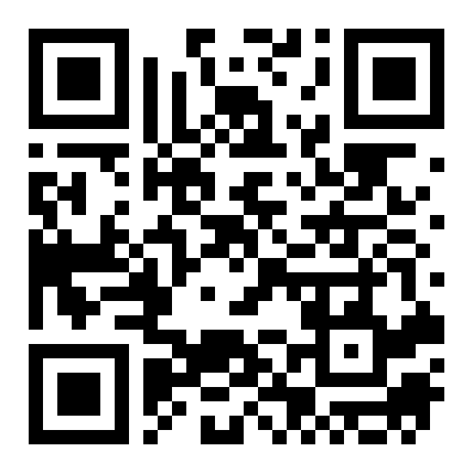
ATTENDANCE
Check in for tonight's meeting
Scan the QR code to sign in for attendance.
Requires your CofC login.
Can't scan? Go to forms.gle/ccN4CuqviXhndixq5
Scan to check in
ATTENDANCE
CofC Cybersecurity Club

Slide 3






AGENDA
Tonight's agenda
From a bare VM to a working web app with a real backend
Apache vs. Nginx
Virtual hosts
Two web servers, and picking one.
Serving more than one site from one server.
Connecting a database
Least-privilege DB accounts
MySQL or PostgreSQL as the backend.
The app user should not be the admin user.
File & ownership permissions
Exercises on the Range
Who can read, write, and serve what.
Build it yourself, end to end.
AGENDA
CofC Cybersecurity Club

Slide 4
RECAP
Quick recap: identity and policy
The last two sessions covered Active Directory, delegated rights, and Group Policy. Carrying forward: stepping away from identity to stand up a web application worth attacking.
RECAP
CofC Cybersecurity Club

Slide 5
PICKING A WEB SERVER
Apache vs. Nginx
Both do the same core job. The differences show up under load
 | Apache | Nginx
Architecture | Process or thread per connection | Event-driven, handles many connections in one process
Config style | .htaccess per directory, flexible | Central config, no per-directory overrides
Typical use | Shared hosting, legacy PHP apps | High-traffic sites, reverse proxying
Install | apt install apache2 | apt install nginx
APACHE VS. NGINX
CofC Cybersecurity Club

Slide 6
SERVING MORE THAN ONE SITE
Virtual hosts
One server, multiple domains, each with its own config
1
Create the site directory
mkdir -p /var/www/site1/html, one folder per site.
2
Write the vhost config
A server block naming the domain, the document root, and the listening port.
3
Enable the site
a2ensite site1.conf on Apache, or a symlink into sites-enabled on Nginx.
4
Reload the server
systemctl reload nginx, or apache2ctl graceful. No downtime for the change.
VIRTUAL HOSTS
CofC Cybersecurity Club

Slide 7

DEFINITION #1
Connecting a database backend
A web app that stores data needs a database behind it. MySQL and PostgreSQL are the two you will see most often, and the setup pattern is the same either way.
The database engine
A dedicated database
A dedicated app user
A connection string
MySQL or PostgreSQL, installed and running as its own service.
One database per application, not one shared database for everything.
Its own login, scoped to just that database.
How the app authenticates to the database, usually in a config file.
CONNECTING A DATABASE BACKEND
CofC Cybersecurity Club

Slide 8


THE APP USER IS NOT THE ADMIN
Least-privilege database accounts
The account your app connects with should be able to do exactly what it needs, nothing more
Create a scoped user
Grant only what is needed
CREATE USER 'appuser'@'localhost' IDENTIFIED BY 'strong-password';
GRANT SELECT, INSERT, UPDATE, DELETE ON appdb.* TO 'appuser'@'localhost';
Never the root account
Rotate the password
An app connecting as root turns any injection bug into full database compromise.
Treat it like any other credential. Change it, and update the app's config to match.
LEAST-PRIVILEGE DATABASE ACCOUNTS
CofC Cybersecurity Club

Slide 9
PRACTICAL STEP ONE
File & ownership permissions
The web server process needs to read, but not everything should be writable
1
Set ownership
chown -R www-data:www-data /var/www/site1, matching the web server's own account.
2
Set directory permissions
chmod 755 on directories: the server can enter and list, others can only read.
3
Set file permissions
chmod 644 on files: readable by everyone, writable only by the owner.
4
Keep config files tighter
chmod 600 on anything holding a database password. Owner only.
FILE & OWNERSHIP PERMISSIONS
CofC Cybersecurity Club

Slide 10
TONIGHT'S PRACTICE
Tonight's exercises
1
Serve a static page with Nginx
Install it, configure a vhost, confirm it loads in a browser.
2
Create a scoped database user
Least privilege from the start, not bolted on after.
3
Set correct permissions
Ownership and access matching what the web server needs.
TONIGHT'S EXERCISES
CofC Cybersecurity Club

Slide 11
EXERCISE 1
Install and serve a page with Nginx
1
Install Nginx
sudo apt install nginx
2
Drop in a page
Replace /var/www/html/index.html with something of your own.
3
Confirm it is running
systemctl status nginx
4
Load it in a browser
Hit the host's IP address from another machine on the Range.
INSTALL AND SERVE A PAGE WITH NGINX
CofC Cybersecurity Club

Slide 12
EXERCISE 2
Create a least-privilege database user
1
Create the database
CREATE DATABASE appdb;
2
Create the app user
CREATE USER 'appuser'@'localhost' IDENTIFIED BY '...';
3
Grant scoped access
GRANT SELECT, INSERT, UPDATE, DELETE ON appdb.* TO 'appuser'@'localhost';
4
Confirm the scope
Try a query outside appdb as appuser. It should be refused.
CREATE A LEAST-PRIVILEGE DATABASE USER
CofC Cybersecurity Club

Slide 13
EXERCISE 3
Set correct file permissions
1
Check current ownership
ls -la /var/www/site1, note what is wrong.
2
Fix ownership
chown -R www-data:www-data on the whole site directory.
3
Fix permissions
755 on directories, 644 on files, 600 on anything with credentials.
4
Verify the site still loads
A permissions fix that breaks the site is not a fix.
SET CORRECT FILE PERMISSIONS
CofC Cybersecurity Club

Slide 14
WHERE THIS CAME FROM
Resources & citations
Nginx Beginner's Guide
Apache HTTP Server Documentation
nginx.org/en/docs/beginners_guide.html
httpd.apache.org/docs
MySQL: Privilege System
PostgreSQL: Database Roles
dev.mysql.com/doc/refman/en/privilege-system.html
postgresql.org/docs/current/user-manag.html
OWASP: Secure Configuration Cheat Sheet
cheatsheetseries.owasp.org
RESOURCES
CofC Cybersecurity Club

Slide 15


NEXT SESSION
Thursday: Application Security & Log Review
You just built it. Thursday is about locking down what you built, and reading its logs for anything that should not be there.
Simons 281, College of Charleston
Tuesdays & Thursdays, 5:30-7:00 PM
Questions on tonight's material? Ask in #defense-team
NEXT UP
CofC Cybersecurity Club

