Slide 1

TUESDAY SESSION · WEEK 20
Introduction to Log Collection
Getting logs off many hosts and into one place, before you need to look back on them
Tuesdays & Thursdays, 5:30-7:00 PM • Simons 281

Slide 2
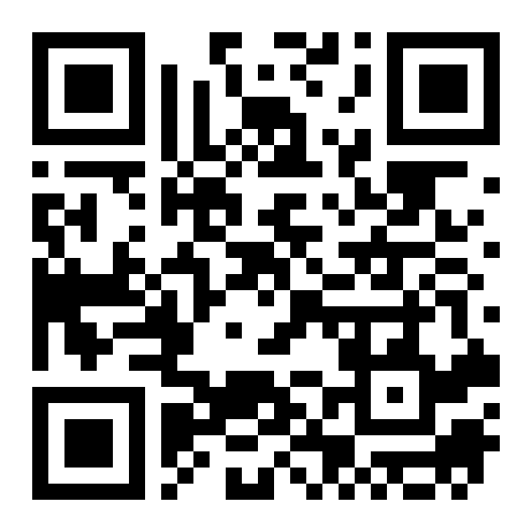
ATTENDANCE
Check in for tonight's meeting
Scan the QR code to sign in for attendance.
Requires your CofC login.
Can't scan? Go to forms.gle/ccN4CuqviXhndixq5
Scan to check in
ATTENDANCE
CofC Cybersecurity Club

Slide 3






AGENDA
Tonight's agenda
From one log on one host to a forwarded event on a collector
What a log is
Windows Event IDs
A record of something a system decided was worth writing down.
Login, logout, and account changes worth knowing by number.
syslog
Windows Event Forwarding
The standard way Linux systems ship logs across a network.
The Windows equivalent, built into the OS.
Why centralize
Exercises on the Range
One place to look, even after a host is gone.
Forward, pull, and compare a real event.
AGENDA
CofC Cybersecurity Club

Slide 4
RECAP
Quick recap: reading logs on one host
Thursday covered hardening a web stack and reading its logs for something suspicious. Carrying forward: that approach only works if the host and its logs are still there.
RECAP
CofC Cybersecurity Club

Slide 5


DEFINITION #1
What is a log, and why centralize?
A log is a record a system writes when something happens: a login, a service start, a denied request. Centralizing means copying that record somewhere else, before the original host is unavailable, compromised, or just gone.
A single log
The problem
A central collector
The payoff
One system's own record of its own events, stored locally.
An attacker who controls a host can edit or delete its local logs.
A separate system that receives a copy the moment the event happens.
A record that survives even if the original host does not.
WHAT IS A LOG, AND WHY CENTRALIZE?
CofC Cybersecurity Club

Slide 6
WINDOWS LOGS
Event IDs worth knowing
A handful of numbers cover most of what you will look for
Event ID | Meaning
4624 | A successful logon.
4625 | A failed logon attempt.
4720 | A user account was created.
4732 | A member was added to a security-enabled local group.
4688 | A new process was created.
1102 | The audit log was cleared. Rare, and worth investigating every time.
EVENT IDS WORTH KNOWING
CofC Cybersecurity Club

Slide 7

SHIPPING LOGS ACROSS THE NETWORK
syslog
The standard most Linux systems, network gear, and appliances already speak
What it is
How it moves
A protocol for sending log messages from one system to another, defined in RFC 5424.
UDP by default, fast but unreliable. TCP or TLS available where delivery has to be certain.
Facility & severity
Where it lands
Every message is tagged with what generated it and how serious it is, so a collector can filter.
A central syslog server, or a SIEM ingesting the same feed.
SYSLOG
CofC Cybersecurity Club

Slide 8
THE WINDOWS EQUIVALENT
Windows Event Forwarding
Built into Windows, no third-party agent required
What it is
Collector-initiated
A built-in mechanism for shipping Event Log entries from many machines to one collector.
The collector subscribes to specific event types on specific machines, and pulls them.
Subscriptions
What you get
Defined centrally: which events, from which hosts, how often.
The same Event Viewer entries, now sitting on a system an attacker on one host cannot reach.
WINDOWS EVENT FORWARDING
CofC Cybersecurity Club

Slide 9
READING THE TAG
Syslog facility & severity
Every message carries both, so a collector can filter without reading the text
Severity | Level | Meaning
0 | Emergency | System is unusable.
2 | Critical | Critical conditions, needs attention now.
4 | Warning | Warning conditions, not yet an error.
6 | Informational | Routine, normal operation.
7 | Debug | Detail useful for debugging only.
SYSLOG FACILITY & SEVERITY
CofC Cybersecurity Club

Slide 10


DEFINITION #2
Structured vs. unstructured logging
A plain sentence is easy for a person to read and hard for a machine to search. A structured log trades some readability for something a collector can filter and query reliably.
Unstructured
Structured
Why it matters
Where you will see it
Free text, like most syslog and Apache logs by default. Easy to read, hard to query precisely.
Key-value pairs, often JSON. Every field has a name a query can target directly.
"Find every failed login" is a real query against structured data, a fragile regex against free text.
Modern apps, cloud services, and most SIEM tooling default to structured output.
STRUCTURED VS. UNSTRUCTURED LOGGING
CofC Cybersecurity Club

Slide 11
WORKED EXAMPLE
One Event Log entry unpacked
The same six fields matter every time
Log Name: Security
Event ID: 4624
Level: Information
Logged: 10/14/2026 7:03:41 PM
Task Category: Logon
Keywords: Audit Success
Six fields. Here is what each one is telling you.
ONE EVENT LOG ENTRY UNPACKED
CofC Cybersecurity Club

Slide 12
READING IT FIELD BY FIELD
What each field tells you
Field | What it tells you
Log Name | Which log this event lives in: Security, System, or Application.
Event ID | The number that identifies what kind of event this is.
Level | Information, Warning, Error, or Critical.
Logged | The timestamp. Confirm the host's clock is accurate before trusting it.
Task Category | Extra context narrowing what happened, like "Logon."
Keywords | A quick tag, like "Audit Success" or "Audit Failure."
WHAT EACH FIELD TELLS YOU
CofC Cybersecurity Club

Slide 13


HOW LONG TO KEEP IT
Log retention
Storage is cheap. Losing the one log you needed is not
Why retention matters
Typical windows
An incident is sometimes discovered weeks after it happened. Logs already rotated out cannot help you.
30 to 90 days hot and searchable is common, longer in cold storage for anything regulated.
What drives the number
Protect the archive too
Storage cost on one side, investigative and compliance value on the other.
Retained logs are still a target. The collector needs its own access controls.
LOG RETENTION
CofC Cybersecurity Club

Slide 14
TONIGHT'S PRACTICE
Tonight's exercises
1
Forward syslog from a Linux host
Configure a Range host to ship its logs to a central collector.
2
Pull a specific Event ID
Find one logon event on a Windows host through Event Viewer.
3
Compare local vs. centralized
The same event, seen two ways. Confirm they match.
TONIGHT'S EXERCISES
CofC Cybersecurity Club

Slide 15
EXERCISE 1
Forward syslog to a central collector
1
Edit the syslog config
/etc/rsyslog.d/, add a line pointing at the collector's address.
2
Restart the service
systemctl restart rsyslog
3
Generate an event
A failed SSH login is an easy, visible one to trigger on purpose.
4
Confirm it arrived
Check the collector for the same event, timestamp and all.
FORWARD SYSLOG TO A CENTRAL COLLECTOR
CofC Cybersecurity Club

Slide 16
EXERCISE 2
Pull a specific Windows Event ID
1
Open Event Viewer
eventvwr.msc, Windows Logs > Security.
2
Filter for Event ID 4624
Filter Current Log, enter 4624 in the Event ID field.
3
Read one entry
Note the account name, the logon type, and the source address.
4
Find its failed counterpart
Filter for 4625 instead, compare the fields.
PULL A SPECIFIC WINDOWS EVENT ID
CofC Cybersecurity Club

Slide 17
EXERCISE 3
Compare local vs. centralized
1
Pick one event
Any event you generated in Exercise 1 or 2.
2
Find it locally
On the host that generated it, in its own log.
3
Find it on the collector
The same event, forwarded.
4
Compare the two
Same timestamp, same details. Confirm nothing was lost in transit.
COMPARE LOCAL VS. CENTRALIZED
CofC Cybersecurity Club

Slide 18
WHERE THIS CAME FROM
Resources & citations
RFC 5424: The Syslog Protocol
Microsoft Learn: Windows Event Forwarding
rfc-editor.org/rfc/rfc5424
learn.microsoft.com/windows/security
Microsoft Learn: Security Event IDs Reference
rsyslog Documentation
learn.microsoft.com/windows/security/threat-protection/auditing
rsyslog.com/doc
MITRE ATT&CK T1070: Indicator Removal
attack.mitre.org/techniques/T1070
RESOURCES
CofC Cybersecurity Club

Slide 19

NEXT SESSION
Thursday: Basic Centralized Monitoring
You can now get logs to one place. Thursday is about watching them: standing up a dashboard instead of reading a raw feed.
Simons 281, College of Charleston
Tuesdays & Thursdays, 5:30-7:00 PM
Questions on tonight's material? Ask in #defense-team
NEXT UP
CofC Cybersecurity Club

