Slide 1

THURSDAY SESSION · WEEK 20
Basic Centralized Monitoring
Standing up Security Onion and Wazuh, from install to a detection rule you wrote yourself
Tuesdays & Thursdays, 5:30-7:00 PM • Simons 281

Slide 2
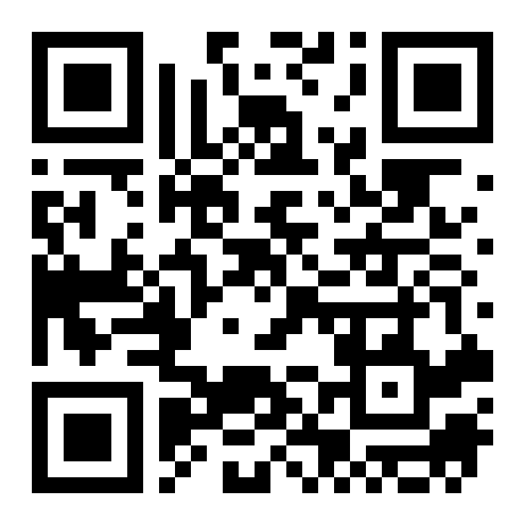
ATTENDANCE
Check in for tonight's meeting
Scan the QR code to sign in for attendance.
Requires your CofC login.
Can't scan? Go to forms.gle/ccN4CuqviXhndixq5
Scan to check in
ATTENDANCE
CofC Cybersecurity Club

Slide 3






AGENDA
Tonight's agenda
Two tools, two different vantage points on the same lab
What a SIEM does
SIEM architecture
Ingest, search, visualize, and alert.
The four layers every stack has in common.
Security Onion
Wazuh
Network-focused: Suricata, Zeek, full packet capture.
Host-focused: file integrity, log analysis, agents.
Searches, dashboards & rules
Exercises on the Range
Making both tools useful, not just running.
Install both, feed them, and alert on something real.
AGENDA
CofC Cybersecurity Club

Slide 4
RECAP
Quick recap: logs, forwarded
Tuesday covered getting logs off individual hosts and into one place, over syslog and Windows Event Forwarding. Carrying forward: two systems on the receiving end, one watching the network, one watching the host.
RECAP
CofC Cybersecurity Club

Slide 5


DEFINITION #1
What a SIEM does
SIEM stands for Security Information and Event Management. It is not one tool, it is a pipeline: four jobs, usually handled by a few tools working together.
Ingest
Search
Visualize
Alert
Receives events from every forwarding host and normalizes them into a common format.
Query across every host at once, in seconds, instead of grepping one log file at a time.
Dashboards turn a wall of raw events into something you can scan at a glance.
A saved rule that notifies someone the moment a specific pattern matches.
WHAT A SIEM DOES
CofC Cybersecurity Club

Slide 6

THE FOUR LAYERS
SIEM architecture, at a glance
Every stack in this space is built from the same shape, whichever tools fill it in
Collection
Ingest pipeline
Agents and forwarders on every host: Wazuh agents, the Security Onion sensor, syslog, WEF.
Parses and normalizes incoming events before they are stored.
Storage & indexing
Search & visualization
Elasticsearch in Security Onion, the Wazuh indexer (an OpenSearch fork) in Wazuh.
A Kibana-family dashboard on top, in both tools, for different reasons.
SIEM ARCHITECTURE, AT A GLANCE
CofC Cybersecurity Club

Slide 7
TWO VANTAGE POINTS
Security Onion vs. Wazuh
Not really competitors. Most real deployments run something like both, together
 | Security Onion | Wazuh
Vantage point | The network: what crosses the wire | The host: what happens on each machine
Core strength | Full packet capture, signature and protocol detection | File integrity, log analysis, vulnerability and compliance checks
How it collects | A sensor watching a mirrored network link | A lightweight agent installed on each endpoint
Best for | Seeing an attacker before they land on a host | Seeing exactly what changed once they do
SECURITY ONION VS. WAZUH
CofC Cybersecurity Club

Slide 8
BEFORE YOU START
Security Onion: system requirements
What the hardware needs to look like
 | Standalone (lab) | Distributed
CPU | 4+ cores | 4+ cores per node
RAM | 12 GB minimum, 32 GB recommended | 16+ GB per node
Disk | 200 GB+, more for longer retention | Similar, split across manager and sensors
Network interfaces | 2: one management, one monitor | Same, per sensor node
SECURITY ONION: SYSTEM REQUIREMENTS
CofC Cybersecurity Club

Slide 9
INSTALLING SECURITY ONION
Step 1: download & verify the installer
Never boot from an ISO you have not verified
1
Get the ISO
github.com/Security-Onion-Solutions/securityonion, from the Releases page.
2
Verify the checksum
sha256sum securityonion-2.4.xx.iso, compare it against the hash published with the release.
3
Write it to media
Rufus on Windows, or dd / balenaEtcher on Linux and macOS.
4
Boot the target machine from it
From USB, or mounted directly if you are installing into a VM.
STEP 1: DOWNLOAD & VERIFY THE INSTALLER
CofC Cybersecurity Club

Slide 10
INSTALLING SECURITY ONION
Step 2: the base OS install
Before the Security Onion setup wizard even starts
1
Choose Install at the boot menu
Not the evaluation or import options, for a fresh lab build.
2
Partition the disk
Guided partitioning is fine for a lab. Use the whole disk.
3
Set the management interface
The NIC that gets an IP address and reaches the web UI.
4
Leave the monitor interface alone
A second NIC, unconfigured, reserved for packet capture.
STEP 2: THE BASE OS INSTALL
CofC Cybersecurity Club

Slide 11
INSTALLING SECURITY ONION
Step 3: the setup wizard
This is where most of the real configuration happens
1
Pick a role
Standalone, for tonight: manager and sensor combined on one machine.
2
Set the network
A static IP on the management interface is worth the extra minute to configure.
3
Create the admin account
A real username and a strong password, not left as any kind of default.
4
Choose which engines to enable
Suricata and Zeek at minimum. Add Strelka if the hardware can handle it.
STEP 3: THE SETUP WIZARD
CofC Cybersecurity Club

Slide 12
INSTALLING SECURITY ONION
Step 4: let it finish, then verify
Setup takes real time. Do not interrupt it
# Setup can take 30 to 60+ minutes depending on hardware.
# Reboot when prompted, then from the command line:
so-status
# every component should read as running
so-allow
# without this, the web UI will refuse your connection
so-allow whitelists your IP for the web UI. It is not open to everyone by default, on purpose.
STEP 4: LET IT FINISH, THEN VERIFY
CofC Cybersecurity Club

Slide 13
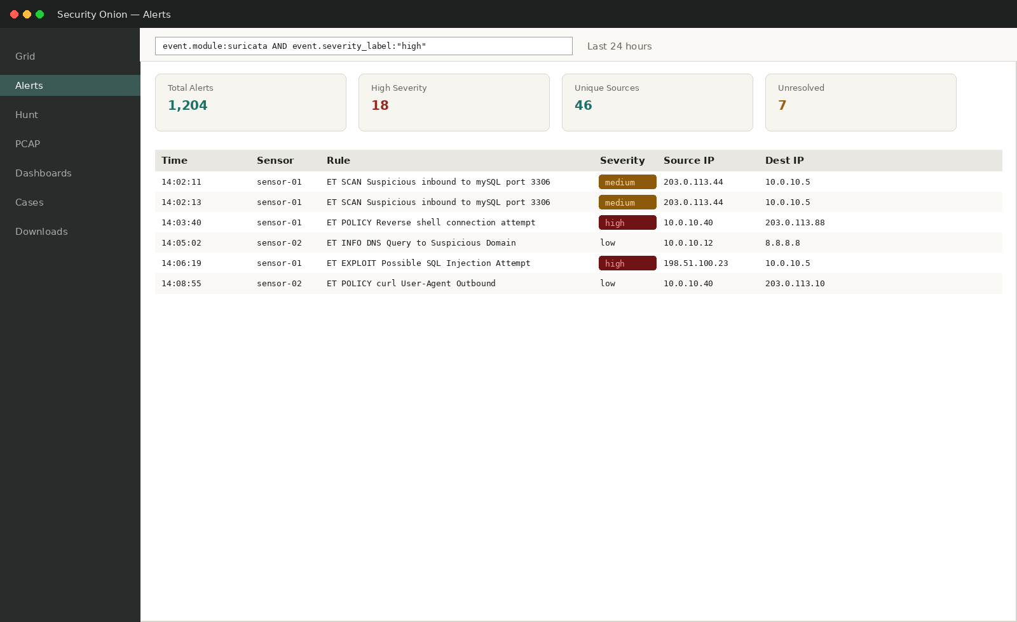
WHAT YOU SEE AFTER SETUP
Security Onion's Alerts view
Every Suricata and Zeek alert, searchable and filterable, with severity color-coded alongside the label.
SECURITY ONION'S ALERTS VIEW
CofC Cybersecurity Club

Slide 14

WHAT IS RUNNING UNDER THE HOOD
Security Onion's built-in tools
One install, four tools, each doing a different job
Suricata
Zeek
Signature-based intrusion detection. Flags traffic matching a known-bad pattern.
Turns raw traffic into structured connection and protocol logs, even when nothing matched a signature.
Elasticsearch
Kibana
Stores and indexes everything Suricata and Zeek generate, plus any forwarded logs.
The search and dashboard interface sitting on top of all of it.
SECURITY ONION'S BUILT-IN TOOLS
CofC Cybersecurity Club

Slide 15
FIRST LOGIN
Initial configuration: Security Onion
A few minutes of setup before the stack is trustworthy
1
Log into the web UI
https://your-manager-ip, using the admin account from setup.
2
Change any default credentials
Same rule as every other service you have hardened this semester.
3
Confirm the sensor is capturing
Check the Grid view for sensor status, and confirm packet counts are climbing.
4
Set a retention policy
Decide up front how many days of full packet capture the disk can hold.
INITIAL CONFIGURATION: SECURITY ONION
CofC Cybersecurity Club

Slide 16
BEFORE YOU START
Wazuh: system requirements
What the all-in-one node, and each port, needs
 | Minimum (lab) | What it is for
CPU / RAM | 4 vCPU, 8 GB RAM | Runs the indexer, manager, and dashboard together
Disk | 50 GB+ | Scales with agent count and retention window
Port 1514 | Open, agent-to-manager | Where enrolled agents send their event data
Port 1515 | Open, agent-to-manager | Where new agents register and get their keys
Port 443 | Open, browser-to-manager | The dashboard web UI
WAZUH: SYSTEM REQUIREMENTS
CofC Cybersecurity Club

Slide 17
INSTALLING WAZUH
Step 1: run the all-in-one installer
One script, one flag, and the whole stack comes up together
curl -sO https://packages.wazuh.com/4.x/wazuh-install.sh
sudo bash wazuh-install.sh -a
-a installs everything on one node: indexer, manager, and dashboard. Fine for a lab, not for scale.
STEP 1: RUN THE ALL-IN-ONE INSTALLER
CofC Cybersecurity Club

Slide 18
INSTALLING WAZUH
Step 2: retrieve your credentials
The installer generates them. It only shows them once
1
Find the generated file
wazuh-install-files.tar, created in the same directory you ran the installer from.
2
Extract it
tar -xf wazuh-install-files.tar
3
Read the admin password
Inside wazuh-install-files/wazuh-passwords.txt
4
Store it somewhere safe
That file is the only place this password is ever shown in the clear.
STEP 2: RETRIEVE YOUR CREDENTIALS
CofC Cybersecurity Club

Slide 19
INSTALLING WAZUH
Step 3: log into the dashboard
https://<manager-ip>
Username: admin
Password: (from wazuh-passwords.txt)
Same rule as every other service this semester: this is the last time that generated password should exist unchanged.
STEP 3: LOG INTO THE DASHBOARD
CofC Cybersecurity Club

Slide 20
INSTALLING WAZUH
Step 4: enroll a Linux agent
Download, install, point it at the manager, start it
curl -so wazuh-agent.deb \
https://packages.wazuh.com/4.x/apt/pool/main/w/\
wazuh-agent/wazuh-agent_4.x-1_amd64.deb
sudo WAZUH_MANAGER='<manager-ip>' dpkg -i ./wazuh-agent.deb
sudo systemctl daemon-reload
sudo systemctl enable wazuh-agent
sudo systemctl start wazuh-agent
WAZUH_MANAGER is set at install time, baked directly into the agent's config.
STEP 4: ENROLL A LINUX AGENT
CofC Cybersecurity Club

Slide 21
INSTALLING WAZUH
Step 5: enroll a Windows agent
Same idea, a different package
1
Download the MSI
From the Agents page in the dashboard, which generates an installer pre-configured for your manager.
2
Run the installer
Or install silently: msiexec /i wazuh-agent.msi /q WAZUH_MANAGER='<manager-ip>'
3
Start the service
net start WazuhSvc, or confirm it started automatically after install.
4
Confirm in the dashboard
The new agent should appear on the Agents page within a minute or two.
STEP 5: ENROLL A WINDOWS AGENT
CofC Cybersecurity Club

Slide 22


WHEN AN AGENT WON'T CONNECT
Verifying agents & troubleshooting
The same handful of causes, almost every time
Check from the manager
Firewall
/var/ossec/bin/agent_control -l lists every registered agent and its current status.
Ports 1514 and 1515 both need to be open between the agent and the manager, in that direction.
Clock skew
Stale keys
Enrollment can fail quietly if the agent and manager clocks disagree by more than a few minutes.
A re-imaged host needs to be re-enrolled from scratch, not just reinstalled with the old config.
VERIFYING AGENTS & TROUBLESHOOTING
CofC Cybersecurity Club

Slide 23
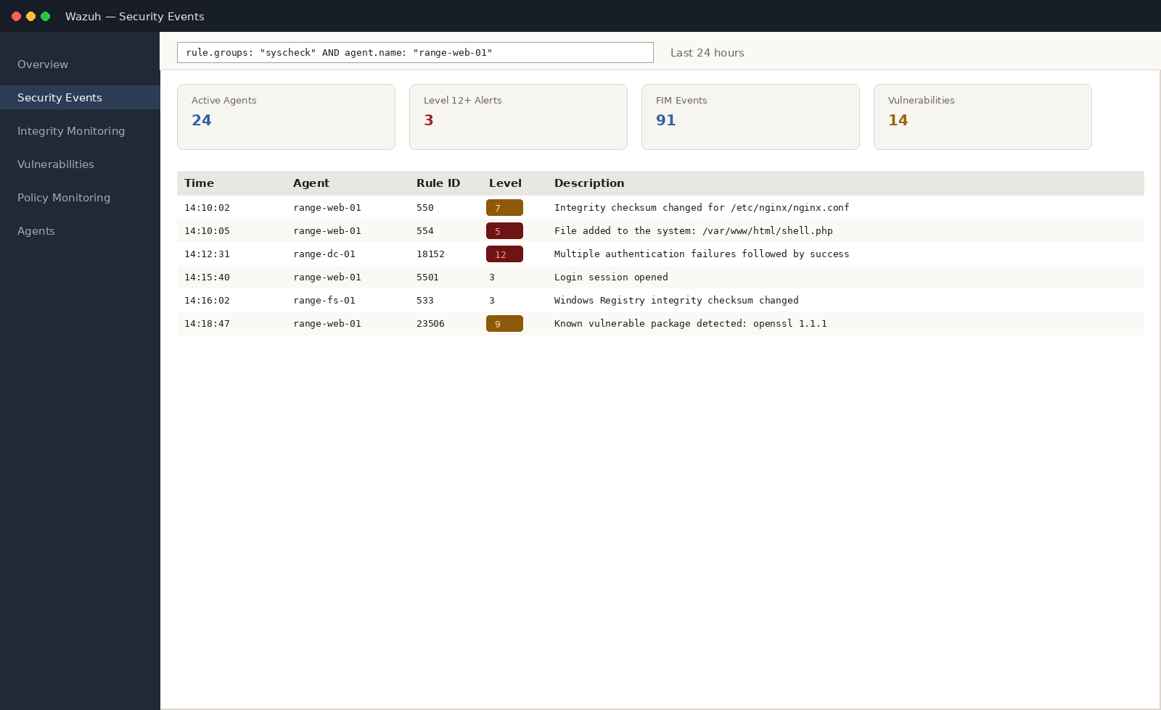
WHAT YOU SEE AFTER SETUP
Wazuh's Security Events view
File integrity, authentication, and vulnerability events, tagged with a rule ID and severity level, per agent.
WAZUH'S SECURITY EVENTS VIEW
CofC Cybersecurity Club

Slide 24
WHAT IS RUNNING UNDER THE HOOD
Wazuh's components
Four pieces, all installed together by the all-in-one script, each with its own job
Wazuh manager
Wazuh agent
Analyzes everything agents send it, applies rules, and generates alerts.
Lightweight, runs on each endpoint, collects logs, file integrity data, and configuration state.
Wazuh indexer
Wazuh dashboard
Stores and indexes every event. An OpenSearch fork, the same lineage as Elasticsearch.
Search, visualize, and manage agents. Built on OpenSearch Dashboards.
WAZUH'S COMPONENTS
CofC Cybersecurity Club

Slide 25


WHAT WAZUH ADDS
Wazuh's specific capabilities
This is where a host agent earns its keep, beyond just forwarding logs
File Integrity Monitoring
Log analysis & decoders
Alerts the moment a watched file or registry key changes, the same idea as week 22's baseline, running continuously.
Built-in decoders parse logs from dozens of common services automatically, no custom regex required.
Vulnerability detection
Compliance auditing
Compares installed software against known-CVE databases, flags what needs patching.
Built-in checks against CIS Benchmarks and PCI DSS, mapped directly to specific findings.
WAZUH'S SPECIFIC CAPABILITIES
CofC Cybersecurity Club

Slide 26
WORKED EXAMPLE
Writing a Wazuh rule
XML, not a one-liner. Each rule extends or reacts to another rule
<rule id="100010" level="7">
<if_sid>550</if_sid>
<field name="file">/etc/nginx/nginx.conf</field>
<description>nginx config file was modified</description>
<group>syscheck,config_change,</group>
</rule>
if_sid 550 means this rule only fires on top of Wazuh's built-in file integrity rule.
WRITING A WAZUH RULE
CofC Cybersecurity Club

Slide 27
WORKED EXAMPLE
Writing your first dashboard search
Both tools search the same way. KQL reads close to plain English
rule.groups : "syscheck" and agent.name : "range-web-01"
# Security Onion, the same shape, a different field set
event.dataset : "suricata.alert" and event.severity_label : "high"
Field, colon, value. AND narrows the search further, exactly like a Wireshark filter.
WRITING YOUR FIRST DASHBOARD SEARCH
CofC Cybersecurity Club

Slide 28
PRACTICAL STEP ONE
Building a dashboard panel
One saved search, turned into something you can glance at
1
Save the search
Run it, then Save from the top bar, and give it a clear name.
2
Create a visualization
A bar chart of matching events over time, built directly from the saved search.
3
Add it to a dashboard
New dashboard, add the panel, resize it to something readable.
4
Set a sensible time range
Last 24 hours for a daily check, last 7 days for a weekly pattern.
BUILDING A DASHBOARD PANEL
CofC Cybersecurity Club

Slide 29

FROM SIGNATURE TO ALERT
How detection rules work
A rule is a bet about what bad traffic or bad behavior looks like
Signature-based detection
Why specificity matters
Suricata rules match known-bad network patterns. Wazuh rules match known-bad host behavior.
A rule too broad fires on normal activity constantly. A rule too narrow misses variants of the same attack.
Test before you deploy
Tune, do not delete
Run new rules against a sample of known-good and known-bad activity before enabling them live.
A noisy rule usually needs a tighter condition, not to be turned off entirely.
HOW DETECTION RULES WORK
CofC Cybersecurity Club

Slide 30
WORKED EXAMPLE
Writing a basic Suricata rule
One line, five parts, each doing a specific job
alert tcp any any -> $HOME_NET 4444 (msg:"Possible reverse shell on port 4444"; sid:1000001; rev:1;)
# action proto src -> dst:port (options)
Alert on any TCP traffic to port 4444 inside the home network. sid is a unique rule ID.
WRITING A BASIC SURICATA RULE
CofC Cybersecurity Club

Slide 31

AFTER THE INSTALL
Operating both tools day to day
Standing them up is the easy part. Running them well is the actual job
Work the triage queue
Escalate deliberately
New alerts, from either tool, get a first look fast. An unread queue is a SIEM nobody is watching.
A clear path for "this needs a second set of eyes right now" versus "note it and move on."
Tune constantly
Keep both updated
The rule set from day one is never the rule set six months in. Noisy rules get narrowed or retired.
Suricata rule sets and Wazuh's CVE feed both update regularly. Old signatures miss new patterns.
OPERATING BOTH TOOLS DAY TO DAY
CofC Cybersecurity Club

Slide 32
HARDWARE OPTION
Feeding Security Onion real traffic
A mirror port on the physical lab switch, same idea from week six. Wazuh does not need this: its agents run on the hosts directly
1
Configure the mirror port
On a managed switch, set a SPAN session copying the uplink to a dedicated monitoring port.
2
Connect the monitoring box
A dedicated machine, receive-only on that port, running Security Onion.
3
Point the stack at the interface
Set the mirrored NIC as the monitor interface during setup, not the management interface.
4
Confirm traffic is arriving
Generate some lab traffic and watch packet counts climb in the Grid view.
FEEDING SECURITY ONION REAL TRAFFIC
CofC Cybersecurity Club

Slide 33

WHAT TRIPS PEOPLE UP
Common pitfalls
Every one of these shows up eventually in a real deployment of either tool
Alert fatigue
Storage vs. retention
Too many low-value alerts, from either tool, and real ones start getting missed in the noise.
Full packet capture fills a disk fast. Decide what to keep, and for how long, before it fills up on its own.
Agent enrollment drift
FIM noise
A Wazuh agent that lost its connection to the manager stops reporting silently, unless someone checks the Agents page.
Watching too broad a set of paths in Wazuh's file integrity monitor buries real changes in routine ones.
COMMON PITFALLS
CofC Cybersecurity Club

Slide 34
TONIGHT'S PRACTICE
Tonight's exercises
1
Install and explore Security Onion
Confirm the sensor is capturing, and find your way around the Alerts view.
2
Install and enroll a Wazuh agent
On a second Range host, and confirm it shows Active in the dashboard.
3
Build one saved search or dashboard panel
In either tool, something specific enough to be useful.
4
Write and test a detection rule
A Suricata rule for a given pattern, confirmed to fire.
TONIGHT'S EXERCISES
CofC Cybersecurity Club

Slide 35
EXERCISE 1
Install and explore Security Onion
1
Complete the setup wizard
Standalone mode is fine for tonight.
2
Confirm sensor health
so-status, every component should read as running.
3
Generate some traffic
Anything visible: a ping, an SSH login, a curl request.
4
Find it in the Alerts view
Confirm you can locate the event you just caused.
INSTALL AND EXPLORE SECURITY ONION
CofC Cybersecurity Club

Slide 36
EXERCISE 2
Install and enroll a Wazuh agent
1
Confirm the manager is running
The dashboard should be reachable in a browser.
2
Install the agent
On a second Range host, pointed at the manager's address.
3
Start the agent service
systemctl start wazuh-agent
4
Confirm it shows Active
On the Agents page in the Wazuh dashboard.
INSTALL AND ENROLL A WAZUH AGENT
CofC Cybersecurity Club

Slide 37
EXERCISE 3
Build one saved search or dashboard panel
1
Pick something specific
High-severity alerts from one sensor, or FIM events from one agent.
2
Write the query
Narrow enough that it would not match constantly on normal activity.
3
Save it, and visualize it
Turn the saved search into a simple chart.
4
Add it to a dashboard
Give the panel a name someone else on the team would understand.
BUILD ONE SAVED SEARCH OR DASHBOARD PANEL
CofC Cybersecurity Club

Slide 38
EXERCISE 4
Write and test a Suricata rule
1
Take the given pattern
A specific port or string, provided at the start of the exercise.
2
Write a Suricata rule for it
Follow tonight's worked example format: action, protocol, direction, options.
3
Load the rule
Add it to your local rule set and reload Suricata.
4
Trigger it and confirm
Generate matching traffic on purpose, and confirm the alert fires.
WRITE AND TEST A SURICATA RULE
CofC Cybersecurity Club

Slide 39
EXERCISE 5 · BONUS
Write a Wazuh FIM rule
1
Pick a file to watch
Something already covered by Wazuh's default syscheck configuration.
2
Write a custom rule
Extend the built-in FIM rule with if_sid, matching tonight's worked example.
3
Reload the manager
systemctl restart wazuh-manager
4
Modify the file and confirm
Change it on purpose, and confirm your specific rule fires, not just the generic one.
WRITE A WAZUH FIM RULE
CofC Cybersecurity Club

Slide 40
WHERE THIS CAME FROM
Resources & citations
Security Onion Documentation
Wazuh Documentation
docs.securityonion.net
documentation.wazuh.com
Wazuh: Ruleset and Decoders
Suricata User Guide: Rule Writing
documentation.wazuh.com/current/user-manual/ruleset
docs.suricata.io/en/latest/rules
Zeek Documentation
MITRE ATT&CK: Detection guidance overview
docs.zeek.org
attack.mitre.org
RESOURCES
CofC Cybersecurity Club

Slide 41

NEXT SESSION
Tuesday: Basic Automation: Scripting
You now have both tools watching the lab. Tuesday builds a different kind of tool: scripts that check, fix, and report on their own, in Bash, PowerShell, Python, and Go.
Simons 281, College of Charleston
Tuesdays & Thursdays, 5:30-7:00 PM
Questions on tonight's material? Ask in #defense-team
NEXT UP
CofC Cybersecurity Club

