Slide 1

Notes:
slide 1

Slide 2
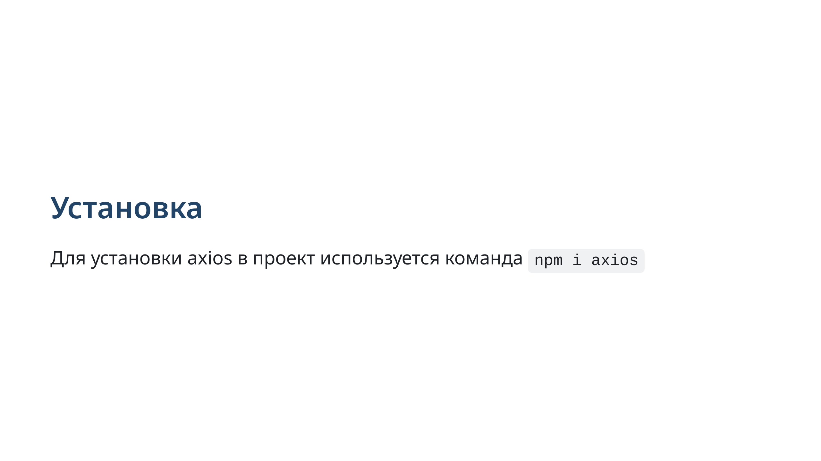
Notes:
slide 2: axios installation

Slide 3
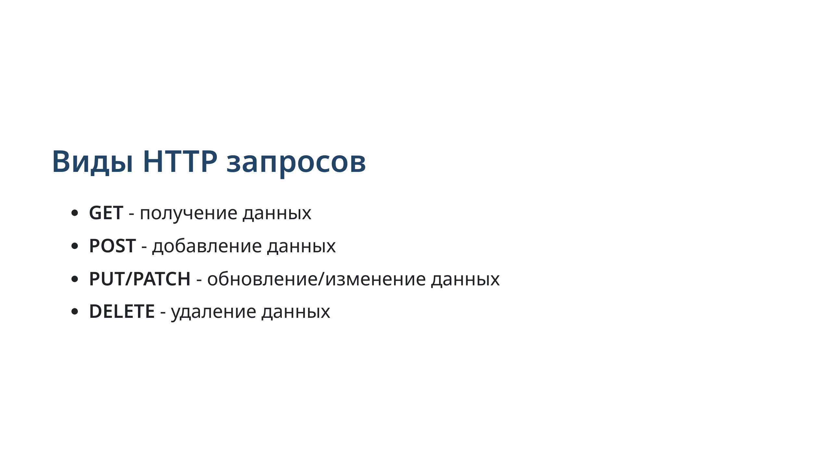
Notes:
slide 3: types of HTTP requests

Slide 4
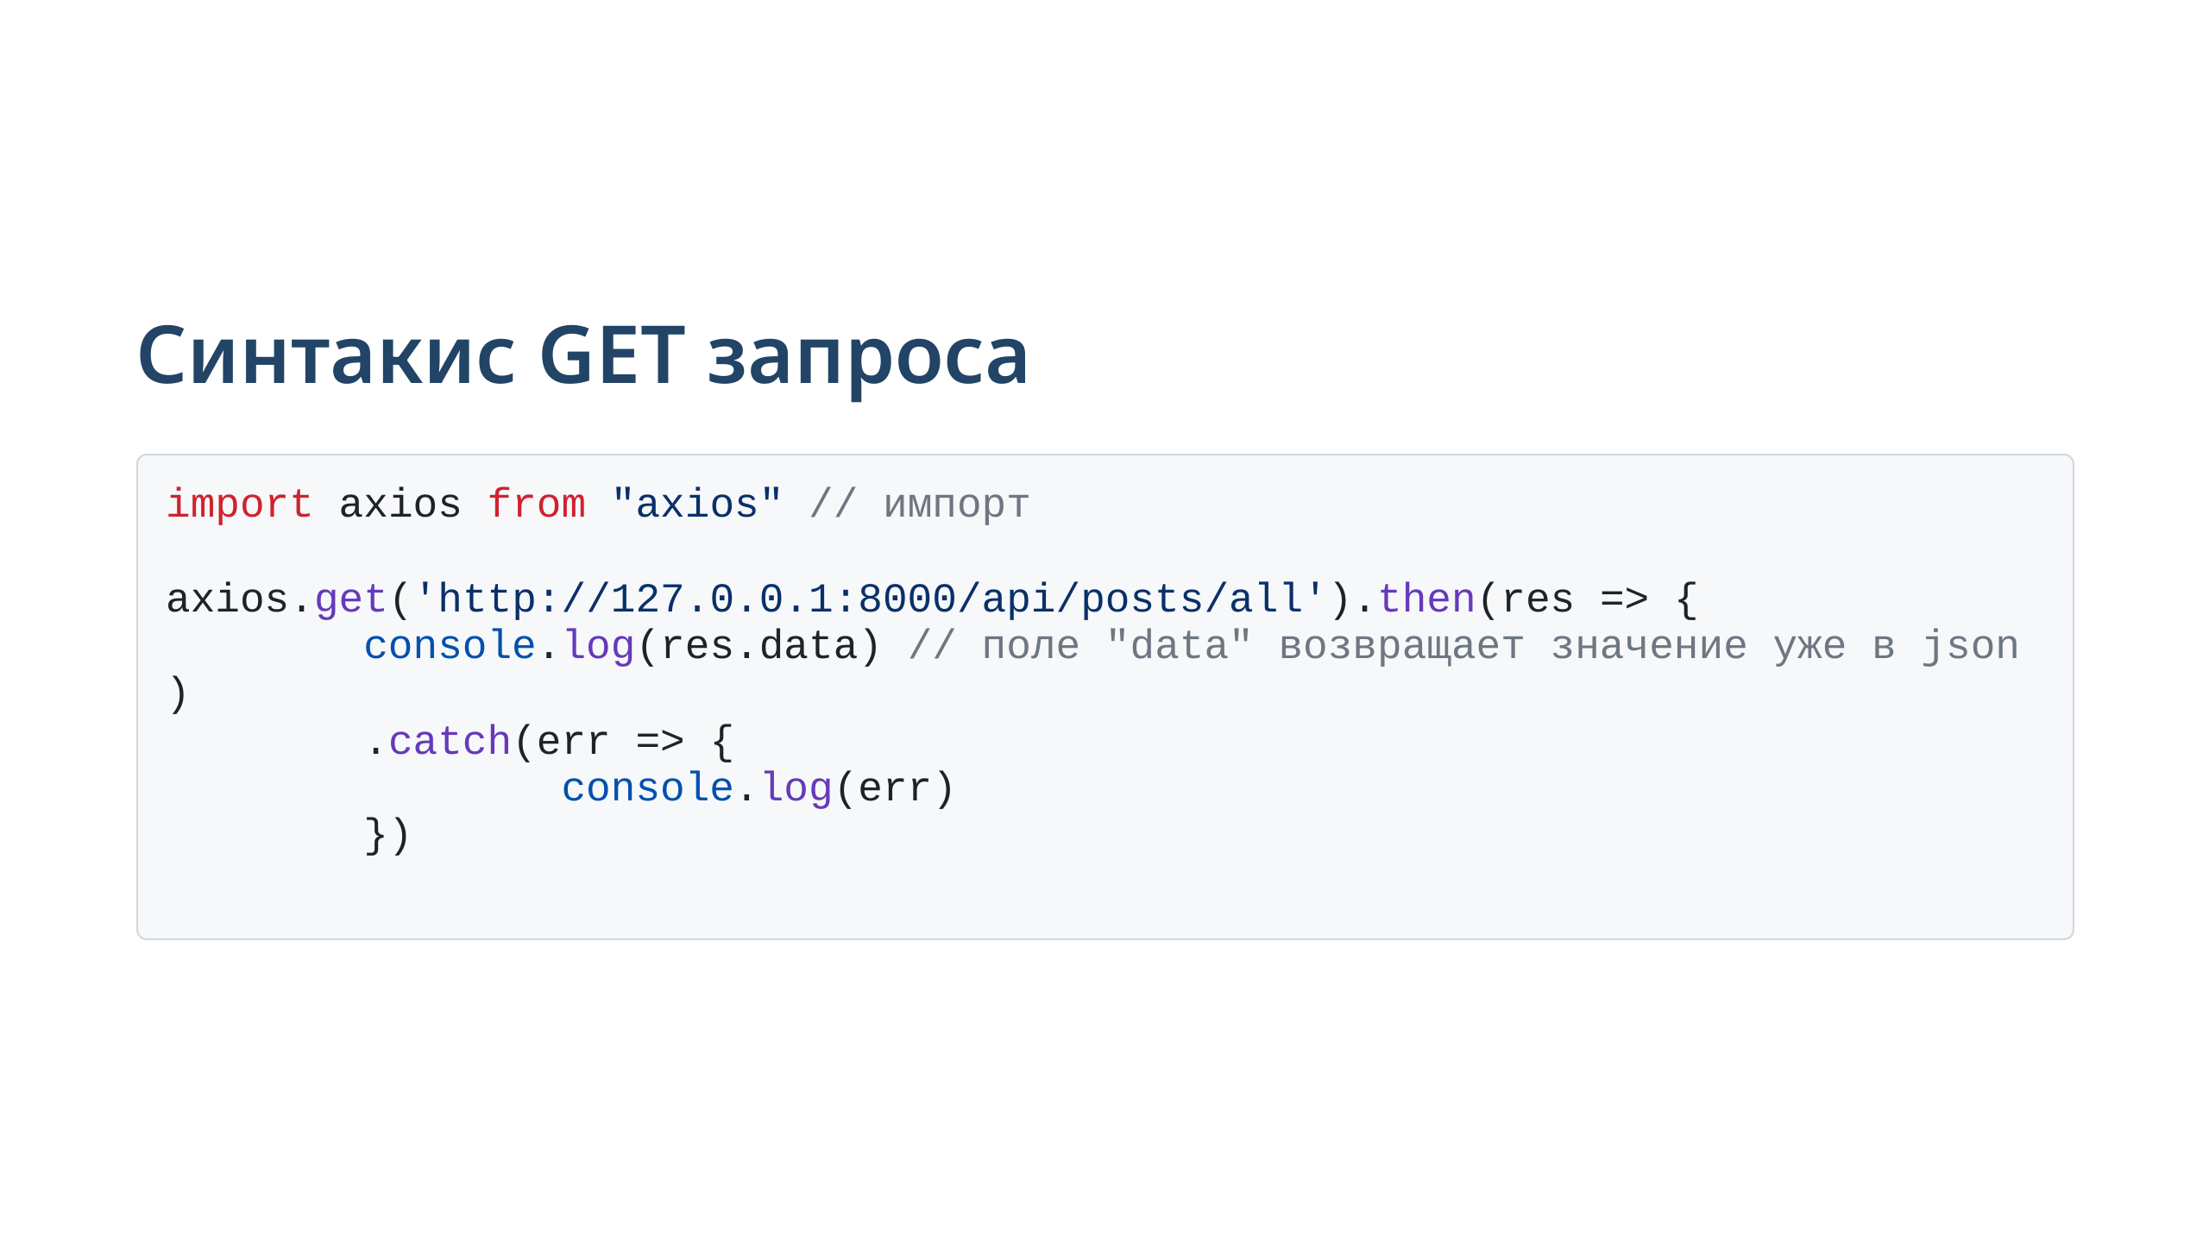
Notes:
slide 4: get request syntax

Slide 5
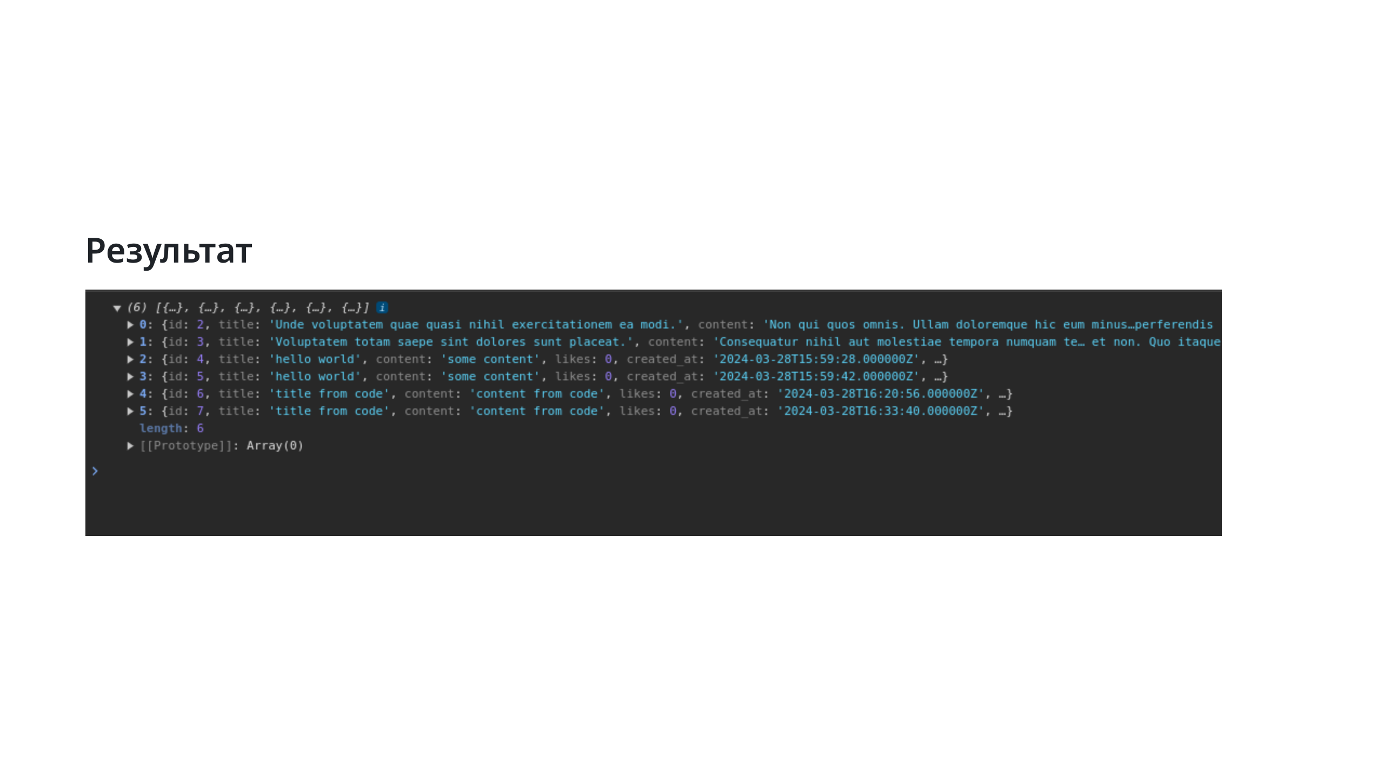

Slide 6
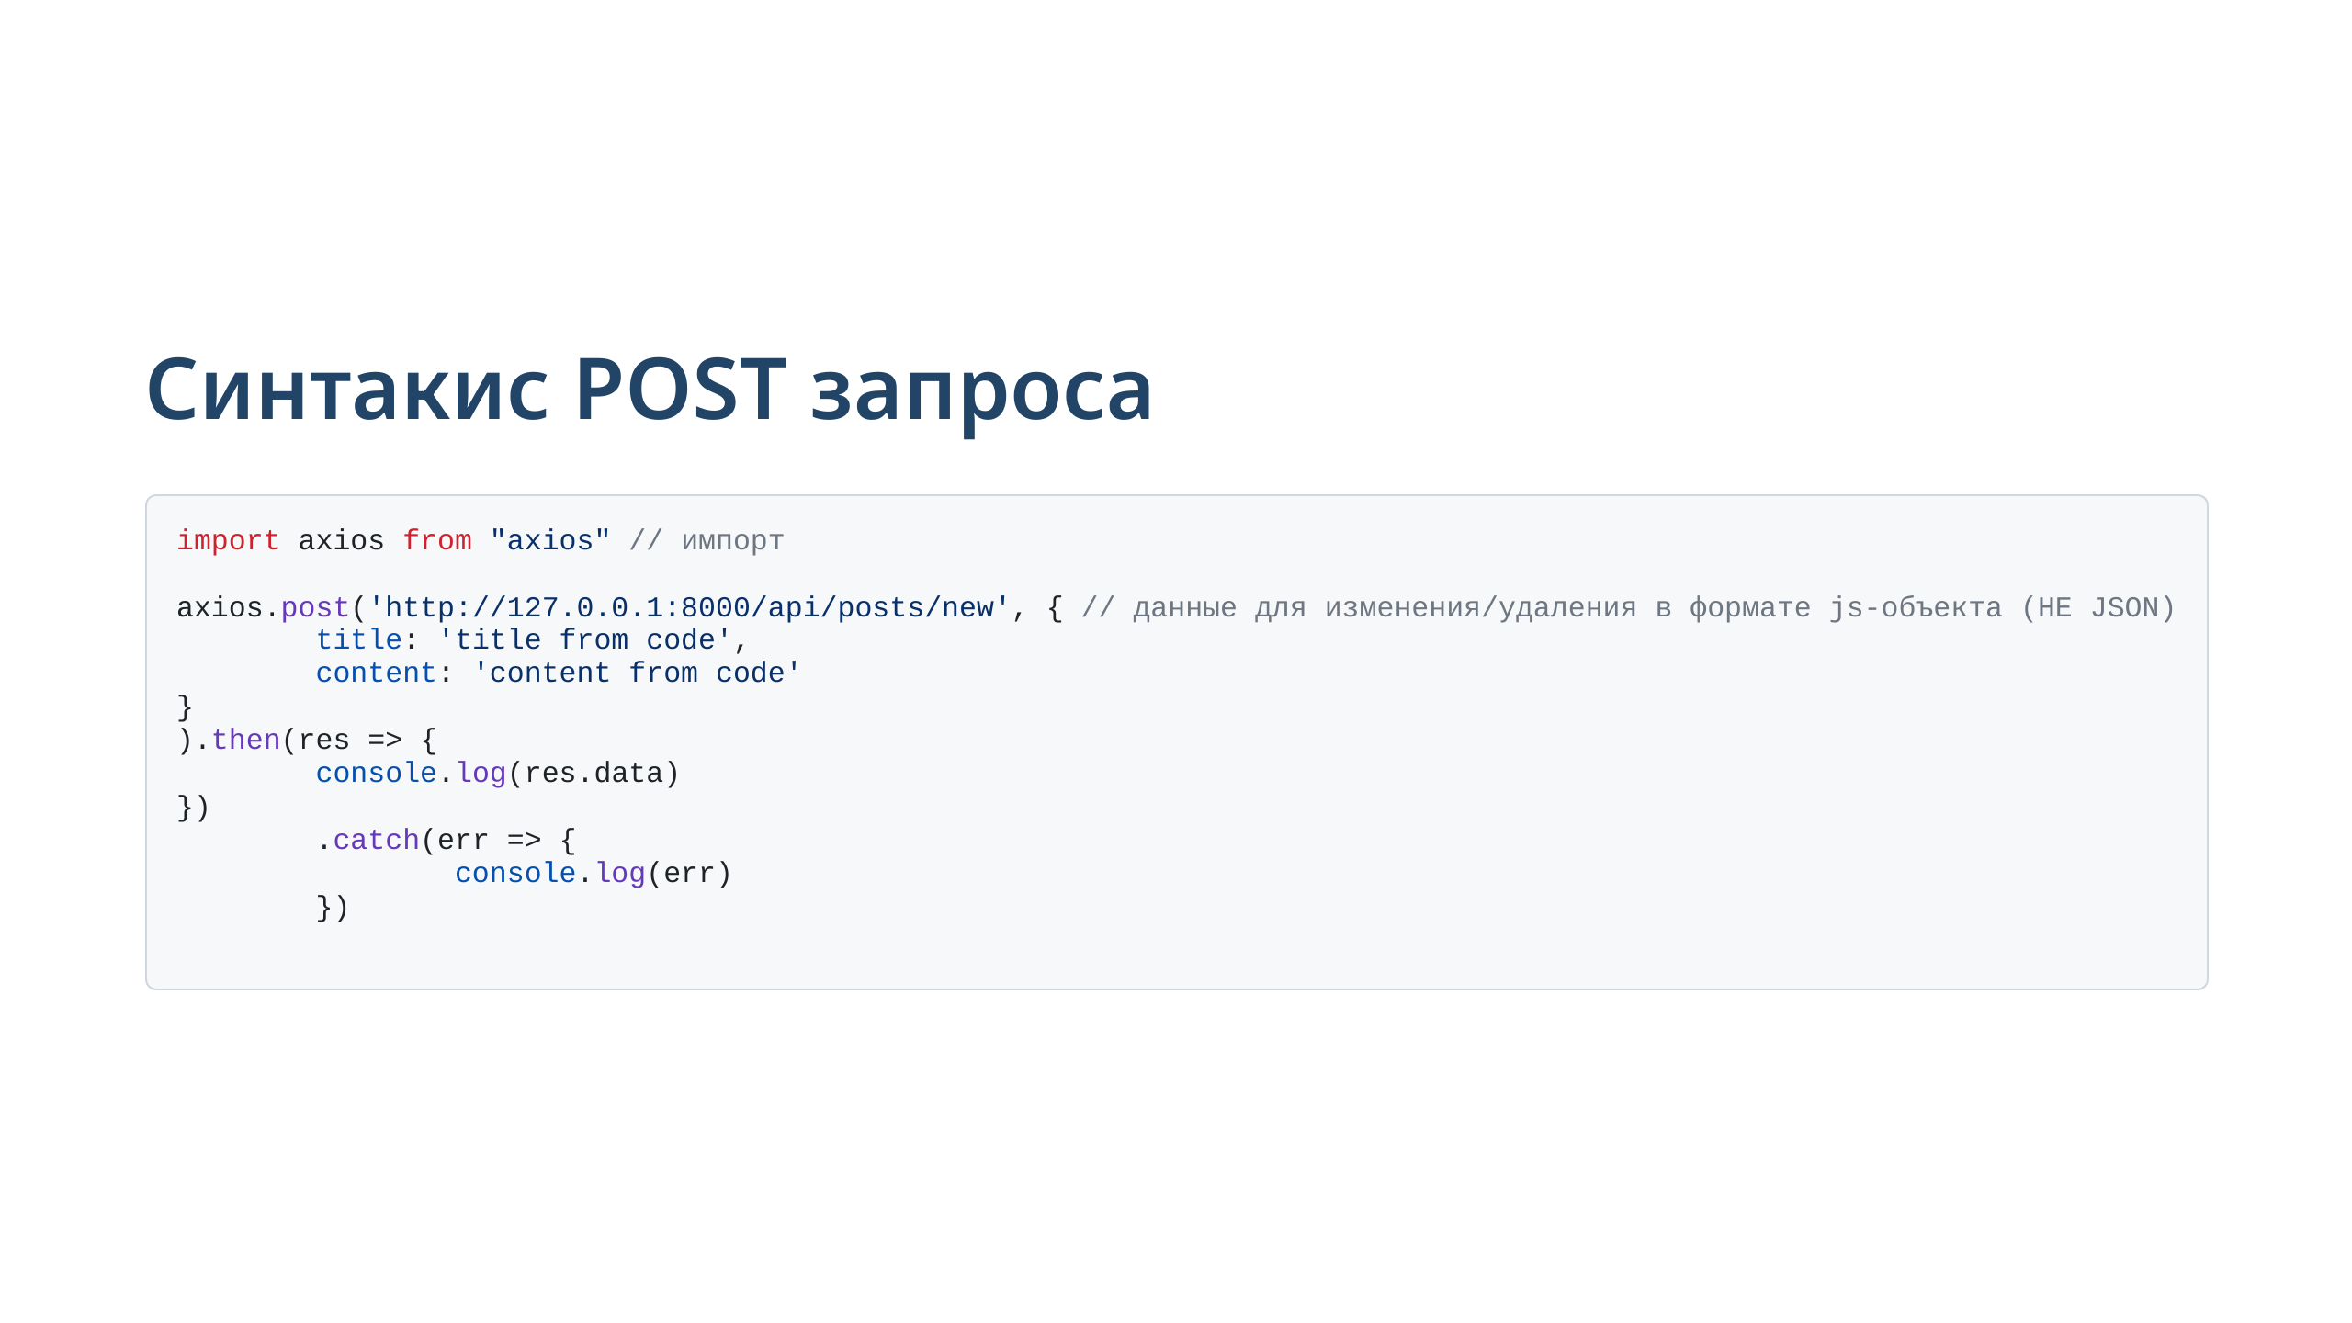
Notes:
slide 4: post request syntax

Slide 7
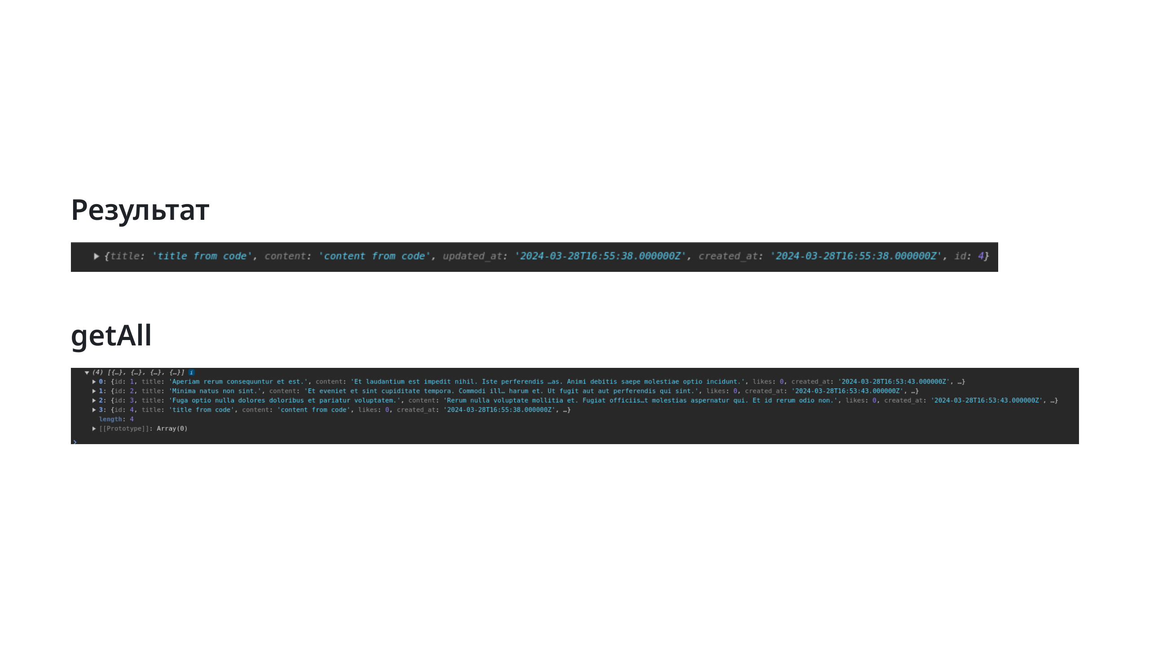

Slide 8
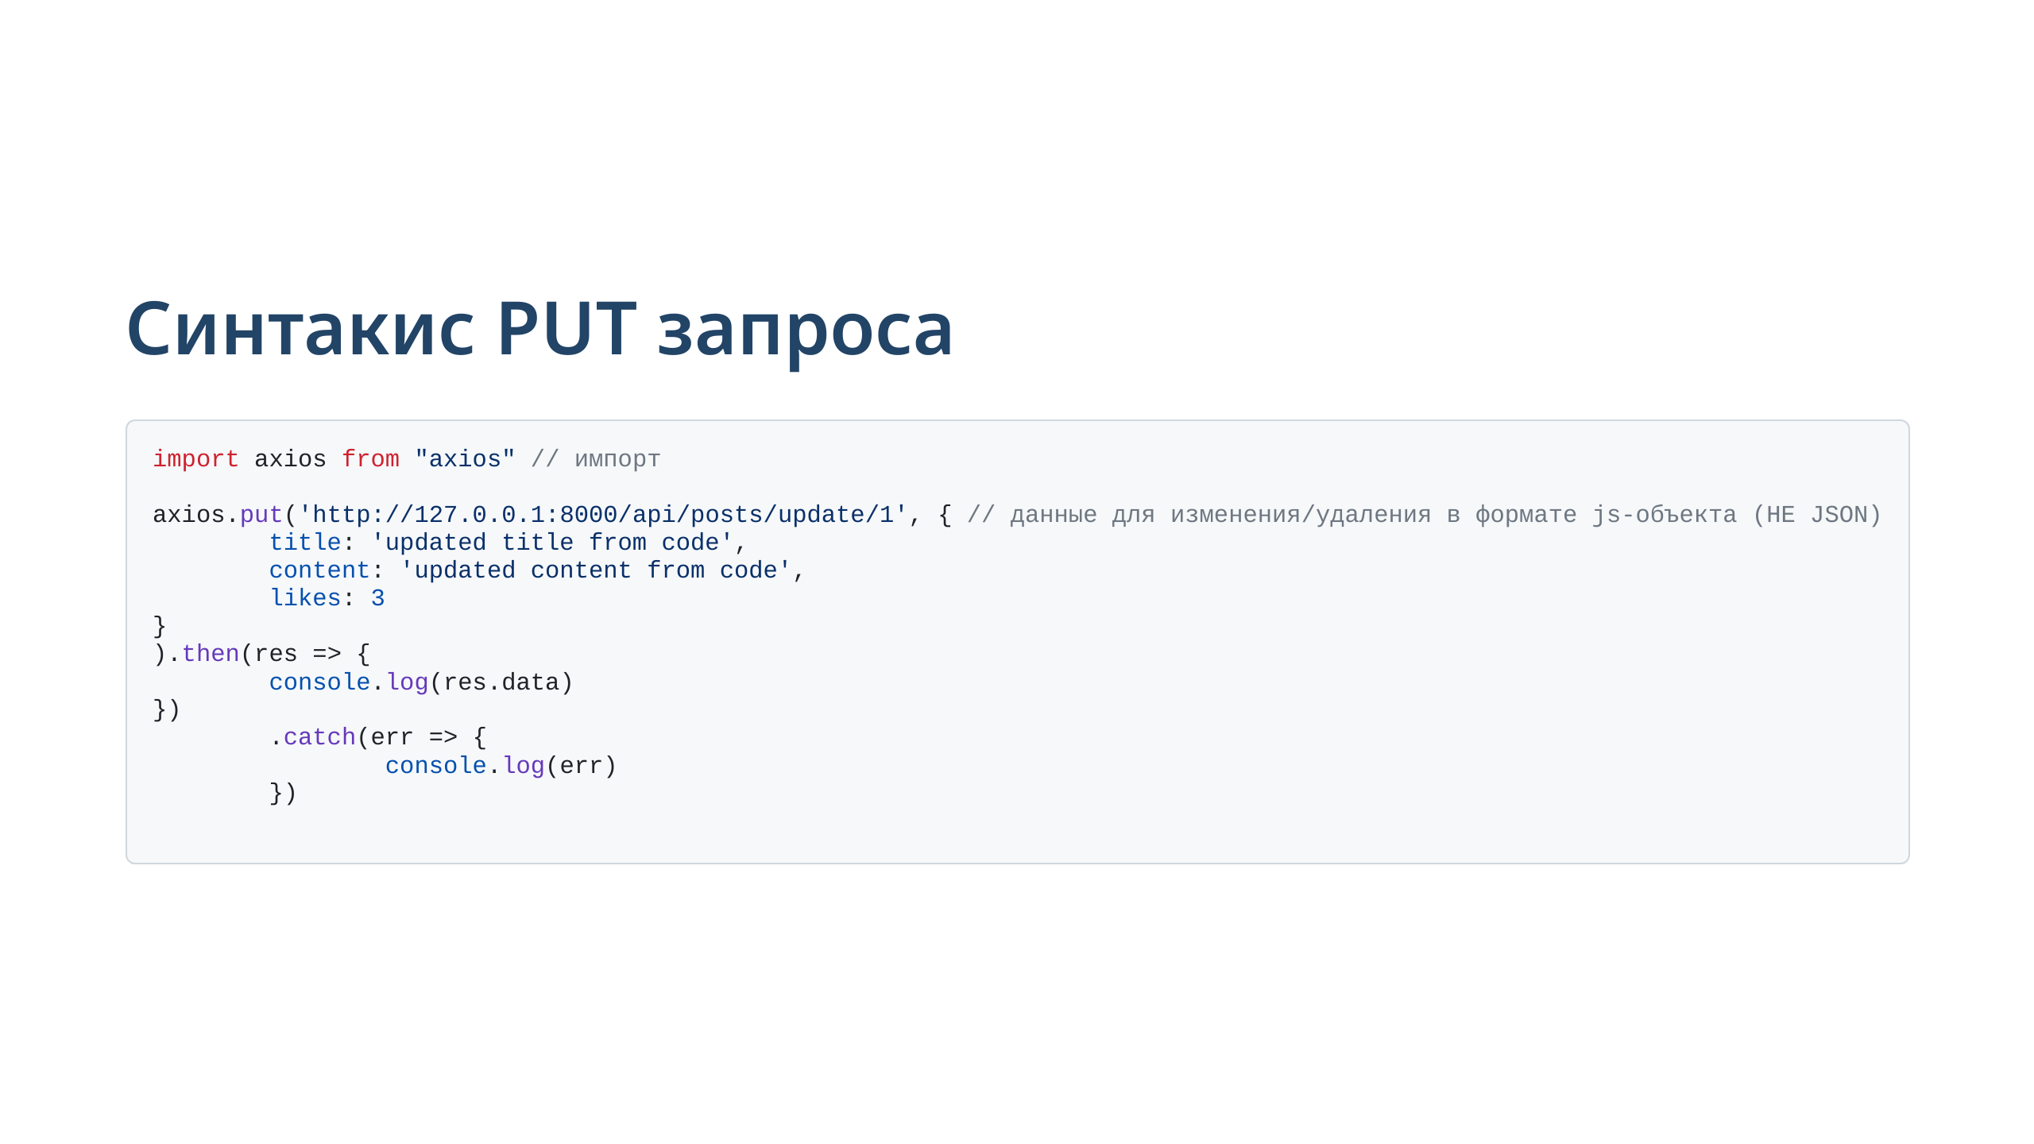
Notes:
slide 5: put request syntax

Slide 9
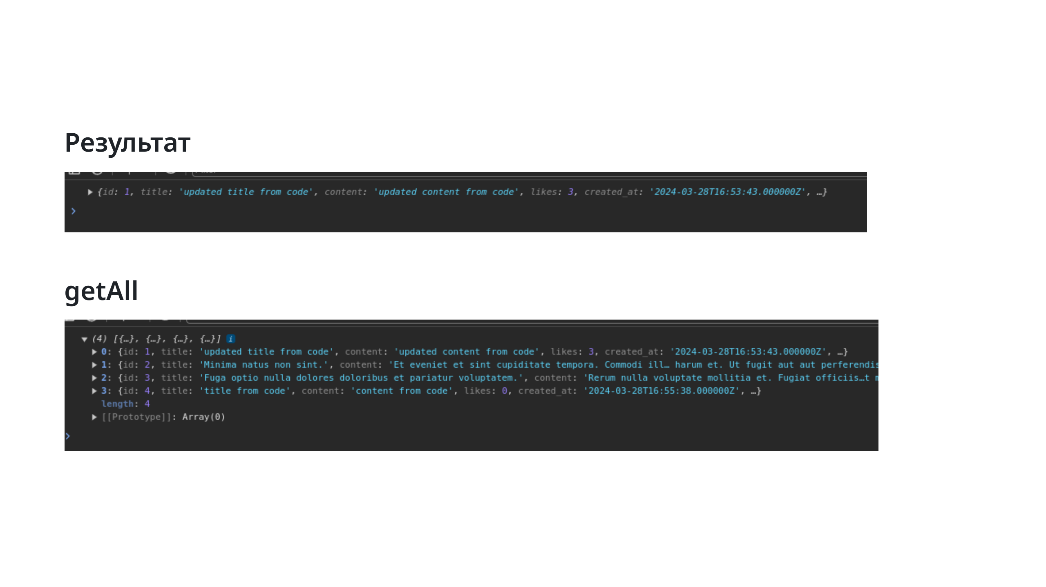

Slide 10
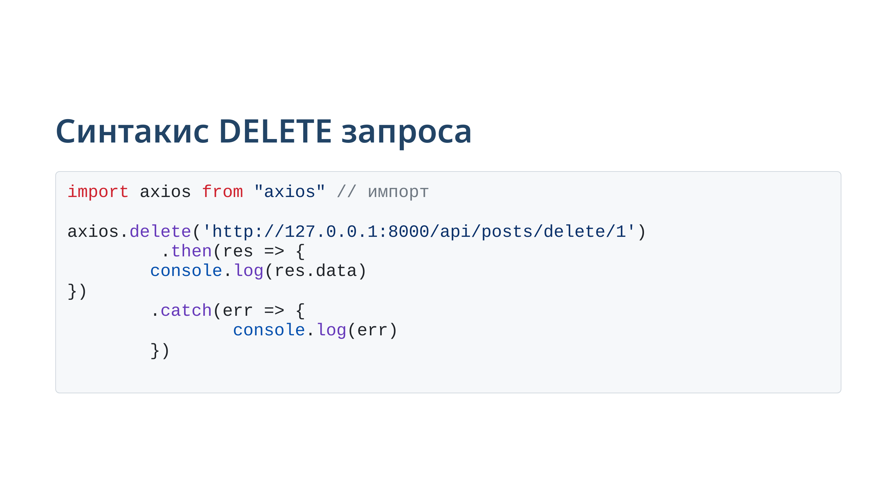
Notes:
slide 5: delete request syntax

Slide 11
